Slide 1
Preparation for the personal statement
The only section you have full control over
Your only chance to market yourself as an individual
UCAS’ similarity detection service:
every personal statement is run through software to check for plagiarism.
The same for all of your choices
A maximum of 4,000 characters, or 47 lines
A minimum of 1,000 characters
There isn’t a spelling or grammar check
No formatting allowed
Security marking: PUBLIC
11 July 2023
| 1

Slide 2
What universities are looking for in a personal statement.
Universities and colleges will consider:
Have you chosen the course for the right reasons?
Can you achieve in a new learning environment?
Do you have a range of interests and aptitudes?
Do you have a depth of interest in the subject?
Have you studied independently?
Do you appear motivated and committed?
Do you have good numeracy and literacy skills?
Security marking: PUBLIC
11 July 2023
| 2

Slide 3
Include:
academic achievements, past and present
why you’re interested in the subject area
your knowledge of the subject area
your enthusiasm to go beyond the syllabus
what you enjoy about studying
details of your independent study skills
Security marking: PUBLIC
11 July 2023
| 3

Slide 4
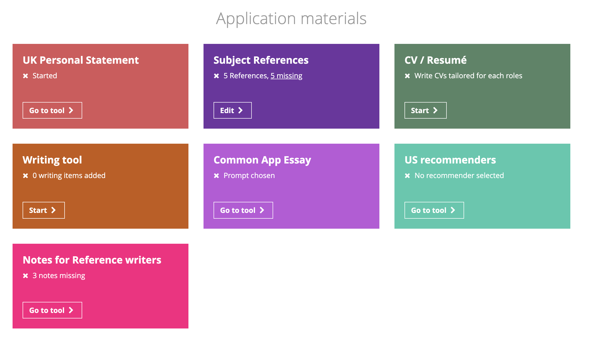
Using Unifrog to support personal statement writing.
Unifrog gives a good structure to guide you through how to write an effective personal statement.
Whether you chose to follow this format or not you must still paste a copy into Unifrog so that your tutor can see it to support with the reference writing process.

Slide 5
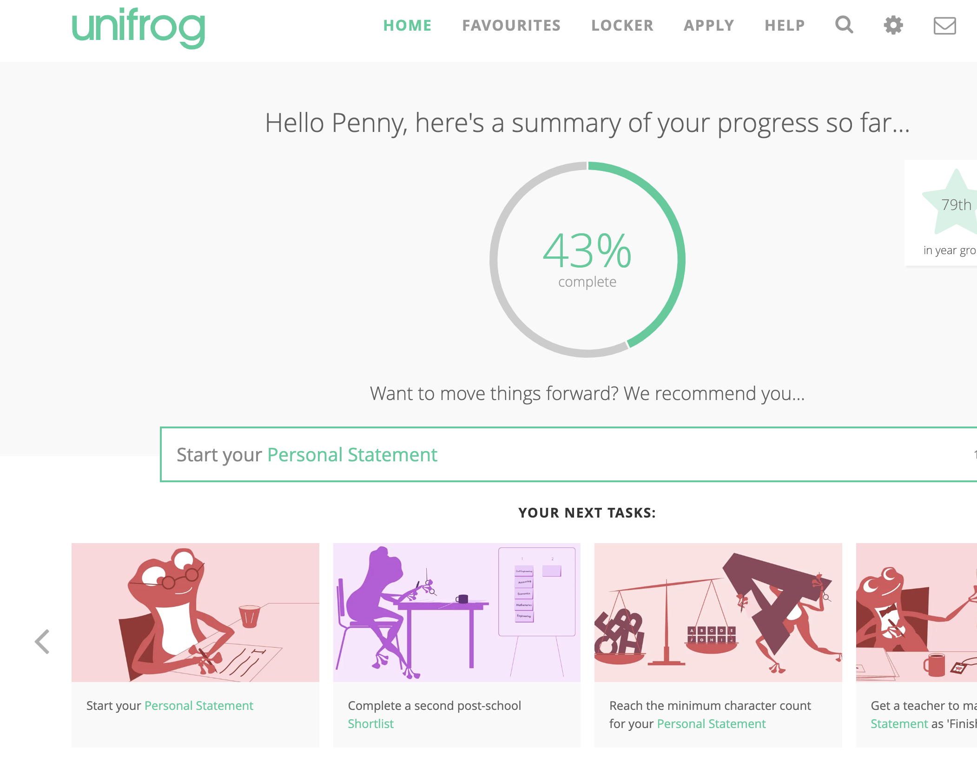
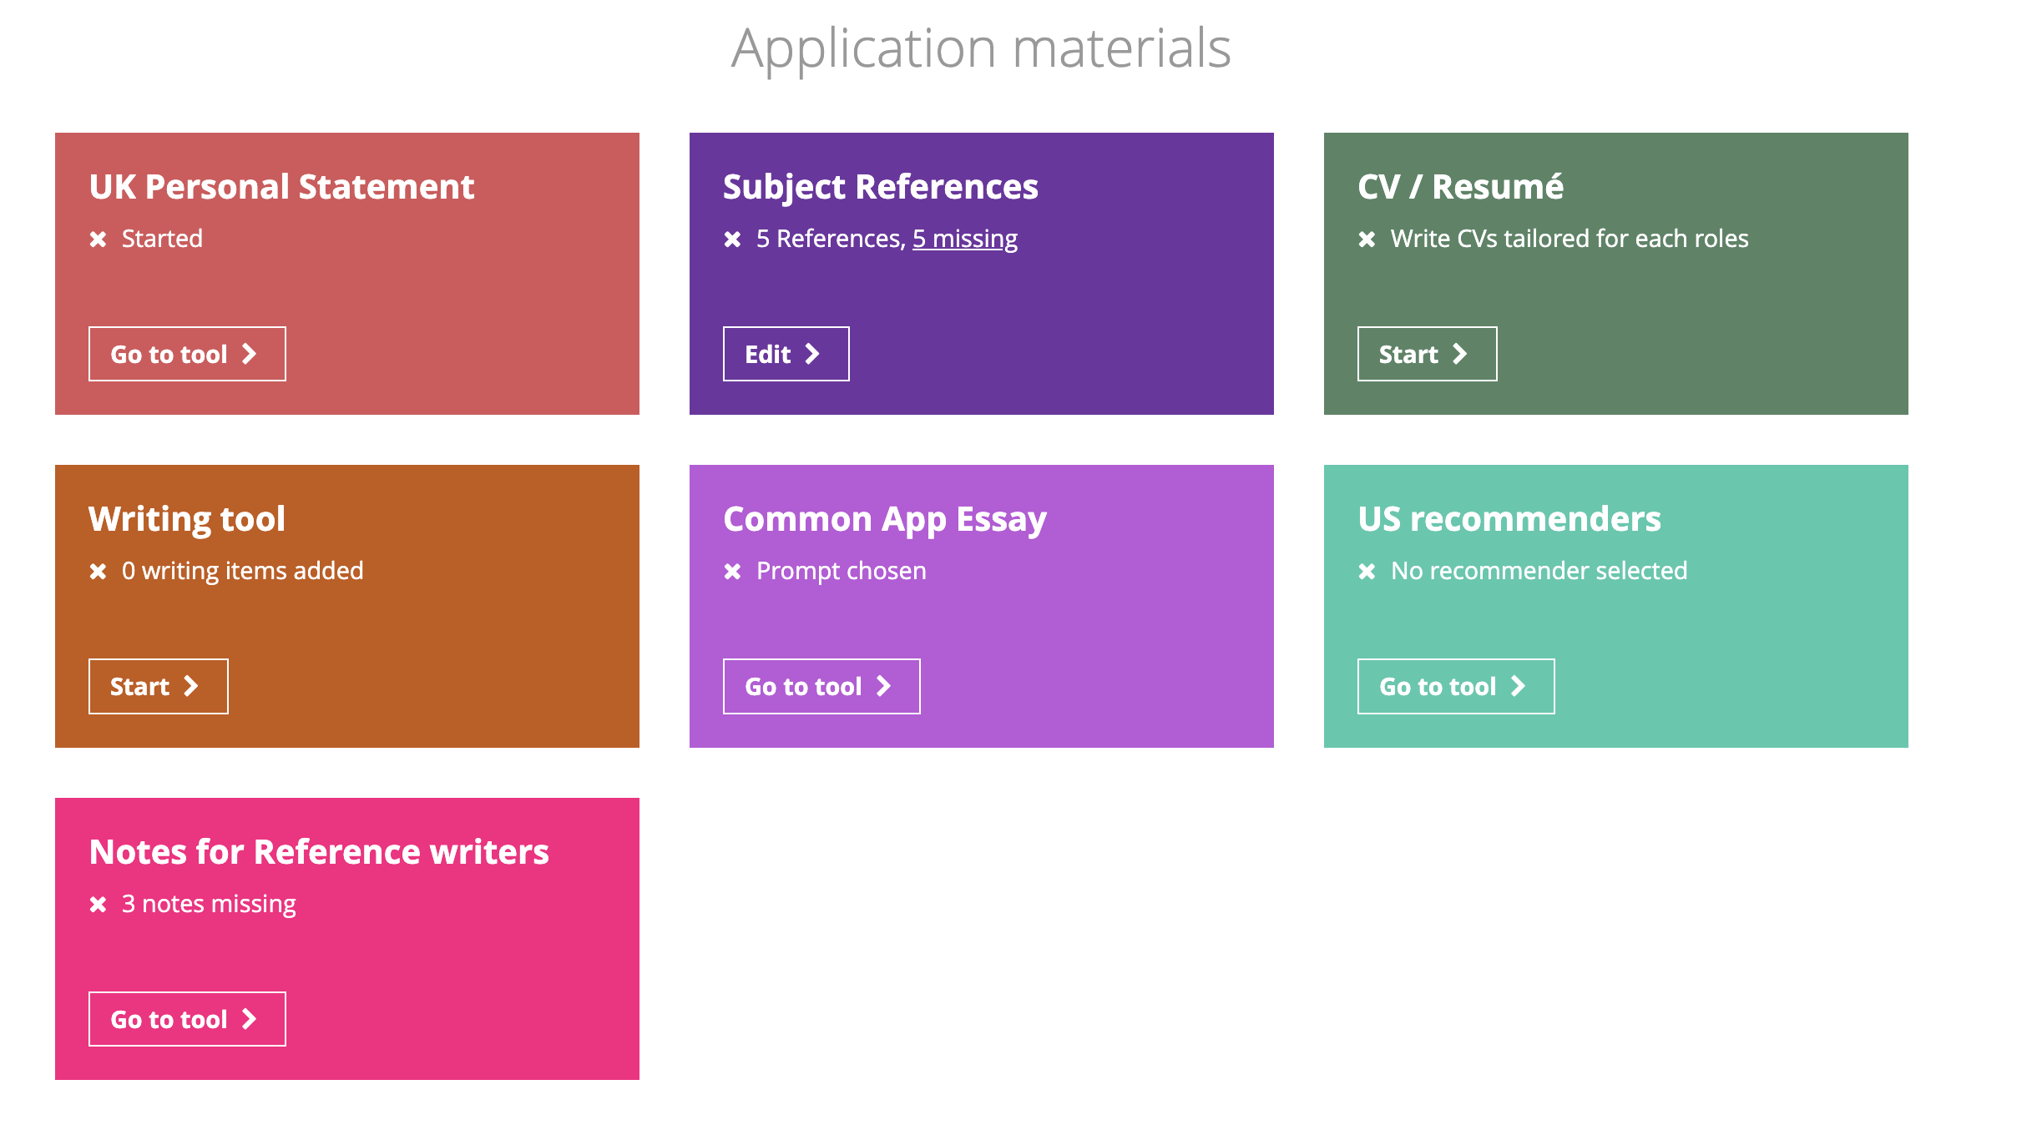

Slide 6
Unifrog structure
Why do you want to study this subject?
What have you done in the past that makes you particularly suitable to study the subject?
What else have you done that would contribute to the university community?

Slide 7
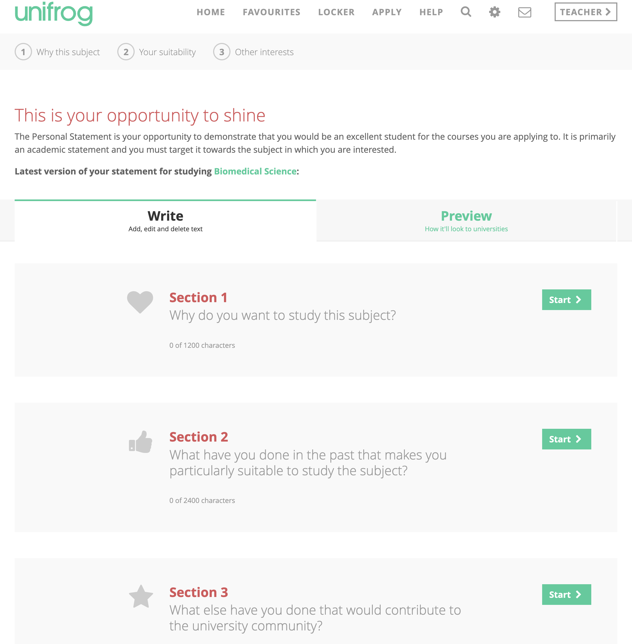

Slide 8
Section 1 (30%) - Why do you want to study this subject?
Knowledge of the subject area - write about your key academic interests in the subject.
Law example: "Having lived in Singapore for nine years, my interest in studying law was originally sparked by the notorious legal system in the country. I read into their laws and policies on crime, safety, and racial quotas, and began exploring criminal law in different countries, comparing their laws and crime rates to see the impact of the legal system in different countries. Studying law will help me develop my research and analysis skills, and improve my ability to construct meaningful, well thought out arguments to support my ideas.”

Slide 9
Section 1 - Why do you want to study this subject
What interest you most about the subject? How has your interest developed? How can you demonstrate this?
Chemistry example: "What I love most about chemistry is the constant sense of discovery. I remember being transfixed watching my teacher burn ammonium dichromate. Physical chemistry quickly became a special interest of mine, specifically thermodynamics and enthalpy changes. I began reading Chemistry World magazine to research these areas in more detail."

Slide 10
Section 1 - Why do you want to study this subject
What skills do you want to develop?
English and Creative Writing example: "My love of literature has led me to write creatively for pleasure. I came in 2nd place in an online writing competition for a short story I wrote based on Wilfred Owen’s poem ‘Futility’. I based the piece on a futuristic war to demonstrate Owen’s own views that war is always the same and always leads to pain and destruction. I used the typical themes of an elegy - like loss and mourning - and combined this with a sense of hopelessness. This story was also published in my school magazine for Remembrance Day. As well as developing my analytical and research skills, and extending my knowledge of a subject for which I have developed a passion, I want to study literature further as a catalyst for my own writing."

Slide 11
Section 2 (60%) - What have you done in the past/currently that makes you particularly suitable to study the subject?
How are your current academic studies preparing you.
Particular project work you have done – EPQ, field work investigations
Things you have learnt online, from books, newspapers, MOOCS, podcasts, Ted Talks etc
Show how you have gone out of your way to pursue the course you are applying for.
Any relevant work experience or voluntary work – this is really important if you are applying for a vocational course. Always say what you learnt from the experience.

Slide 12
Section 3 (10%): What else have you done that would contribute to the university community?
Your hobbies and leisure activities.
Sports, music, drama
Other extra curricular
Significant responsibilities you hold at home, school or in clubs or societies.
Special achievements
What you have learnt if you have a job.

Slide 13
Section 3: What else have you done that would contribute to the university community?
Show that you:
Are engaging and interested in the world
Have picked up skills and experiences that will be useful at university but aren’t related to your course, like handling a varied schedule
Demonstrate the skills you have developed that are not necessarily related to your chosen course. You should also mention what you have learnt from these experiences and responsibilities.
Mention competencies you might have developed including:
Managing a varied schedule
Teamwork
Taking responsibility

Slide 14
Personal statement dos
Give details. Explain exactly which topics or activities you've taken part in and enjoyed. It's much more compelling to read about 1 or 2 detailed examples than 5 or 6 brief ones.
Give academic examples that demonstrate why you want to study the course and what makes you a good candidate. You need more than just "enjoying the subject" (this should be a given!).
Write about the skills you have and the skills you want to learn - avoid writing about the job you want in the future. You’re trying to show how you’d be a great student, not a great future employee!
If you have completed work experience, write about what you learnt from it and how you have applied what you learnt to your studies or wider/deeper reading.

Slide 15
Personal statement dos
5. Be reflective. If you make a point like 'I like reading', 'I travelled abroad', say what you got from it.
6. Try to be concise - make every word count!
7. Choose one or two trusted and qualified people to show your Personal Statement to. Ask them what you've left out, what needs to be improved, and if you’ve overdone anything. If your one trusted reader isn’t a specialist in the subject you’re applying for, you could also ask a subject specialist to check your accuracy.
8. Be enthusiastic
9. Expect to do several drafts – it is worth investing the time
10. Use the information on the University websites – what are their admissions tutors looking for?

Slide 16
Personal statements don’ts
Try to define the subject in any way. Remember that your Personal Statement is about you - it's not about how much you know about a subject; it's about your interest in and suitability for it.
Mention skills and activities without giving examples of when they have been demonstrated and what you learnt from them. Anyone can write "I have great leadership skills"; actually using a example that shows when you demonstrated good leadership skills is much more effective.
Refer to experiences that took place before your GCSEs (or equivalent)
Give explanations about medical or mental health problems. These should be explained in your reference, not your Personal Statement.

Slide 17
Personal statements don’ts
5. Apply for significantly different courses using the same Personal Statement.
6. Write a statement specific to just one institution, unless you're only applying to that one university.
7. Copy and paste the statement from somewhere else! All statements are automatically checked for plagiarism by UCAS. If you are found to have plagiarised parts of your statement, the universities you apply to will be informed.
8. Let spelling and grammatical errors ruin your statement. Don’t just rely on a spell checker, proofread and ask friends/family to check.

Slide 18
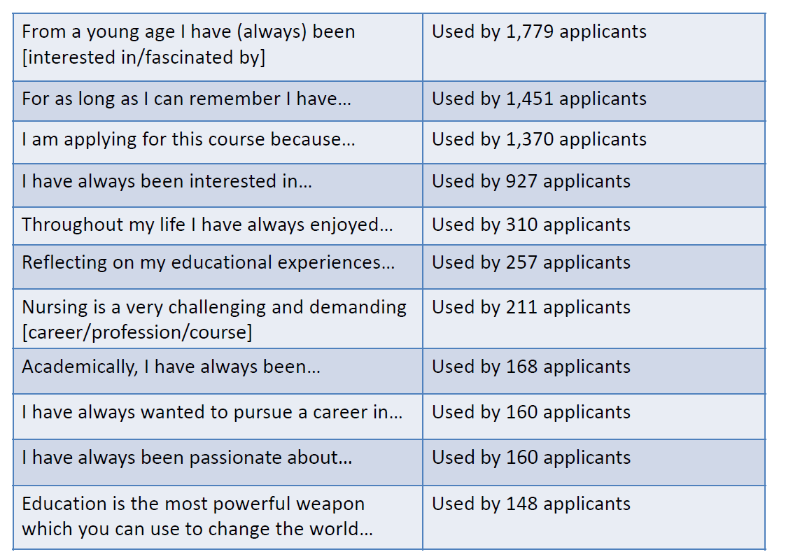
Avoid cliches!

Slide 19
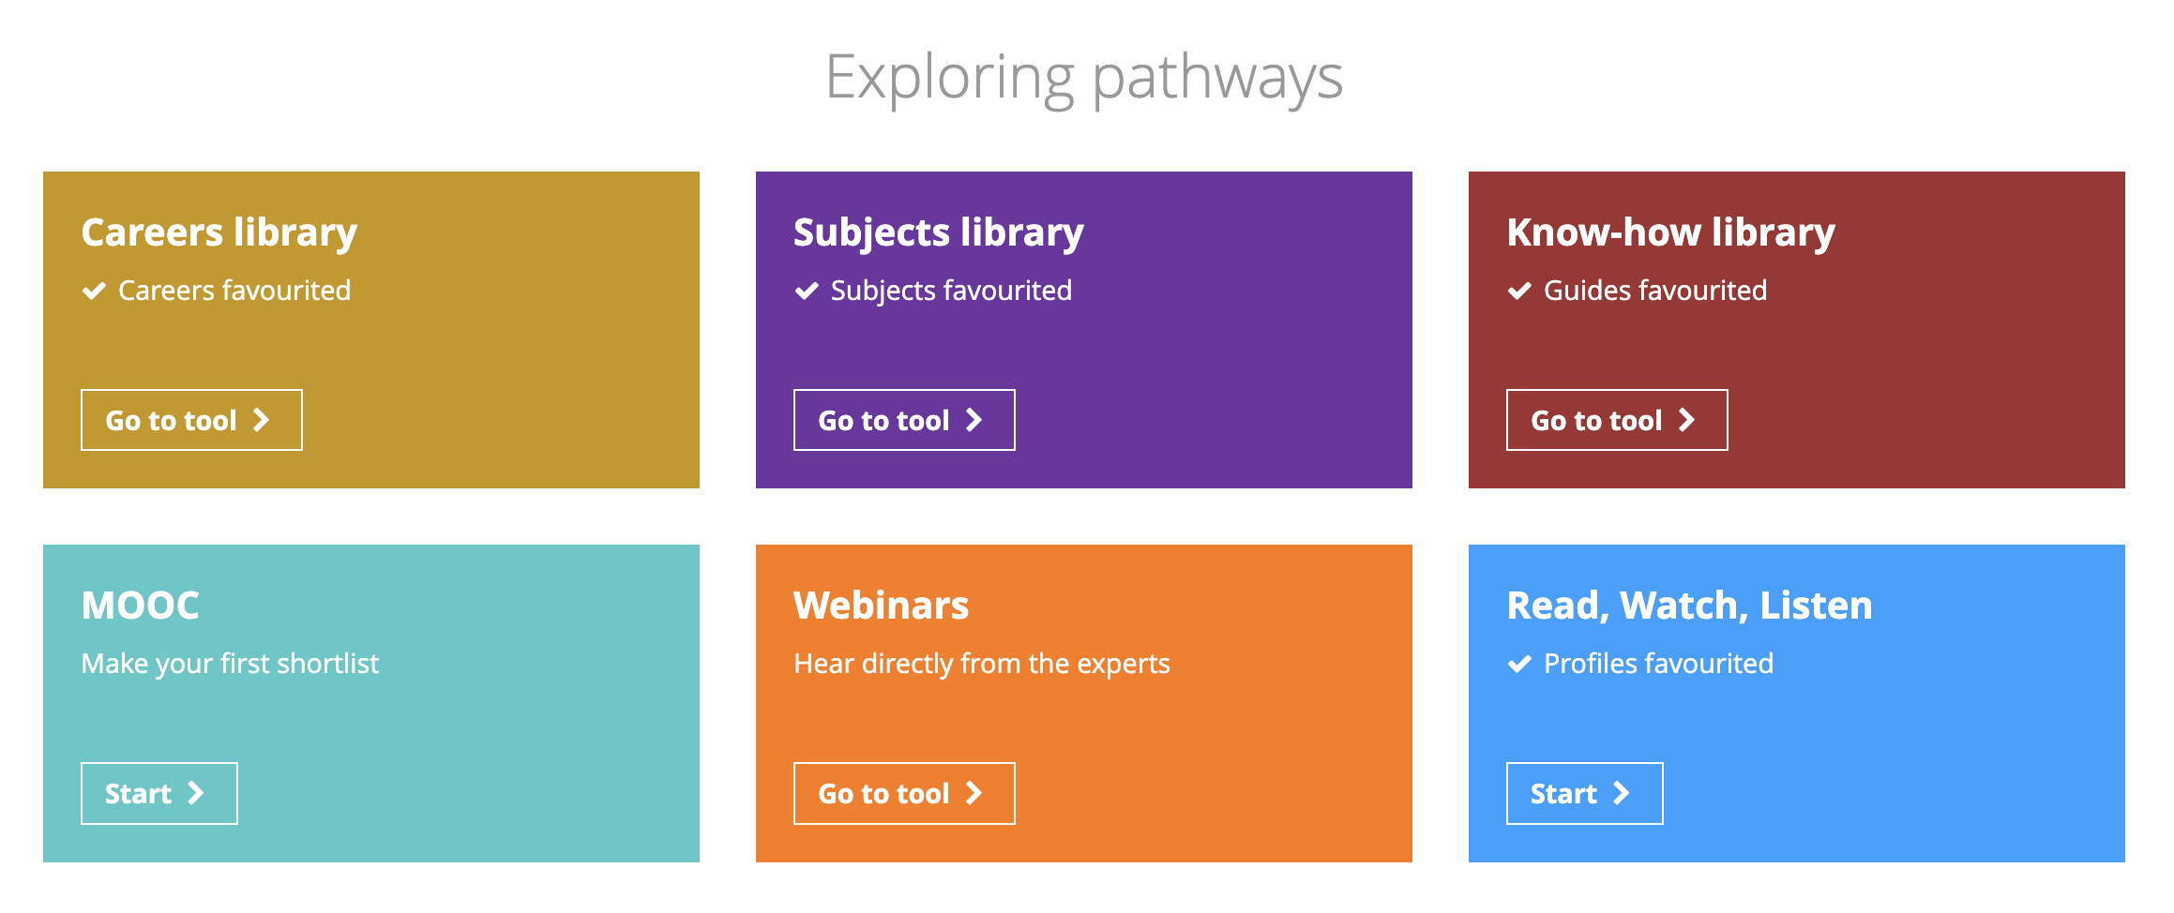
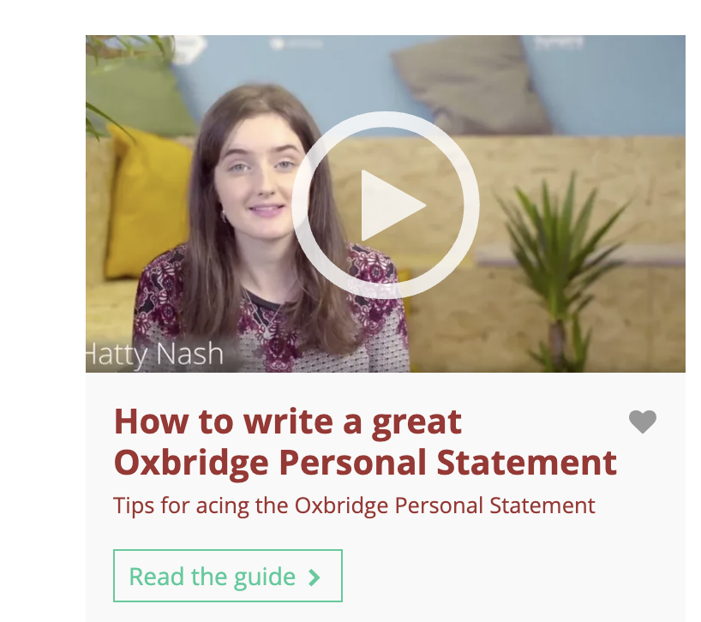
The know -how library has videos with tips on writing personal statements.

Slide 20
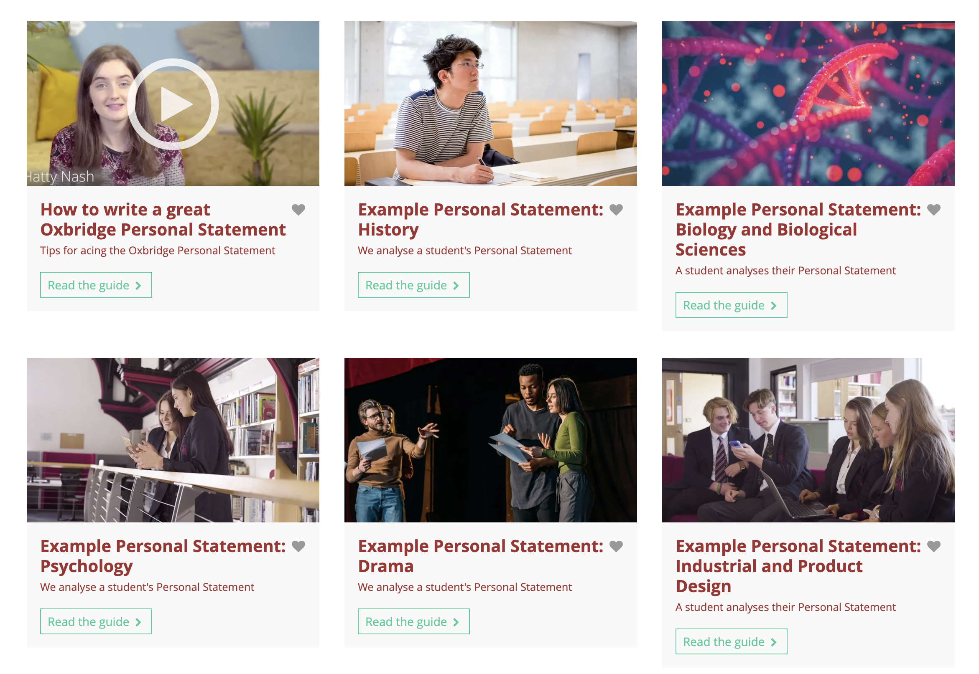
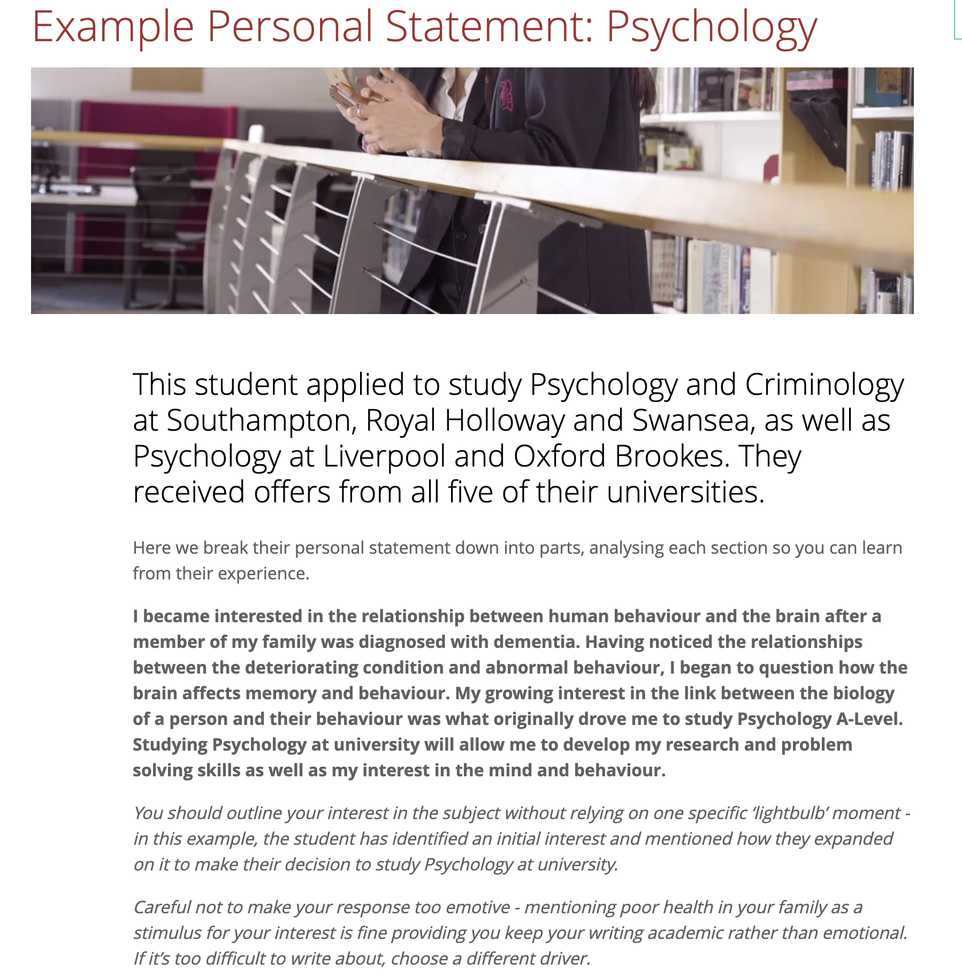
In the Know-how library you can also search for example personal statements.

Slide 21
Where else can I get help?
Form | Supporting staff
12B | Mrs Cotton & Mrs Bamber
12C | Mrs McCammon & Mrs Bamber
12D | Ms Dawson & Mrs Bamber
12J | Mr Cuthbert & Mrs Hadwin
12M | Mr Mason & Mrs Weller
12P | Mr Martin & Mrs Weller
12R | Mrs Rafferty & Mrs Weller
12S | Mrs O’Boyle & Mrs Taylor
12T | Miss March & Sixth Form Progress Leader
Your tutor will be excellent support and subject staff will be happy to help out with the subject specific part if you need guidance.
Each form has member of SFO who can support with personal statements. They will also check you UCAS application, attach the final reference and send it to UCAS.

Slide 22
Month | University preparation activities | Key dates
April 2023 | Explore course choices & locations. Attend Open Days. Continue super curricular exploration. Virtual Work experience | Wb 24/04/23 Work experience.
May 2023 |  | UCAS search tool display 2024 courses
June 2023 | Year 12 Exams – grades are used as one of the components informing projected grades for UCAS. | 20/06/23 UCAT booking opens
July 2023 | UCAS applications begin. Early entry personal statement writing first draft deadline to SFO 17/07/23 | 12/07/23 Conservatoire applications open for 2024 entry.
August 2023 | Personal statement writing and finalising course choices.
September 2023 | Early entry personal statement writing second draft to SFO 04/09/23 Early Entry final draft to SFO 25/09/23 Early entry book admissions tests.
October 2023 | Interim internal deadline for applications for all UCAS courses 13/10/23 BMAT & other Oxbridge admissions tests. | 02/10/23 Conservatoire music application (Drama, Dance and musical Theatre vary – see websites) 16/10/23 Oxbridge, Medicine, Dentistry and Veterinary deadline.
November 2023 | Final internal deadline for all applications for UCAS courses 25/11/23
December 2023 | Interviews.

Slide 23
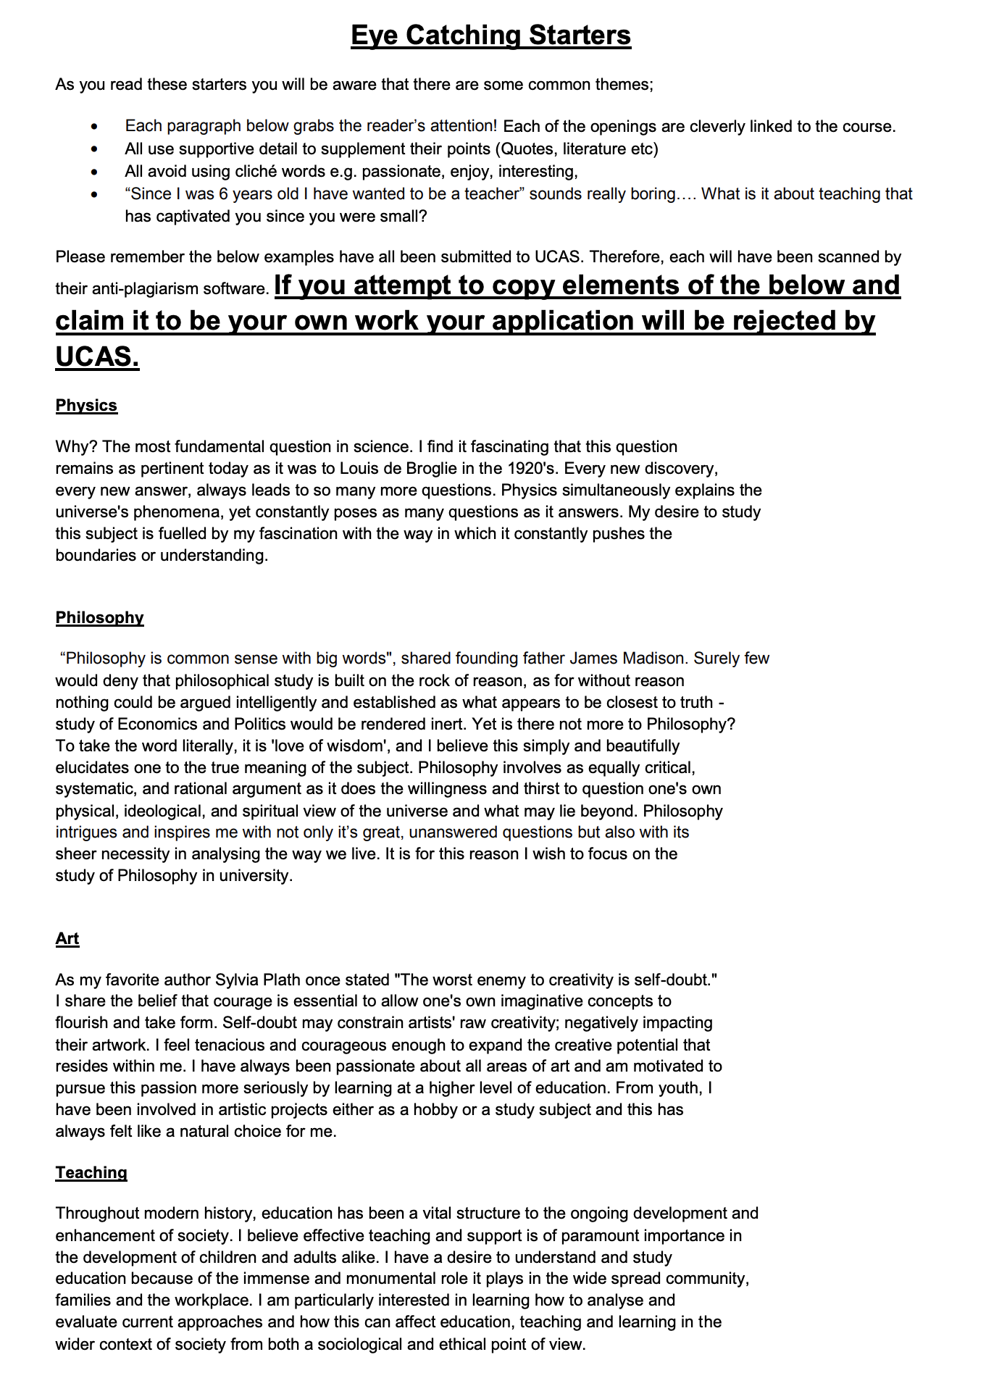

Slide 24
