Slide 1
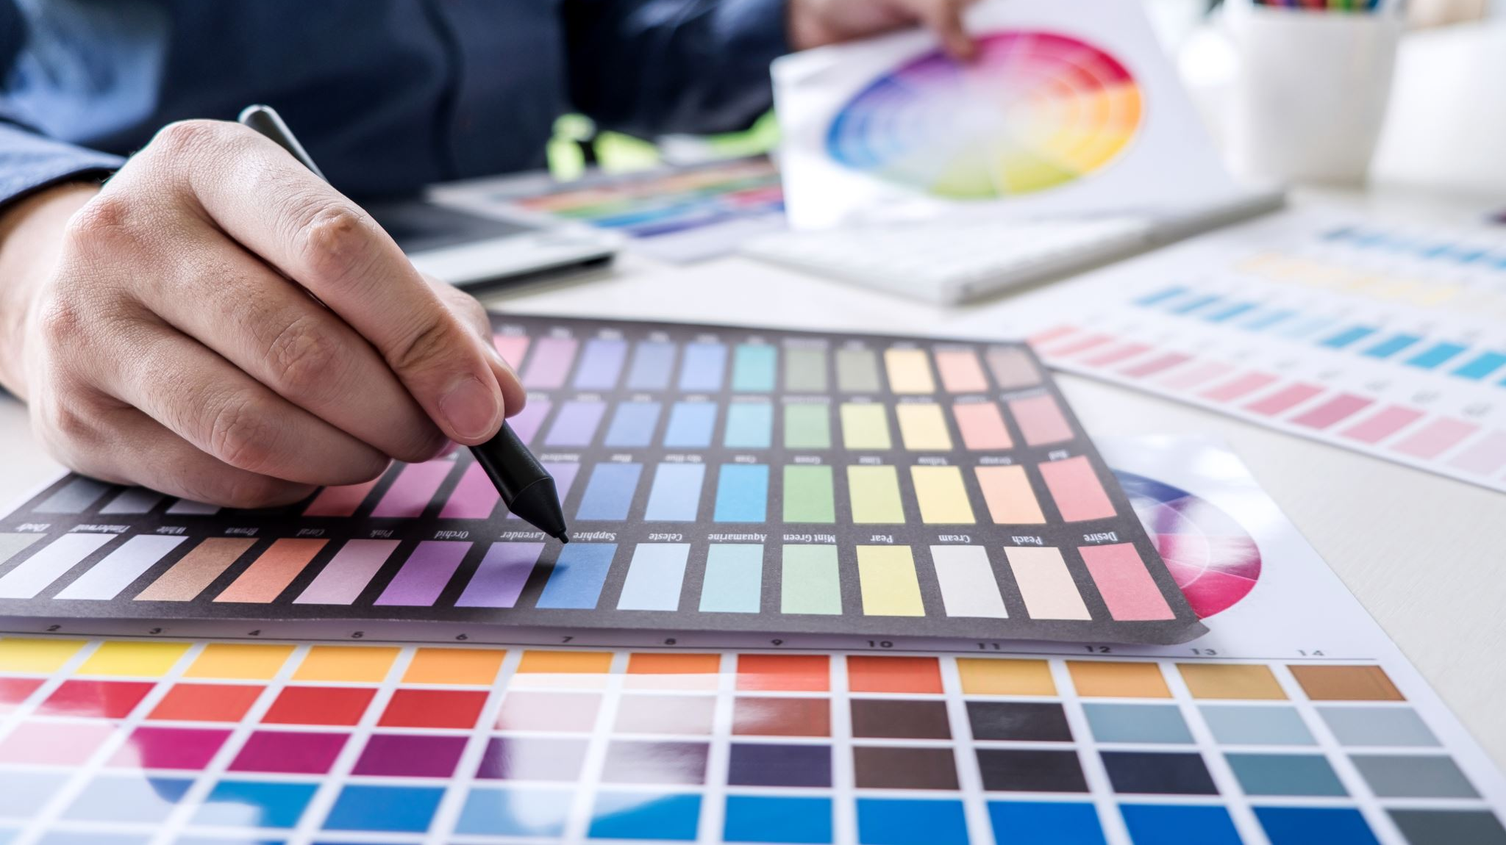
What is product design?
Welcome Year 11 2025/26

Slide 2
A-Z of product design
For every letter of the alphabet try to think of a 3D product.. How many can you come up with.
You have 2 minutes..go!
A
B
C
D
E
F
G
H
I
J
K
L
M
N
O
P
Q
R
S
T
U
V
W
X
Y
Z

Slide 3

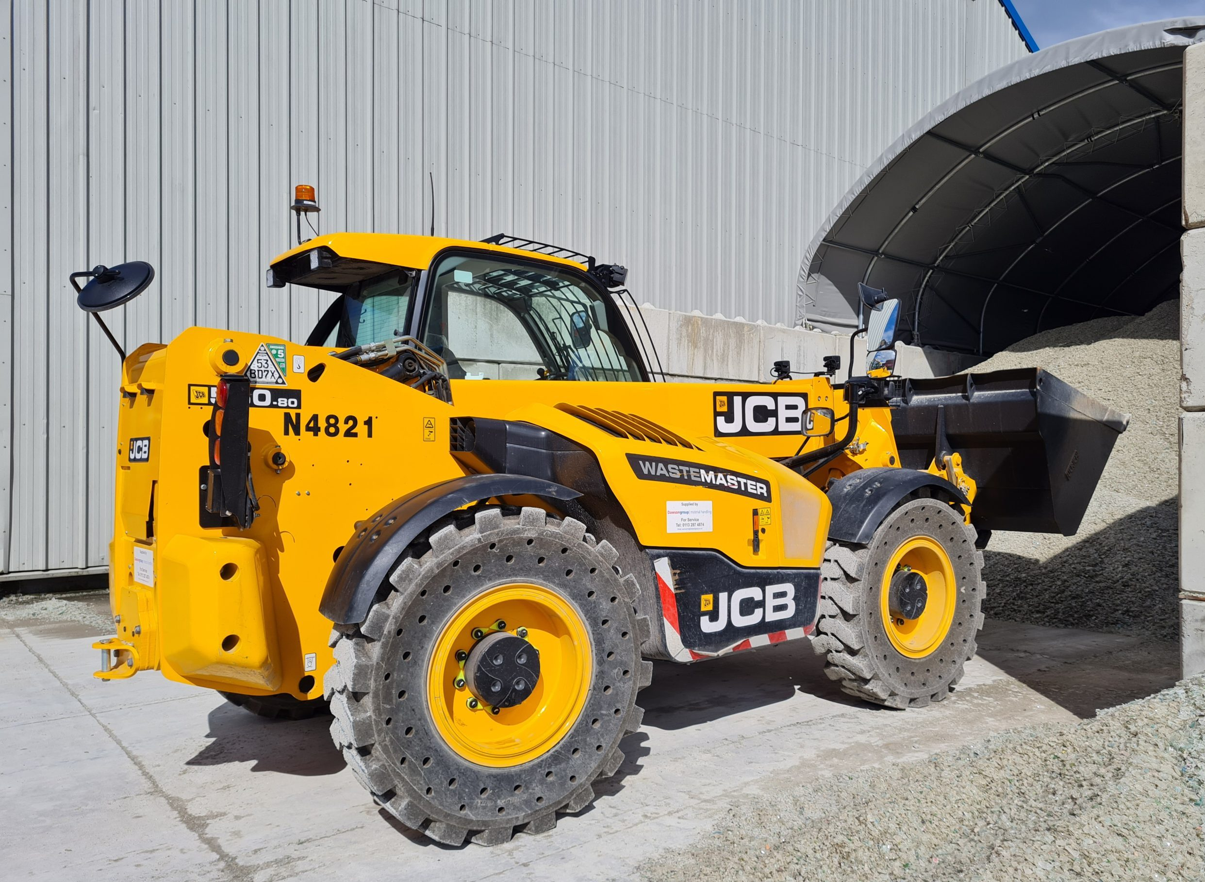
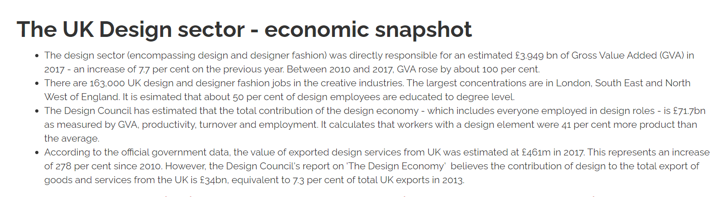

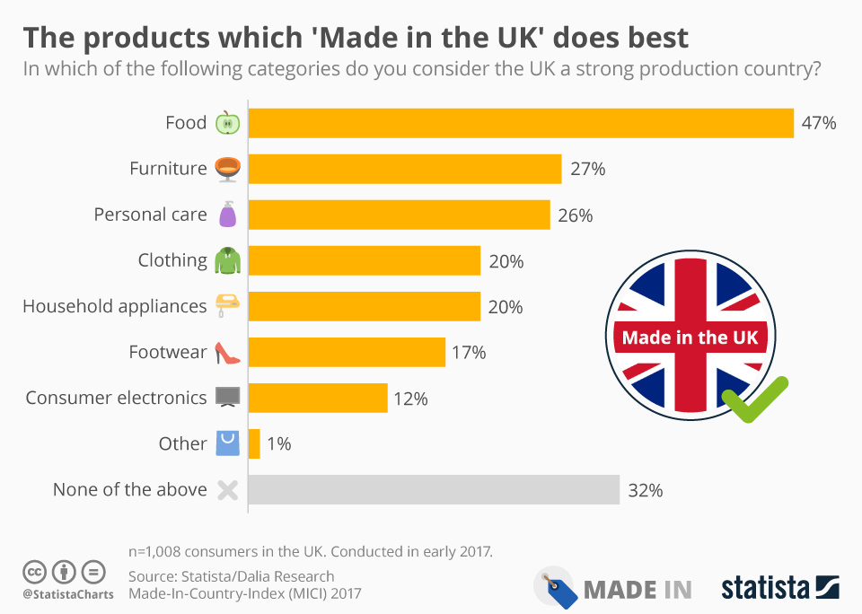
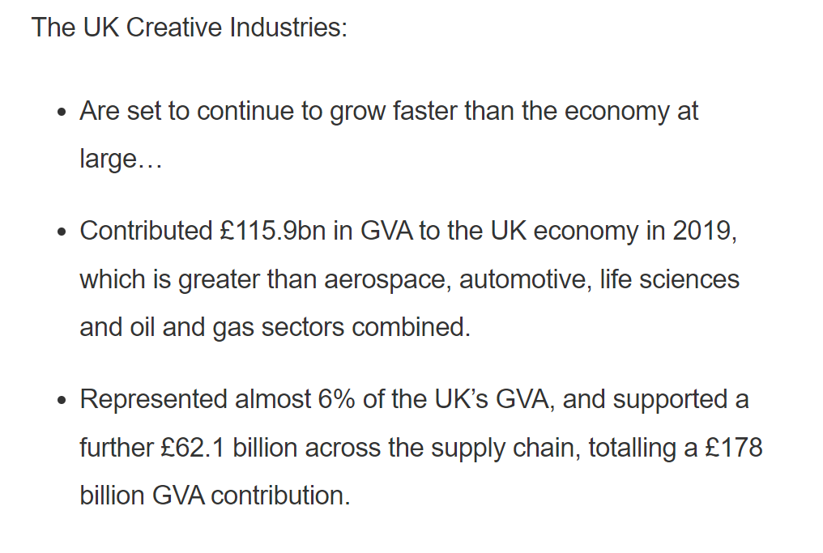

Slide 4
Equipment list
Pens
Pencils
Ruler
Sharpener
Rubber
Protractor
Compass
Set square (e.g. typical maths set)
A Scientific Calculator – one maths lesson a week
Set of colouring crayons (optional but helps!)
Highlighters
A4 lever arch folder (large) with enough dividers for maybe 20+ subtopics.
Hole punch (this can stay at home, but helpful!)
AQA revision guide – letters will go out in September to everyone, though they are not cheap (£30)
Once projects are finalised for next year will may also ask for a small contribution to materials costs but again this will be communicated in September.

Slide 5
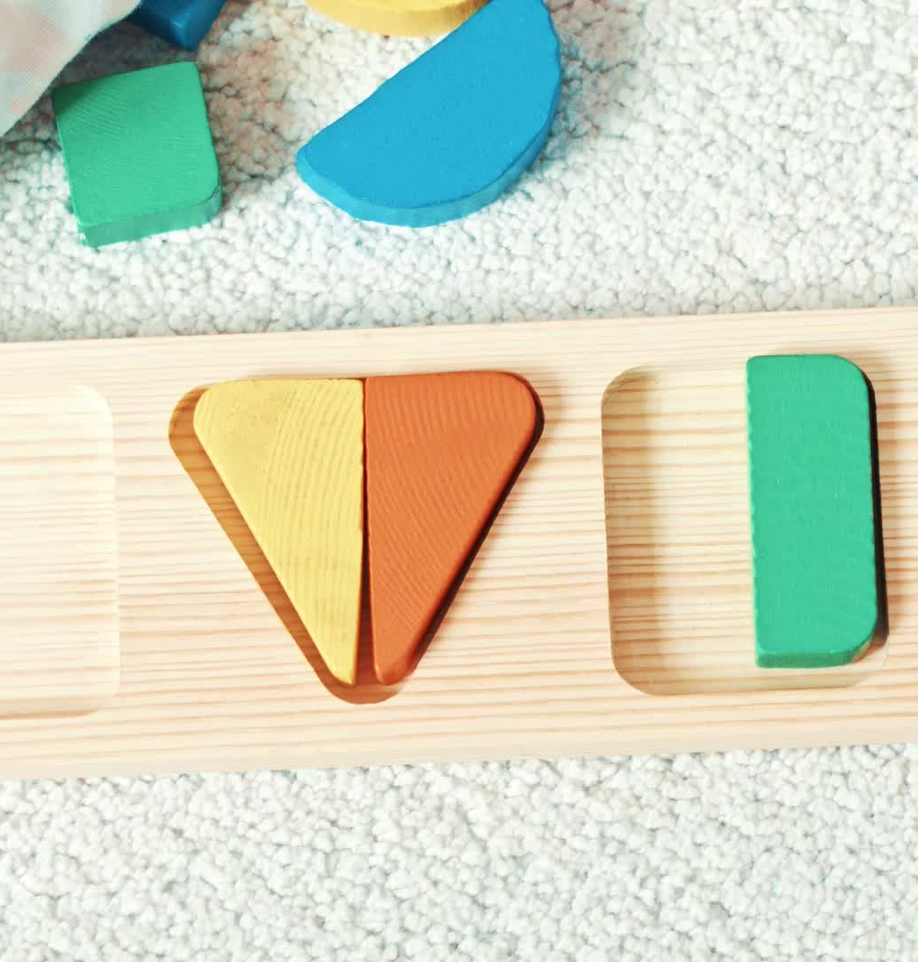
Design challenge
Design brief: To design and prototype a new Bottle opener
One must be Ergonomic
One must be Novelty and can be as creative as you like.
One can be your own them/client, so must be suitable for them.

Slide 6
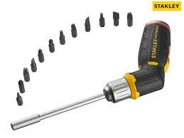
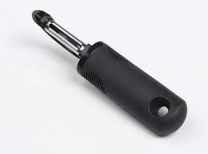
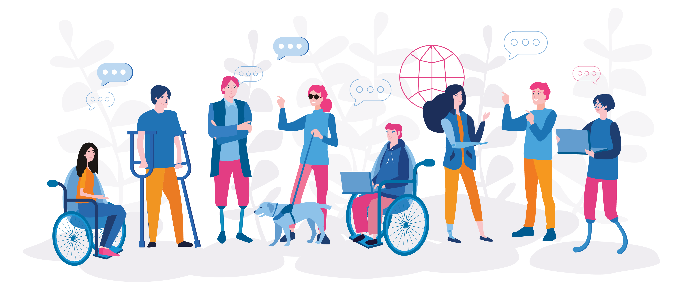
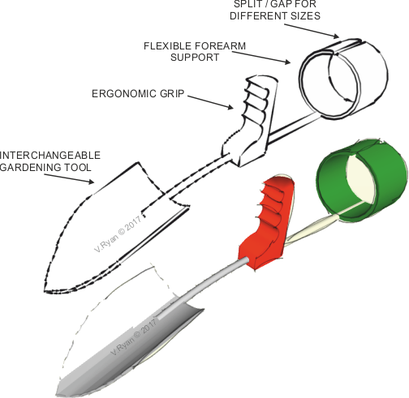
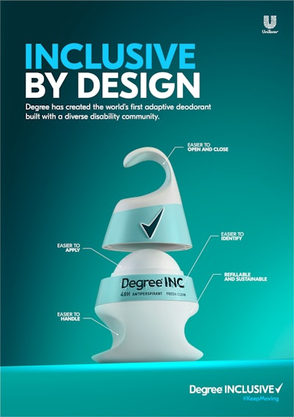
Ergonomic design
Ergonomic design makes products and places safe, easy and comfortable to use.
Light, temperature, texture, noise, shape can all effect the ergonomics of a product or place.

Slide 7
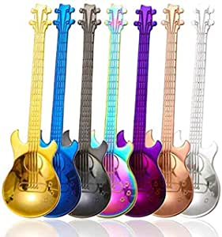
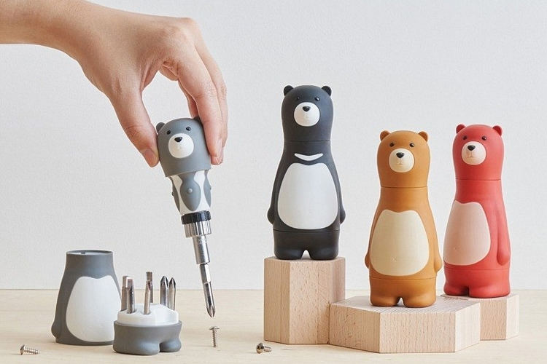
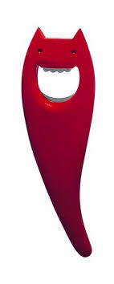
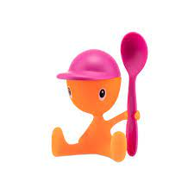
Novelty design
novelty is the degree of uniqueness or originality in that solution. It's often seen as the most important measurement of the quality of an idea.
Allessi create novel kitchen ware.

Slide 8
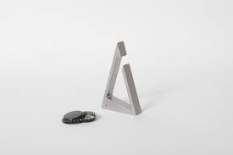
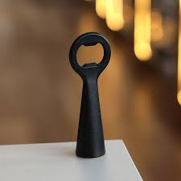
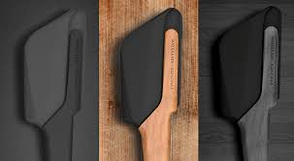
Own client

Slide 9
Summer task
Complete Technical principles paper exam questions.
These will give you a chance to see some A-level questions.
Design challenge: Complete bottle opener designs
One Ergonomic
One Novelty
One high end
-Bring papers and Ideas with you to the first lesson in September.

Slide 10

Any Questions?

