Slide 1
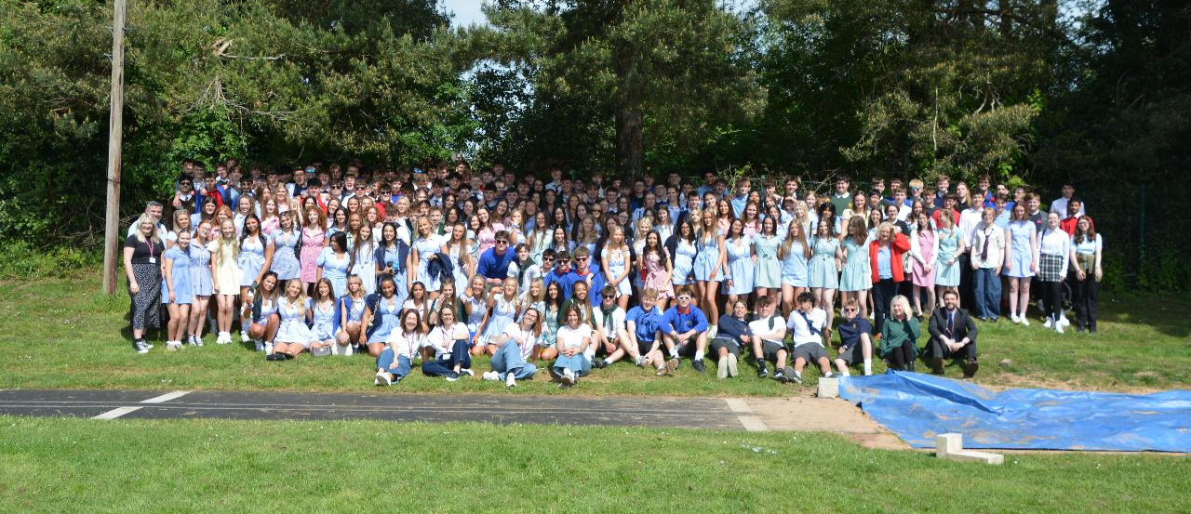
Welcome to Ecclesbourne Sixth Form
New starters 2026-28

Slide 2

The Ecclesbourne School strives to be a successful and caring learning community that inspires individuals to meet the challenges of the future

Slide 3

A few house keeping notices
If there is a fire alarm today you will be guided to the MUGA by a member of staff. Please line up where told and wait to be registered.
Lunch and break are in the SFC - You will NOT be allowed offsite at lunch. You can pay with cash or cards or thumbs.
Today we finish at 3.40pm tomorrow at 12.40pm.

Slide 4

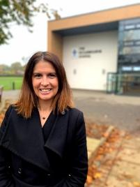
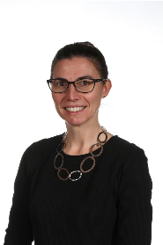
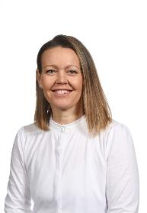
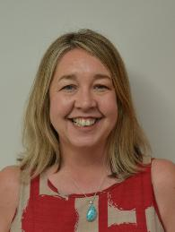
Meet the Sixth Form Office (SFO) Team
2026 - 2028
Mrs Weller
Head of Sixth Form
Mrs Hadwin
Head of Year 13
Mrs Bamber
Head of Year 12
Mrs Cox
Administration/
Admissions Lead

Slide 5
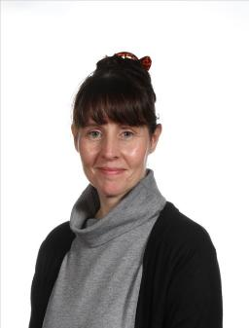
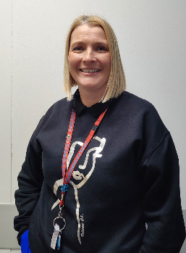
Pastoral Support Team
Mrs Tanser
Pastoral Support and School Nurse​
Mrs Parry
Pastoral Support

Slide 6
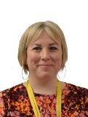
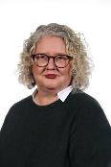
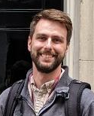
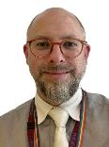
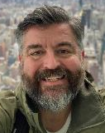
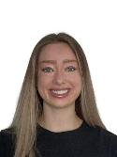
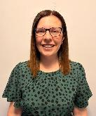
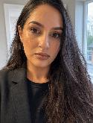
Meet the Tutor Team 2025 - 2027
12B | B1 | Ms G Calladine
12C | B3 | Ms S McCammon
12J | A1 | Mr J Cuthbert
12M | E6 | Mr R Mason
12P | A4 | Mr C Martin
12R | A3 | Miss E MacCormick
12S | L2 | Mrs S Abbott
12T | B1 | Mrs S Chowdury
You should know your form from the refectory lists but any questions or if you are not sure see one of us at the end and we will help you.
Notes:
Add pics. PKB will introduce the tutor meeting – EMB will talk more about role of tutor tomorrow

Slide 7
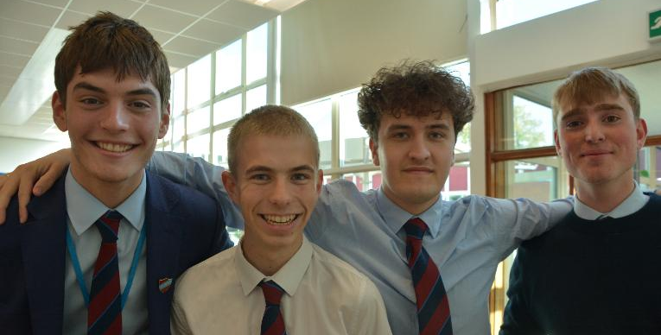
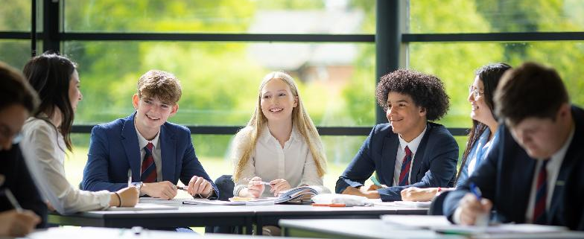
Plan for the two days
Meet your form and tutor and get to know each other through a range of activities.
Experience a lesson in each of your chosen subject areas and have summer work set.
Experience an extended curriculum lesson bespoke to your course.
Meet current year 12 and talk to them about activities and opportunities.
Notes:
PKB to use to outline the program for the next two days.

Slide 8
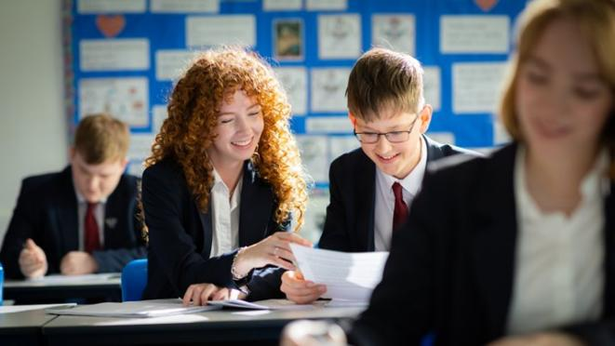
What will a typical student timetable look like?
3 Core subjects – These could be A level or BTEC or a combination. You will have 5 hours of teacher led lessons for each subject.
You will also be expected to spend additional independent study time in school and at home.
1 Extended curriculum option – AS Business, Extended Project Qualification (EPQ), Sports Leader, Young Enterprise, Core maths, IDEAS
These options will cover 2- 5 hours on your timetable.
1 hour of Health & Wellbeing – Options may include: fitness centre, badminton, football, yoga, dance or volunteering either in school or the local community.
Notes:
I will explain that some students may follow 4 a levels – mention further maths – only 3 additional lessons

Slide 9
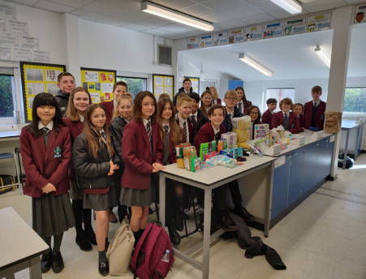
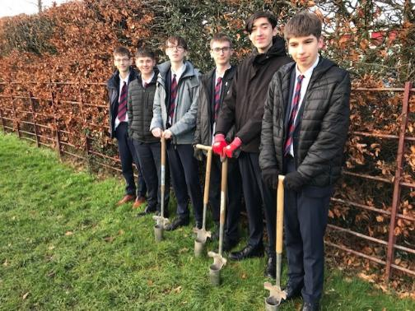
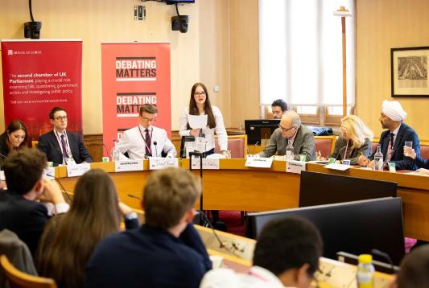
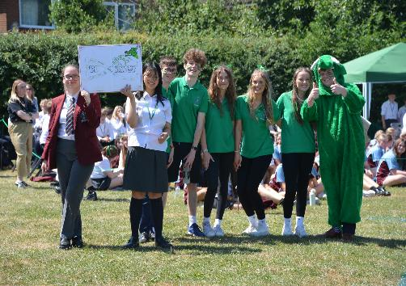
Leadership and enrichment
Get involved in Leadership roles –
Co-Heads
House Captains
Ambassadors – Wellbeing, Anti-Bullying and Diversity
Subject Mentoring
Lesson support
Buddy readers
Debate leaders
Peer mentors
School council
Community volunteering
Prefects
Notes:
These will discussed tomorrow

Slide 10
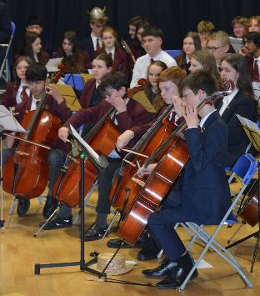
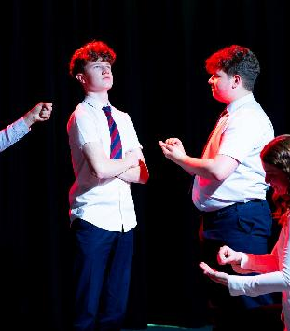
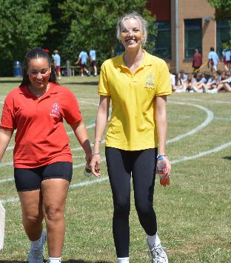
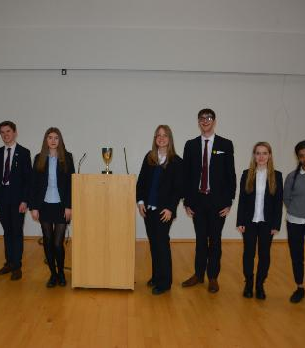
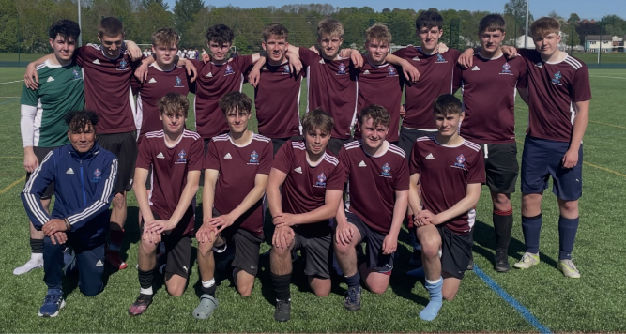
Why bother….?
Make new friends and develop personal skills that are hgihly transferrable to many jobs.
They help you grow as a person, give you new skills, and look great on your CV.
So find things you enjoy and throw yourself into them.
There is definitely something for everyone!

Slide 11
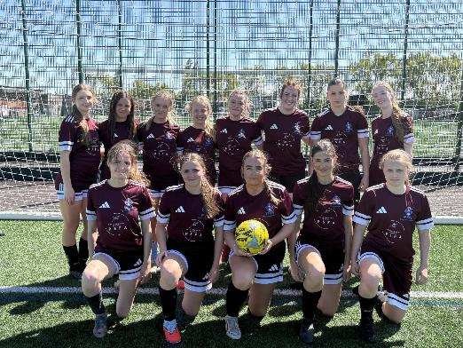
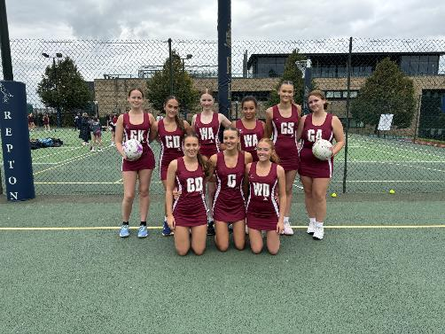
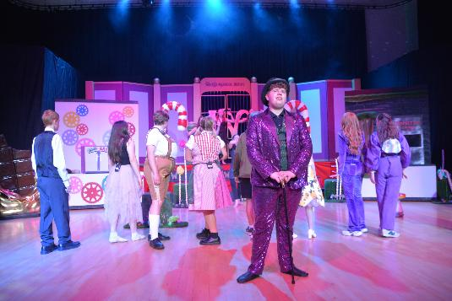
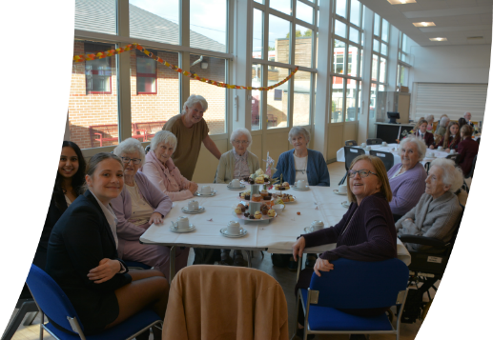
Other opportunities to get involved…
Sports teams
D of E
Newspaper/shine media
Interact
Debate
Music concerts/choir/performance
Community Tea party’s
Drama productions
Sign up, let you tutor know what you are interested in!

Slide 12
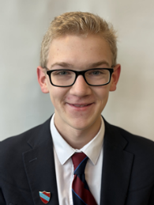
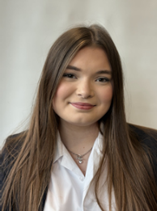
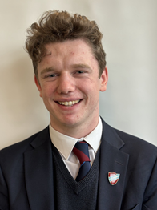
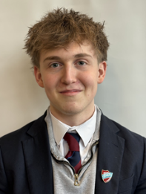
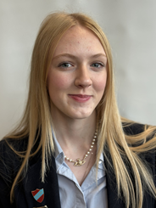
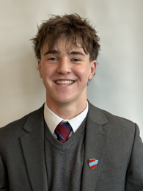
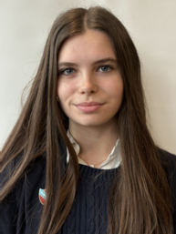
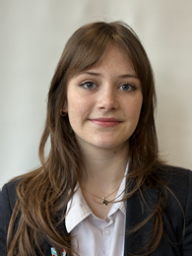
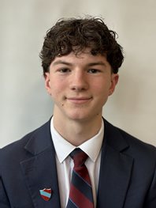
Meet our Co- heads

Slide 13
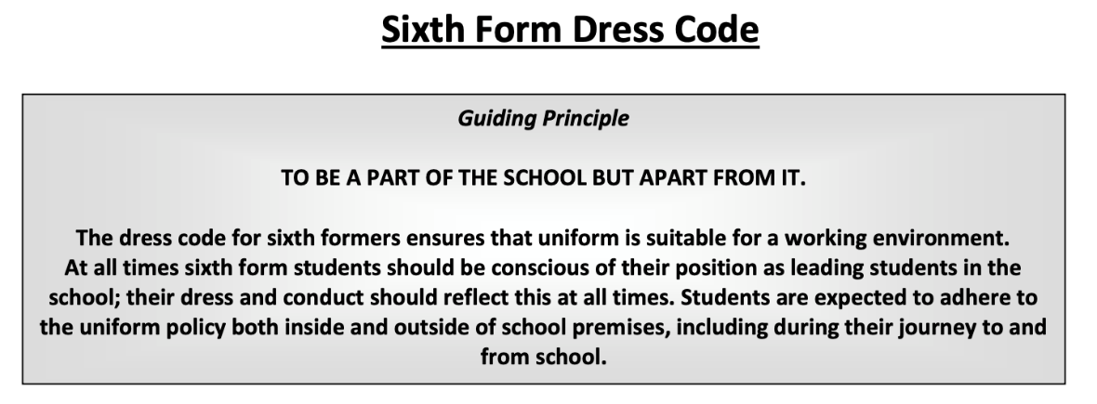
Notes:
Do we want to do thi on the Friday when we talk about PE uniform?

Slide 14
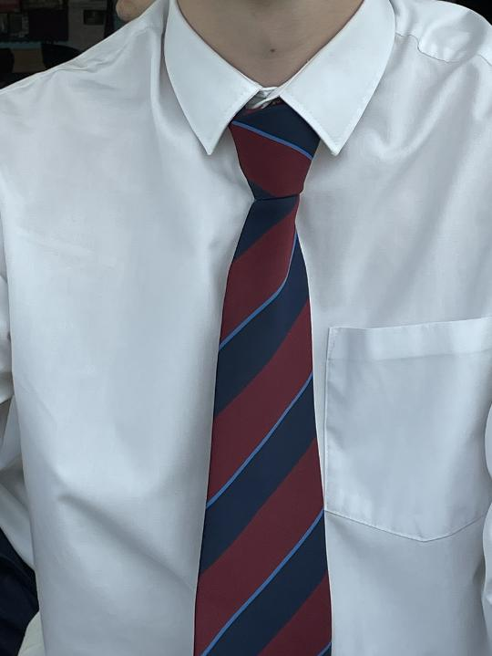
Ties
Ties - Students may require a tie, as per the dress code. The cost of the ties is £5.50. Please make this payment via ‘ParentPay’ by Friday 29th August 2025. Ties will be ready to collect on the first day of term in September from form tutors.
For students new to Ecclesbourne payment can be made by making a bank transfer to the following bank account:
Name - The Ecclesbourne School
Sort code - 40-19-37
Account number - 11670344
Reference - "student name tie” e.g. Harry Styles TIE

Slide 15

Wellbeing
PE uniform is required for anyone wishing to take part in sporting activities in wellbeing hour or outside this, such as gym use.
If you are intending on completing community volunteering or school volunteering, you will not need a top.

Slide 16
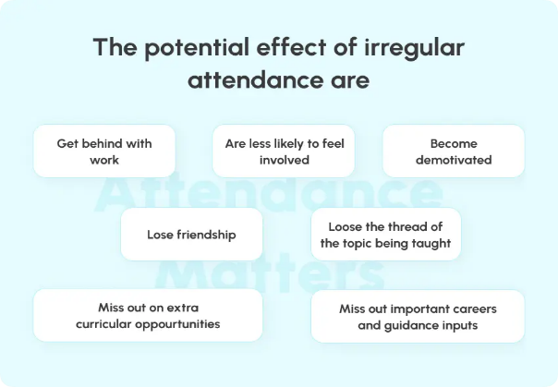
PUNCTUALITY AND ATTENDANCE
  We are FULL TIME establishment, and you are expected as before to attend school full time from 9am to 3.40pm.
  A 95% or above attendance is expected
  Punctuality is vital as you are now the role models for others.
  We will support you in reaching these targets and will allow you to leave early at 3.15pm if you have a study period each day, allow you to leave site at lunchtime and allow you to have driving lessons during the school hours.
  If you do not adhere to expectations these will be removed and further consultation about this will take place.
  This is never more important with applications to post 18 where references are requested. Attendance is ALWAYS ASKED for

Slide 17

What to do if you would like to change your course choices.
We will not be able to make changes for these two days but on results day you can request a change, and we will do our best to accommodate.
It will depend on:
Space
Timetable
GCSE grades

Slide 18

Who to ask?
If at any point over the next couple of days, you have any concerns please talk to :
Your Tutor
Mrs Bamber pbamber@ecclesbourne.derbyshire.sch.uk
Mrs Weller -
hweller@ecclesbourne.derbyshire.sch.uk
Any member SFO Team.

Slide 19

A new chapter awaits!

Slide 20
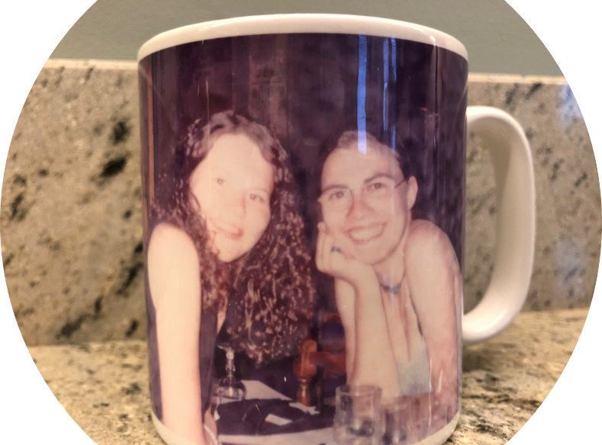

Slide 21
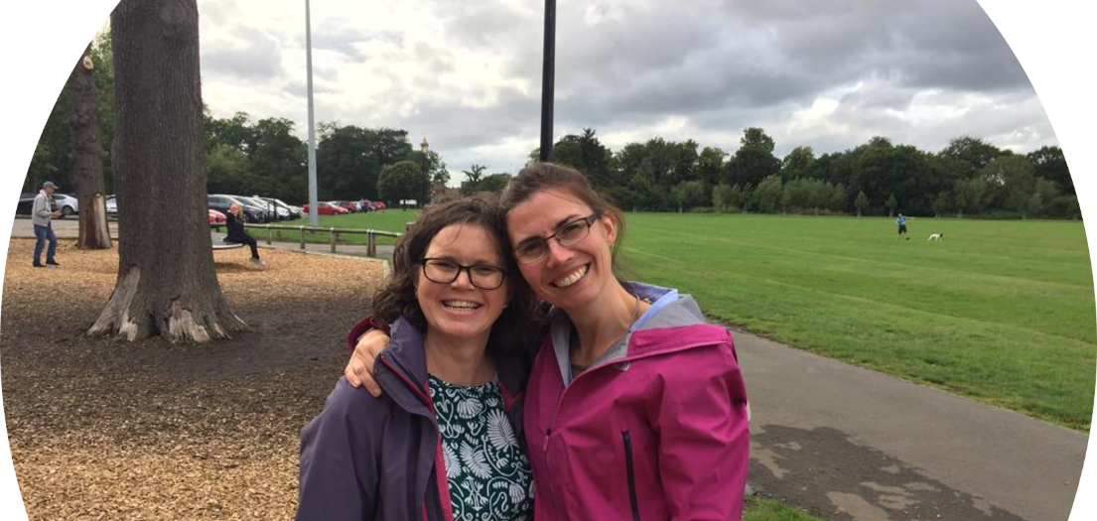

Slide 22
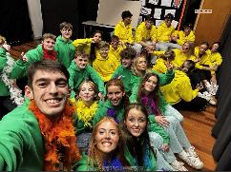

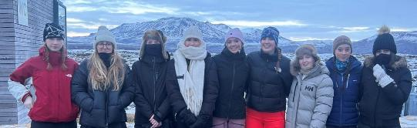
We're in this together!
Be honest with your feelings.
Ask for help if/when needed.
Challenge yourself daily!
Learn from your mistakes.
Accept advice when offered.
Support your peers.
Take appropriate risks!
Embrace this new chapter of your life!

Slide 23


How to make the best start to Sixth Form
Take ownership
Embrace challenge
Sixth Form is a step up. You are choosing to study here. Set your own personal targets and deadlines and hold yourself to them — this is the habit that separates students who thrive from those who struggle.
You will find the content harder than GCSE. That feeling of struggle is normal and productive. Ask questions in lessons, attend drop-in sessions, and never sit in confusion for long.

Slide 24

Study Habits &
Organisation
Check regularly Show My Homework and your school email so you can keep up to date with important messages, useful information and deadlines.
1
2
Aim for 1–2 hours of independent study per subject per week on top of lessons. Build this in from week one.
3
Review lesson notes within 24 hours — retrieval practice is the most effective revision technique proven by research.
4
Break large tasks into small steps with their own mini-deadlines. Starting is always the hardest part.
Notes:
Walk through each habit. The 24-hour review point is particularly important — ask students to write it in their planners now.

Slide 25


Look after yourself
Get involved
Build relationships
Sleep, nutrition and downtime are not optional extras — they are part of your performance. Build a routine that includes time away from screens and revision.
Get involved in an enrichment activity within the first two weeks. Students who are involved in school life outside lessons report higher wellbeing and stronger friendships throughout Sixth Form.
Introduce yourself to your teachers as a Sixth Former, not just a student. Visit them outside lessons with questions. These relationships open doors to references, mentoring and university advice.

Slide 26
What to expect in your subject taster sessions.
You will meet a subject teacher from your chosen subject.
They will outline what the subject is about & possibly give you an experience of the type of things that you do in lessons.
Set you up with summer work. It is an expectation that this task is completed by the first day of term in September.
This will be your subject teachers first impression of you as a Sixth Form student - make sure you shine!

Slide 27
Off to form – meet your new family!

