Slide 1
A-Level Drama and Theatre
Edexcel

Slide 2
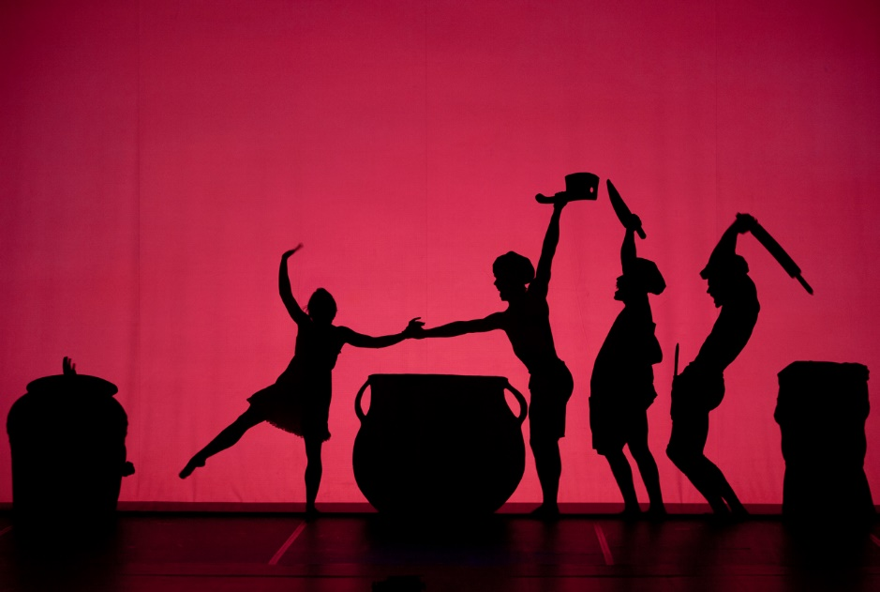
Hello Year 11.
I am thrilled that you are considering the A-Level Theatre and Drama course.
For those of you that have studied Drama at GCSE, you will find that the course structure at A-Level is very similar.

Slide 3
In the following few slides, I will explain the course and provide you with a few activities that you can complete in order to help you to prepare for the course in September.
Any work that you can complete is a bonus! Please, don’t stress about the tasks.
There may be a few things that you don’t fully understand at this point.
Don’t let that put you off.
If you have any questions or concerns then just email me on my school account.
gshuttleworth@ecclesbourne.derbyshire.sch.uk

Slide 4
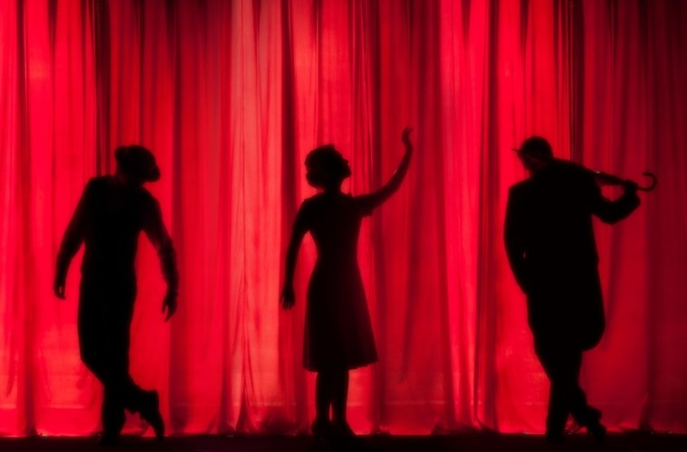
Course structure
The A-Level course is split into three components.
Component One-Devising
Component Two-Individual and group performance
Component Three-Written Exam

Slide 5
Component One Devising-40% of your final grade
You will complete Component one at the end of Year 12.
You will be required to study a play.
You will then be given a short extract from the play that you will use as the starting point for your devised Drama.
You will explore the themes of the extract and undertake in-depth research in order to create an original piece of Drama.
You will work in small groups to produce the performance.
The Performance will be recorded and you will be marked on your acting skills.

Slide 6
Component One Devising
When you are creating your piece of Drama, you will be required to produce a written portfolio of 3000 words. This will analyse and evaluate your rehearsal process and the final piece of Drama that you produce.
In the portfolio, you will be required to respond to the following 6 questions:
Outline your initial response to the key extract and practitioner and track how it was developed throughout the devising process.
Connect your research material/s to key stages in the development process and to performance outcomes.
Evaluate how your chosen role/s emerged and developed from initial ideas through to the final performance.
Analyse how your contribution was influenced by the selected theatre practitioner and/or theatre makers, and the impact live theatre has on your own practical work.
Discuss how social, historical and cultural conventions impacted on your work
Evaluate the creative choices you made and whether or not they were successful in performance.

Slide 7
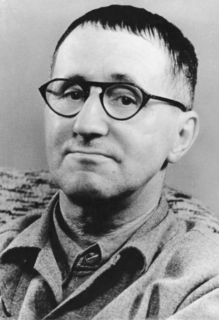
Task
Your devised performance has to be produced in the style of a practitioner. A Theatre Practitioner is somebody who has influenced the way in which theatre is rehearsed, performed or designed. They could be a writer, designer, actor, choreographer or director.
Your Practitioner for Component One will be Bertolt Brecht.
Brecht had a really interesting life and his life experiences influenced the way in which he wrote and directed plays.
I would like you to research Bertolt Brecht and produce a fact sheet that can be copied and shared with the class in September. Please make sure that the work isn’t copied and pasted! It must be your own work!
This youtube link is a really good starting point
https://www.youtube.com/watch?v=l-828KqtTkA
GCSE Bitesize also provides a clear outline of the basic principles of Brecht’s ideas. This will help you to start your research.
https://www.bbc.co.uk/bitesize/guides/zwmvd2p/revision/2

Slide 8
Component Two-20% of your final grade
For Component Two you will have to take part in two performances.
Both performances will be marked by a visiting examiner.
The first performance is a solo performance (monologue) or a duologue. You will be marked on your acting skills. The pieces must be from a published play.
The second performance will be in a group piece. This will be scripted and will be directed by a member of the Drama staff.

Slide 9
Task
Challenge yourself to find a monologue from a published play. Make sure that you read the whole play. Choose something new. Don’t use a monologue that you have previously performed.
Learn the monologue and rehearse it so that you can perform it in September.
When you perform the monologue it should be staged. Do not just stand and speak it.
You need to demonstrate a strong understanding of the character that you are performing.

Slide 10
Task
Write 250 words explaining the character that you are playing and how you are performing the role. You must address the following points:
What role are you playing?
What is happening to your character in the monologue?
How does the monologue connect to the whole play?
What are your character’s objectives(what do they want?)/motivations/feelings?
How are you interpreting this character in performance?(vocal/physical/communication of intent)
Be specific. Write about pitch/pace/volume/gesture/physicality/movement

Slide 11
Component Three-40% of your final grade
At the end of Year 13 you will sit a written exam.
The exam has three sections.
In preparation for the exam you will be taken to the theatre to watch a performance that you will write an essay about.
You will study a play that you will write two essays about. One essay about performing and one essay about theatre design.
You will study a second play that you will write an essay about how you would direct the play.

Slide 12
Section A-Live Theatre Evaluation
You will be taken to see a performance of a play.
You will make detailed notes about the production, commenting on :
Costume, lighting, acting, set, sound, props and stage furniture, use of stage space.
In the exam you will be given a statement like:
“Theatre today has nothing to say to a young audience.”
You will be expected to express your opinion on this statement by writing about the production that you have seen.

Slide 13
Component 3-Section B
The set text that you will study for section B of the written paper is “Equus” by Peter Shaffer.
This is a brilliant play that centres around the relationship between a psychiatrist named “Dysart” and his patient “Alan Strang”. Alan has been sent to Dysart because he has blinded 6 horses with a pick.
The play explores religion, ritual, worship, the question of normality and asks why people might be driven to commit acts of violence.
You will notice that it is written in a Brechtian style.
For this play, you will have to create a design for a production of the play and you will have to write about how you would perform certain characters.
You will also have to research the social, historical and political context of the play.

Slide 14
Task
If you are able to get hold of a copy of this play and read it and re-read it and read it again, that would be brilliant. You need to know this play inside out and back to front!
If you are unable to get a copy, don’t worry. We have some copies in school that you can borrow in September.
If at all possible it would be very helpful for you to have your own copy to keep notes in.
If you decide to order a copy online, please make sure that you get the correct edition. The details are below.
Equus, Peter Shaffer. Penguin Classics. ISBN. 9780141188904

Slide 15
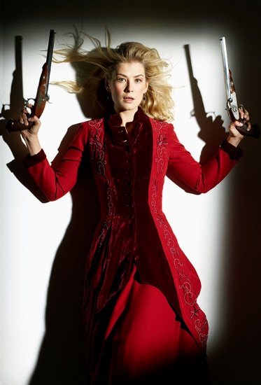
Component Three-Section C
The set text that you will study for section C is “Hedda Gabler”, by Henrik Ibsen.
Henrik Ibsen is a very important playwright. Many of his plays were very controversial at the time that they were written because he wrote strong female characters that were considered scandalous because they didn’t conform to social constraints.
Hedda is about a newly married woman who is bored with her life and appears to manipulate the people around her in order to make her life more interesting.
You will have to write about how would direct this play using the ideas of another practitioner, Stanislavski.

Slide 16
Tasks
Task One
If possible, get hold of a copy of the play and read it and re-read it. You need to know this play in great detail!
If you can’t get hold of a copy then don’t worry, we have plenty that you can borrow in September.
It would be good if you had your own copy to make notes in. Make sure that you get RICHARD EYRE’S adaptation.
“Hedda Gabler”, Henrik Ibsen (adapted by Richard Eyre)
Nick Hern Books
ISBN 9781854598424

Slide 17
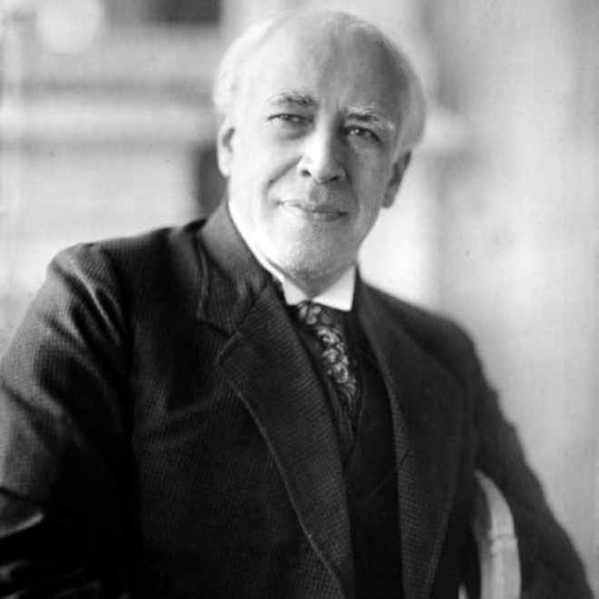
Task Two
Create a practitioner fact sheet for Constantin Stanislavski that can be copied and shared with the class in September.
He is a really important practitioner because he helped to develop believable, true to live performances on stage.
Make sure that you research his ideas on how to approach acting. Magic “If”, Given Circumstances, Units and Objectives, Emotional Memory, Inner Tempo Rhythm.
Bitesize is a really good starting point for his basic ideas.
https://www.bbc.co.uk/bitesize/guides/zxn4mp3/revision/1

Slide 18
Extra tasks
Keep your eye on what is happening in the news. This is a really difficult time for the creative arts industry.
Use any spare time that you have to revisit some key terminology by using the BBC Bitesize website. It provides the foundations for ideas that we will build upon in more detail as we move through the A-Level course.
Here are some useful links.
https://www.bbc.co.uk/bitesize/topics/zn6k92p
https://www.bbc.co.uk/bitesize/guides/zdp4vk7/revision/1
https://www.bbc.co.uk/bitesize/guides/zvph2sg/revision/1

Slide 19
Remember…
Any of the tasks that you can complete are a bonus!
Please don’t stress.
Have a good summer.

Slide 20
Component One Marked by your Teacher (20 Marks) | Devised performance | You will devise a piece based on chosen text. Your performance must be in the style of a chosen practitioner
(60 Marks) | Portfolio | You must produce a written portfolio of 2500-3000 words
Component Two Marked by an external examiner (60 Marks) 20% of final Mark | Group Performance of a published play | You will perform in a staff directed performance of a published play
 | Monologue | You will perform a monologue
Component Three Marked by an examiner | Written Exam
(20 Marks) | Section A | You will answer a question based on a Live Performance that you have seen.
(18 Marks) (18 Marks) | Section B | You will answer an acting question and a design question based on a set text that you studied
(24 Marks) | Section C | You will answer a question about directing a performance of a second set text that you have studied. You must consider practitioner influence and original performance conditions

