Slide 1
What is product design?
Welcome Year 11-12 2024/25

Slide 2
A-Z of product design
For every letter of the alphabet try to think of a 3D product.. How many can you come up with.
You have 2 minutes..go!
A
B
C
D
E
F
G
H
I
J
K
L
M
N
O
P
Q
R
S
T
U
V
W
X
Y
Z

Slide 3

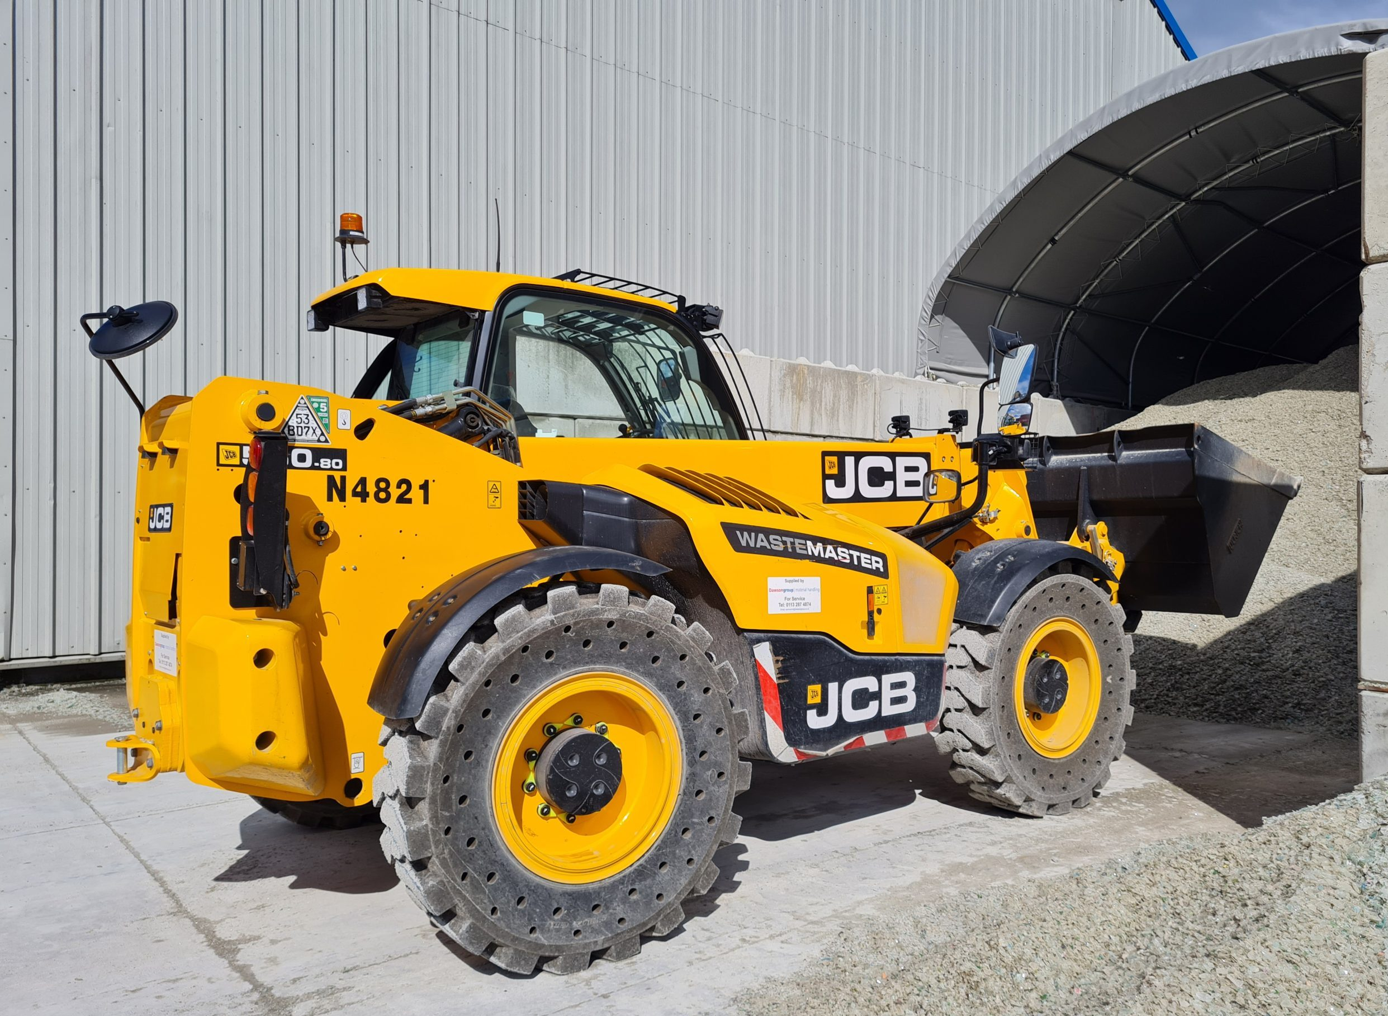
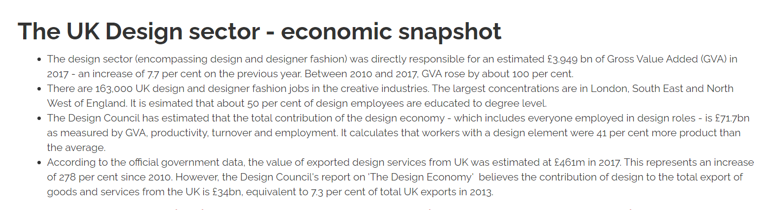

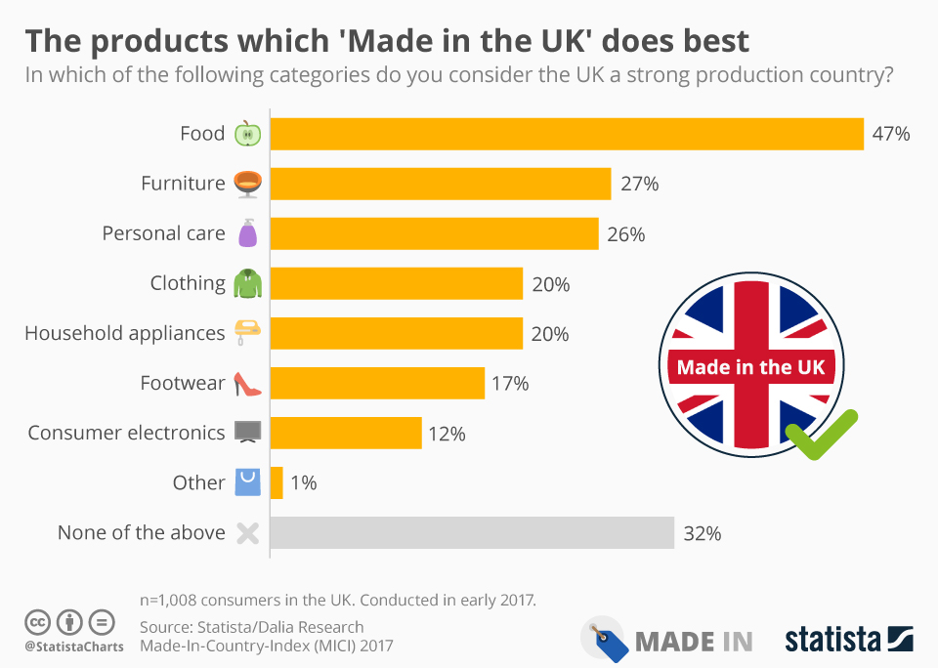
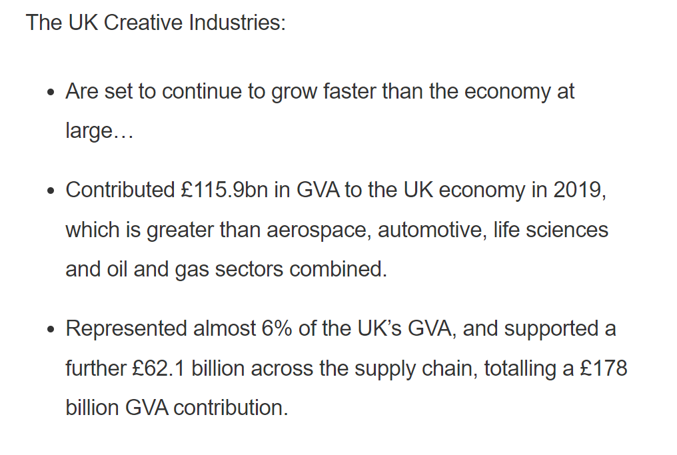

Slide 4

Equipment list
Pens
Pencils
Ruler
Sharpener
Rubber
Protractor
Compass
Set square (e.g. typical maths set)
A Scientific Calculator – one maths lesson a week
Set of colouring crayons (optional but helps!)
Highlighters
A4 lever arch folder (large) with enough dividers for maybe 20+ subtopics.
Hole punch (this can stay at home, but helpful!)
AQA revision guide – letters will go out in September to everyone, though they are not cheap (£30)
Once projects are finalised for next year will may also ask for a small contribution to materials costs but again this will be communicated in September.

Slide 5
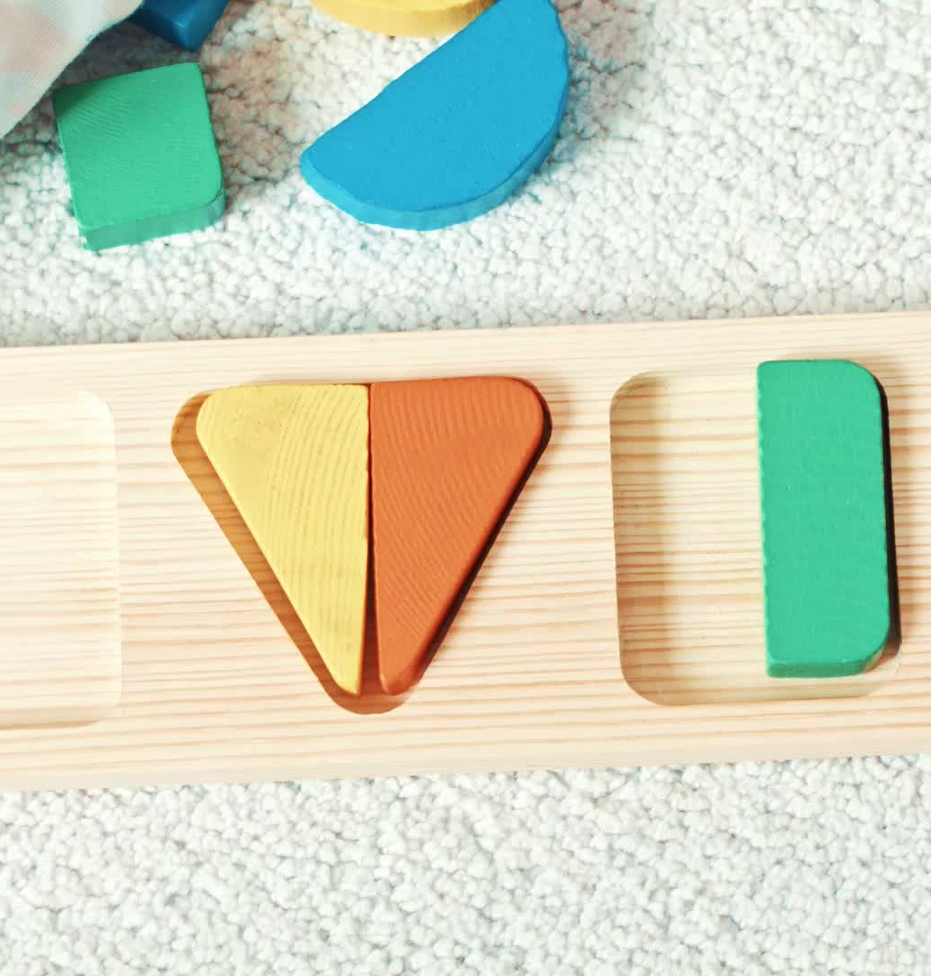
Design challenge
Design brief: To design and prototype a new Pizza slicer.
One must be inclusive and work for someone who has little to no use of their hand/s
One must be novelty and can be as creative as you like.
One must be suitable and encouraging for a child to use safely.

Slide 6
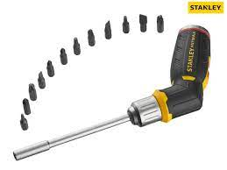
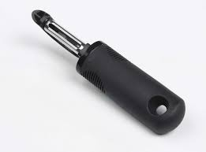

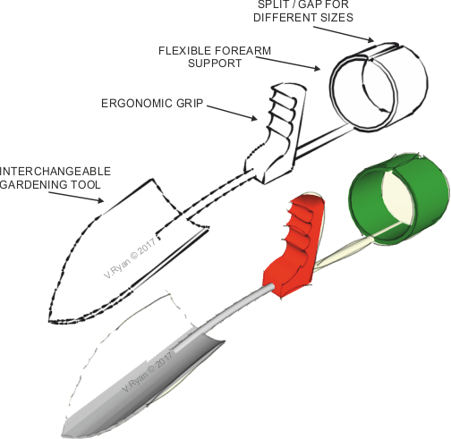

Inclusive design
Inclusive design makes places usable by everyone, regardless of age, ability and circumstance. It is based on the simple principle that designing for the widest range of people creates better designs and benefits everyone.

Slide 7
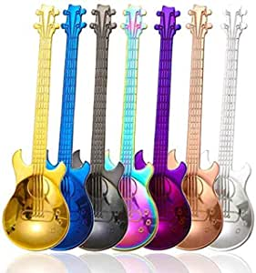
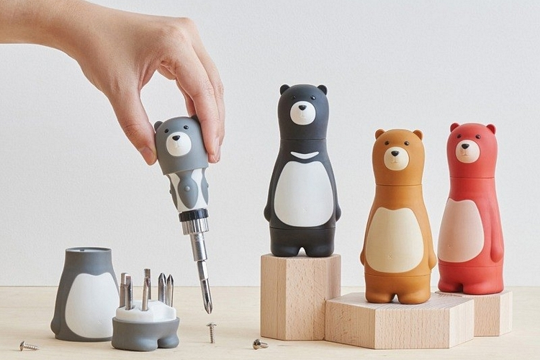

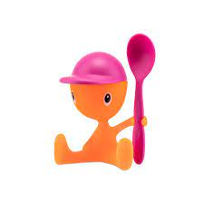
Novelty design
novelty is the degree of uniqueness or originality in that solution. It's often seen as the most important measurement of the quality of an idea.
Allessi create novel kitchen ware.

Slide 8
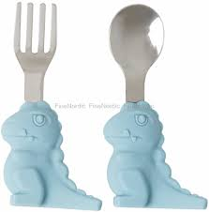
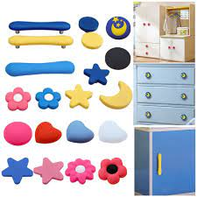
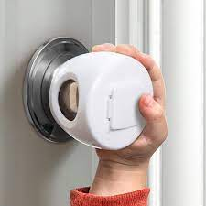
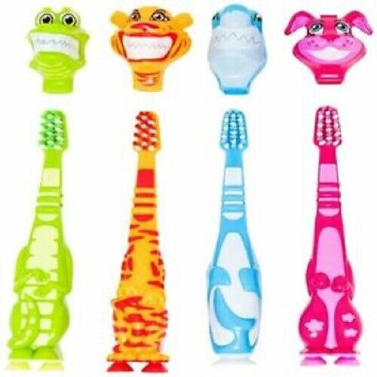
Kids design
Kids design should be safe and fun, encourage interaction so textures and bright colours will be important.
Cosider the saftey of the blade.

Slide 9
Summer task
Complete AS paper exam questions.
These will give you a chance to see some basic A-level questions.
Design challenge: Create three design ideas for a refillable drinks bottle.
One Inclusive
One Novelty
One Kids
-Bring papers and Ideas with you to the first lesson in spetmber.

Slide 10

Any Questions?

