Slide 1
OCR A level Biology A

Slide 2
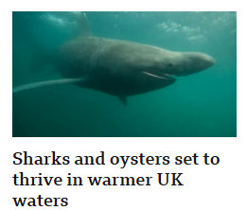
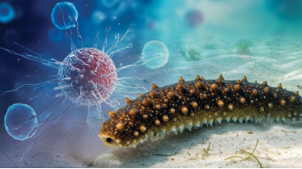
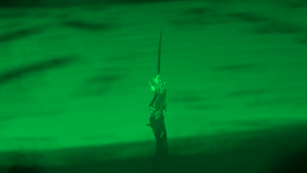
The Importance of Biology
Notes:
Science & Environment | Latest News & Updates | BBC News
Clever worms form superorganism towers to hitch rides on insects | ScienceDaily
Scientists discover natural cancer-fighting sugar in sea cucumbers | ScienceDaily

Slide 3
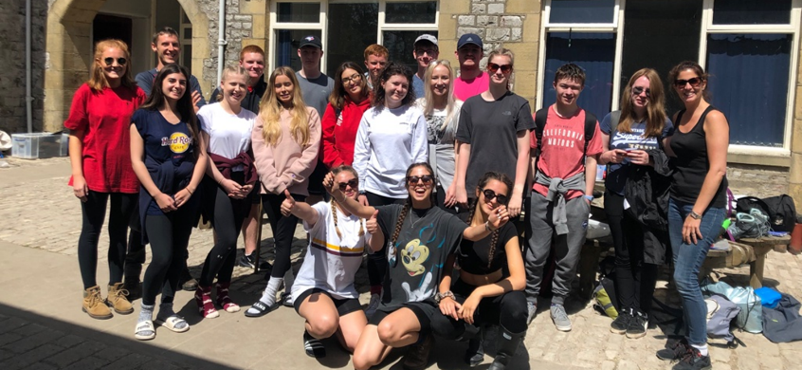
Introduction to A level Biology
‘Biology is my favourite subject, not only is it fascinating, but its importance as a subject is unquestionable. The teachers and support you receive is exceptional and there is no other subject I would rather do’ Year 13 student.

Slide 4
Course Overview Year 1
1. Development of practical skills (Across both years) | 2. Foundations in Biology | 3. Exchange and Transport | 4. Biodiversity, Evolution and Disease
Planning, implementing, analysis, evaluation and research. Development of skills in use of specific apparatus and techniques. These skills are delivered across 12 Practical Activity Groups (PAG) | Different types of cells (Eukaryotic and Prokaryotic) Production of new cells through mitosis and meiosis The internal structure of a cell. Cell surface membrane Cell communication DNA and it’s structure Enzymes and how they work | Exchange Surfaces Transport in Animals Transport in Plants | Communicable diseases, disease prevention and the immune system Biodiversity Classification and Evolution

Slide 5
Course Overview Year 2
1. Development of practical skills (Across both years) | 5. Communication, homeostasis and energy | 6. Genetics, evolution and ecosystems
Planning, implementing, analysis, evaluation and research. Development of skills in use of specific apparatus and techniques. These skills are delivered across 12 Practical Activity Groups (PAG) | Communication Homeostasis Excretion Neuronal & hormonal communication Plant and animal responses Photosynthesis & respiration | Cellular control Patterns of inheritance Manipulating genomes Cloning and biotechnology Ecosystems Populations and sustainability

Slide 6
Practical work
The practical component is assessed in the final exam.
Students also receive a practical endorsement if they show competency in the skills required. The practical endorsement may be given as an entry requirement by Universities.

Slide 7
Structure of year 12 teaching
2 teachers for 5 hours per week.
Lessons typically involve coverage of theory, opportunities for discussion, application of knowledge, problem solving and practical activities.
Independent study is vital.
Regular topic tests and assessment tasks at key points during the modules – related back to targets to ensure maximum progression.

Slide 8
Assessment
Component | Marks | Duration | Weighting | Content
Biological processes | 100 | 2 hours 15 minutes | 37% | Modules 1,2, 3 and 5
Biological diversity | 100 | 2 hours 15 minutes | 37% | Modules 1, 2, 4 and 6
Unified Biology | 70 | 1 hour 30 minutes | 26% | Content from all modules
Practical endorsement | - | - | - | -
3 Written examination papers
Practical Skills Endorsement through 12 specific practical activities completed throughout the year -Pass/Fail
Note that this goes alongside the A level Biology grade, it has NO impact on the outcome of the grade, however it could potentially be required by Higher Education providers.
Notes:
Terminally accessed course – fully examined at the end of the course with in-class assessments throughout

Slide 9
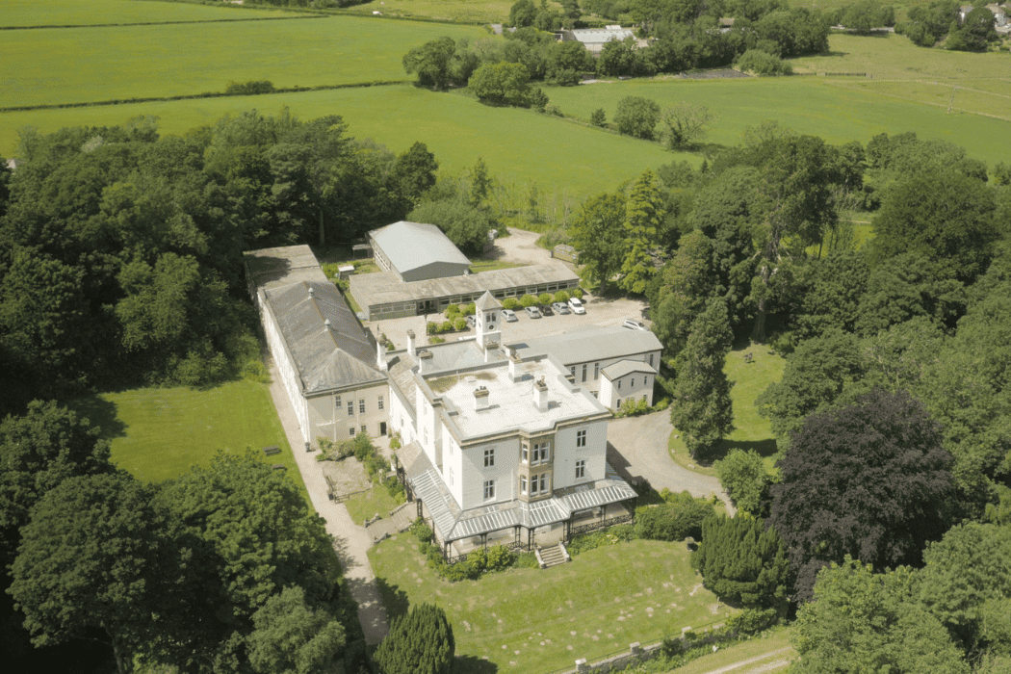
Residential Field Trip
Consolidate understanding of the basic principles of ecology and biodiversity, and develop sampling strategies.
FSC Castle Head, Cumbria
Notes:
Our hope – residential field trip depending

Slide 10
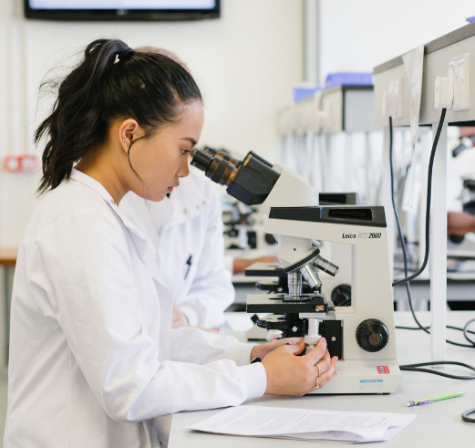
Courses at University
Psychology
Medicine
Biosciences
Neuroscience
Biomedical Science
Biochemistry and Molecular cell biology
Optometry
Physiotherapy
Veterinary Medicine

Slide 11
Careers
Research scientist
Pharmacologist
Biologist
Ecologist
Nature conservation officer
Biotechnologist
Forensic scientist
Government agency roles
Science writer
Teacher

Slide 12
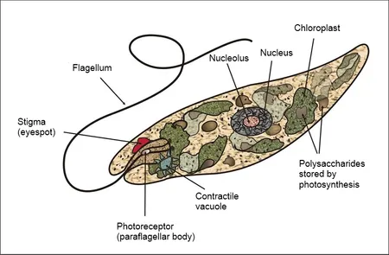
Practical activity – Euglena
Using microscopes, you will work in pairs to observe, measure and draw Euglena.
Complete your work on the A4 sheet provided, and attempt all of the task.
Single celled Eukaryotic organism – autotroph - flagellated

Slide 13
Method
Place 1 drop of Euglena onto the dimple slide (ensure the correct way round!)
Carefully lower a coverslip SLOWLY onto the dimple slide
Use a paper towel to soak up any excess
Place the slide on the microscope stage and focus under the low power object lens. Use the aperture under the stage to adjust the light levels to show a clear contrast. Draw your observations of the low power plan.
Increase the magnification to ultimately view on the x40 objective lens, draw your observations, ENSURE you include the graticule (ruler) on your drawings to show relative size. Use the table on the next slide to calculate the actual size of the Euglena

Slide 14
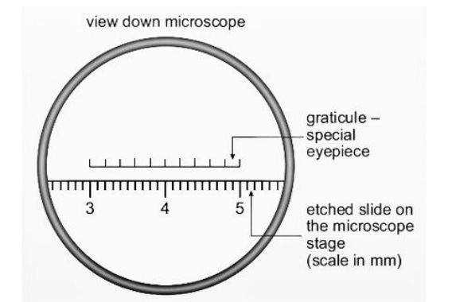
Calibrating the graticule
An eyepiece graticule can be fitted to a microscope - this acts like a ruler, allowing structures to be measured under the microscope.
A stage graticule (aka stage micrometre) is a microscope slide with an accurate measuring scale – this is used to calibrate the value of the eyepiece divisions at different magnifications. Often it is 1mm long in 10μm divisions

Slide 15
The following process is used to calibrate an eyepiece graticule:
Set up the microscope to the required magnification to view the sample.
Place a stage graticule on the stage.
Line up the two scales (the stage and eyepiece graticules) similar to the diagram.
Count the number of divisions on the eyepiece graticule equivalent to each division on the stage micrometre.
As the length equivalent to each division on the stage micrometre are known, it is possible to calculate the length of one eyepiece division.
So above you can see that 10 eye piece graticule units are equal to 20 stage micrometre unit.
Each stage micrometer unit is equal to 10 μm so 20 = 200 μm
So one eye piece unit = 200/10 = 20 μm
If a cell then has a width of 5 eyepiece units is real width is 5 x 20 μm

Slide 16
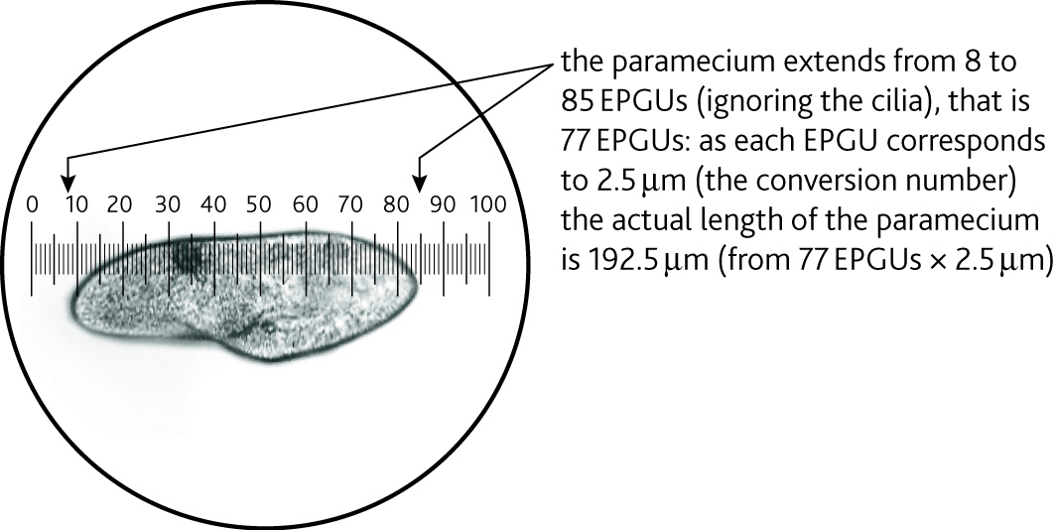
Eyepiece graticule; how big is one ‘unit’?
Paramecium seen under the eyepiece graticule (‘high’ power x400)

Slide 17
Typical values for light microscopes:
Present new information
Magnification of eyepiece lens | Magnification of objective lens | Total magnification | Value of each eyepiece division (EPU) (µm)
X10 | X4 | X40 | 25
X10 | X10 | X100 | 10
X10 | X40 | X400 | 2.5

Slide 18
Summer work
To ensure that you are fully prepared to begin your A level in Biology in September, the Biology team would like you to complete several transition work tasks and bring back to your first lesson. These are outlined on the school website.
Thank you and looking forward to seeing you in September!

