Slide 1
to Art

Slide 2
The AQA
Fine Art
A Level course
starts right here…

Slide 3
“My name is
Mr Davies…
…the Head of Art.”

Slide 4
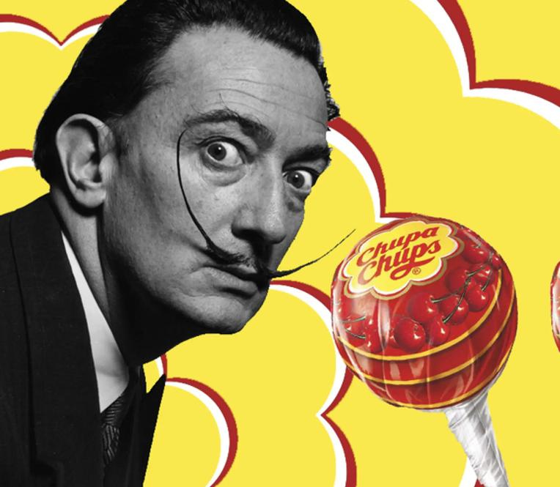
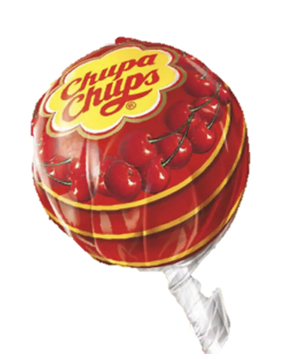
Which artist
designed the
Chupa Chups
Lollipop logo?
The Surrealist artist Salvador Dalí designed the
logo in 1969.
Its first marketing campaign used the slogan…
"It's round and long-lasting".

Slide 5
Sixth Form
Summer Induction Task

Slide 6
Fine Art A Level Induction
The Fine Art A Level Component 1 Personal
Investigation comprises of an extended project.
The theme for this project is one you will develop with help next term.
However, to enable you to start the Fine Art course with confidence and in a suitably focused way, we are setting you a creative task to complete in time for the first lesson in September.

Slide 7
Fine Art A Level Induction
The aim of the task is to explore at least 3 different/potential themes, that you may wish to use for your extended project, completed later in the course.

Slide 8
Fine Art A Level Induction
The themes considered will need to be of a personal interest to you, so that it maintains your enthusiasm.
The themes chosen also need to allow you to resource them without an over reliance on the internet.

Slide 9
Fine Art A Level Induction
For those of you who find the idea of selecting your own theme too daunting I have put together some ideas to help you.
You may use any of these suggestions or alternatively devise your own. In addition, some previous questions from A level examination papers are also included which you may wish to use as inspiration for your own ideas.

Slide 10
Fine Art A Level Induction
Still Life Portraiture Travel Decay
My Family Holidays Flowers Isolation
Natural World Festivals Addiction The Senses
Looking through Surface textures Places Unusual viewpoints
Emotion Anatomy Landscapes People at Work
Clothing Protect Containers Dreams and Nightmares
The garden Sequence Machinery Hide and Seek
Cycling Collections Unlock Metamorphosis
Light and Shade Barriers Movement As seen on TV
Performance Imprint Time Inside out
Found materials Architecture Danger Me, myself and I
Where next? Construction Layers Good, Bad, Evil
Ageing Celebration Industry Windows & Doorways

Slide 11
Fine Art A Level Induction
Some suggested starting points from previous examination papers:
1. Reflections
Many artists have created works based on reflections in mirrors, water or shiny surfaces. Reflections can be subtle or elusive. They may be static or moving and can often create interesting distortions. Produce your own response to these ideas.
Artists: M. C. Escher, Audrey Flack
2. Light, Weather and Locations
Weather conditions can have a profound effect on the appearance and atmosphere of a location. Artists past and present have been inspired by the effects of light and weather conditions. Develop your own ideas relating to this theme.
Artists: Turner, David Tress, Lewis Noble (local - Ashbourne)
3. Villages, Towns and Cities
Villages, Towns and Cities provide many opportunities to explore particular locations or aspects of everyday life. Many artists have been inspired by the architecture or the diversity of people. Decide on your own focus and explore the theme.
Artists: Richard Estes, Robert Cottingham, L. S. Lowry
4. Facial Expressions
Many artists have explored work which considers different facial expressions. Their work depicts moods such as serenity, discomfort, frustration or delight. Consider relevant examples and produce your own ideas.
Artists: Leonardo da Vinci, Ernst Ludwig, Franz Xaver Messerschmidt

Slide 12
Fine Art A Level Induction
5. Patterns in Nature
Many artists have produced work based on patterns that can be seen in shells, plants and animals. Consider your own response to the idea of patterns found in the natural world.
Artists: Ernst Haeckel, Karl Blossfeldt, Peter Randall-Page.
6. Shadows
Shadows can create illusion and a sense of mystery. They can create atmosphere and drama or direct the viewers eye to particular parts of a picture or scene. Explore ideas relating to the use of shadows of different kinds in your own work.
Artists: Henry Fuseli, Caravaggio, Joseph Wright of Derby, Cornelia Parker
7. Everyday objects
Artists often explore everyday objects in their work. Some consider the objects in great detail, whilst others enlarge their scale or represent them in an abstract or unusual manner. Consider your own series of everyday objects in your work.
Artists: Michael Craig-Martin, Patrick Caulfield, Wayne Thiebaud, Claes Oldenburg
8. Significant Events
Numerous artists have produced work in response to political, social or personal events. These can evoke feelings such as joy, happiness, excitement, anger or despair. It can be serious events such as war and environmental disasters or perhaps something more personal like learning to ride a bike, climbing a mountain or even dropping an ice-cream!
Artists: Kathe Kollwit, Henry Moore, Paul Nash

Slide 13
Fine Art A Level Induction
The A6 sketchbook (which you have/will collect from me) is meant to be mostly visual. You should experiment with ideas, materials and techniques throughout the book. Some pages will be quick to complete whilst others with require more time and energy.
You must include/produce at least:
30 Photographs that explore your chosen themes and ideas.
10 high quality observational drawings.
4 well painted double pages.

Slide 14
Fine Art A Level Induction
This sketchbook will be included in your ‘Personal Investigation’ and contribute to your overall A Level Grade.
Make it as impressive, inventive and skilful as you can over the extended summer break.

Slide 15
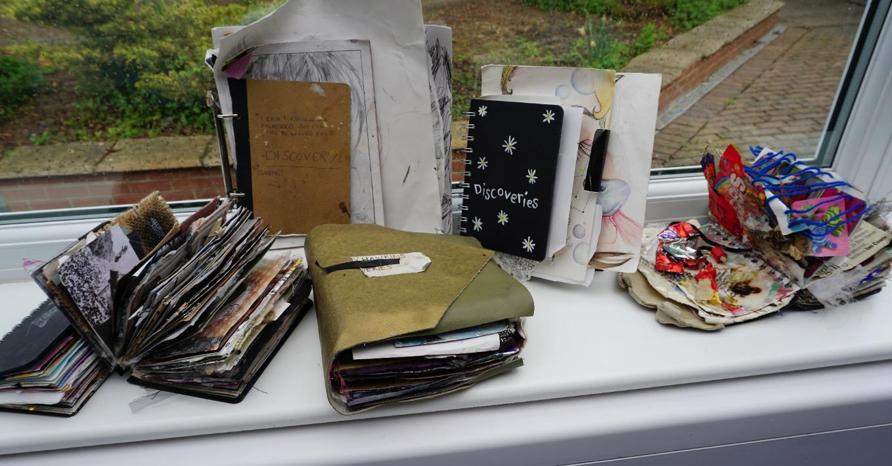
Fine Art A Level Induction
Examples:

Slide 16
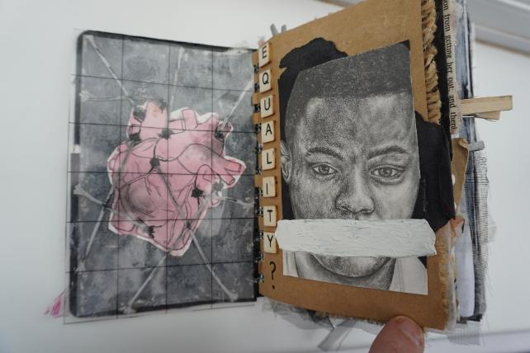
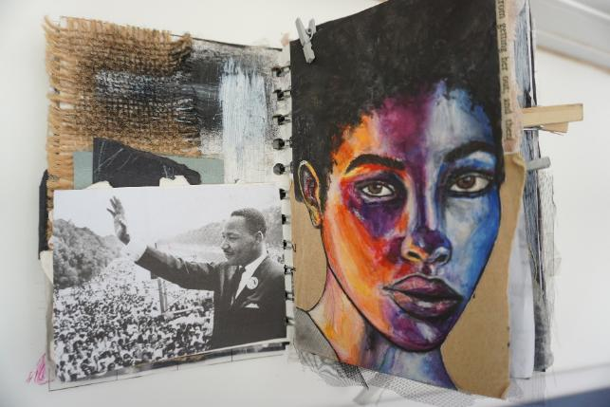
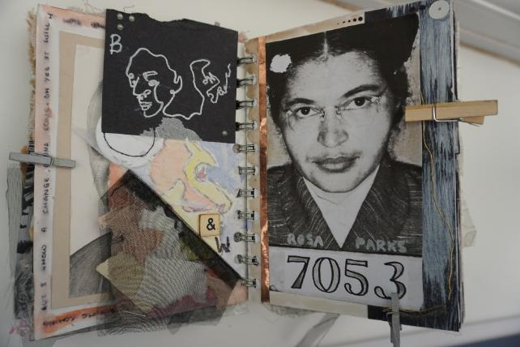
Fine Art A Level Induction
Examples:

Slide 17
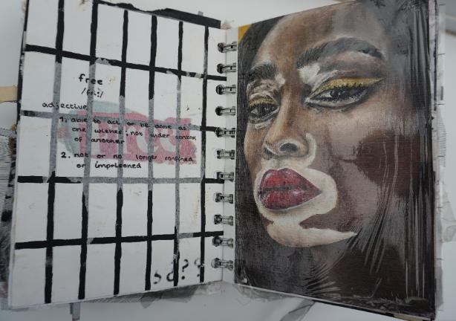
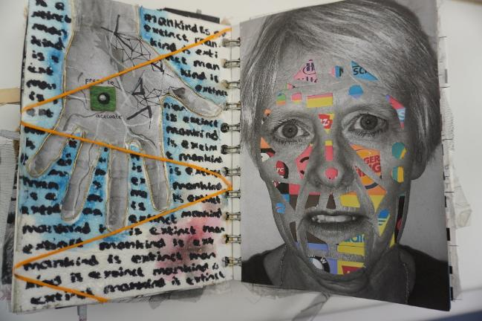
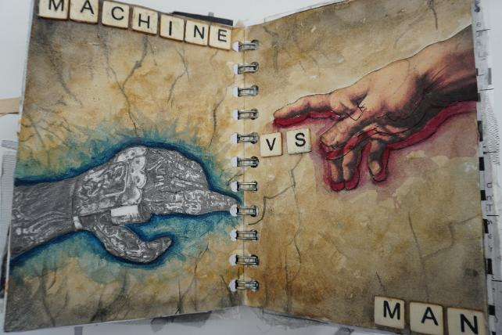
Fine Art A Level Induction
Examples:

Slide 18
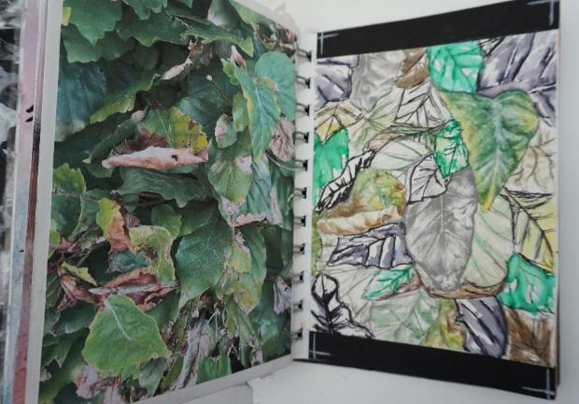
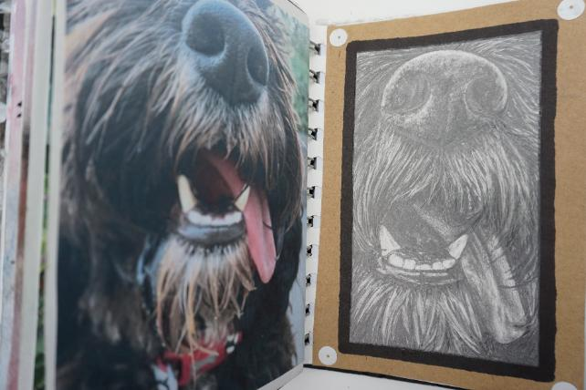
Fine Art A Level Induction
Examples:

Slide 19
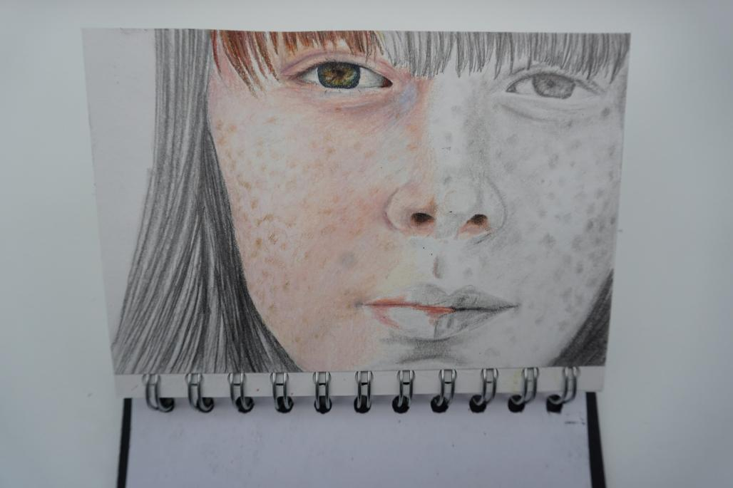
Fine Art A Level Induction
Examples:

Slide 20
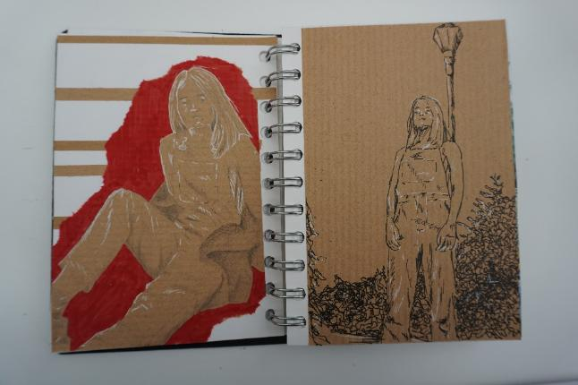
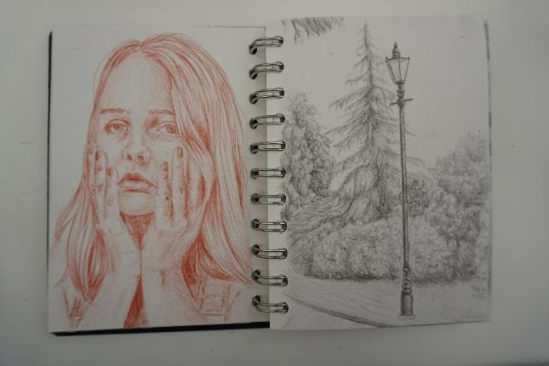
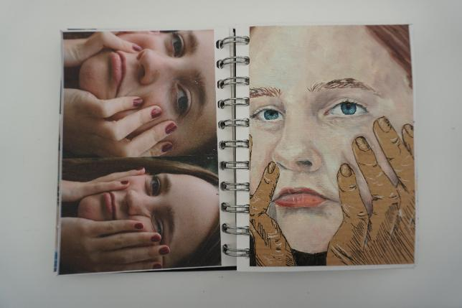
Fine Art A Level Induction
Examples:

Slide 21
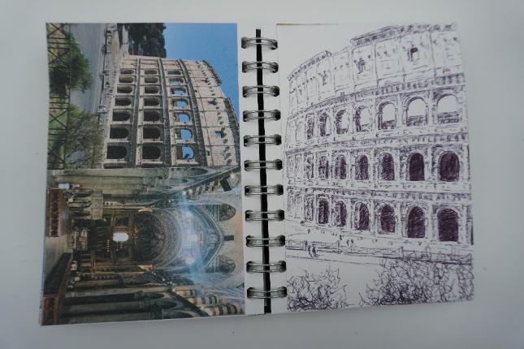
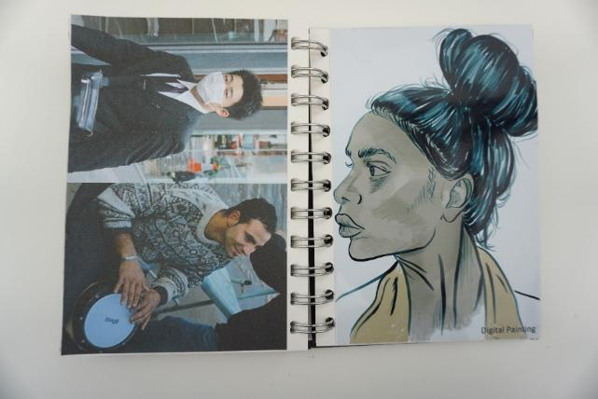
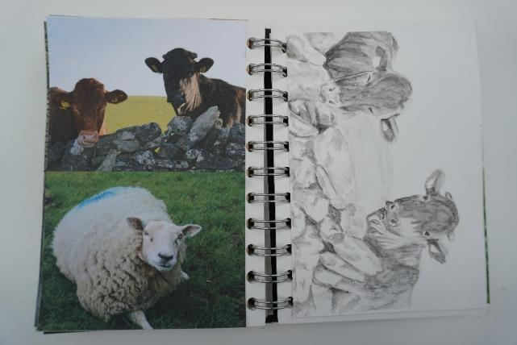
Fine Art A Level Induction
Examples:

Slide 22
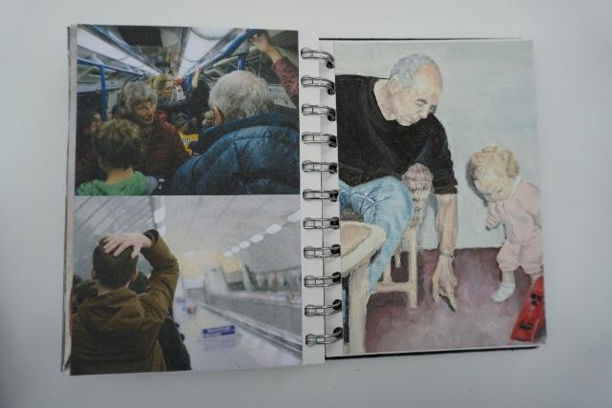
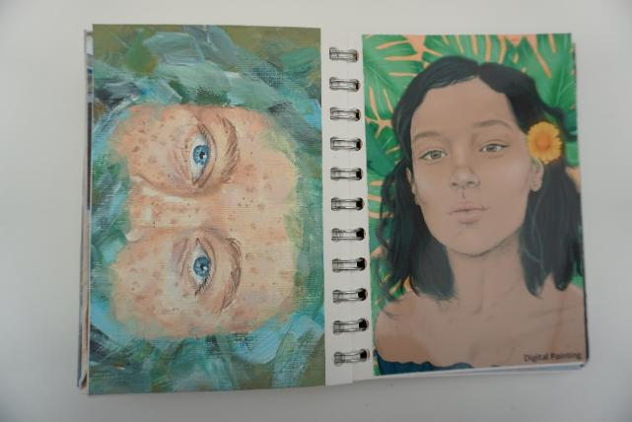
Fine Art A Level Induction
Examples:

Slide 23
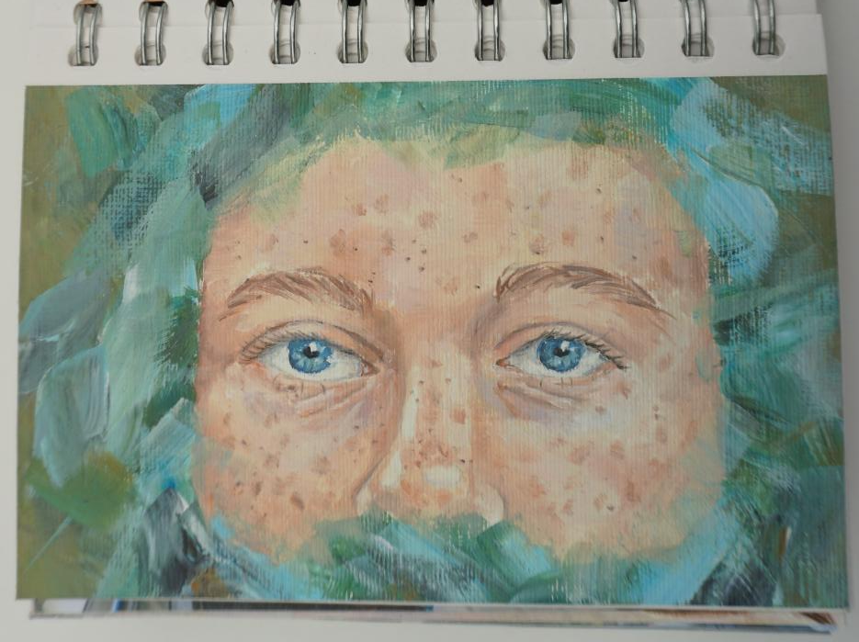
Fine Art A Level Induction
Examples:

Slide 24
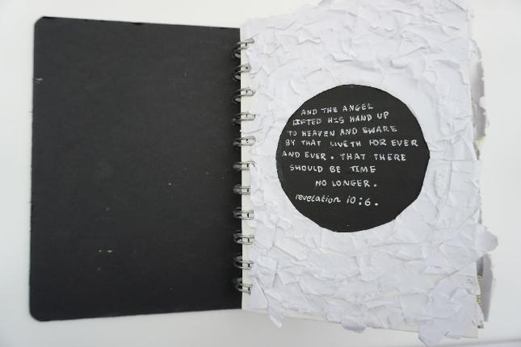
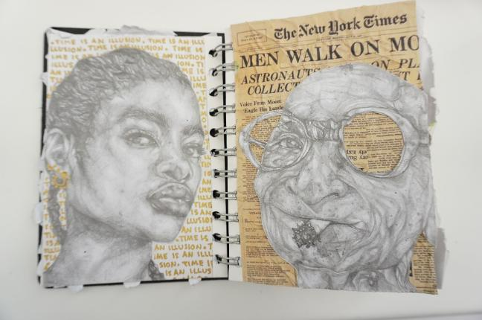
Fine Art A Level Induction
Examples:

Slide 25
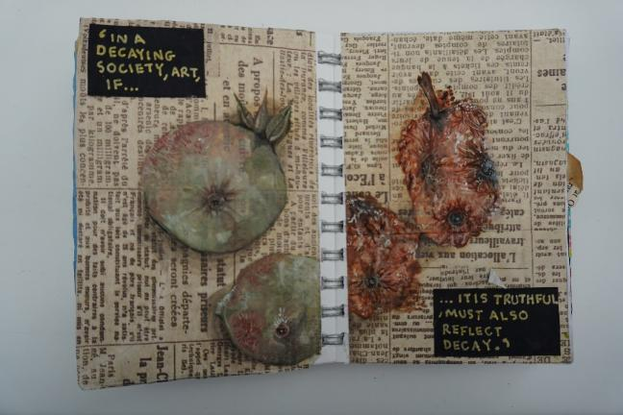
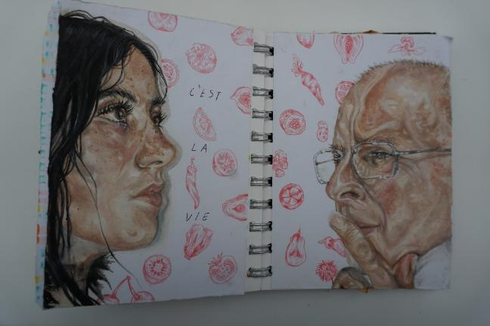
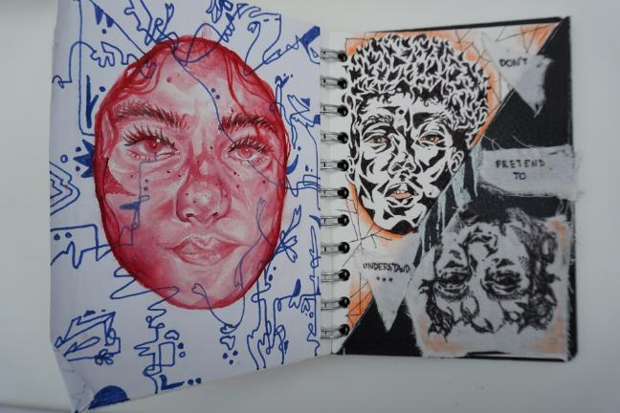
Fine Art A Level Induction
Examples:

Slide 26
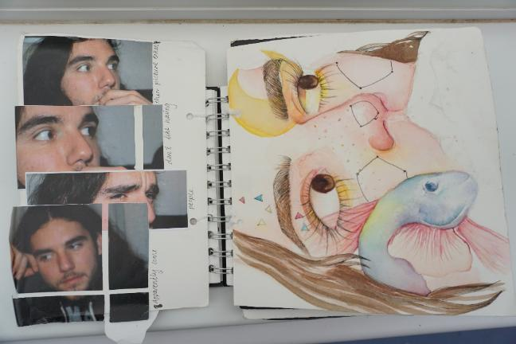
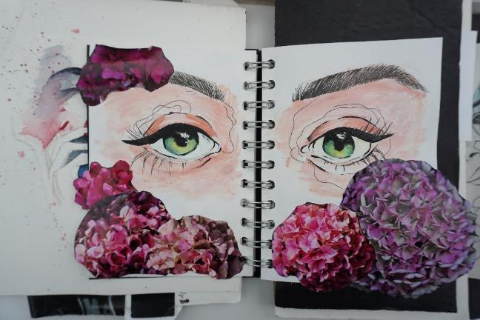
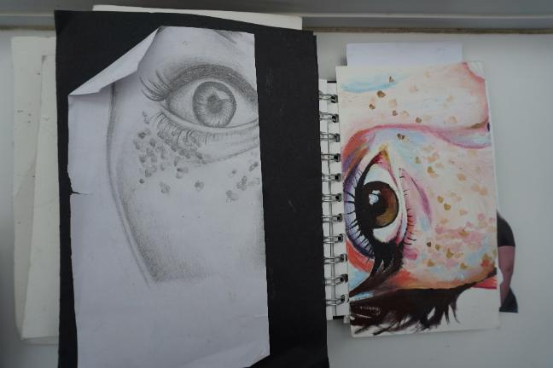
Fine Art A Level Induction
Examples:

Slide 27
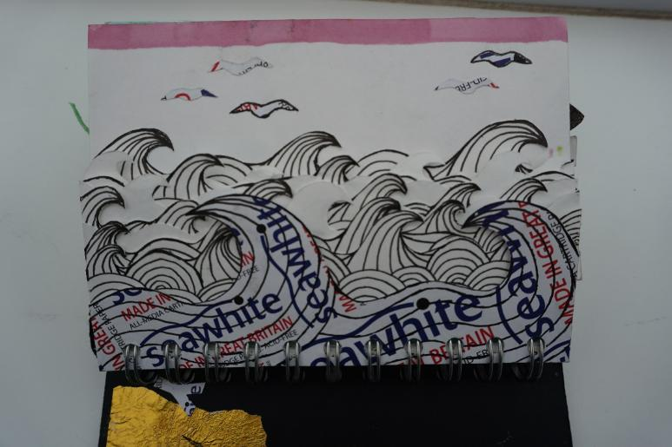
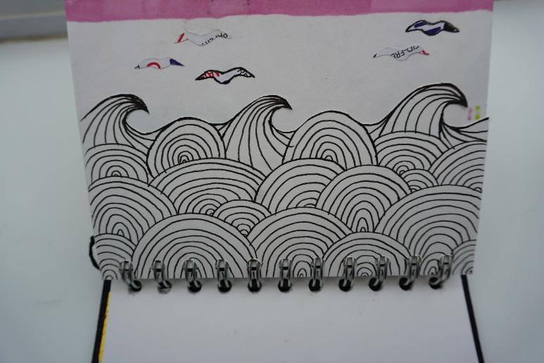
Fine Art A Level Induction
Examples:

Slide 28
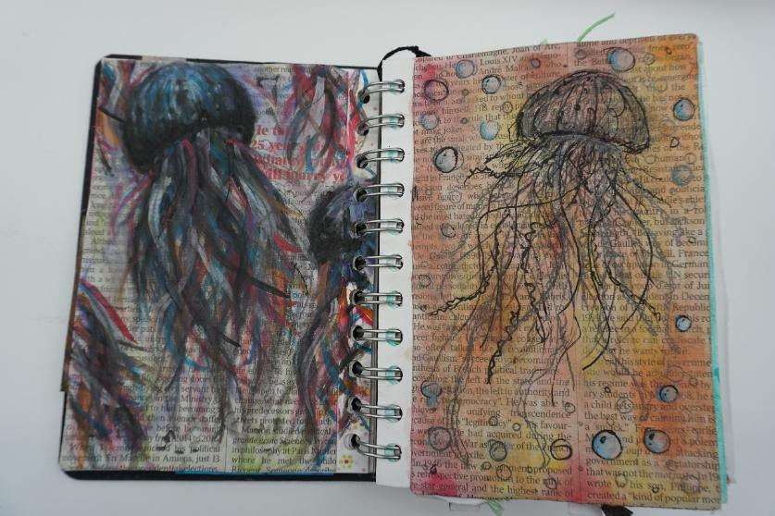
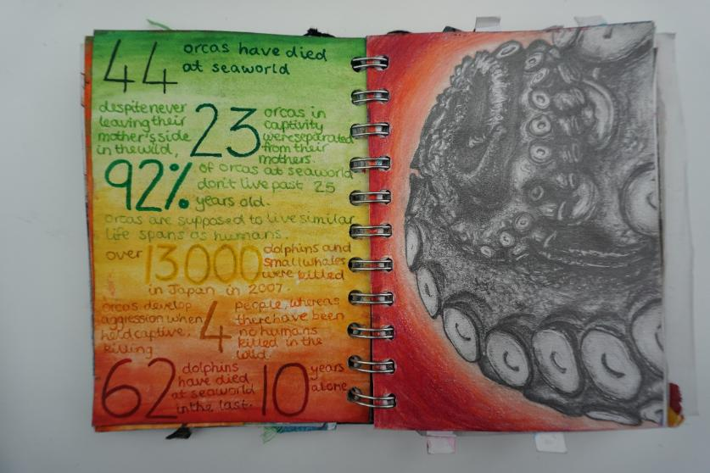
Fine Art A Level Induction
Examples:

Slide 29
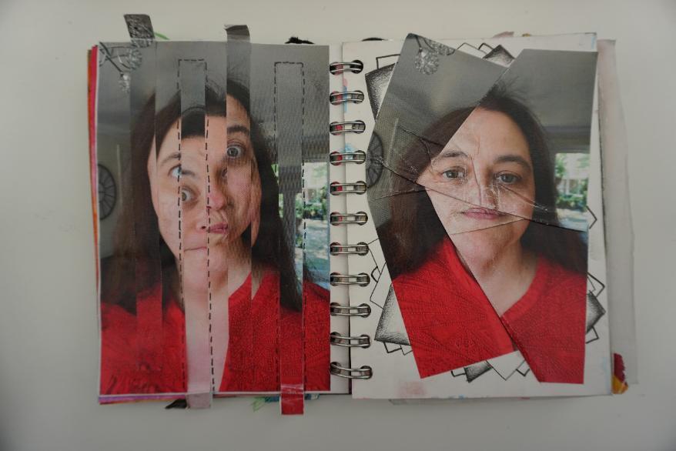
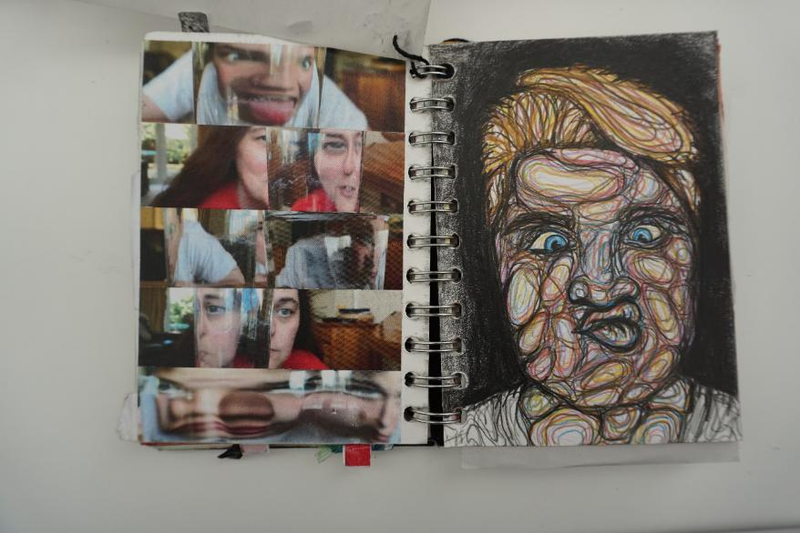
Fine Art A Level Induction
Examples:

Slide 30
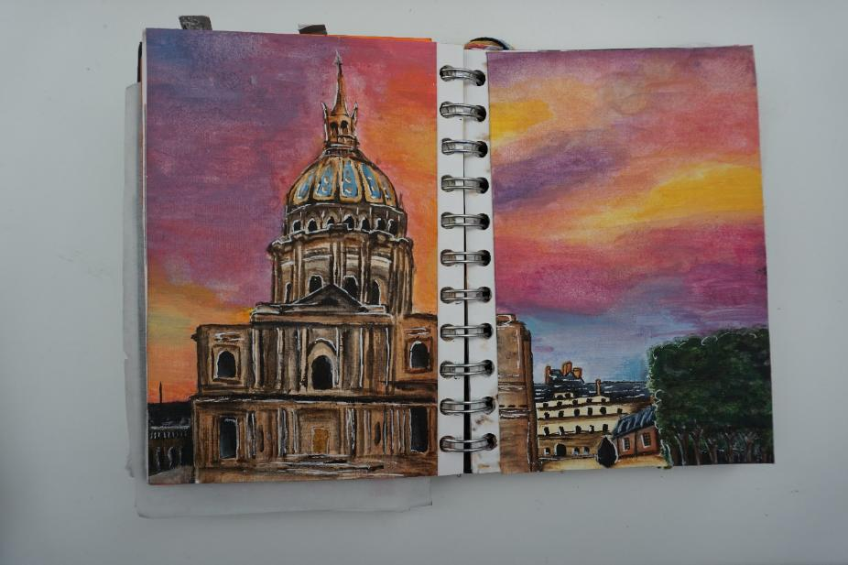
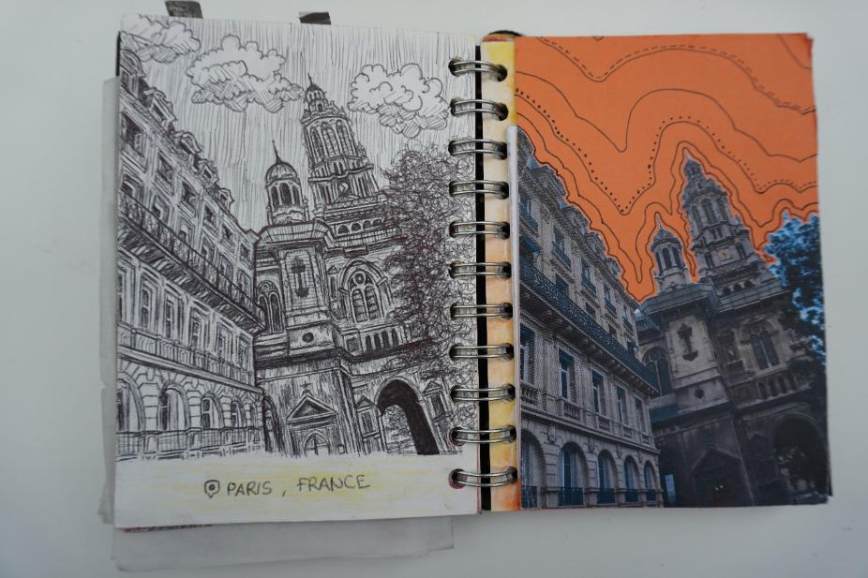
Fine Art A Level Induction
Examples:

Slide 31
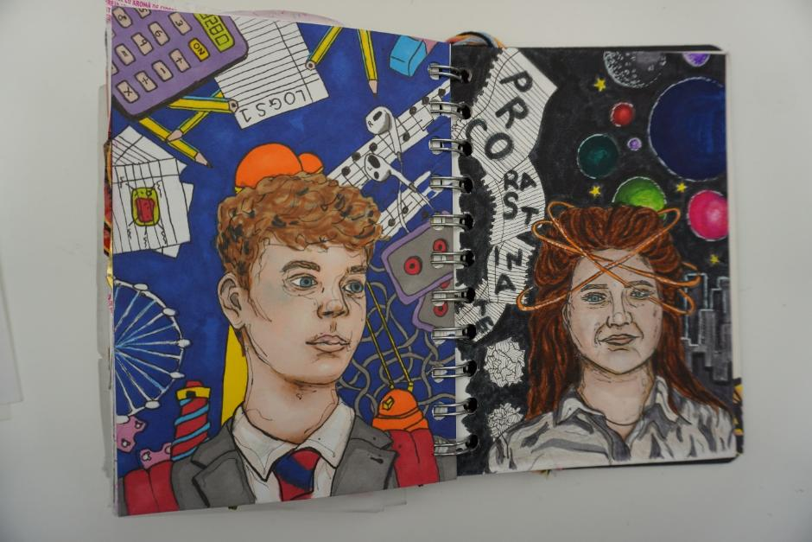
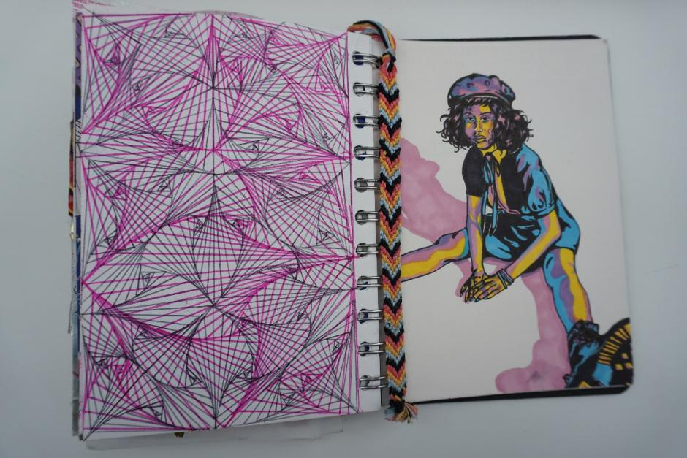
Fine Art A Level Induction
Examples:

Slide 32
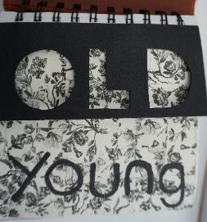
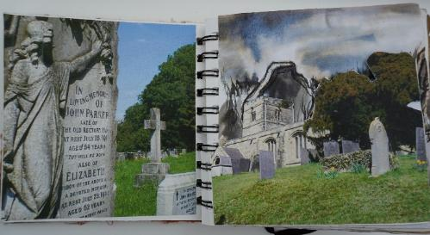
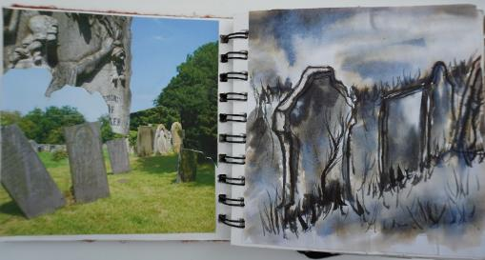
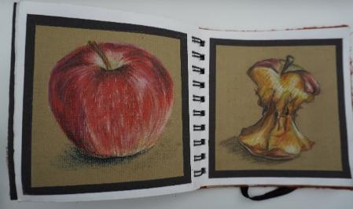
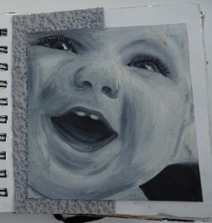
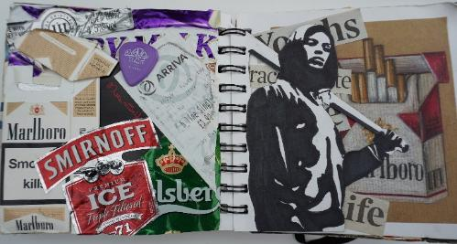
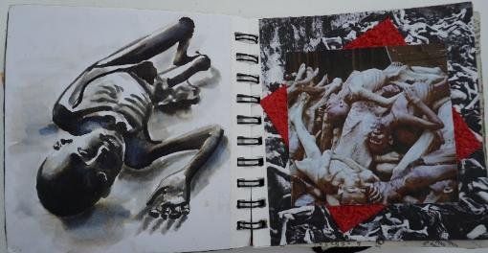
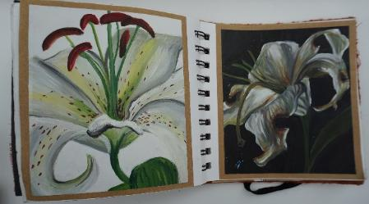
Fine Art A Level Induction
Examples:

Slide 33
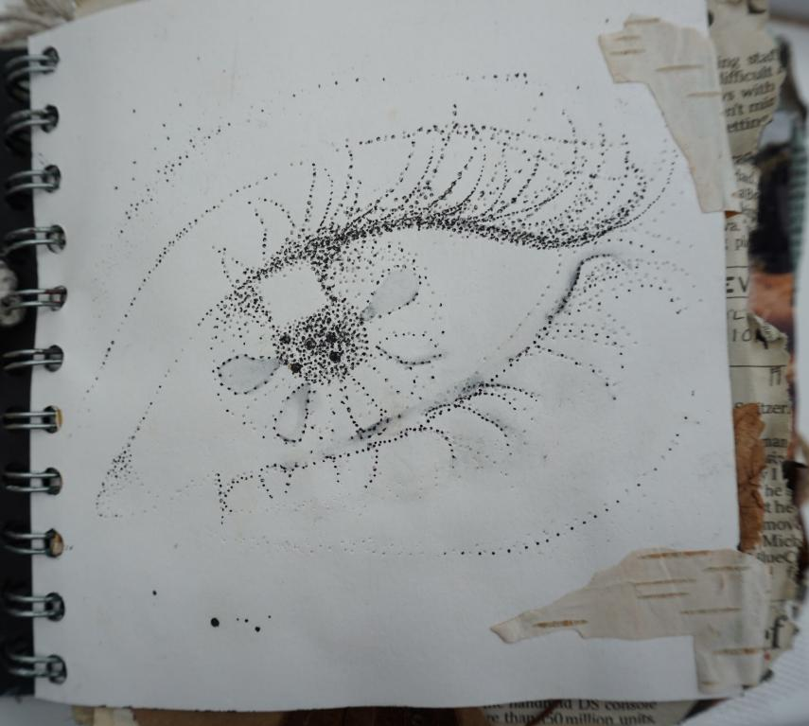
Fine Art A Level Induction
Examples:

Slide 34
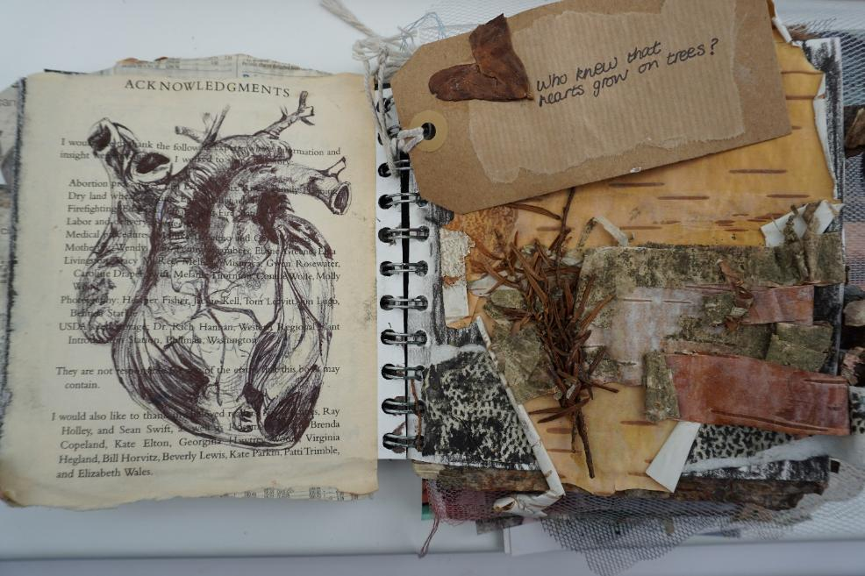
Fine Art A Level Induction
Examples:

Slide 35
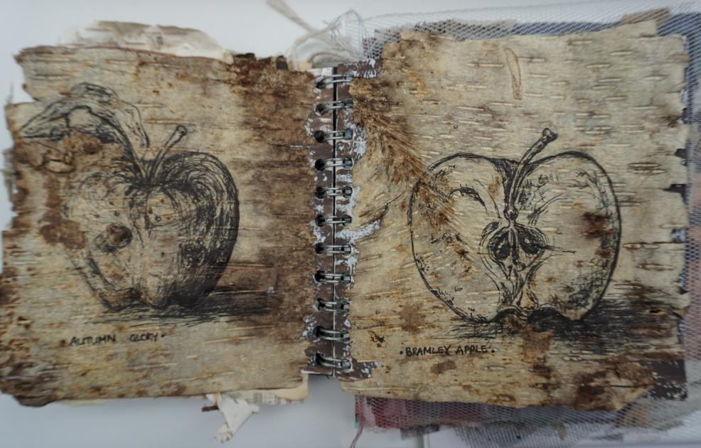
Fine Art A Level Induction
Examples:

Slide 36
Fine Art A Level Induction
Examples:

Slide 37
Fine Art A Level Induction
Examples:

Slide 38
Fine Art A Level Induction
Examples:

Slide 39
Fine Art A Level Induction
Examples:

Slide 40
Fine Art A Level Induction
Examples:

Slide 41
Fine Art A Level Induction
Examples:

Slide 42
Fine Art A Level Induction
Examples:

Slide 43
Fine Art A Level Induction
Try and fill the book as much as possible.
Drawing
Pencil, ink, charcoal, pastels, biro, felt pens, cluster of pencils/pens, brushes, sticks, a drawing tool made from found materials etc.
Work on different papers and surfaces (emulsion paint, sandpaper, fabric etc).
Painting
Water-colour, acrylic, oil painting.
Mix sand, earth etc., into the paint for different textures.
Apply the paint with palette knives, pieces of card and sponges.
Use small dots of colour.
Dilute the paint so it runs and drips.
Use modelling paste and wall filler.
Again, work on different papers and surfaces.

Slide 44
Fine Art A Level Induction
Photography
Photograph in colour and black and white.
Cut up photographs and rearrange them.
Use Photoshop (if you have it) to manipulate the images.
Use a mixed media approach
Cut the pages to help reveal pages in a sequence.
Add fold outs.
Make a large drawing cut it up and fill a number of pages.
Be resourceful with whatever you have available!

Slide 45
Fine Art A Level Induction
Don’t worry about the task.
It is impossible to get it wrong!
Initially build on the work and techniques learned at GCSE level.
Then enjoy trying some creative ideas and methods in your book!

Slide 46
Fine Art A Level Induction
For more information about the course and department visit the school website.

Slide 47
Fine Art A Level Induction
Follow the mantra of famous pop artist Andy Warhol when he said:
“Don’t think about making art, just get it done. Let everyone else decide if it’s good or bad, whether they love it or hate it. While they are deciding, make even more art.”

Slide 48
Fine Art A Level Induction
Art Exhibitions you might like to visit over the summer.
The best artists are always looking at different kinds of
artwork to gain inspiration for their own work. Whether influenced by the content, composition, use of colour, application of paint, use of materials or overall concept - the more you see, the more you absorb and can use.
So, with that in mind - if you get any time over the summer there is one exhibition not to be missed - Jenny Saville: The Anatomy of Painting @ the National Portrait Gallery.
An incredible artists and I imagine this will be a first-class exhibition if you can make it!

Slide 49
Fine Art A Level Induction
Art Exhibitions you might like to visit over the summer.
Jenny Saville: The Anatomy of Painting is the largest major
museum exhibition in the UK dedicated to one of the world’s foremost contemporary painters.
Saville rose to prominence in the early 1990s, following her acclaimed degree show at the Glasgow School of Art. Since then, she has played a leading role in the re-invigoration of figurative painting – a genre that she continues to test today. Her unique ability to create visceral portraits from thick layers of paint reveals an artist with a deep passion for the process itself.
From charcoal drawings to large-scale oil paintings of the human form, this chronological display includes works that question the historical notions of female beauty, the monumental nudes that launched Saville to acclaim in 1992, and new works on display for the first time.

Slide 50
Fine Art A Level Induction
Art Exhibitions you might like to visit over the summer.
Jenny Saville: The Anatomy of Painting brings together 45 works made throughout the artist's career. It traces the development of her practice, spotlighting key artworks, and exploring her connection to art history. The exhibition was created in close collaboration with the artist. It brings together works from public and private collections worldwide.
20 June - 7 September 2025
Jenny Saville: The Anatomy of Painting National Portrait Gallery

Slide 51
Fine Art A Level Induction
Art Exhibitions you might like to visit over the summer.
Another joyous show is the Summer exhibition 2025 @ the Royal Academy. It is full of varied work and unlikely that you will leave without finding something to inspire your own practical work. The Royal Academy is about a 10/15-minute walk from the National Portrait Gallery if you can visit both.
17 June - 17 August 2025 - Royal Academy | Burlington House
The UK’s best-loved art show. Held every year, the Summer Exhibition showcases a diverse array of contemporary works, including prints, paintings, films, photography, sculpture, and architectural works. It features a mix of art by household names and emerging talent.
Summer Exhibition 2025 | Royal Academy of Arts
Summer
Exhibition
2025

Slide 52
Fine Art A Level Induction
Have fun with it
and see what happens!

Slide 53
Fine Art A Level Induction
We can’t wait to see what you create!
☺

