Slide 1
Welcome to Ecclesbourne Sixth Form
Subjects
Extra Curricula / Roles
Welcome
New starters 2025-27

Slide 2
A few house keeping notices
If there is a fire alarm today you will be guided to the MUGA by a member of staff. Please line up where told and wait to be registered.
Lunch and break are in the SFC - You will NOT be allowed offsite at lunch. You can pay with cash or cards or thumbs.
Today we finish at 3.40pm tomorrow at 2.40pm.
Tomorrow you may wear PE kit suitable for an activity all day.

Slide 3
Meet the Sixth Form Office (SFO) Team 2025 - 2027
Mrs Weller (Head of Sixth Form)
Mrs Hadwin (Head of Year 12)
Mrs Bamber (Head of Year 13)
Mrs Cox (Admin and student support)
Mrs Taylor (Head of Teaching and Learning, Assistant Head)
Mrs Monk (Attendance & pastoral support worker)
Mrs Tanser (School nurse)
Notes:
PKB will add photos and talk about her role as HOY

Slide 4
Meet the Tutor Team 2025 - 2027
12W | G7 | Mr T Walton
12H | A6 | Mrs J Wilden
 |  | Ms D Rankin
12G | L5 | Mrs M Daly
12D | M3 | Mrs S Rafferty
 |  | Mr Dickson
12J | G7 | Mrs J Smith
12S | A9 | Miss L Short
 |  | Ms J Boden
12P | C12 | Dr A Page
12C | B13 | Dr C Gregory
You should know your form from the refectory lists but any questions or if you are not sure see one of us at the end and we will help you.
Notes:
Add pics. PKB will introduce the tutor meeting – EMB will talk more about role of tutor tomorrow

Slide 5
Plan for the two days
Meet your form and tutor and get to know each other through a range of activities.
Experience a lesson in each of your chosen subject areas and have summer work set.
Hear from coordinators of extended curriculum and experience some activities bespoke to your course.
Meet current year 12 and talk to them about activities and opportunities.
Notes:
PKB to use to outline the program for the next two days.

Slide 6
What will a typical student timetable look like?
3 Core subjects – These could be A level or BTEC or a combination. You will have 5 hours of teacher led lessons 1 allocated silent study session for each subject.
You will also be expected to spend additional independent study time in school and at home.
1 Extended curriculum option – AS Business, Extended Project Qualification (EPQ), Sports Leader, Young Enterprise, Core maths
These options will cover 2- 5 hours on your timetable.
1 hour of Health & Wellbeing – Options may include: fitness centre, badminton, football, yoga, dance or volunteering either in school or the local community.
Notes:
I will explain that some students may follow 4 a levels – mention further maths – only 3 additional lessons

Slide 7
Subjects
Extra Curricula / Roles
Enjoy your extra curricular activities
They help you grow as a person, give you new skills, and look great on your CV.
Find things you enjoy and throw yourself into them.
There is definitely something for everyone!

Slide 8
Leadership and enrichment
Get involved in Leadership roles –
Co-Heads
House Captains
Ambassadors – Wellbeing, Anti-Bullying and Diversity
Subject Mentoring
Lesson support
Buddy readers
Debate leaders
Peer mentors
School council
Community volunteering
Prefects
Notes:
These will discussed tomorrow

Slide 9
The Student Council
It’s your voice
Use it!
Studentvoice@ecclesbourne.derbyshire.sch.uk

Slide 10
Y12 Form Rep Leader​
Form Representative
Each form will each have a Form Rep and a Deputy Form Rep.
You will be responsible for attending Student Council meetings and representing your Form’s Voice.
Feedback information from the meetings to your form
First refusal at getting involved in projects.
SF Form Rep Leader x 2
Oversee the Y12 Form Representatives ​
Running half termly meetings to gain feedback on each form and then reporting back to the Coheads, Miss Mooney and Sixth Form Office. ​
Liaise with other Student Body groups to organise events throughout the year.
Committee Liaison Leader ​
Responsible for overseeing and supporting the leaders in the School Council
Coordinating between the Coheads, committees and Leaders ​
Reporting directly to Miss Mooney and the Sixth Form Office to summarise details of the half termly meeting with form reps​
Supporting Leaders in organising projects
Roles of responsibility

Slide 11
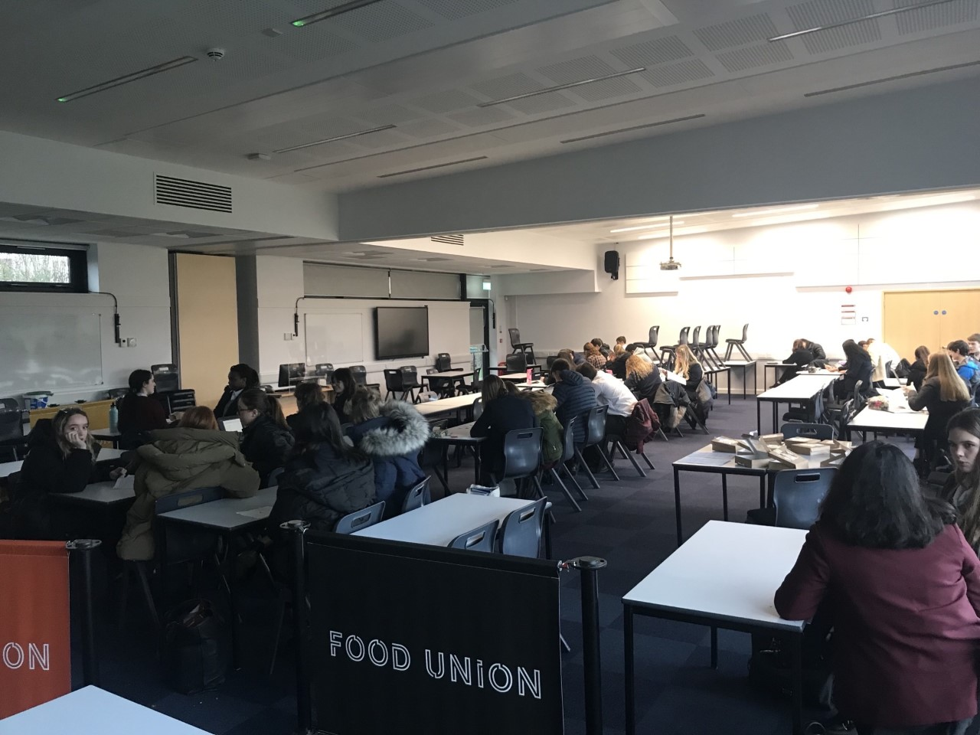
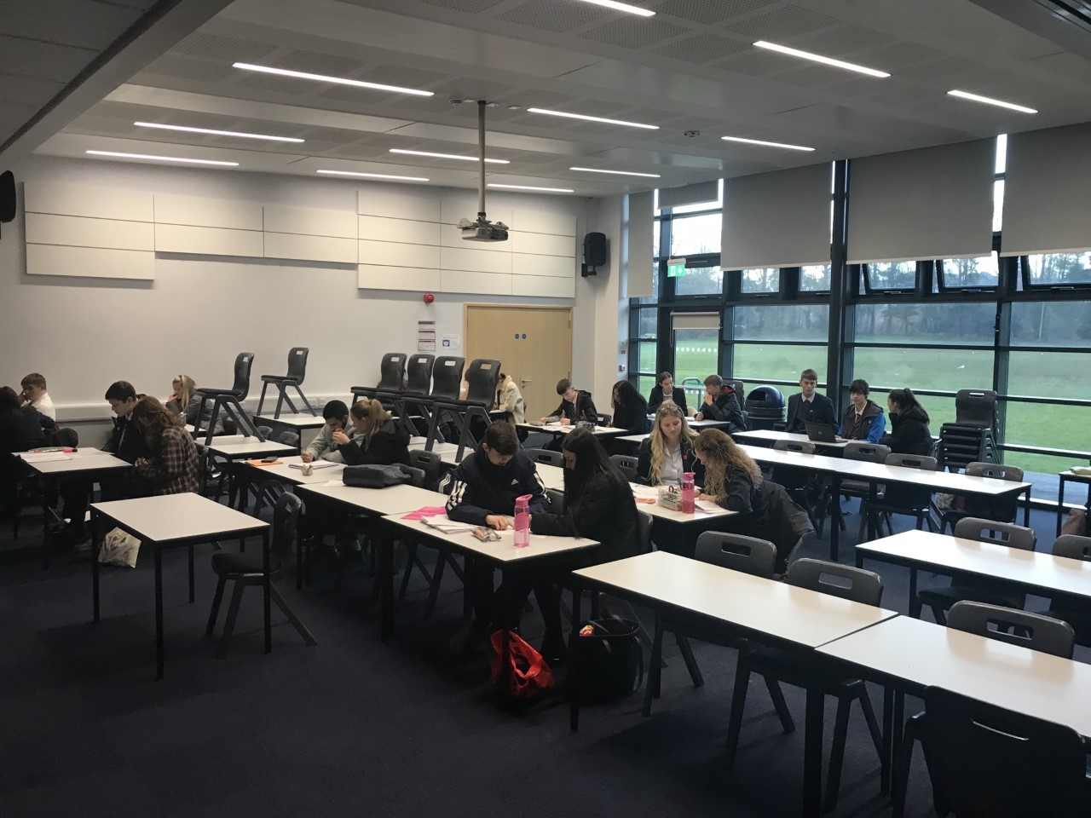
Subjects
Extra Curricula / Roles
Why do subject mentoring with year 11?
Sixth Formers who have done this find it extremely rewarding. You start to build a connection with your mentee and can tailor work to their needs. You genuinely make a difference to their lives by helping improve their confidence in a subject area they may struggle with. You will be supported by teaching staff and me, who will provide materials to help you to teach them effectively. The year 11s are very grateful for the help and prefer help from someone nearer to their age.

Slide 12
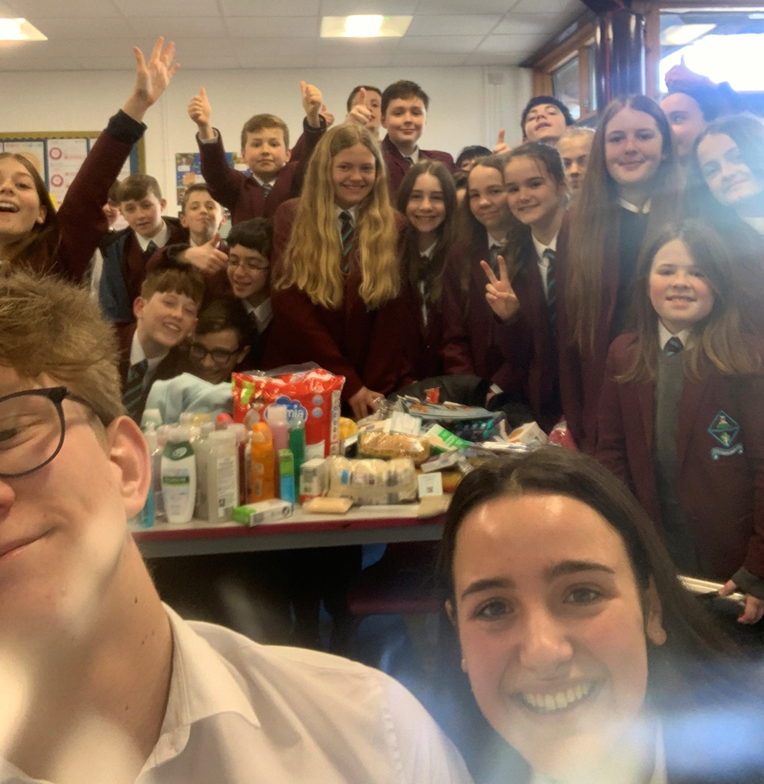
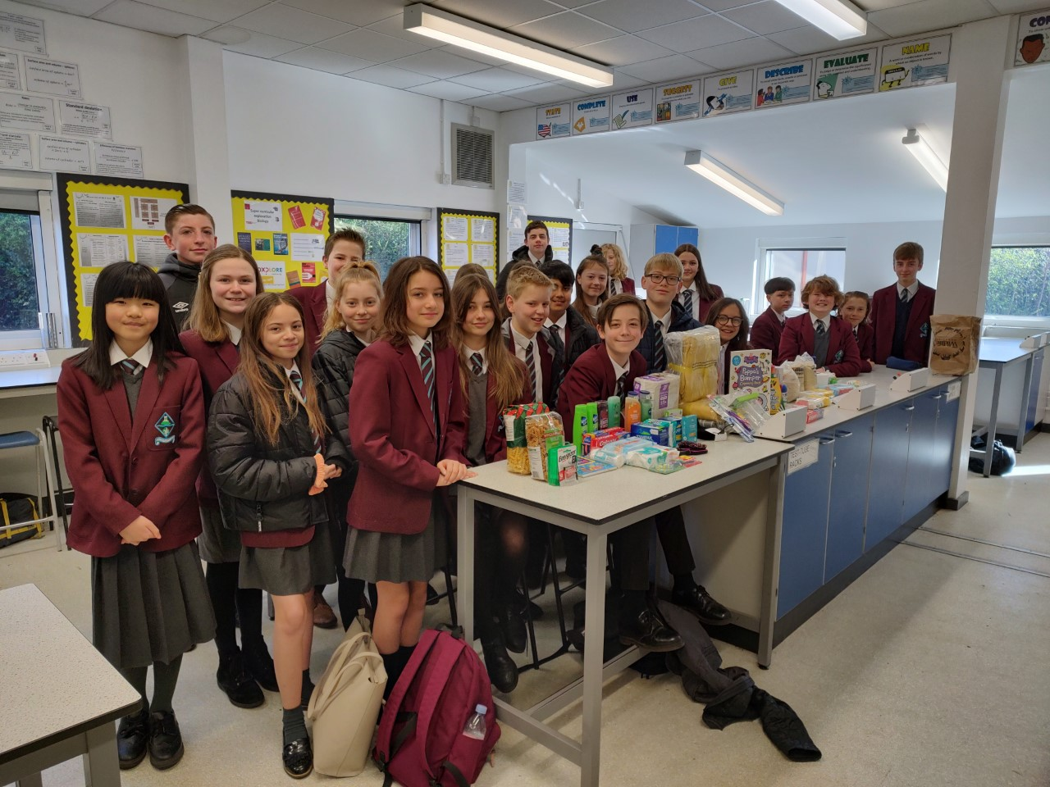
Subjects
Extra Curricula / Roles
Why do peer mentoring with year 7?
You will go into a year 7 form every Friday AM reg and work on different projects with them. Past projects include collecting items for Ukraine, making Anti-Bullying and LGBTQ+ posters which are displayed around school, as well as helping with the Christmas song competition.
You will get the chance to use your experience and maturity to guide and encourage the year 7s to think about society, current affairs and school spirit.

Slide 13
Subjects
Extra Curricula / Roles
Why do lesson support?
Subject staff love the help!
Can be used to support SEND pupils
Teachers will direct you how best to help the students
Particularly good if you're interested in being a teacher

Slide 14
Other opportunities to get involved…
Sports teams
D of E
Newspaper/shine media
Interact
Debate
Music concerts/choir/performance
Community Tea party’s
Drama productions
Sign up, let you tutor know what you are interested in!

Slide 15
Meet some of our 6th form students

Slide 16
Notes:
Do we want to do thi on the Friday when we talk about PE uniform?

Slide 17
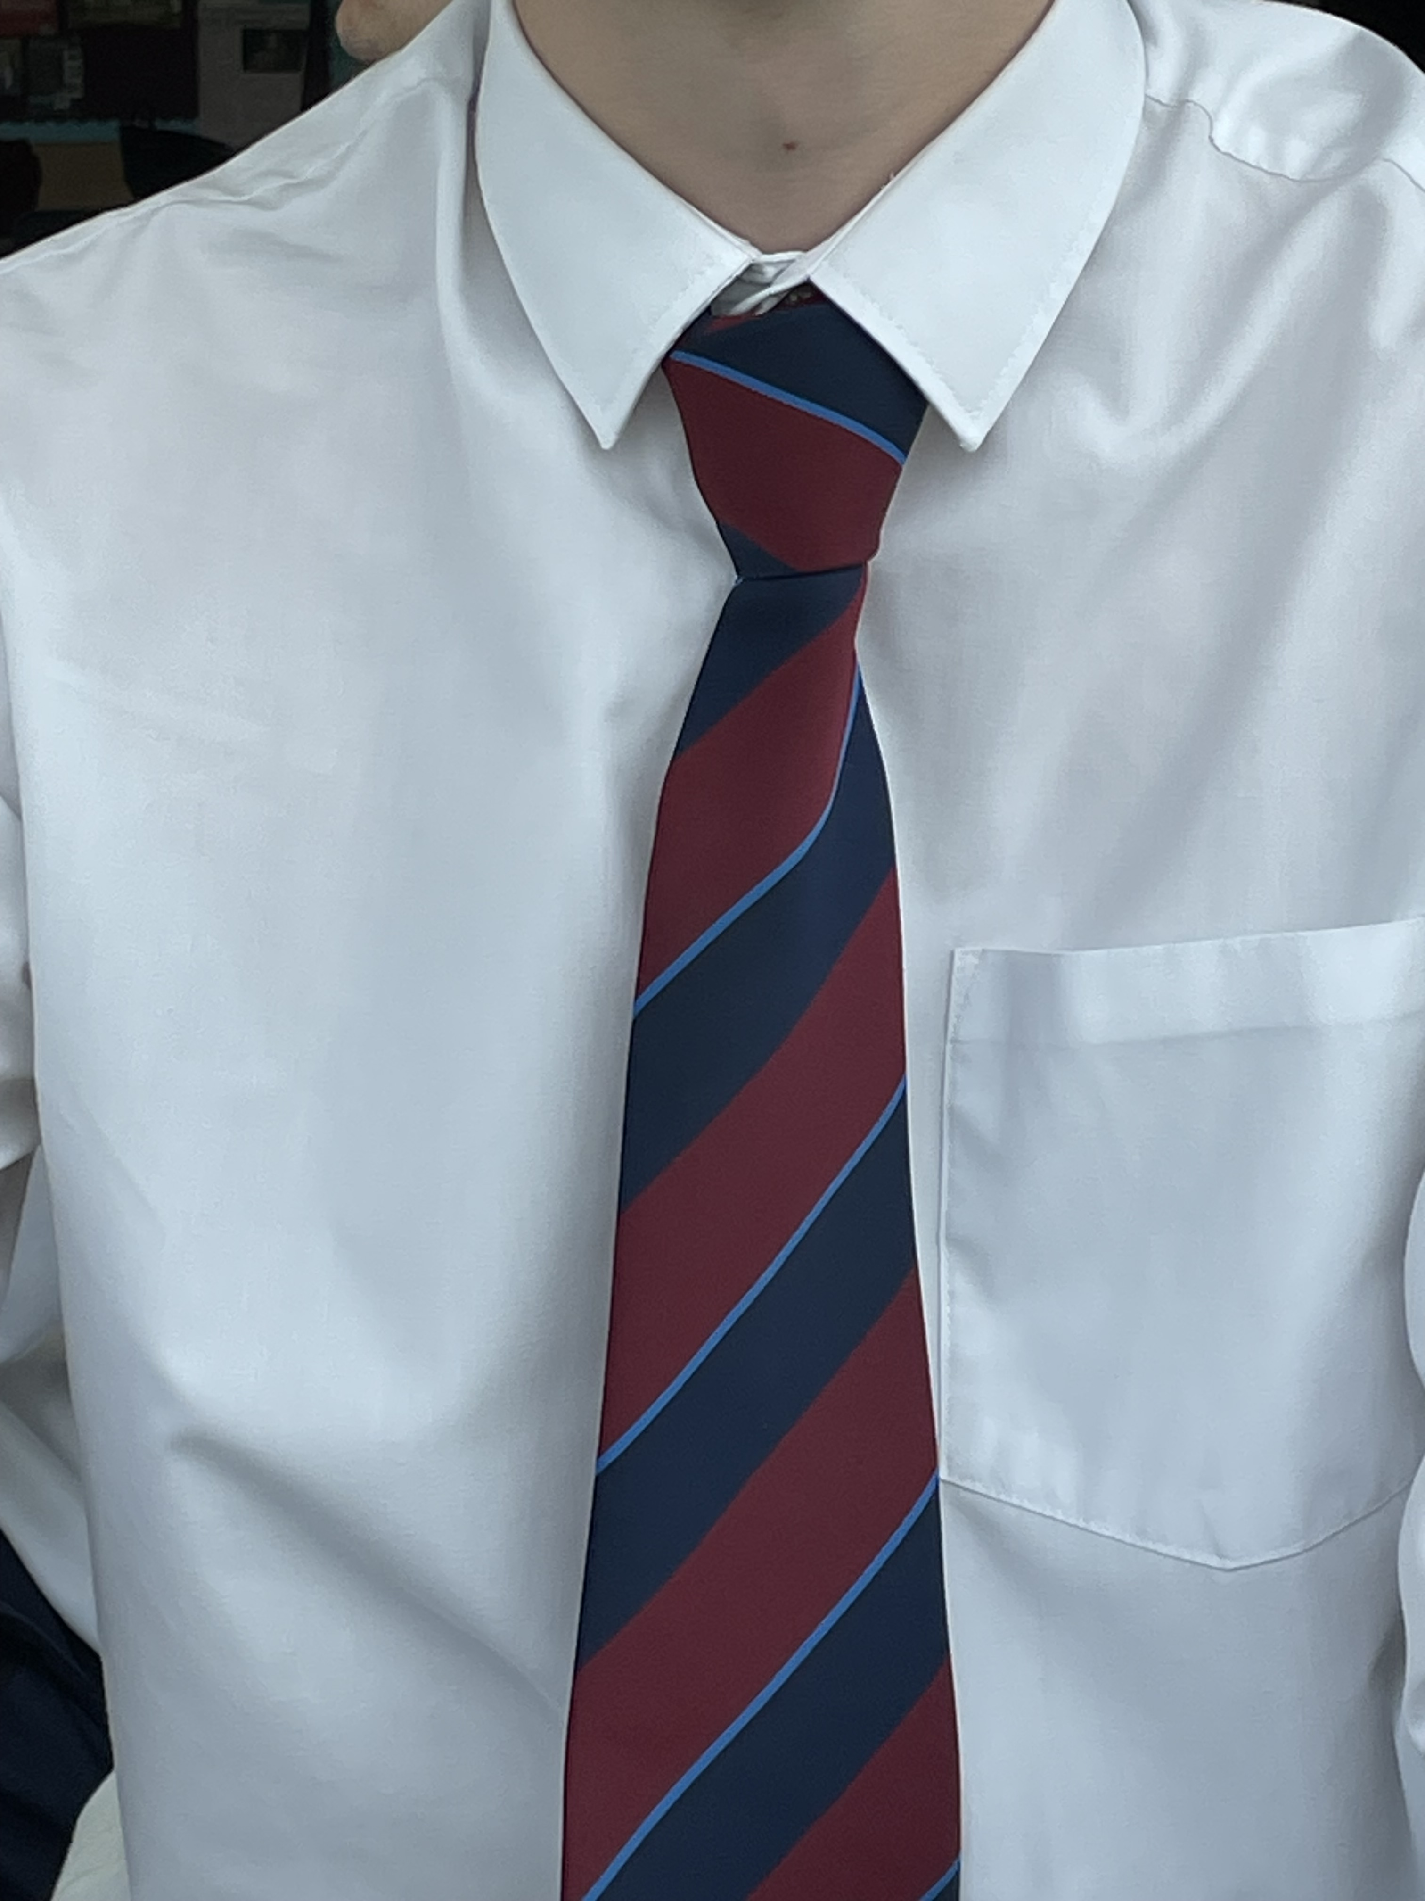
Ties
Ties - Students may require a tie, as per the dress code. The cost of the ties is £5.50. Please make this payment via ‘ParentPay’ by Friday 29th August 2025. Ties will be ready to collect on the first day of term in September from form tutors.
For students new to Ecclesbourne payment can be made by making a bank transfer to the following bank account:
Name - The Ecclesbourne School
Sort code - 40-19-37
Account number - 11670344
Reference - "student name tie” e.g. Harry Styles TIE

Slide 18
Health and wellbeing.
PE uniform is required for anyone wishing to take part in sporting activities in wellbeing hour or outside this, such as gym use.
If you are intending on completing community volunteering or school volunteering, you will not need a top.

Slide 19
PUNCTUALITY AND ATTENDANCE
We are FULL TIME establishment, and you are expected as before to attend school full time from 9am to 3.40pm.
A 95% or above attendance is expected
Punctuality is vital as you are now the role models for others.
We will support you in reaching these targets and will allow you to leave early at 3.15pm if you have a study period each day, allow you to leave site at lunchtime and allow you to have driving lessons during the school hours.
If you do not adhere to expectations these will be removed and further consultation about this will take place.

Slide 20
What to do if you would like to change your course choices.
We will not be able to make changes for these two days but on results day you can request a change and we will do our best to accommodate.
It will depend on:
Space
Timetable
GCSE grades

Slide 21
Who to ask?
If at any point over the next couple of days, you have any concerns please talk to :
Your Tutor
Mrs Hadwin - shadwin@ecclesbourne.derbyshire.sch.uk
Mrs Weller -
hweller@ecclesbourne.derbyshire.sch.uk
Mrs Ourabi -
courabi@ecclesbourne.derbyshire.sch.uk
Any member SFO Team.

Slide 22
A new chapter awaits!

Slide 23
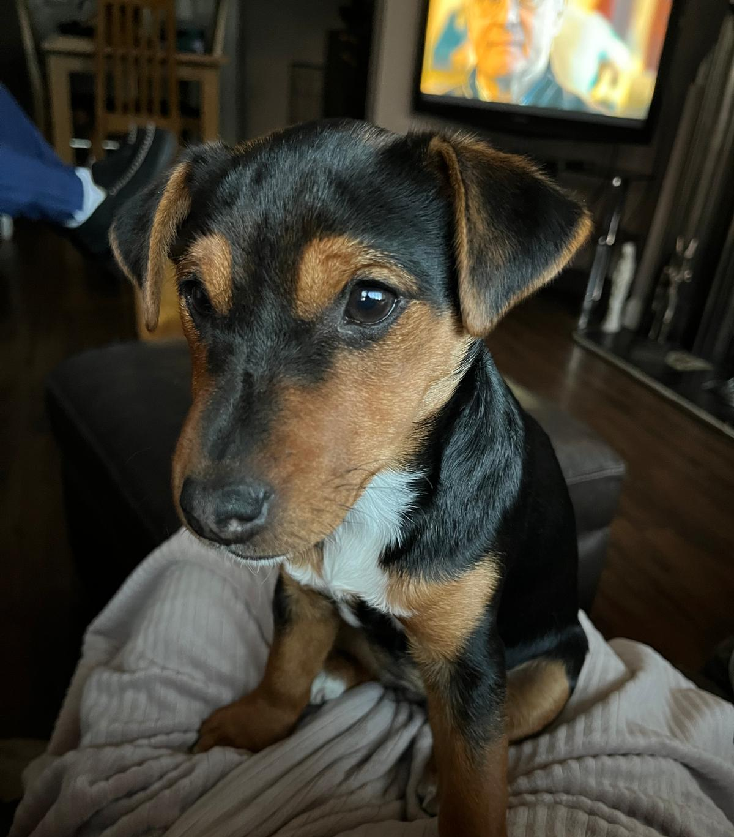
Mrs Hadwin...

Slide 24
We're in this together!
Be honest with your feelings.
Ask for help if/when needed.
Challenge yourself daily!
Learn from your mistakes.
Accept advice when offered.
Support your peers.
Take appropriate risks!
Embrace this new chapter of your life!

Slide 25
What to expect in your subject taster sessions.
You will meet a subject teacher from your chosen subject.
They will outline what the subject is about & possibly give you an experience of the type of things that you do in lessons.
Set you up with summer work. It is an expectation that this task is completed by the first day of term in September.
This will be your subject teachers first impression of you as a Sixth Form student - make sure you shine!

Slide 26
Subjects
Extra Curricula / Roles
Tips to making the best start
What we wish we were told by our peers at the beginning of Sixth Form!

Slide 27
Subjects
Extra Curricula / Roles
Tips to making the best start
In Sixth Form you’ll be treated more like an adult.
This means that you’ll have more responsibility.
Studying at this level is a lot of work, and it’s easy to get overwhelmed if you don’t get organised as early as possible.
Try to keep up to date with work by using Show My Homework or a calendar.
Plan the use of your study periods

Slide 28
Subjects
Extra Curricula / Roles
Make The Most Of Your Study Periods!
There’s nothing wrong with spending some of your free periods enjoying time with your friends or hanging out in the group area, but if you use them all this way, you might fall behind in your studies.
Here are some great ways to use your free periods:
Get ahead with your homework
Team up with a friend to study together or test one another
Attend supervised independent study sessions
Visit the careers guidance service or research universities
This is something that most of the current year 12s would say they could have done better.

Slide 29
Subjects
Extra Curricula / Roles
Managing the leap from GCSE to A Levels
The start of Sixth Form is the ideal time to get into some good study habits, as these will help you get the best possible grades, as well as standing you in good stead for university and the workplace
One of the best things you can do when you start is to revise as you go along, as this will reduce your revision workload nearer to exam time by ensuring that you learn it properly first time round.
After a class, read up on what you learned to consolidate your new knowledge, and make flashcards/mind maps with short snippets of useful information on each topic. These will be useful when you revise, both days and months down the line.

Slide 30
Subjects
Extra Curricula / Roles
Make use of all resources
When it comes to A-level study, you don’t just have to rely on textbooks to get you through your course material.
Try to utilise as many different resources as you can, as this will give you different ways of looking at the curse that will help you absorb information more easily.
Teachers are incredible resources – they know their subjects inside out and they want you to succeed! So ask for extra help when you need it, speak up in class, and take their feedback on board. They will also be able to point you in direction for further resources to help you work independently.

Slide 31
Subjects
Extra Curricula / Roles
Have fun and enjoy it!
Sixth Form is a time when you’ve finally left behind the subjects you disliked at GCSE and you’re now able to concentrate on subjects that genuinely interest you.
Sixth Form will go by in a flash!
You will definitely look back on it as one of the most exciting times of your life. Enjoy your time and make the most of the experience.

Slide 32
Off to form – meet your new family!

