Slide 1

Assembly
Briefing –
Access Arrangements

Slide 2

Extra time
Use of laptops
Supervised rest breaks
Ear defenders

Slide 3

Extra Time
JCQ requires evidence that a candidate needs extra time.
This evidence must be provided for every subject in order for extra time to be awarded.
When you’re told by the invigilator, swap pens…

Slide 4
Laptops
There are JCQ regulations regarding how scripts produced on word processors should be formatted:
Information in the header
Font: Arial 12
Spacing: double spacing
Page numbers (e.g. Page 2 of 6)

Slide 5
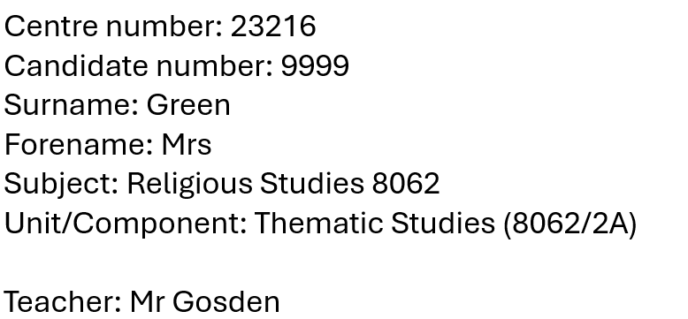

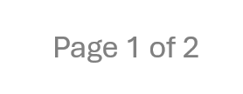
Laptops - formatting

Slide 6
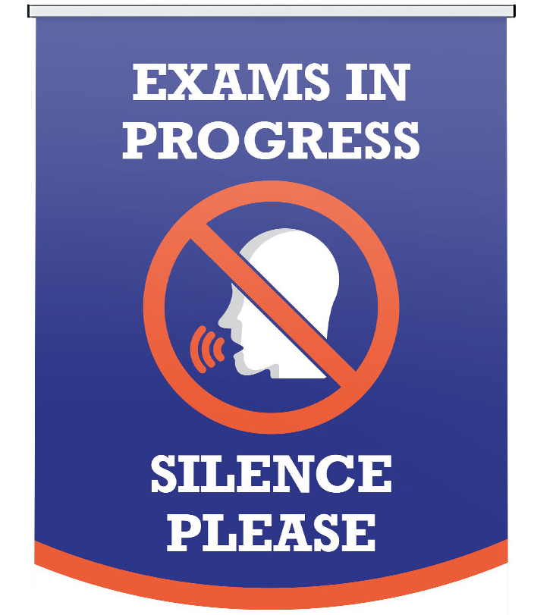
Laptops – printing and checking
You remain in exam conditions until the point at which you have handed in your script to a member of the Exams Office.
Only one candidate at time in the Exams Office
Silence when queuing up waiting to print

Slide 7
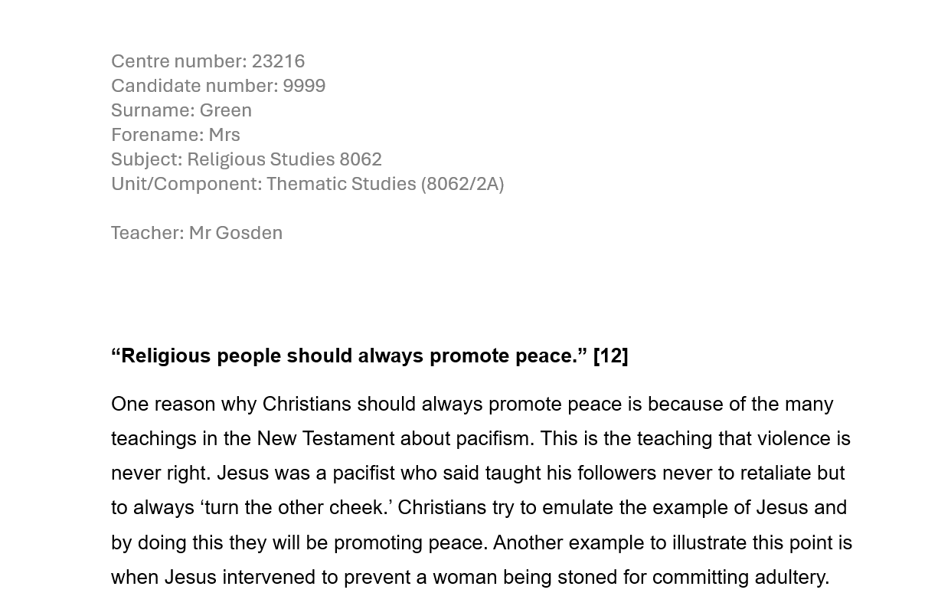

Laptops – printing and checking
Authenticating your work:
After you have printed your script, check that all of the pages have printed out.
Staple them together and then sign the front page.

Slide 8

Supervised rest breaks
SRBs are not extra time.
They are granted to candidates who tire easily and struggle to focus for long periods of time.

Slide 9
Supervised rest breaks
Regulations about SRBs:
They are not ‘thinking time’
They cannot take place within the first 10 minutes or the last 10 minutes of an exam.
The number of SRBs can be limited if candidates are misusing them.

Slide 10

Ear defenders
Should only be worn AFTER all of the announcements are made by the senior invigilator.

Slide 11
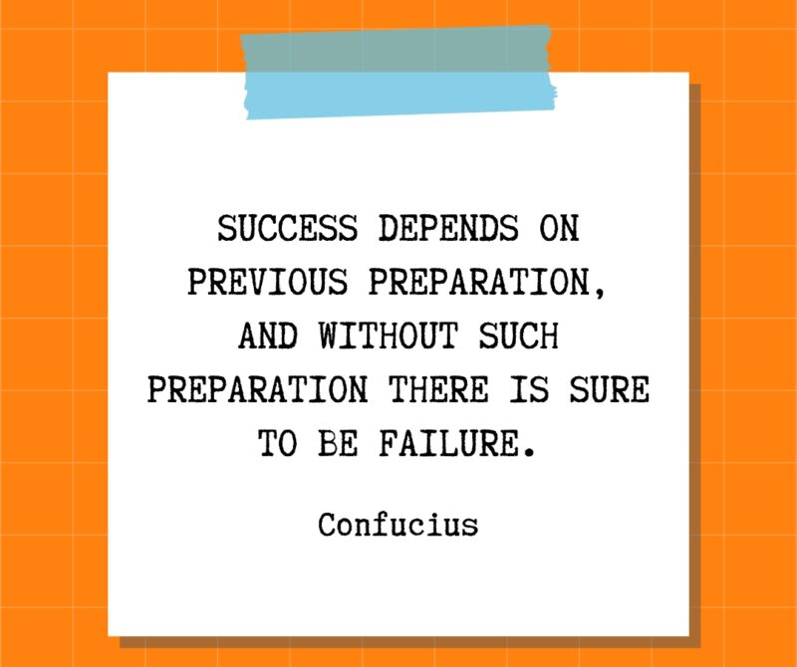
Good luck

