Slide 1
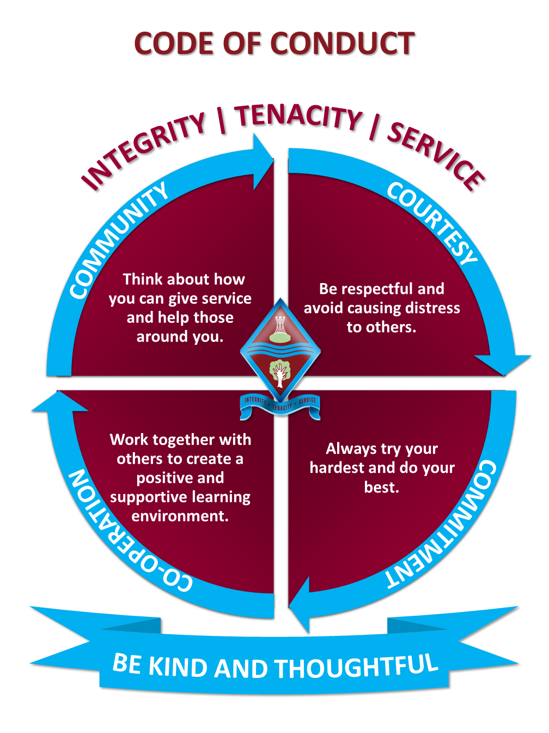
Assembly
Briefing

Slide 2
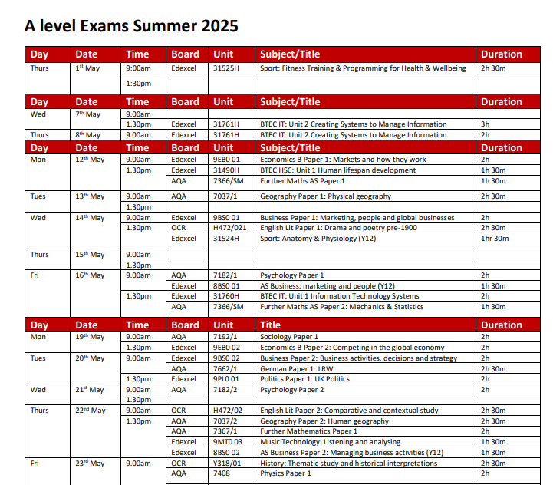
Timetable
The exam timetable is found on the School’s website.
You will be emailed a copy of your individual timetable. Screenshot it. You will need to remember your seat numbers.

Slide 3

Clashes (Year 13 only)
Your individual timetable will not show you where you have a clash. So, you must cross-reference your timetable with the main timetable.
If you have a clash, you will be supervised between your exams. During that time, you must not:
Have access to the internet
Have any contact with other students
Receive coaching from staff
You CAN revise from your own notes.

Slide 4
Timings
For a morning exam you must be outside your exam venue at 8.40/8.45am at the latest.
For an afternoon exam you must be outside your exam venue at 1.15/1.20pm at the latest.
Arriving on time will mean a calm start to the exam for you.
And you will be present to hear important instructions.

Slide 5
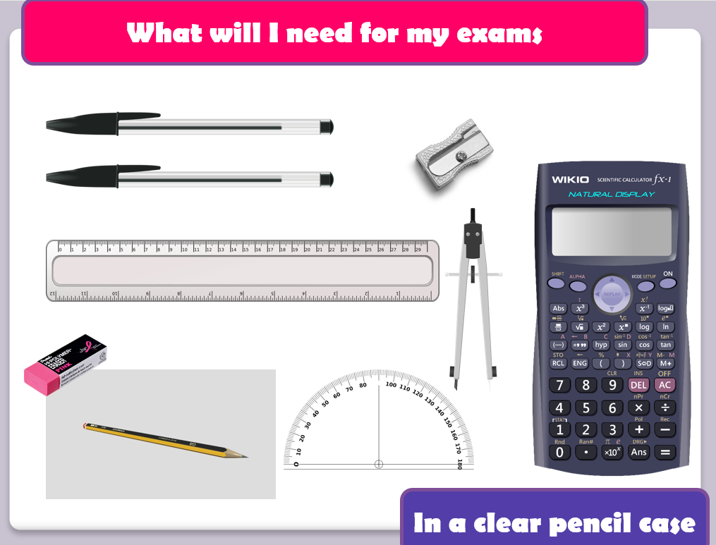
Don’t take anything into your exam that you are not allowed

Slide 6

Prohibited (banned) items
No phone, smart glasses
No watch (of any kind)
No headphones
Anything with any writing on it.
Calculator cases/covers
If you bring any of these items into the exam you must inform the invigilators immediately.

Slide 7

Lanyards
You MUST wear your lanyards.
This is a way of our invigilators identifying you.
And you will use it to sign in/out of school.

Slide 8
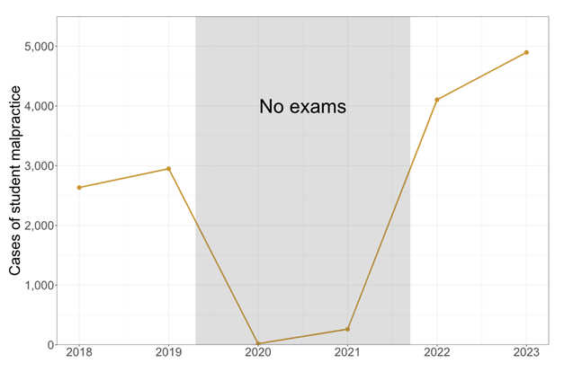
Malpractice
Malpractice means not following the rules. Malpractice is the intentional and unintentional not following of the rules.
We have to conform to JCQ regulations to uphold the integrity of the exams.

Slide 9

Candidate malpractice
Communicating or attempting to communicate with other candidates in the exam room.
Having unauthorised items and materials in the exam room.
Attempting to access papers before an exam.

Slide 10
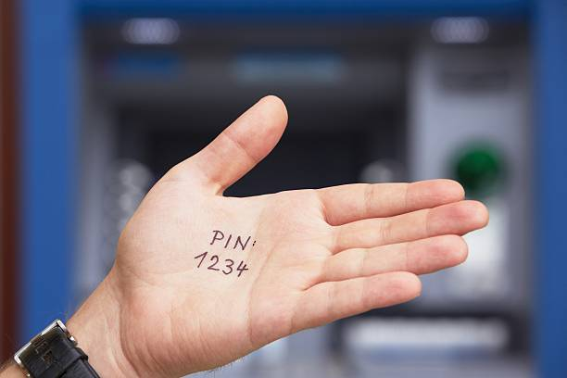


No writing on your hands
No correcting fluid
Highlighters ONLY to be used in the questions or source material NOT in your answers

Slide 11
Consequences of malpractice
Loss of marks
Loss of paper
Loss of qualification
Loss of qualifications
…

Slide 12

Emergencies
Follow the instructions of the invigilators.
Close your paper.
Do not communicate.
Assemble in your usual place on the MUGA.
DON’T PANIC.
You will get to finish your exam

Slide 13

Contingency day
11th June 2025 (PM)
25th June 2025 (AM + PM)

Slide 14

Results day
A level – Thursday 14th August
GCSE – Thursday 21st August
If you are not going to be able to come to school email Mrs Green or exams@ecclesbourne.derbyshire.sch.uk

Slide 15

Certificates (November)
A level & GCSE leavers– You can pay for us to send your certificates to you in the post (Parent Pay)
OR
You can collect them from Reception from November onwards.
We only keep them for TWO YEARS.

Slide 16
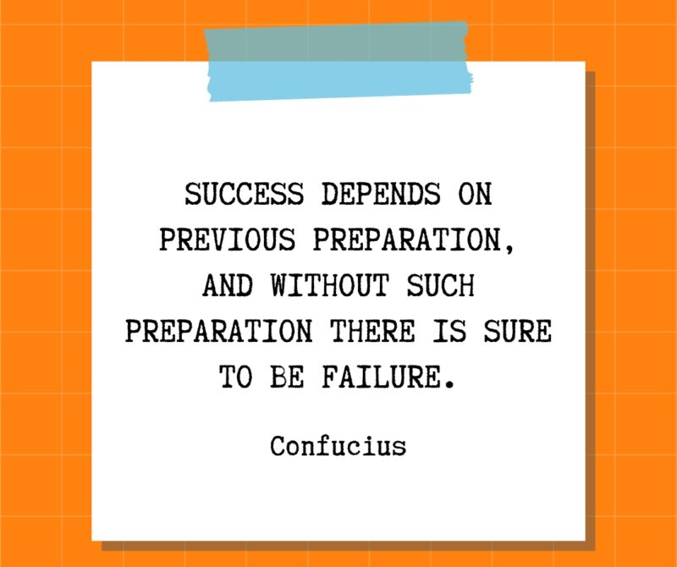
Good luck

