Slide 1
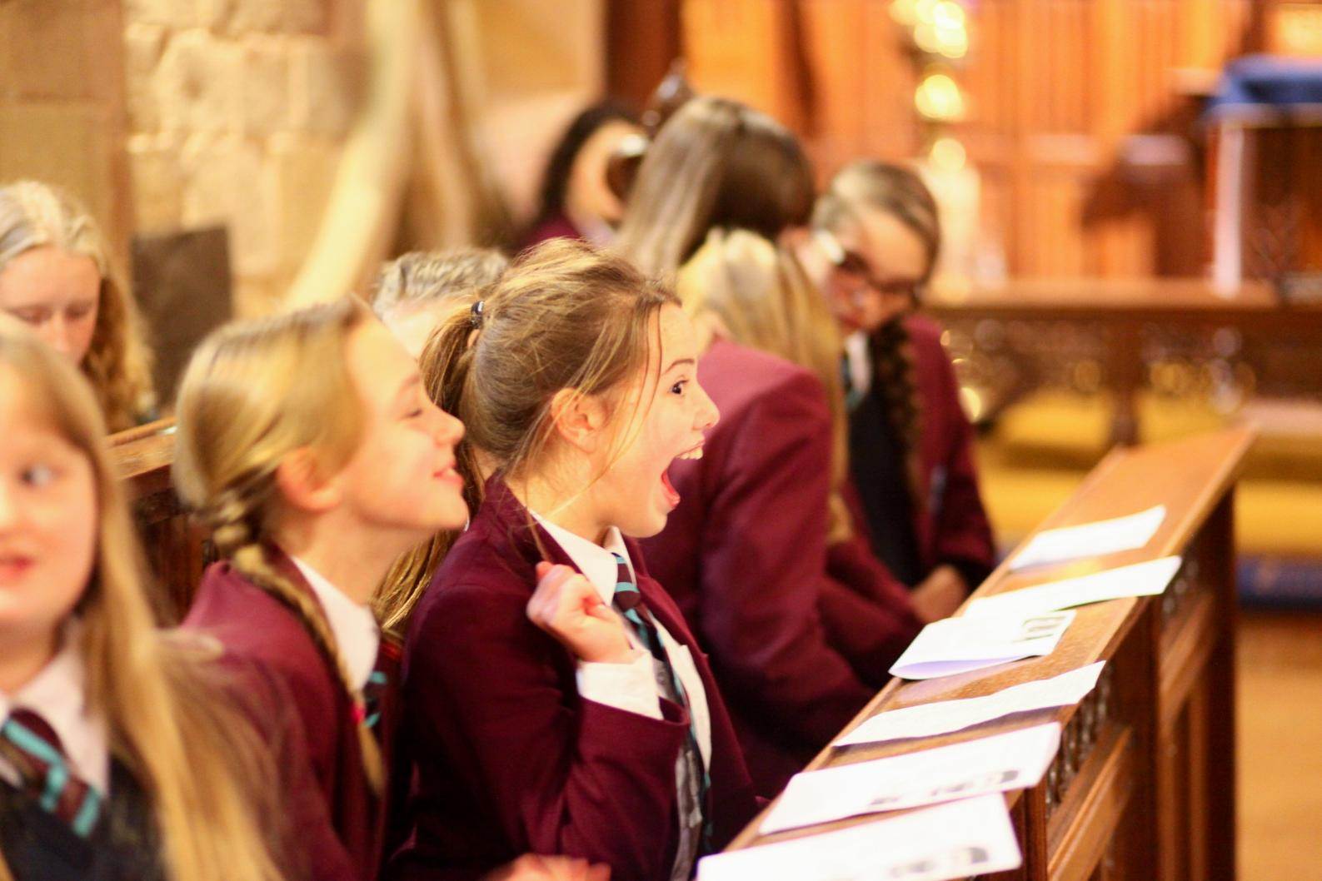
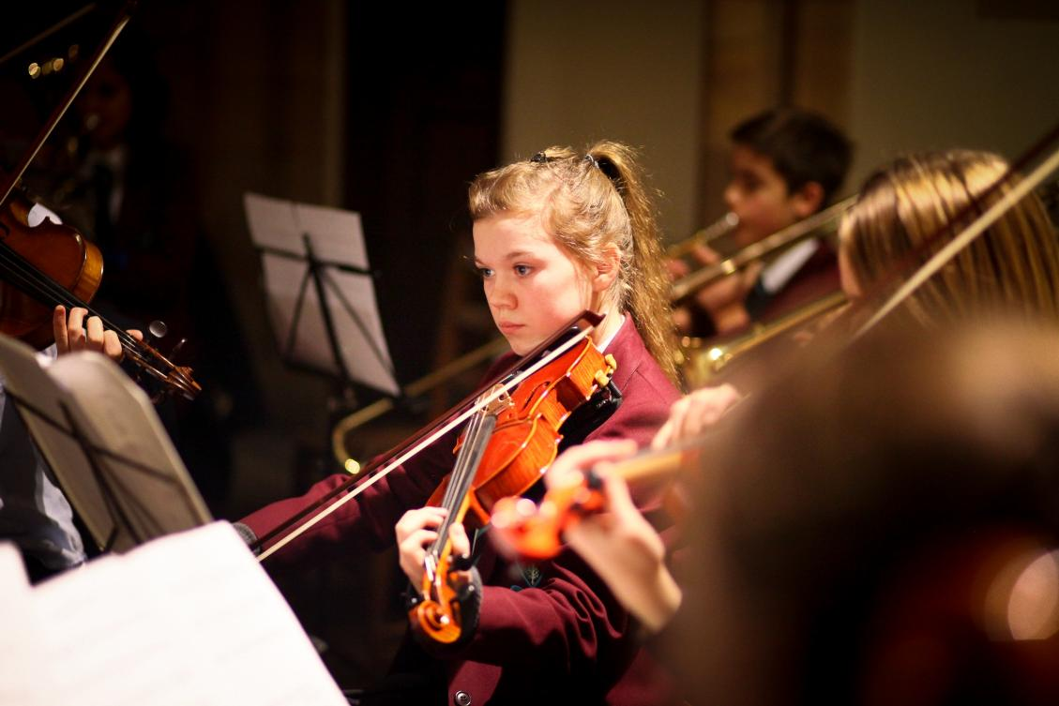
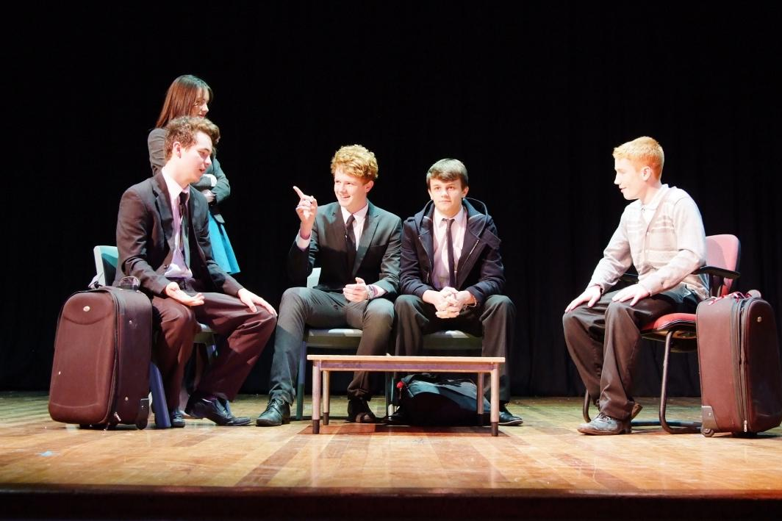
Free Options
14+ Options Evening 2026
Personal Choice

Slide 2
Year 9 Senior Section events so far:
Summer Reward challenge
GCHQ Languages competition
Serving at Community Tea Party
Padley centre donations
Weekly quiz with reward
Photography competition
Hindu temple trip
Football team
Musical performances
House plays
Enterprise day

Slide 3
Y9 PDC programme to date
Behaviour
Banter & Bullying
From failure comes success
Assertiveness
Social media and Online stress
Saving and managing your money
What are my skills ?

Slide 4
Year 9 Senior Section Upcoming Events
Visit to Beth Shalom
Chelsea’s story
Theatre production
Stars in your eyes
House sing off competition
End of Year exams (June)

Slide 5
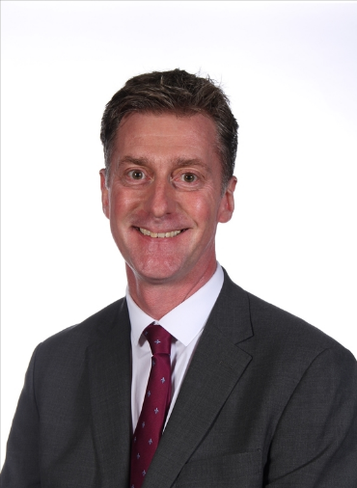
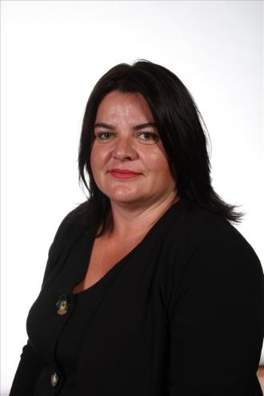

Meet the Pastoral Team
Mr McNamara
Head Teacher
Mrs Ourabi
Senior Deputy Head

Slide 6
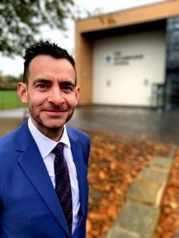
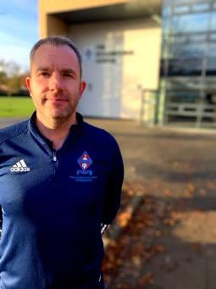
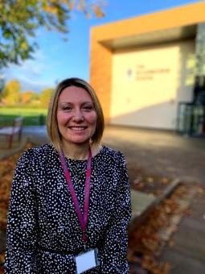
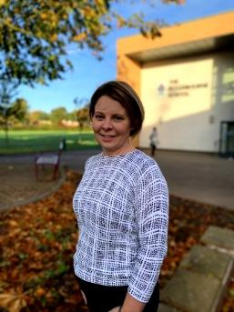
Meet the Pastoral Team
Mr Duncker-Brown
Head of Upper School
Mr Sellers
Head of Year 10
Mrs Dodson
Head of Year 11
Mrs Stott
Head of Year 9

Slide 7
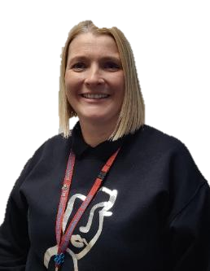
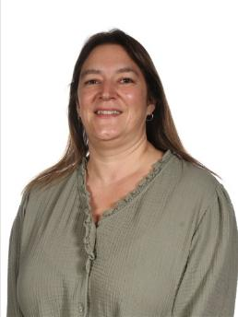
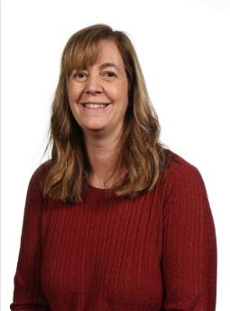
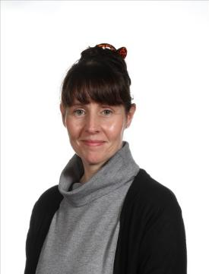

Meet the Pastoral Team
Mrs Parry
Progress Leader ​
Mrs Laughlin
Progress Leader ​
Mrs Monk
Pastoral Support and Attendance Officer​
Mrs Tanser
Pastoral Support and School Nurse​

Slide 8
The Options Process:
The options process is the first part of the transition from Senior Section to Upper School and plays an important role in determining student's academic pathways.
Tonight, and the options booklet, are the starting point for students, parents and carers to make their GCSE options choices.
In the coming weeks students will be supported by the 14+ team from the pastoral team as they make their GCSE option choices.
Students will receive a guidance interview to help them make the best set of choices.

Slide 9
Guiding principles of our options process:
To provide a broad and balanced curriculum with a strong academic core within the statutory guidelines;
To ensure that everyone has access to all the curriculum areas;
To meet the learning needs of individuals;
To provide suitable vocational choices for those who will benefit from them;
High expectations and achievement for all;
Clear communication with students and parents;
Students are equipped to meet the future expectations of employers.

Slide 10
Key Dates 2026
19th January; Options forms with recommendations distributed
30th January; 14+ options choices submitted to tutor
2nd February; 14+ interviews with 14+ Team
9th February; Final Options choices
Feb to June; Timetable Constructed
2nd March 9 B,C,L,R Parent’s evening
9th March 9 E,N,S,U Parent’s evening
22nd -26th June (inclusive) Year 9 Exams

Slide 11

Sunday Times Schools Guide

Slide 12
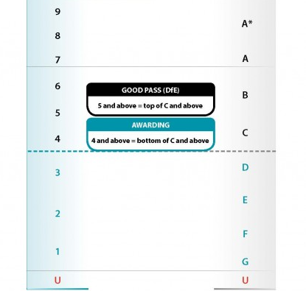
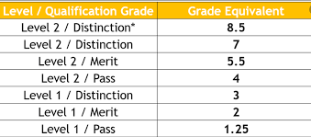
GCSE and Technical Qualifications Grading
GCSE subjects graded 1 to 9.
BTEC Level 1 Pass to Level 2 Distinction *
Coursework in some subjects and all BTECs/Cambridge Nationals.

Slide 13
OPTIONS ROUTE A; Separate Science
Ecclesbourne 14+ GCSE Options

Slide 14

Route A
Compulsory Core
YEAR 10
3 hours English
4 hours Maths
6 hours Science
1 hour PDC
1 hour PE
TOTAL= 14 hours
YEAR 11
4 hours English
4 hours Maths
6 hours Science
1 hour PDC
1 hour PE
1 hour Study/ Enrichment
TOTAL= 18 hours
English & English Literature
Mathematics
Separate Science
(Biology, Chemistry & Physics)
Core PE & PDC/RS
Core 1
Compulsory Curriculum

Slide 15
Route A
Compulsory Core
English & English Literature
Religious Education, Personal Development & Citizenship
  Drugs and Health Education
  Sex and Relationships
  Careers
  RS; Ethics
Physical Education
Enrichment
  1 hour in Year 11 is either a Study Period or Duke of Edinburgh award.
Mathematics
Separate Science
(Biology, Chemistry & Physics)
Core PE & PDC/RS
Core 1
Compulsory Curriculum

Slide 16

Route A
Compulsory Core – Choices 1 and 2
English & English Literature
YEAR 10
3 hrs MFL
3 hrs Humanities
YEAR 11
2 hrs MFL
2 hrs Humanities
French or German or Spanish
Mathematics
Separate Science
(Biology, Chemistry & Physics)
History or Geography
Core PE & PDC/RS
Core 1
Compulsory Curriculum
Core 2
Humanities and Languages

Slide 17
Ecclesbourne Options – Route A
2 Further Choices
English & English Literature
Art & Design
Drama
Music
GCSE PE
French
German
Spanish
Business
BTEC IT
Cambridge National Sports Science
Computing
Food & Nutrition
Resistant Materials
Textiles
Religious Studies
History
Geography
BTEC Health & Social Care
Cambridge National Engineering
2 Further Subjects
French or German or Spanish
Mathematics
Separate Science
(Biology, Chemistry & Physics)
History or Geography
Core PE & PDC/RS
Year 11
2 hrs Free Option 1
2 hrs Free Option 2
Year 10
3 hrs Free Option 1
3 hrs Free Option 2
Core 1
Compulsory Curriculum
Core 2
Humanities and Languages
2 Free Choices

Slide 18
Options route b; Combined Science
Ecclesbourne 14+ GCSE Options

Slide 19
Route B
Compulsory Core
YEAR 10
3 hours English
4 hours Maths
6 hours Science
1 hour PDC
1 hour PE
TOTAL= 14 hours
YEAR 11
4 hours English
4 hours Maths
6 hours Science
1 hour PDC
1 hour PE
1 hour Study/
Enrichment
TOTAL= 18 hours
English & English Literature
Mathematics
Combined Science
Core PE & PDC/RS
Core 1
Compulsory Curriculum

Slide 20
Route B
Compulsory Core
English & English Literature
Religious Education, Personal Development & Citizenship
  Drugs and Health Education
  Sex and Relationships
  Careers
  RS; Ethics
Physical Education
Enrichment
  1 hour in Year 11 is either a Study Period or Duke of Edinburgh award.
Mathematics
Combined Science
Core PE & PDC/RS
Core 1
Compulsory Curriculum

Slide 21
Route B
Compulsory Core – Choices 1
English & English Literature
YEAR 10
3 hrs Humanities
YEAR 11
2 hrs Humanities
Mathematics
History or Geography
Combined Science
Core PE & PDC/RS
Core 1
Compulsory Curriculum
Core 2
Humanities

Slide 22
Ecclesbourne Options – Route B
3 Further Choices
English & English Literature
Art & Design
Drama
Music
GCSE PE
French
German
Spanish
Business
BTEC IT
Cambridge National Sports Science
Computing
Food & Nutrition
Resistant Materials
Textiles
Religious Studies
History
Geography
BTEC Health & Social Care
Cambridge National Engineering
3 Further Subjects
Mathematics
History or Geography
Combined Science
Core PE & PDC/RS
Year 10
3 hrs Humanities*
3 hrs Free Option 1
3 hrs Free Option 2
3 hrs Free Option 3
Year 11
2 hrs Humanities*
2 hrs Free Option 1
2 hrs Free Option 2
2 hrs Free Option 3
Core 1
Compulsory Curriculum
Core 2
Humanities
3 Free Choices

Slide 23
Learning Support Option
Why might Learning Support be a good option for Year 10 + 11?
How can we support?
  Reinforce learning in all subject areas.
  Support coursework.
  Help with literacy and numeracy.
  GCSEs are a big step up in terms of expectations.
  There is pressure from coursework and final examinations.
  Learning Support can give an opportunity for students to have some additional time to spend on fewer subjects.
Who?
  Students identified by the Learning Support Faculty.

Slide 24

Options and Balance
Remember to aim for balance and choose subjects that reflect your interests and aptitude
Options | Ecclesbourne School

Slide 25
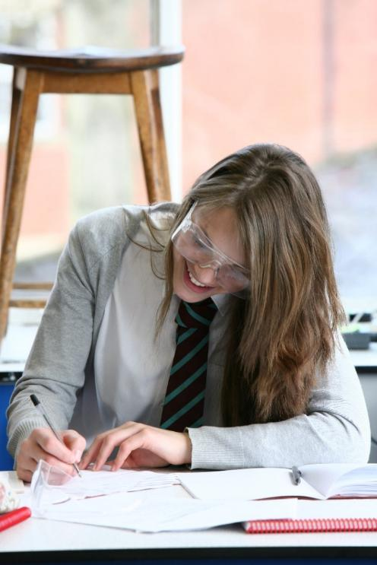
No need to worry
There will be lots of help and advice from the Pastoral Team.
We will offer guidance to ensure options do not close down future career choices or opportunities for further study.

Slide 26
There is plenty of help available
Students can talk to:
Form Tutor
Head of Year
Staff in Senior Section
Staff in Upper School Office
Careers Team
Parents:
If you need help, or just want to talk through options with us then don’t hesitate to pick up the phone and give us a ring or drop us an email.

Slide 27

BTEC Tech Award
Health and Social Care
(Level 2) = 1 GCSE

Slide 28


Why Health and Social Care?
1.3 million people are employed full time by
NHS England
(September 2023, Office for National Statistics)
317,000 employed in Health or Social Care related jobs in
East Midlands
(December 2021, Office for National Statistics)

Slide 29
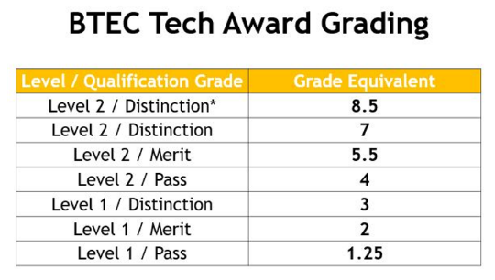
Course overview
BTEC Tech Award Health and Social Care
Component 1
Human Lifespan Development
(Coursework – 30%)
Component 2
Health and Social Care Services and Values
(Coursework – 30%)
Component 3
Health and Well-Being
(External exam – 40%)
How will you be assessed?
Apply what you have learnt to scenarios and case studies
A mixture of written coursework and written exam content

Slide 30
Are you interested in…?
Learning more about physical and mental health & wellbeing of individuals with a range of needs
Understanding the barriers individuals face, such as where they live or not speaking English
Learning strategies and ways to support individuals to overcome or reduce these barriers
Developing communication skills e.g. learning some sign language
Gaining skills on time management (deadlines!)

Slide 31
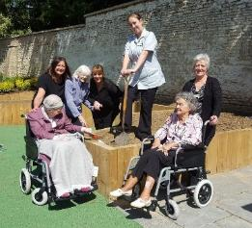

Examples of how you will be assessed
Case study 1
Reema is 82 years old and is a resident in Cherrybrook Care Home. She is a wheelchair user with some hearing loss. Reema enjoys gardening and painting, although she finds this more difficult since she developed arthritis.
Case study 2
Kian is 4 years old and has recently joined Big Smiles Nursery. Kian is very quiet and shy, his family have only recently moved to the area. He lives with his dad and older sister, 10 years old. Kian’s sister has down’s syndrome.
You are a care worker supporting Reema
Identify Reema’s needs
Explain ways you could help to support Reema
What other health or social care professionals could help to support Reema? Explain how.
You are a nursery worker supporting Kian
List 3 professionals that could help support Kian and his family
Research and explain financial support that Kian’s family might be able to access

Slide 32
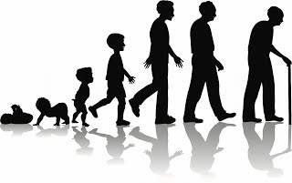
Component 1:
Human Lifespan Development
Physical, intellectual, emotional and social growth from birth to late adulthood
Factors (e.g. economic, social, physical) which affect human development
Life events and changes such as divorce, bereavement
Support for life events and changes
Internally assessed coursework
30% of final grade
Completed during Year 10

Slide 33

Component 2:
Health and Social Care Services and Values
Different health and social care services
Barriers to accessing services (e.g. psychological, physical, economic)
Care Values and how to demonstrate them
Internally assessed coursework
30% of final grade Completed in Year 11

Slide 34

Component 3:
Health and Well-Being
Lifestyle choices and well-being
Health indicators
Measures of health
Treatment and care plans
Externally assessed exam in summer of Year 11
40% of final grade

Slide 35
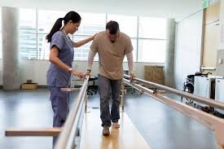

Where can Health and Social Care lead?
Health care
Nurses and midwives
Paramedic
Occupational therapist
Speech and language therapist
Physiotherapist
Home support workers
Administration staff
Social care
Social worker
Family support worker
Care home manager
Foster carer
Nursery worker
Residential support worker
Study at Level 3
(A Level)
Career pathways

Slide 36


GCSE Computer Science
BTEC Tech Award in Digital Information Technology
Two computer based options choices:

Slide 37

GCSE Computer Science
Learn to program using Python
Brilliant if you enjoy problem solving and the programming elements of the course
Often people who are good at Maths do well at Computer Science
Important if you wish to pursue Computer Science at A-Level, wish to study it at University or would like a job which requires programming
Assessment is two exams at the end of Year 11:
  Paper 1: Programming
  Paper 2: Computer Science Theory

Slide 38


BTEC Tech Award in Digital Information Technology
Learn how to make:
  Professional user interfaces in PowerPoint
  Complex data models using Microsoft Excel
Brilliant if you enjoy doing coursework rather than just focussing on an exam.
Important if you wish to develop your ICT skills further but do not wish to learn how to program.
Assessment:
2 Pieces of course work done in class are worth 60% of the final grade
1 theory exam in Year 11 worth 40% of the final grade

Slide 39

Frequently Asked Questions
Can students I take both subjects?
  Yes, you can if timetabling allows
Is there any overlap between the two subjects?
  No, they are completely different
What is a BTEC?
  A BTEC is a practical subject which includes coursework and is graded Pass, Merit and Distinction, a GCSE is a traditional exam-based subject graded 1-9

Slide 40

Why study GCSE Business?
Inevitably when you leave school you will either become an employee for a business/organisation or own your own business!
GCSE Business will give you the transferable skills such as:
  communication,
  decision making,
  numeracy,
  presentation and
  generally understanding how an organisation operates!
The world is constantly changing and the jobs that you will have as adults might not yet exist
GCSE Business will give you the opportunity to develop the skills you need to thrive!

Slide 41

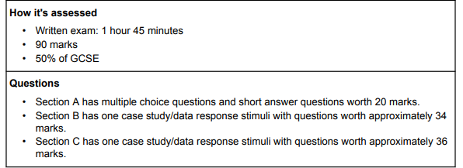
GCSE Business
How will I be assessed:
Two exams at the end of the course – no coursework
Paper 1 – Business in the real world, influences on business, operations and human resources
Paper 2 - Business in the real world, influences on business, marketing and finance

Slide 42






































GCSE Business
- Route through the whole course
Revision
Globalisation
Paper 1
Competitive environment
Influences on business
Paper 2
Legislation
Economic climate
Technology
POST 16
Human resources
Mock exam
Recruitment & selection
Organisational structures
Motivating employees
Training
Financial performance
Finance
Financial calculations
Cash flow
Sources of finance
Economic climate: Interest rates
YEAR 11
Year 10 exam
Customer service
Environmental considerations
Ethical considerations
Marketing
Understanding customers
Market research
Segmentation
Marketing Mix
Concept of quality
Production processes
Business Operations
Expanding a business
Business planning
Globalisation: exchange rates
Business location
Key
Role of procurement
Unit of work
Business in the real world
Purpose & nature of business
Aims & objectives
Stakeholders
Teaching Topic
KS 3
YEAR 10
Internal assessment
Business Ownership
External assessment

Slide 43
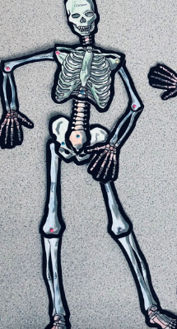
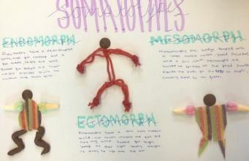
GCSE Physical Education (Edexcel)
Course Overview and Assessment
There are 3 components to GCSE Physical Education:
Component 1 - The Human Body and Movement in Physical Activity and Sport
Movement analysis
Physical training
Applied anatomy and physiology
Assessment: Written exam 1 - 1 hour 15 mins (30%)

Slide 44

Component 2+3
Component 2 - Socio-Cultural Influences and Well-being in Physical Activity and Sport
Health, fitness and well-being
Sports psychology
Socio-cultural influences
Written exam 2- 1 hour 15 mins (30%)
Component 3 - Non-Exam Assessment
Practical assessment in individual and team activities 30%
Written Coursework 10%

Slide 45
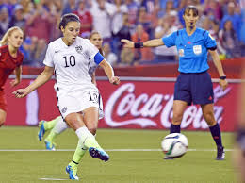
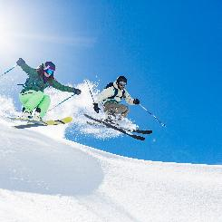
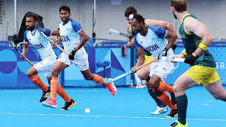

Practical Assessment
Students have to be assessed in 3 activities from the list within the AQA specification.
One activity must be from the individual list and one from the team list. The third activity can be from either list.
The written coursework is on one sporting activity from the specification.

Slide 46

OCR Cambridge
National
Certificate
in Sport Science
Level 2

Slide 47
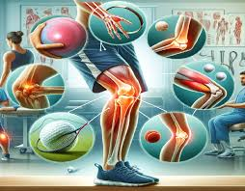

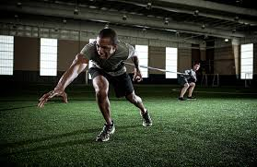
Course outline
Three units to be completed over the 2 years:
Unit R180
Reducing the risk of sports injuries 40%
Unit R181
Applying the principles of training 40%
Unit R185
Sports Nutrition 20%

Slide 48
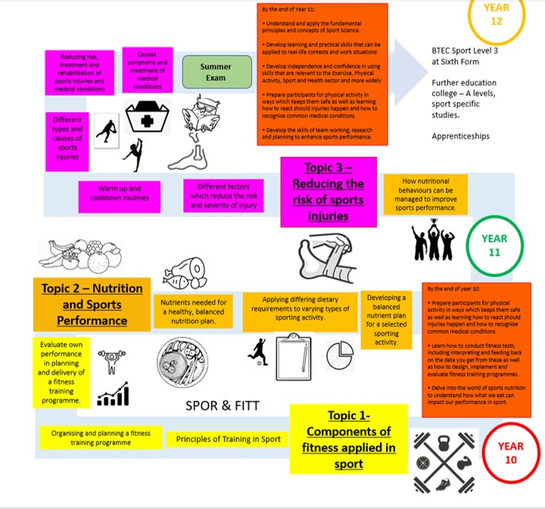

Slide 49
UNIT 1: Reducing the risk of sports injuries and dealing with common medical conditions
This unit is assessed by an exam.
By completing this unit, you will prepare to take part in physical activity in a way which minimises the risk of injuries occurring. It will also prepare you to know how to react to common injuries, and how to recognise the symptoms of some common medical conditions.
Topics that you study will include:
Different factors which influence the risk and severity of injury
Warm up and cool down routines
Different types and causes of sports injuries
Reducing risk, treatment and rehabilitation of sports injuries and medical conditions
Causes, symptoms and treatment of medical conditions

Slide 50
UNIT 2: Applying the principles of training, fitness and how it affects skill performance
This unit is assessed by a set assignment and practical application:
By completing this unit, you will conduct a range of fitness tests, understand what they test, and their advantages and disadvantages. You will also learn how to design, plan and evaluate a fitness training programme. You will then interpret the data collected from these fitness tests and learn how best to feed this back.
Topics include:
Components of fitness applied in sport
Principles of training in sport
Organising and planning a fitness training programme
Evaluate own performance in planning and delivery of a fitness training programme

Slide 51
R183: Nutrition and sports performance
This is assessed by a set assignment.
By completing this unit, you will gain understanding of healthy, balanced nutrition. You will consider the necessity of certain nutrients and their role in enabling effective performance in different sporting activities. The knowledge you gain will be used to produce an appropriate, effective nutrition plan for a performer.
Topics include:
•Nutrients needed for a healthy, balanced nutrition plan.
•Applying differing dietary requirements to varying types of sporting activity
•Developing a balanced nutrition plan for a selected sporting activity
•How nutritional behaviours can be managed to improve performance.

Slide 52

Comparisons with two sports courses:
GCSE PE & Sports Science both have the same amount of practical time.
Both courses are worth a full GCSE.
Both will give you a pathway through into the 6th form to study sport, no dead ends.

Slide 53
Comparison
GCSE PE
Equivalent to one full GCSE
1 x GCSE PE practical lesson per week
2 x GCSE PE theory lessons per week
(You also get one core PE lesson per week that everyone in Year 10 completes).
Assessment:
60% Theory (two exams in Year 11).
10% coursework
30% Practical (three sports)
Sports Science
Equivalent to one full GCSE
1 x Sports Science practical lesson per week
2 x Sports Science theory lessons per week
(You also get one core PE lesson per week that everyone in Year 10 completes).
Assessment
40% Theory (one exam in Year 11).
60% Coursework (two units completed including assessment in two sports)

Slide 54

GCSE
Design and Technology:
Resistant Materials

Slide 55




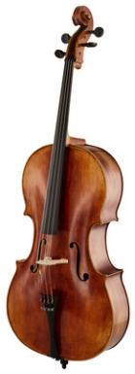
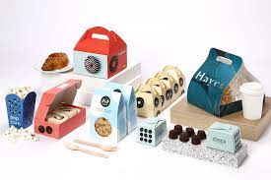
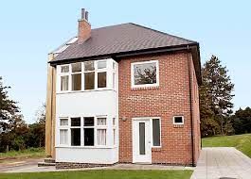


What do all these items have in common?

Slide 56
Design and Technology; Resistant Materials
What is D&T – and why do we need it? (youtube.com)
Offers an opportunity to apply maths, science and problem solving skills to a range of mini projects and practical work in both Year 10 and 11.
50/50 Split of coursework (NEA) and exam
Exam is sat in the summer of Year 11.
NEA starts in the summer term of Year 10 and runs till Easter of Year 11.
NEA, you get to choose what you design and make from one of three contexts, e.g., Storing and securing items for 2023-24.
Cover three main areas in the exam:
  Core principles- All materials knowledge
  Specialist principles
  Design and make principles.

Slide 57
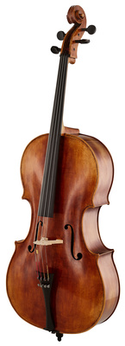
Resistant Materials; What is involved?
Material focus: Timbers, plastics and metals.
CAD: TinkerCAD, Fusion 360 and 2D Design
Design/projects: Furniture, storage devices, decorative items, Interior design, engineering, Architecture, Product design.
Resistant Material Projects:

Slide 58


Cambridge National Level 2 in Engineering Manufacture

Slide 59

Overview
Who is the course aimed at?
The OCR Cambridge National Level 2 in Engineering qualification is designed for students who are interested in pursuing a career in engineering or further studies in the field.
It provides a practical and theoretical understanding of various engineering concepts, offering a solid foundation in the core principles of the industry.
The course is divided into units, covering topics such as:
Engineering Technical Drawings
Manufacturing Processes
Materials and their Properties
Engineering Maintenance
The application of modern engineering technology

Slide 60
Assessment and Learning
Assessment
Practical and theoretical learning
Core units are assessed through controlled assessments (practical tasks).
  2 NEA based tasks, when combined make up 60% of the students grade.
External exams used to test theoretical knowledge on topic areas of the syllabus.
  This makes up the remaining 40% of a students final grade.
Students will develop hands-on skills through practical tasks while also gaining the ability to apply theory to real-world engineering problems.
NEA tasks focus on application of practical knowledge and design skills being applied to a given either set of instructions or technical drawing.

Slide 61

Progression
Progression:
This qualification is suitable for those wanting to enter the workforce in various engineering roles, such as manufacturing, design, and technical support, or continue further education, such as apprenticeships or A-Level study in related fields, e.g. A-level product design or Apprenticeships.
Equivalent to a GCSE, meaning it is ideal for students in secondary education (ages 14-16) who want to explore engineering in depth before choosing their next steps.

Slide 62
D+T Vs Engineering
 | OCR Cambridge Nationals Engineering Manufacture (J823) | AQA GCSE Design & Technology – Resistant Materials (8552)
Qualification Type | Technical / vocational | Academic GCSE
Content Focus | Manufacturing processes, materials & production skills | Broad design, materials & making with creative design emphasis
Maths | Embedded in practical tasks and NEA work; not in exam. | 15% maths based questions in exam as well as imbedded in practical tasks and NEA work.
Assessment | 1 exam + practical NEA units | 1 written exam + 1 substantial design portfolio & 1 make task
Skills Developed | Practical engineering, manufacturing planning | Design thinking, innovation, prototyping, evaluation
Progression Routes | Engineering apprenticeships, vocational study within manufacturing industries | A-Level Product design, interior design, architecture, STEM academic routes

Slide 63
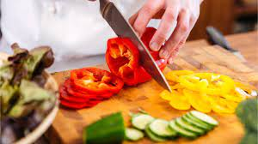
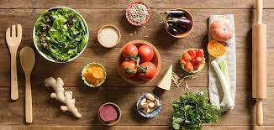
GCSE Food Preparation & Nutrition
GCSE Food Preparation and Nutrition aims to equip students with the knowledge, understanding and skills required to cook and apply the principles of food science, nutrition and healthy eating.

Slide 64


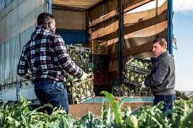
GCSE Food Preparation & Nutrition: Content
The main emphasis is the development of strong practical cookery skills and techniques and a good understanding of nutrition.
You will discover the essentials of food science, nutrition and how to cook. You will understand the huge global challenges that we face to supply the world with nutritious and safe food.
It is another step towards creating a healthier society and improving the nation’s cooking skills as well as setting some students on the path to careers in the food and hospitality industry.

Slide 65
GCSE Food Preparation & Nutrition: Assessment
Food Preparation and Nutrition written exam
1 hour 30 minutes 50% of total GCSE
Food Investigation Task (Scientific investigation)
45 marks
Non-examined assessment (NEA) 15% of total GCSE
Food Preparation Task (Prepare 3 dishes in 3 hours)
105 marks
Non-examined assessment (NEA) 35% of total GCSE

Slide 66


