Slide 1
Ecclesbourne School
Year 13 booster post 18 evening September 2025

Slide 2
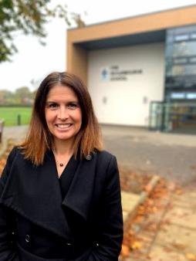
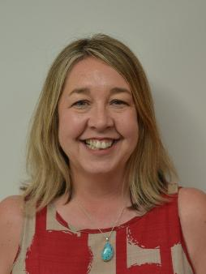

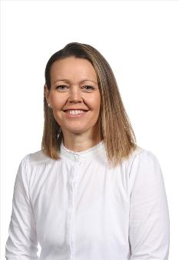
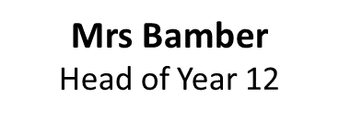

Sixth form Pastoral Team
Mrs Weller Head of Sixth Form
Mrs Hadwin
Head of Year 13
Mrs Cox
Administration/
Admissions Lead

Slide 3

University applications
Non – early entry
All other courses
Early entry
(Oxford, Cambridge, Medics, Vets, dentists)
Finalising personal statements.
Paying and submitting UCAS form.
Staff are reference writing.
Internal deadline:
Friday 29th September 2025
UCAS deadline Early Entry deadline:
Wednesday 15th October 2025
Choosing courses/open days.
Writing personal statements.
Paying and submitting UCAS form.
Staff are reference writing.
Internal deadlines:
Monday 10th November 2025
UCAS equal consideration deadline: Wednesday 14th January 2026

Slide 4


Resources to support students.
Show My Homework – guide to completing applications
Post 18 support - links to useful resources to help you with you post 18 choices
UNIFROG
How to complete the UCAS form
How to request references from staff
How to write a personal statement
*info for apprenticeship applications is also on here.

Slide 5
What can you do to help at this stage?
Form | Supporting staff
13B | Mrs D Cotton
13C | Ms S McCammon
13J | Mr J Cuthbert
13M | Mr R Mason
13P | Mr C Martin
13R | Miss E MacCormick
13S | Ms D Fones
13T | Mrs T Bartlett Ms S James
Support them to explore their options – open days, applicant days.
Help them check the entry requirements.
Help them make sensible choices – have they got an insurance?
If they are worrying get them to talk to their tutor or a member of SFO.
Help them draft their personal statement.
Check their UCAS form – errors cause delays.

Slide 6
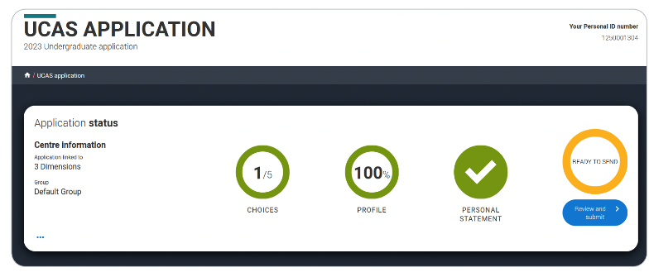
What happens when you pay and submit?
The UCAS form comes to Sixth Form Office.
We check the applications and send them back if there are errors.
We add the school reference and predictions.
We check with the student if they are happy to send to UCAS.
We hit send – after this point it is very difficult to make changes.
Wait for offers to come rolling in. This could be within days or a few months. Some institutions wait until after the equal consideration deadline, others do them in batches.

Slide 7

Admissions testing for Oxford, Cambridge, UCAT and LNAT
Students may be invited to interview – this varies by course.
Oxford interview dates
Cambridge key dates
Students may be required to submit work or a portfolio.
We will provide interview prep for any students who need it:
Medics, vets, Oxbridge, vocational roles like nursing, physiotherapy, teaching
If you think you can help us out with these or know someone who can please get in touch.

Slide 8
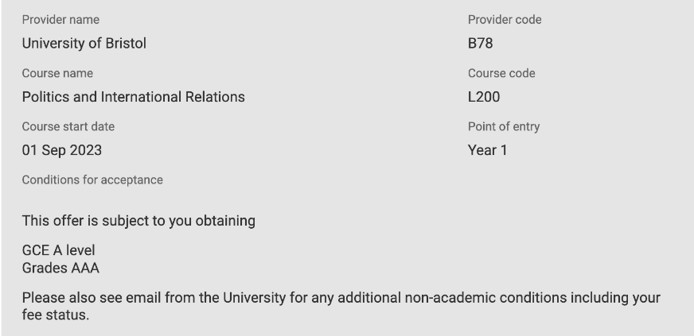
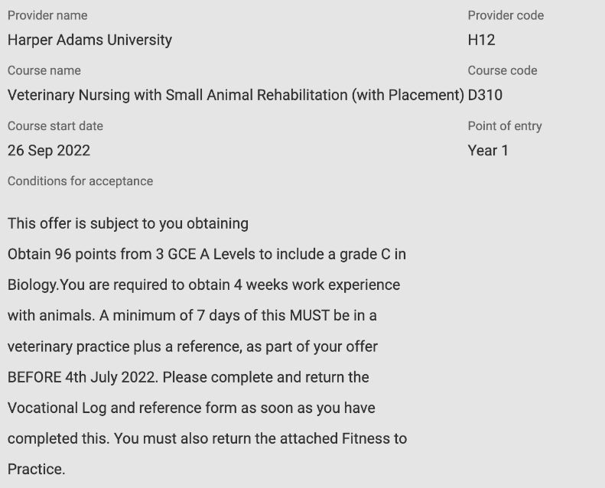
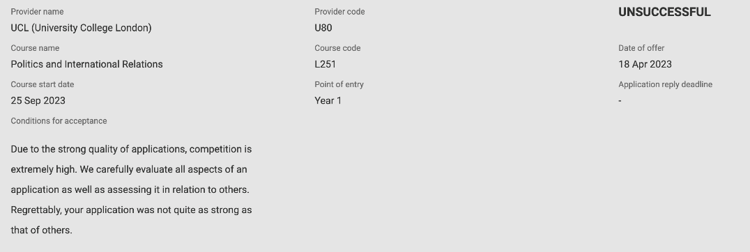
Conditional
Unconditional
Unsuccessful

Slide 9
Wednesday 26th Feb 2026
UCAS Extra opens. If your child has used all five choices and is not holding an offer, they can add another choice using Extra.
If you receive all your offers by 31st March you must reply by Friday 6th May 2026
Offer and reply combinations
Unconditional firm (UF) – You're in!
Conditional firm (CF) – You're in if you meet the conditions.
Conditional firm (CF) and conditional insurance (CI) – You've made a first and second choice – you'll be in at the first if you meet the conditions. If not, you might have met the conditions of the second – if so you'll be on that course instead.
Conditional firm (CF) and unconditional insurance (UI) – You've made a first and second choice – if you meet the conditions of the first you'll be on that course. If not, you'll definitely be on the second.

Slide 10
Results day - Thursday 13th August 2026
Scenario 1 - your child gets the grades required for their firm choice and they take up their place.
Scenario 2 - your child gets the grades required for their firm choice but they decide they have seen a course they prefer in clearing. They should secure an offer through clearing and ask to be released into clearing by the firm choice.
Scenario 3 - your child does not get the grades required for their firm choice.
Check the UCAS website, they may have been accepted anyway.
If they meet the insurance offer they will be accepted there.
If they have seen a course they prefer in clearing they should secure an offer through clearing and ask to be released into clearing by the insurance choice.

Slide 11
Scenario 4 - They do not get either their firm or insurance choice. They are now eligible for clearing.
First thing is don’t panic. Students will need a hug, some time to process and to know that you are there to help them with a plan.
On results day we always have SFO staff on hand to help with this.
Look at what is available in clearing – open Thursday 5th July 2025
You can do this in advance of results day but the picture of what is available becomes clearer on results day.
Each university will have a clearing helpline – students call them, staff take details and an admissions tutor gets back in touch to let them know if they will make them offer. Sometimes a phone interview is required particularly for vocational courses.
You can secure as may offers as you like in clearing but the universities may make it time limited – particularly at competitive places.
It is important to act quickly.

Slide 12

Things to help in scenario 4.
Have raw scores – we can provide these on the day.
If you have missed a grade by 1 mark it can help to have this information.
If you smashed a grade boundary this can help.
It may be worth contacting grade/points equivalents – each university is different, eg one may reject A, A, A but another may accept A*, A, B
Try the same universities but with a slightly different course title eg Politics and Spanish rather than Politics and International relations.

Slide 13
Things to consider
Paper remarks – on results day we can support with this.
Consider taking a year and re-applying if they are unable to find something suitable.
Some students re-sit A levels and use the extra time to get some more work experience.
Some student get the grades required and re-apply the next year – more common in subjects like medicine/veterinary.
Things tend to work out!

Slide 14

Student Finance
Financial support is available to meet your two main costs at university
Your Tuition Fees – up to £9,535 per year
Your Living Costs – rent, food, bills

Slide 15

Support available: tuition fees
Apply through Student Finance England
Paid directly to your university
Scan the QR code for information about SFE

Slide 16
Maintenance loans
In assessing you for your Maintenance Loan, Student Finance England will want to know a few things from you:
1. Where will you be living whilst you’re at university?
2. What is your total annual residual household income?

Slide 17

Maintenance loan
Key Advice:
Use the Student Finance England Calculator to see how much funding you could get:
https://www.gov.uk/student-finance-calculator
Up to £8,877*
Parental Home Rate:
Live at home while you study
Up to £10,544*
Elsewhere Rate:
Live and study away from home outside of London
Up to £13,762*
London Rate:
Live and study away from home in London
*based on 2025/26 figures

Slide 18
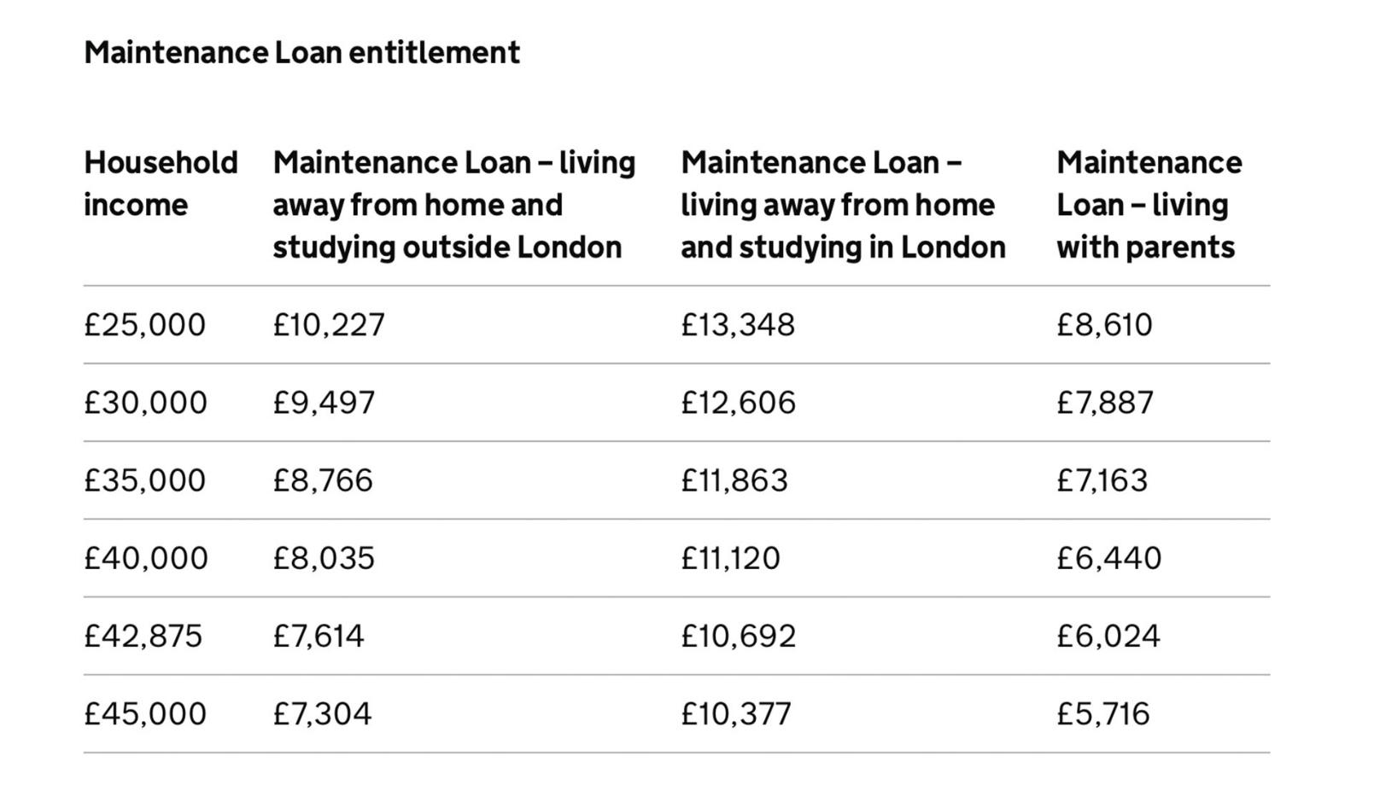
Maintenance loan – Household Contributions

Slide 19
Student finance – am I eligible?
To qualify for Financial Support the student must meet two main criteria:
You have been resident in the UK for three years prior to the start of your course.​
You do not already hold an honours degree (previous study in HE may affect your entitlement). There are some exceptions to this.​
EU students can apply for Maintenance Loan support if they have been resident in the UK for five years or more

Slide 20


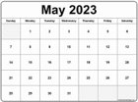

How to apply...
Apply online for funding from Student Finance England at www.gov.uk/studentfinance
February 2024
May 2024
May - September
Sign and return declaration form
September 2024
Deadline for Application
Start Application
Enrol on course
Check out some helpful videos on:
www.youtube.com/user/sfefilm
Government studnet finance guide
Guide from Martin Lewis

Slide 21
Repayments
Earning less than £25,000 = no repayment
Do NOT repay loan
Uni
World of work
Repayment: April after completing course and earning more than £25,000
Earning over £25,000 = repayments
40 years after completing your course, all debt is written off
Interest rate = Retail Price Index (RPI)

Slide 22
Repayments – what does this mean?
Repayments are made on 9% of earnings above the £25,000 threshold
Income each year before tax | £25,000 | £35,000 | £40,000 | £45,000
9% will be deducted from | £0 | £10,000 | £15,000 | £20,000
Monthly Repayments (Approximately) | £0 | £75 | £112 | £150

Slide 23

Grants and bursaries
Government Grants
Parents learning allowance
Childcare grant
SHU Scholarships and Bursaries
Student success scholarship
NHS Learning Support Fund
£5000 per year
Adult dependant grant
Care leaver bursary
Placement bursary
Performance athlete support programme
£2000 for child dependants
Excess travel expenses
+ more
Disabled Student Allowance (DSA)
Check eligibility on the websites: www.thescholarshiphub.org.uk

Slide 24


NHS LSF and Social Work Bursary
Nursing & Midwifery
Allied Health
Social Care
Nursing (Adult)
Nursing (Child)
Nursing (Mental Health)
Learning Disability Nursing & Social Work
Midwifery
Occupational Therapy
Physiotherapy
Diagnostic Radiography
Operating Department Practice
Paramedic Science
Radiotherapy and Oncology
Social Work
Check eligibility on the website: www.nhsbsa.nhs.uk/social-work-students
Check eligibility on the website:
www.NHSbsa.nhs.uk/nhs-learning-support-fund

Slide 25

Disabled Students Allowance
Disabled Students Allowance
You can apply for DSA from Student Finance England before you start your course. This is applied to separately from your maintenance/tuition fee loan
Disclosure
Disclosing a disability on your application does not impact the outcome. It is only asked so support can be recommended to you.
Application
It can take up to three months to get your DSA support in place so you should apply for it as soon as you have applied for a course.

Slide 26

Managing your money
Before Uni
Bring money with you – your maintenance loan is deposited in your account within 3-5 working days after you enrol
Talk to your bank about setting up a student bank account – different banks have different offers e.g. free rail card, cash incentives, 0% interest on overdrafts
Plan and budget – blackbullion.com can be used to help you budget
At Uni
Part time work - Students can work an advised 10 - 12 hours per week without studies being affected
Your maintenance loan is paid in three installments throughout the year
Budget – blackbullion.com can be used to help you budget

Slide 27

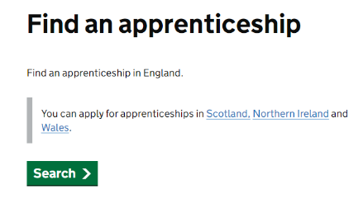














Apprenticeships - where to look
www.gov.uk/apply-apprenticeship
www.ratemyapprenticeship.co.uk
notgoingtouni.co.uk
www.healthcareers.nhs.uk
Company websites

Slide 28
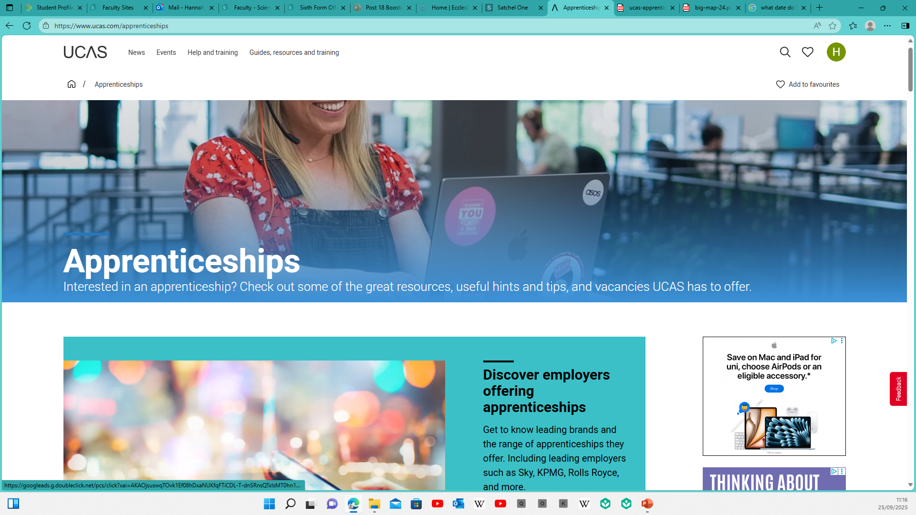

Slide 29


Slide 30
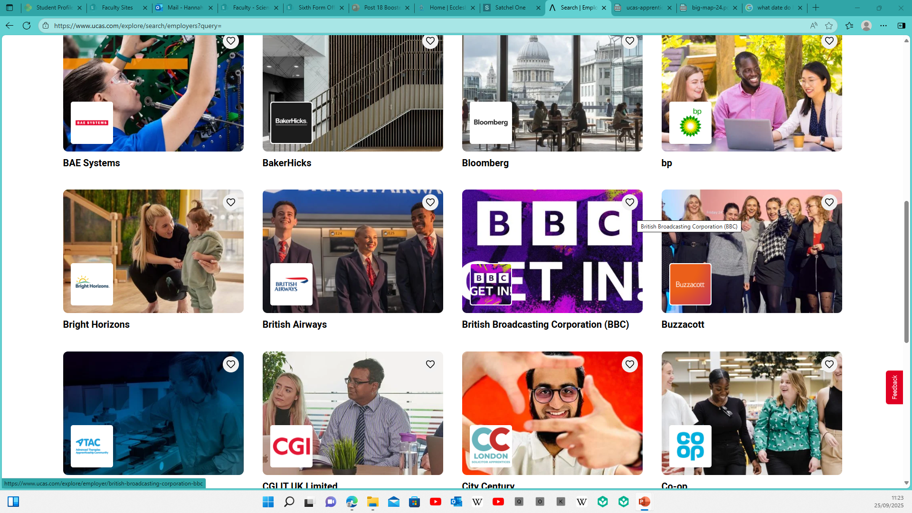

Slide 31
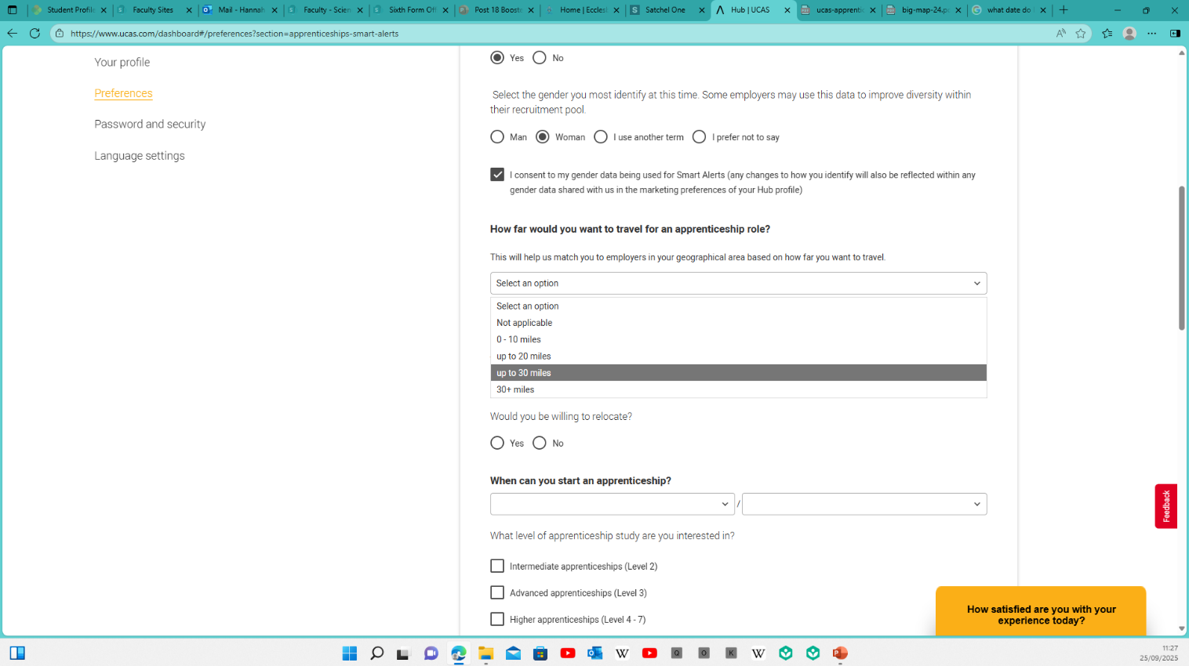
Smart alerts…..
Asks what area you are interested in

Slide 32
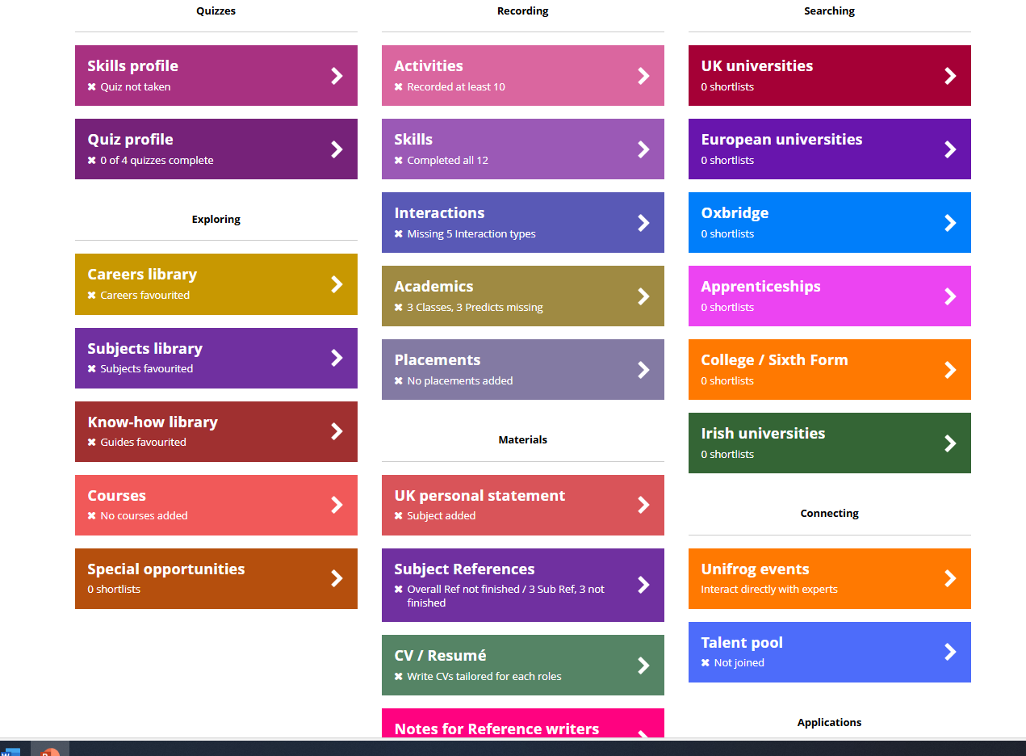
Apprenticeship search – through Unifrog
Log in and scroll down to the apprenticeships tile.

Slide 33
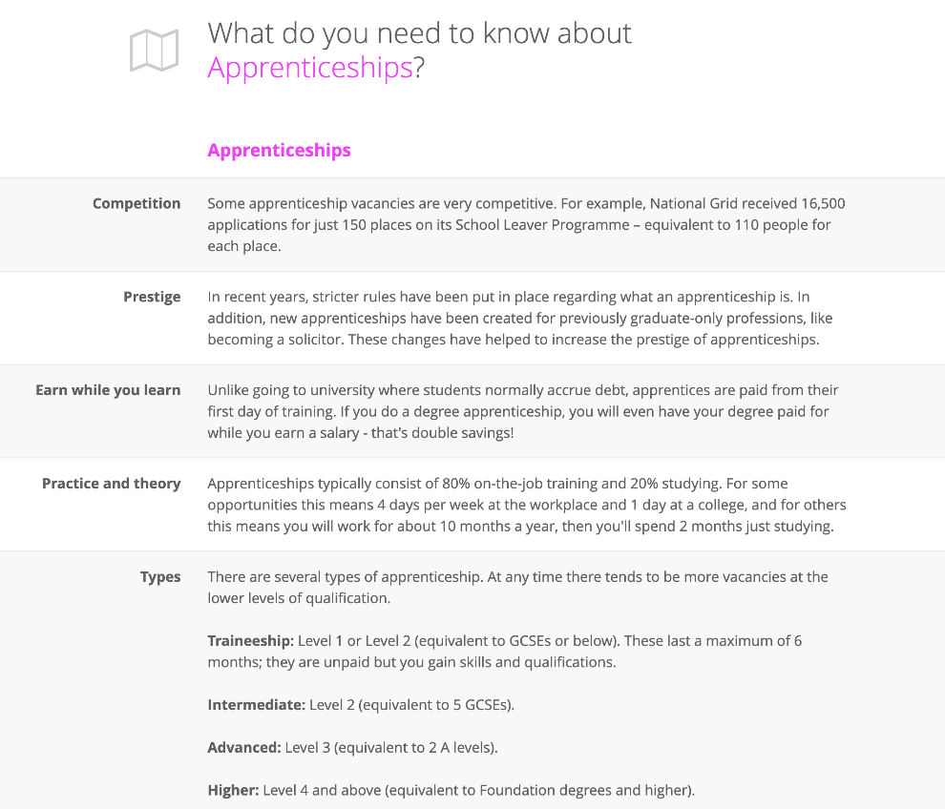
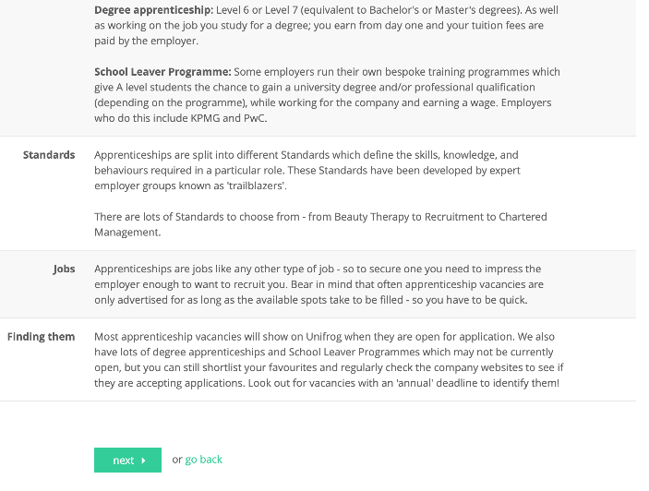
Read through this page – it tells you everything about apprenticeships and then scroll down to the bottom of the page and select next.

Slide 34
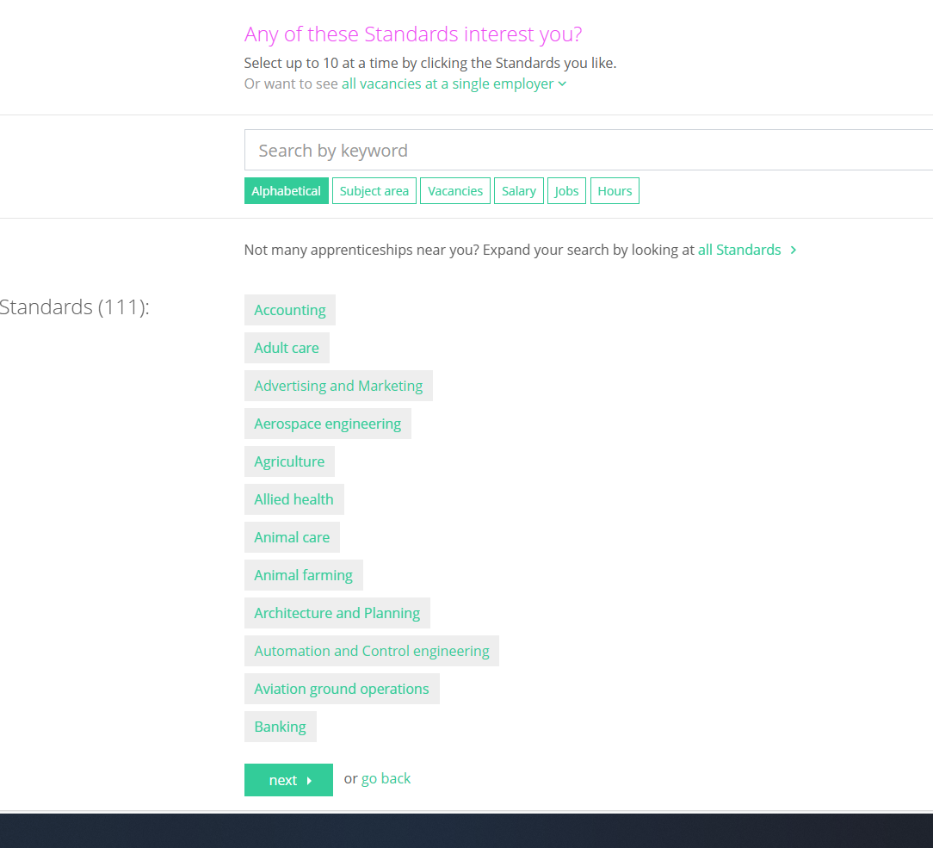
Select the 10 standards you are interested in.
or you can search by all vacancies by a single employer

Slide 35
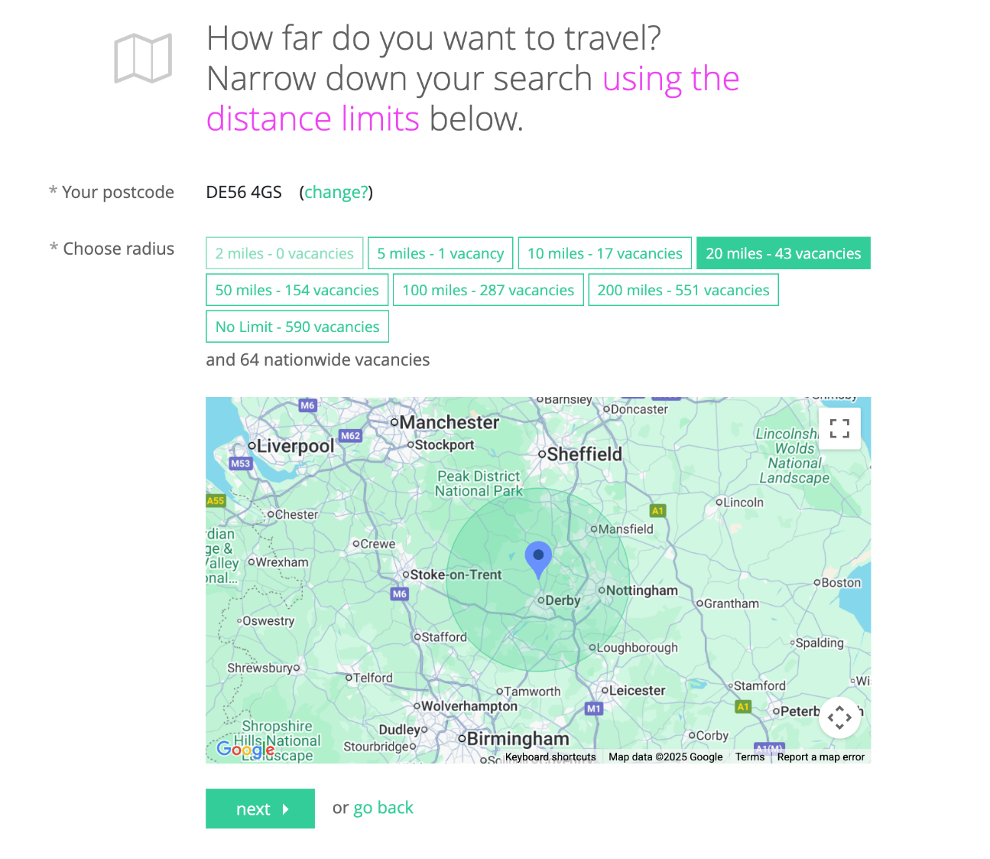
Select how far you want to travel

Slide 36
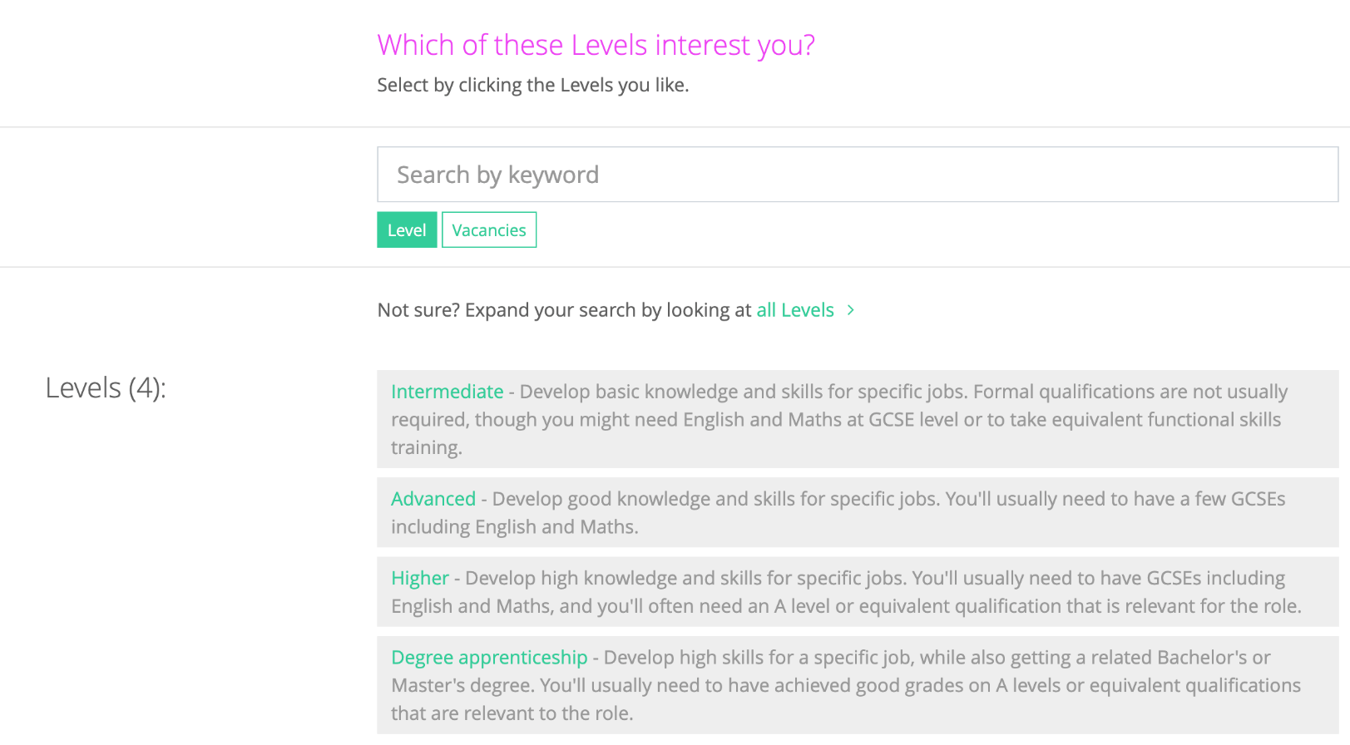
Select the level you are interested in.

Slide 37
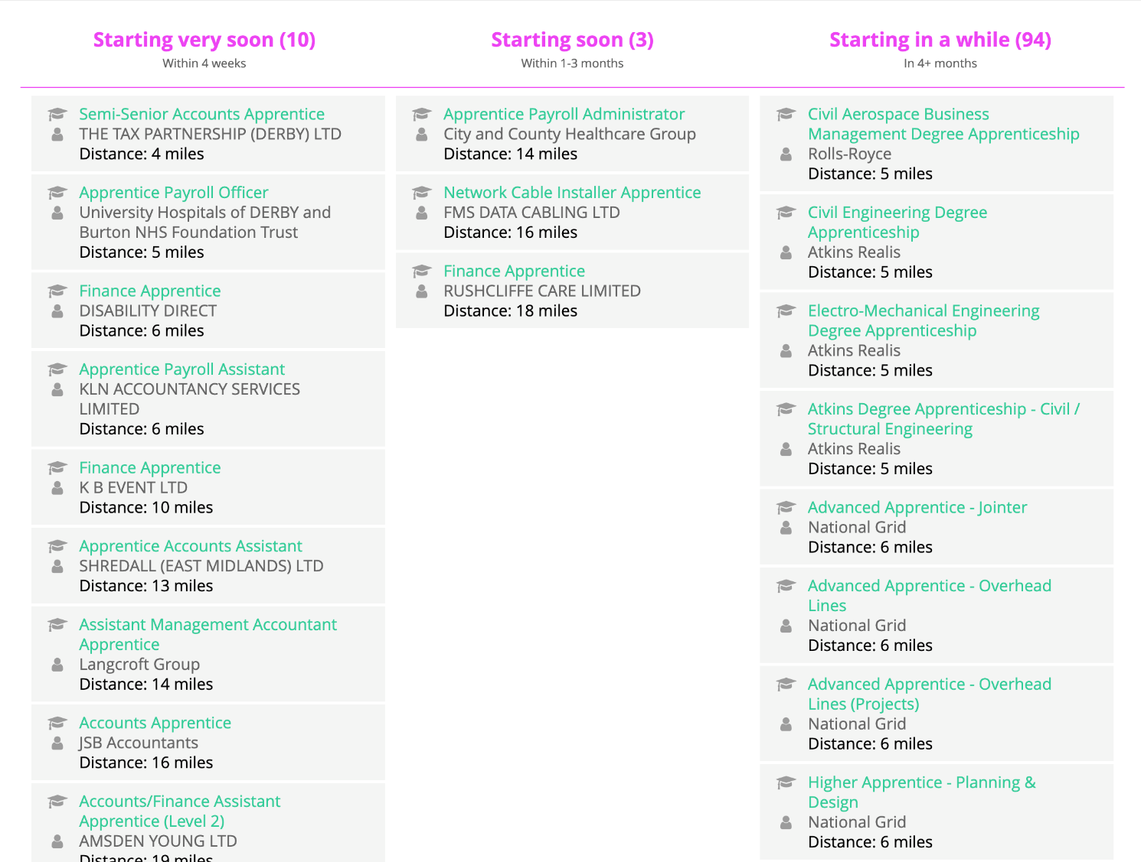
They are shown by start date – you need starting in a while.
Then select the ones you are interest in looking at.

Slide 38
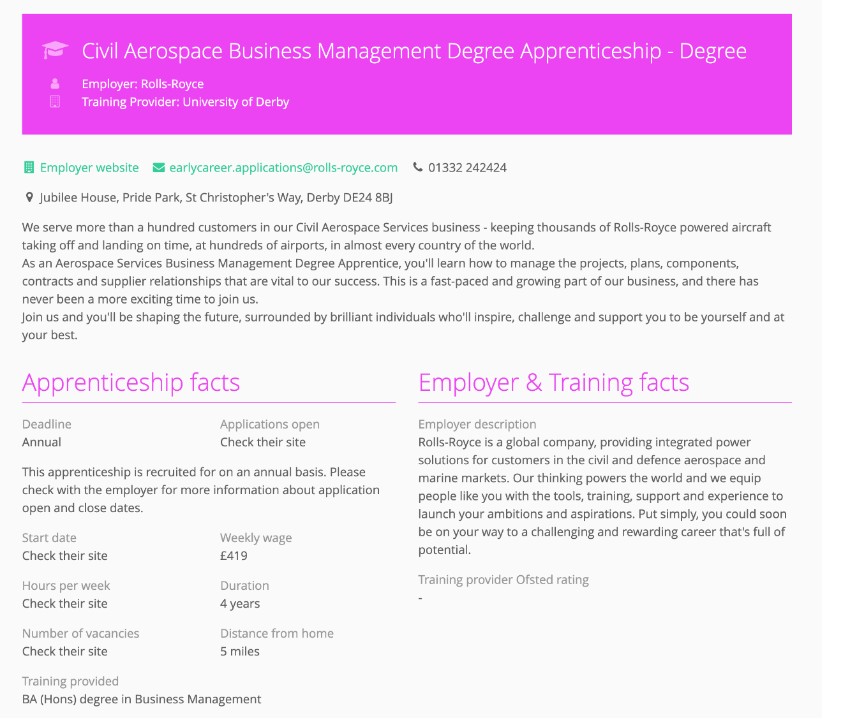
Information is then given that you can then follow up by exploring the company website.

Slide 39
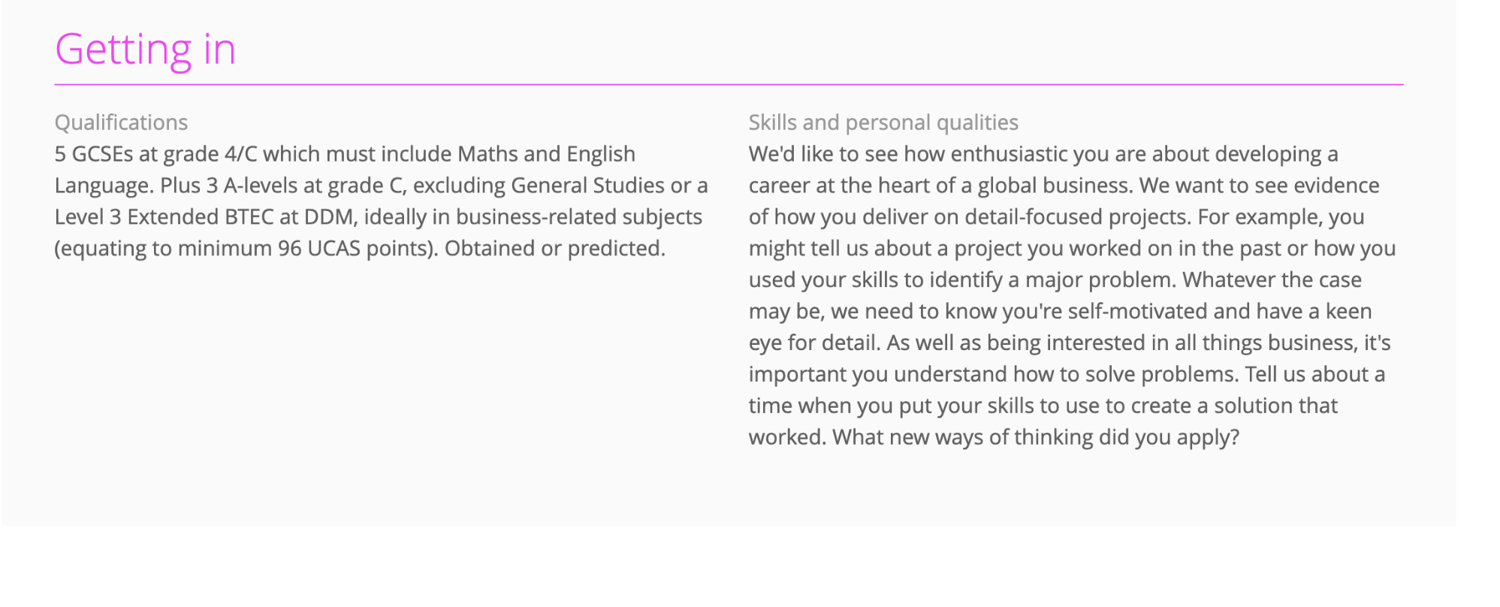

Slide 40


Degree apprenticeships in engineering, project management and business. Other level 4 apprenticeships. Any information will be shared. Entry requirements 3 x C at A-level or equivalent.
Degree apprenticeships in business and engineering. Other level 4 apprenticeships. Open day Saturday 11th October – link sent to students. Entry requirements 3 x C at A-level or equivalent.
Degree apprenticeships in quantity surveying and construction management. Application details to follow.
Degree apprenticeships in project management and chartered surveying. Application details to follow.
Degree apprenticeships (level 7) in finance. Applications opened October 2024. West Midlands based.
Degree apprenticeships and level 4 apprenticeships. Application details to follow.
Level 3 apprenticeships in production and maintenance. Applications open early October, open days in early November.
“Flying Start” degree apprenticeships applied for via UCAS at 6 different universities.

Slide 41






Various Level 2, 3 and 4 apprenticeships in Business, Operational and STEM based areas
Various levels – Business, Digital, Newtorks and Consumer sectors.
Smith Cooper – Accountancy
Tesco accountancy
Fluid Ideas – Darley Abbey
Rolls Royce cars

Slide 42
Recruitment Processes
Open days / evenings
Application form and/or upload a CV
Video interviews
Online tests – logic / numeracy / reasoning
Assessment centres – interview / presentation / group activity

Slide 43
Study skills and preparing for exams
How do you ensure that your child is prepared for this year and support them in planning their time and making study time as useful as possible?

Slide 44

Be Organised!
A Study Timetable and Weekly Progress Sheet are essential
Study Folder & Refill Pad will help you to organise your studies
Recommended Study for Year 13 :
60 mins. per night plus homework

Slide 45

Your Study Area…
Make sure
the room is well lit
It’s free from distractions and noise
(No mobile phones )
You have everything you need to study (Calculators/ Books / Work books / Refill Pad)

Slide 46

Tips For Making Study Easier…
Be
Be active while studying: take notes – recite out loud – use flash cards – mind maps – test yourself
Take
Take regular short breaks (5 - 10 mins. every 40 -60 mins.)
Eat
Eat properly – Take regular exercise – Reward yourself

Slide 47
Remember….
Listening in class is vital
Review what was learned in class as soon as possible
Try and complete homework on the day it’s given

Slide 48
Improving Memory…
Studies indicate that 66% of material is forgotten within 7 days if it is not reviewed or recited again by the student
88% is gone after 6 weeks

Slide 49
Tips For Making Study Easier…
Plan in
Plan in advance what topic you are going to study
Break up
Break up tasks into small manageable sections (the contents page of a book is helpful for this)
Try
Try to base the topic around questions at the end of a chapter or the topics your teacher has advised you to study
Start
Start with the subject you find most difficult or dislike

Slide 50

4 Steps to Revising:
Map → Organise where you need to be going…
Filter → Highlight the key facts / info…
Summarise → Create a mind-map (and pictureboard)…
Activate! → Create a quizzes, crosswords, word-searches etc.

Slide 51
An Effective Memory Technique
Before starting a study period write down everything you know about the topic (even if its only a few words)
Then open the book. Quickly read through the relevant section, taking brief notes (don’t write sentences; only key words).
Now comes the important part. Quickly test your knowledge by jotting down all you now know
Then check your notes to see how you did (if you forget something write it down in red pen)

Slide 52
Effective Memory Techniques
This method works for two reasons
Because you call on your brain to retrieve the information before and after the session, your brain learns that this is information it needs to store
The act of testing yourself before and after gives you a clear idea of where the gaps in your knowledge are.

Slide 53
NO SHORT CUTS
Unfortunately there are no short cuts to learning your work but you can be smart about it.
Get organised, start early and be consistent.
Find what works for you and ensure you can concentrate – NO PHONES IS A MUST!

Slide 54
Looking after them
It will get stressful as exams approach – on top of exams a big change is coming that they cannot control but ensuring that they view this as exciting and highly supported will really help.
Talk to them regularly about how they are feeling and what they have coming up. If you concerned about them get in touch and we will help.
Our website has lots of links to places you can get help too.

Slide 55







Support should they need it
Sixth Form are always here to help you – get in contact
Other key resources for mental health:
Derbyshire 24/7 mental health support line on 0800 028 0077

Slide 56


External Support
Get in touch with our Parents Helpline
Our Parents Helpline offers vital advice and guidance to parents/carers who are concerned about their child’s mental health.
We can give you advice on:
how to access support
navigating services for your child
practical techniques that can help you and your child
signposting to other organisations
If you are a parent/carer in need of some help, please get in touch.
Derbyshire Mental Health Support Line
Derbyshire Mental Health Support Line tel: 0800 028 0077. Mental health support line for Derbyshire people of all ages. Open 24 hours per day, 7 days per week.

Slide 57


More external resources
provides free, safe and anonymous mental health and emotional well-being online support for young people aged 11 to 25.
offers free online counselling and emotional wellbeing support for parents and carers of young people.

Slide 58
Important dates
Parents evening – 5th February 2026
Mock Examinations - 5th - 16th January 2026
Reports – 21st November 2025
First A level provisional date -11th May 2026
PROM – Friday 8th May 2026

