Slide 1


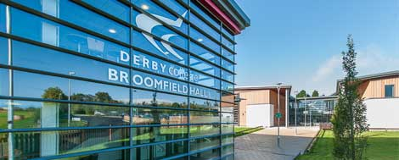
16+ Launch Assembly September 2025

Slide 2
16+ Launch Assembly September 2025
Options Post-16:
Sixth Form at The Ecclesbourne School
Sixth Form at other schools
College
Apprenticeships

Slide 3





Post-16 Options
A provider of specialist courses in engineering and health and life sciences. | A provider of a range of technical, vocational and academic courses as well as apprenticeships.
CT Skills are an apprenticeships and training provider but will talk about all apprenticeship options. | At Ecclesbourne Sixth Form you can study A-levels and some BTECs alongside extended curriculum options.

Slide 4
Key dates
Event | Date
Launch of 16+ | 23rd September
Application Letters | From September 26th; to be completed by 21st October
Post-16 Morning | 30th September
Sixth Form Open Evening | 2nd October
Interim data from staff | 24th October
First 16+ interview | 18th November
Y11 Language Mocks | 12th December
Year 11 Reports | w/b 15th December
Year 11 Mocks | 5th-16th January
Year 11 Projected Grades | w/b 9th February
Final 16+ Interviews | 10th February
Year 11 Parents’ Evening | 11th February
Letters out for Sixth Form | 27th February

Slide 5
Ecclesbourne Sixth Form Entry Requirements
General Entry Requirements:
5 GCSEs 4 – 9 (including grade 5 in English Language or Literature & Maths).
N.B. Maths, Science and Languages have Foundation and Higher tier. You can get grade 5 on both tiers. It does not matter which tier you gain your 5 on.
Subject specific entry requirements:
e.g. Biology = Combined Science: 6,6 or Separate Science grade 6 in Biology and in either Chemistry or Physics.
You will not be able to opt for a subject you have not met entry requirements for.
To take 4 A-levels/BTECs you need a GCSE average point score of at least 7.

Slide 6

A-Level Economics
Students who enjoy economics most and achieve well tend to:
Be very interested in news and current affairs
Already ask lots of questions about the economy
Want to know why big issues like economic growth or interest rates matter
Enjoy reading beyond the demands of the course
Sign up to the free FT schools subscription and find that stimulates their interest
Want to debate tricky topics like membership of trade blocs or income inequality.
This Photo by Unknown Author is licensed under CC BY-SA

Slide 7


A-Level Film Studies
Film Studies allows you to explore your love of Cinema!
Consider your answer to the following questions:
Do you enjoy watching and evaluating the impact of films?
Have you ever considered how film form, such as cinematography, contributes to the reading and deeper meaning of a film?
Have you ever thought about film as a cinematic language that communicates ethical, political, social and cultural values?
Are you interested in pursuing a future career in the fields of marketing, film production or journalism? This course gives you the opportunity to investigate how film works both as a medium of representation and an aesthetic medium.
The course is 70% exam + 30% coursework.
In Year 13, you will also make your own short film.

Slide 8
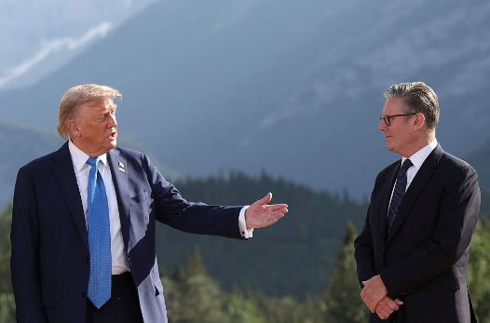


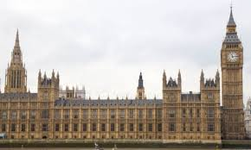

A-Level Government & Politics
UK
Parliament
PM & Executive
Laws & Constitution
Democracy
Political Parties
Electoral Systems
The media
USA
Congress
The President
Constitution
Democracy & voting behaviour
Supreme Court & Civil Rights
Political Theories
Socialism, Conservatism, Liberalism…

Slide 9


A-Level Psychology
Psychology is the SCIENCE of mind and behaviour
In Psychology we try to answer questions such as:
Why might eyewitness testimonies be inaccurate?
How can we try to reduce stress?
Why do we conform to rules and authority?
What causes depression and how should it be treated?
Which research method is best to use to investigate any given behaviour?

Slide 10


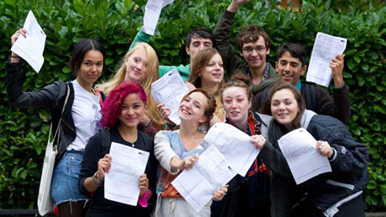
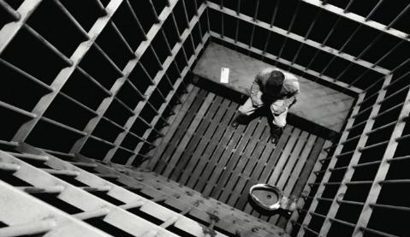

A-Level Sociology
Family and Households
How are family shapes changing?
How does this affect us?
What is the role of the family?
Is childhood toxic?
Education
Why do some groups outperform others?
Does education brainwash us?
Is the education system fair?
Why are girls more likely to pick some subjects?
Crime and Deviance
If we know it’s wrong, why do some people commit crime?
Is prison really the best form of punishment?
Can crime be a positive force?
Mass Media
Who controls our media?
How much influence do they really have?
Can the media cause violence?

Slide 11
Sixth Form Open Evening
Thursday 2nd October 6.00-8.30pm
Introductory talk at 6.30pm
Subject talks after; you can see up to six subjects, so choose wisely
There will be subject classrooms and the sixth form centre open. There will be displays and staff and students to talk to

Slide 12
Making your choices
First have a think about what you are interested in, what do you want to do career wise?
Pick a subject/s that interest you or you are good at.
Ask teachers what their subject are like at A-level.
Don’t pick them based on your friend’s choices or teachers.
When writing your letter think about why are you applying.
What skills and experiences do you have that make you stand out?
You might write about work experience, employment, volunteering, sport, music, drama or other out of school activities, etc.
This letter will be useful for applying for apprenticeships, other sixth forms, some colleges, jobs, etc. It is an important skill to learn.

Slide 13
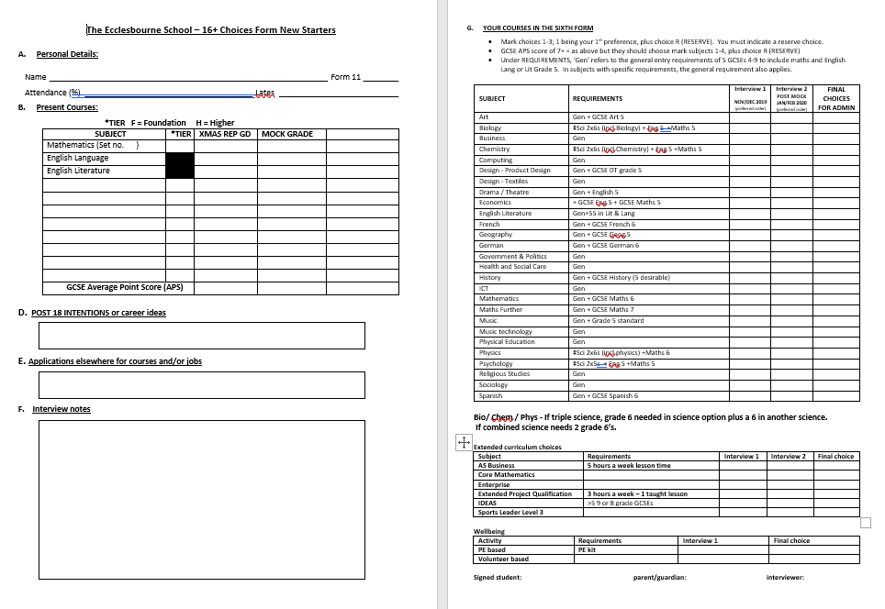
16+ Green Card

Slide 14


First 16+ Interview
On the 18th November you will meet with a member of the 16+ team where we will:
Discuss what your plans are
Check your grades meet entry requirements and subject specific requirements for your chosen route
Talk about the if your choices seem suitable based on your plans
Advise on combinations
If Sixth Form; check your extended curriculum and wellbeing choices
Top tips:
Quietly wait to be called for interview
Be smartly dressed.
Be prepared to discuss your post-16 intentions.

Slide 15

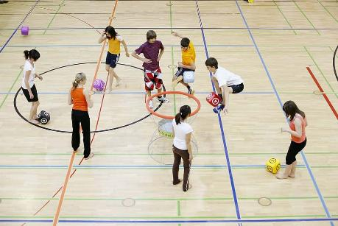



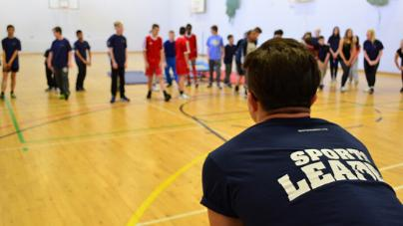

Extended Curriculum and Wellbeing
You also need to pick one option from both the extended curriculum and wellbeing options below.
You need to carefully consider the option in terms of workload and timetable commitment.
Extended Curriculum
AS Business
Core Maths
Enterprise
EPQ
IDEAS
Sports Leader Level 3 Qualification
Wellbeing
PE
Volunteering

Slide 16
Second 16+ Interview
You will be interviewed by a member of the 16+ team who will:
Check you have met entry requirements for sixth form/your chosen route
May advise you to look at back up options
If Sixth Form;
Check you have met subject specific requirements
Confirm subject choices (and check changes)
Confirm extended curriculum and wellbeing choices.
It is important that these are as accurate as possible as the timetable and staffing is decided on these. Changes will not always be possible

Slide 17
After Your Second Interview
Three possible outcomes:
You will receive an offer letter if you meet the entry requirements based on your mock grades.
If you do not meet the entry requirements you will receive non-acceptance letter and we will support you in looking at other options. You will need to make applications elsewhere if you haven’t already.
If you meet the entry requirements on GCSE results day you will be offered a place. However, some subjects may be full.
You will be planning to continue the next step of education somewhere else.

Slide 18
Preparing for Mocks
You’ve a lot of work to revise! So start early, do little and often, using resources like flashcards, revision websites and videos.
Schedule your time; include time for relaxation and hobbies.
Make revision really active; make sure you are testing your knowledge through quizzes and questions.
Focus on learning key vocabulary and terminology and ensure you use it.
Make sure you stay on top of your workload; meet deadlines for NEAs, coursework and homework.
Bring your equipment to lessons and mocks; pens, pencils, rulers, mathematical instruments, calculators, fully charged laptops etc.
Make sure you carefully read the question, what does it want you to do?

Slide 19

Careers Advisor
Every Year 11 will have a careers interview with our external careers advisor.
If needed we can organise further interviews; just speak to your form tutor, USO or the careers team.

Slide 20


Post-16 Morning
Apprenticeship Ambassador
Tuesday 30th September

Slide 21
Preparing for Post-16 Morning
What do you know already?
What would you like to find out?
Remember that you can apply to more than one option, and it is a good idea to have a back-up option.

