Slide 1

Year 9 Information Evening
Senior School
The Ecclesbourne School
24th September 2025

Slide 2

A broad and balanced curriculum that develops the knowledge and skills pupils need to thrive now and for a fulfilling future

Slide 3
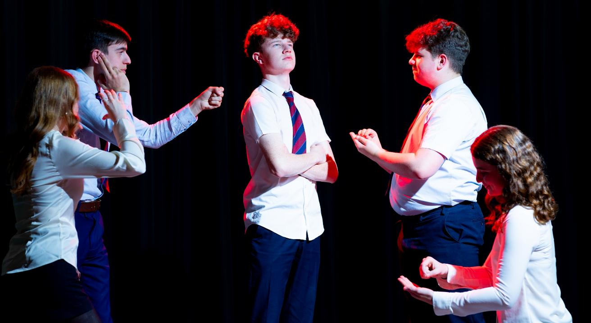
Develop pupils’ resilience and confidence in themselves and their capacity for growth

Slide 4
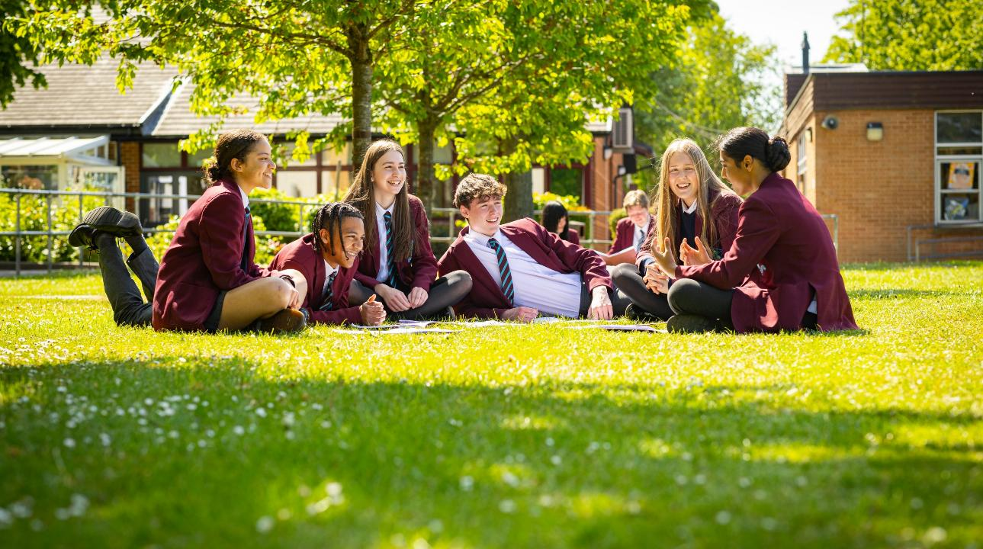
Ensure pupils feel valued, value others and learn to work together to make a positive contribution

Slide 5

Ensure pupils stay safe and healthy in mind and body

Slide 6

Develop creativity in an innovative learning environment

Slide 7
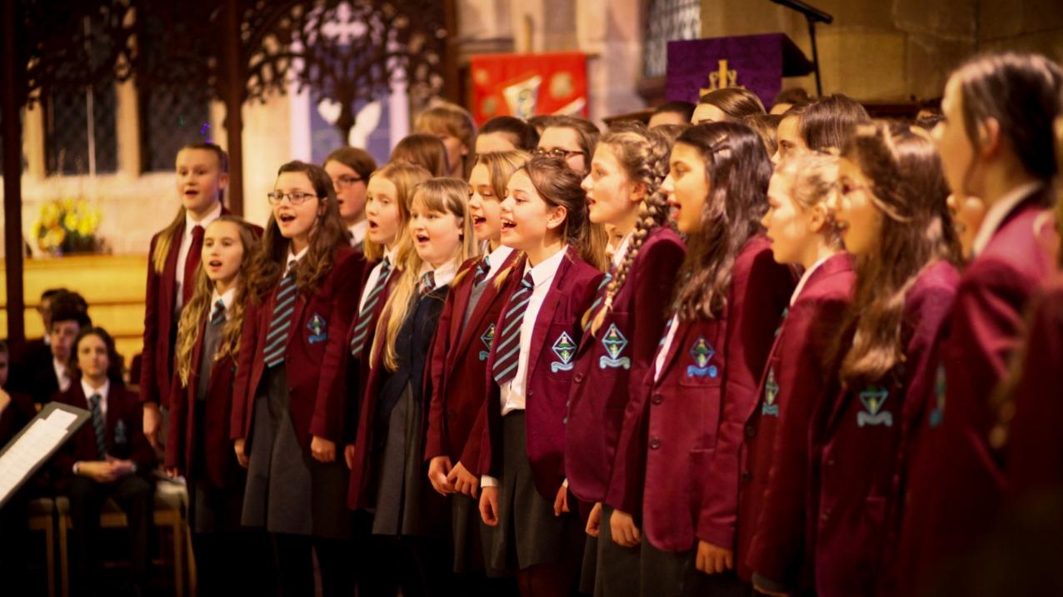
Appreciate the spiritual, moral, social and cultural richness of the world at large

Slide 8

The Ecclesbourne School strives to be a successful and caring learning community that inspires individuals to meet the challenges of the future

Slide 9

Academic Performance

Slide 10
Results - Year 11
 | 2017 | 2018 | 2019 | 2023 | 2024 | 2025
% 5 A-C (9-4) | 90 | 89 | 93 | 86 | 86 | 91
% 5A-C (9-4) EM | 86 | 84 | 91 | 84 | 82 | 83
A*- A (9-7) | 38 | 25 | 38 | 32 | 34 | 35
% A*-C EM (9-4) | 87 | 86 | 91 | 86 | 86 | 87
% A*-C EM (9-5) | 73 | 64 | 72 | 68 | 67 | 71
% Ebacc (4+) | 44 | 45 | 43 | 46 | 52 | 50
P8 | +0.2 | +0.4 | +0.6 | +0.4 | +0.46 | +0.74
A8 | 58 | 55 | 59 | 57 | 57.32 | 58.31

Slide 11

Derbyshire Ranking
87%
71%
58
9-4 inc E&M
9-5 inc E&M
Attainment 8

Slide 12

Year 9 Tutors in Senior Section
9B Mrs H Heanue
9C Ms L Mooney
9L Mrs K Goddard
9R Ms J Colgan
9E Mrs V Windle
9N Mr D Hewitt/ Mr E Swindell
9S Mrs A Street
9U Miss L Bailey
Head of Year
Mrs Emma Stott
Progress leader
Mrs Rachael Laughlin
Notes:
So who is our community? Explain about structure of school offices and breadth and depth of staff

Slide 13
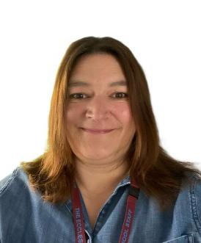
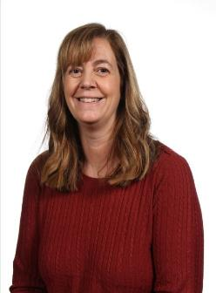
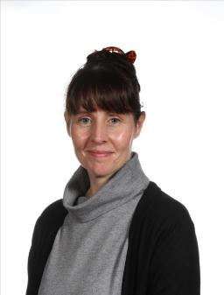
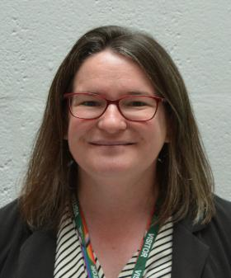
Pastoral Support Team
Mrs Laughlin
Pastoral Support
Mrs Monk
Pastoral Support and Attendance Officer​
Mrs Tanser
Pastoral Support and School Nurse​
Mrs Wiggins
SENCO

Slide 14

Year 9 Vision
A story of kindness, friendship, courage and hope.
An unlikely group of friends goes on a journey to find home.
Notes:
Where has the journey started . This Journey involves support from lots of people and determination on their part to contribute, show resilience

Slide 15
Our Values
We are a large and inclusive school community with respect and tolerance at the heart of our core values.
We expect each and every child to treat others utilising these core values.
Where a pupil’s actions fall short of expectations we will address this through a combination of sanctions and learning opportunities.
The school is proud of its excellent exam results and the progress that pupils make during their time at our school. These results and progress are a tribute to the excellent teaching and learning and the hard work of pupils.
Where a pupil impacts the learning of others then action will be taken.

Slide 16


CODE OF CONDUCT
Be respectful and avoid causing distress to others.
Always try your hardest and do your best.
Think about how you can give service and help those around you.
Work together with others to create a positive and supportive learning environment.
INTEGRITY | TENACITY | SERVICE
COURTESY
COMMUNITY
CO-OPERATION
COMMITMENT
Our theme for this term is Community
BE KIND AND THOUGHTFUL

Slide 17
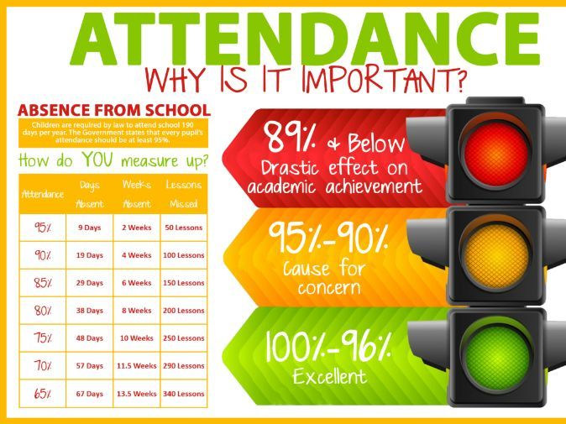


Attendance

Slide 18


Our Attendance Process
Set high expectations for attendance
Monitor data looking for patterns of absence for students and sub-groups
Maintain contact with families and follow statutory guidance' Working together to improve school attendance 2024’.
Listen and understand where problems emerge
Facilitate and formalise support to improve attendance
Liaise with the local authority

Slide 19

Personal Development
PDC curriculum
Leadership opportunities
Wider curriculum
Assemblies
Pastoral support
Our VALUES

Slide 20
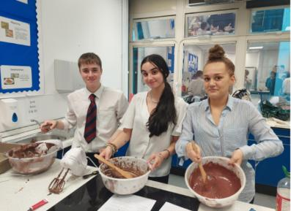
Leadership Opportunities
To get support from:
6th form
House Captains
To get involved in:
Student Council
Well-Being Ambassadors*
Anti-Bullying Ambassadors*

Slide 21

Rewards
Merits
Prize Giving
Roll of Honour
Merit/Colour Ties
Governors Awards Evening
Breakfast celebrations
Postcards home

Slide 22
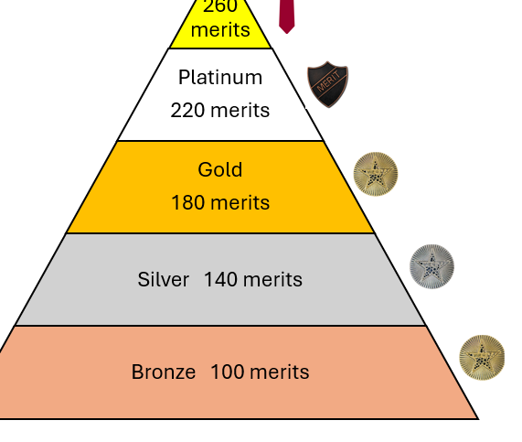
Merits & Rewards
We are still running the Merits for rewards this year! We will be offering the same rewards as last year, including:
Praise
Phone call home
Pin badges
Postcards
Rewards trips
Form breakfasts
Golden ticket early lunch pass
Merit ties

Slide 23
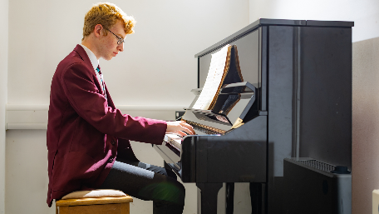

Extracurricular Activities
Sports teams and clubs
Music
Drama
House plays
Trips and Visits
And there is a wide range of subject related clubs to go to!

Slide 24
Extra curricular activities

Slide 25
Key dates (Please note these can be subject to change)
25th Sept Maths Olympiad Girls Challenge (Set 1)
26th September 2025 Prize Day
8th October community tea party
14th October WRAT (Wellbeing, Record of Achievement and Target setting) review
3rd November 2025 Whole School Closure Day
10th-13th November 2025 Hindu temple trip
17th -21st Nov GCHQ competition
26th November 2025 House Play performance
17th December Christmas Concert 2025
^{7th} Jan Enterprise day
8th Jan GCSE Options evening to parents
13th January GCSE Options To students
w/c 2nd February GCSE choices interviews
February 2025 Stars in Your Eyes.
12th Feb Half term
2nd March Parents eve BCLR
9th March Parents eve ENSU
17th March WRAT (Wellbeing, Record of Achievement and Target setting) review
20th March Interim reports issued
March – Battle of the bands
17th April 2025 Whole School Closure Day
20th April Drama evening event
22nd-26th June End of Year exams
7th July Sports day
15th July Health day
17th July Rewards trip day
w/c 20th July Full reports issued
20th -24th July Outward Bound trip
Notes:
So when does all this take place BE MINDFUL TO NOT BOOK HOLIDAYS FOR EXAM WEEK

Slide 26
Supporting your Children with Behaviour
Make sure your child has the correct equipment including: stationery, a fully charged laptop and subject specific supplies, e.g. PE kit or ingredients.
Download the Satchel One App to keep track of your child's homework. This is a great way to help them keep on top of their workload!
Ensure they arrive to school on time.
Inform the Head of Year if there is something that is worrying your child. This can stop situations escalating and support can be put in place.
Talk to your child about their behaviour as there might be an underlying reason as to why they are not adhering to the school rules.
Support the school in its behaviour decisions, pupils will thrive where everyone works together.

Slide 27
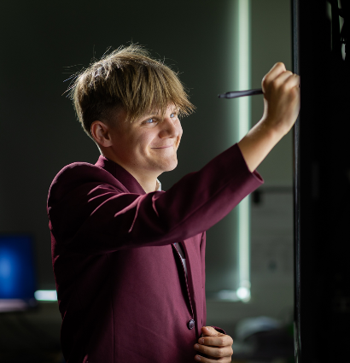
Academic Support with work
Students should talk to their subject staff.
Talk to their Head of Year or one of the wider team or their form tutor.
The library is available at lunchtimes and after school until 4.45pm.
We will also identify students throughout the year and offer them some subject specific tutoring.
We can also arrange for mentors.
Revision sessions are offered by a range of subjects as exams get closer.

Slide 28
Sanctions
To support the management of good classroom behaviour, pupils will be given a chance to correct their behaviour, but if the behaviour persists a teacher detention will be issued.
Sanctions which staff may use include: verbal reprimand; detention; a written apology or reflection; lesson removal; missing break time; extra work or repeating unsatisfactory work until it meets the required standard; or school-based community service.
Sanctions which pastoral leaders may use include: loss of privileges – for instance, the loss of a position of responsibility or not being allowed to participate in a non-uniform day or extra-curricular activity; internal seclusion; being placed “on report” for monitoring for behaviour, uniform or punctuality.

Slide 29
Strategic Leadership Team Involvement
If a pupil continues to be disruptive, is defiant to the class teacher, is unkind to another pupil or uses discriminatory language then the pupil will be removed from the classroom by a member of the Strategic Leadership Team. This will result in a significant sanction and parents/carers will be informed.
Where we continue to concerned with a child's behaviour then parents/carers will be invited into school for a meeting to discuss the concerns, and a behaviour support plan can be put in place working with everyone’s input so the plans have the best chance of succeeding.

Slide 30
The Detention System
Section 5 of the Education Act 1997 gives schools the authority to detain pupils after the end of a school session on disciplinary grounds.
Teacher Detention: 30 minutes during lunchtime or after school. Students will always be given enough time to have lunch and use the toilet.
Faculty Detention: 60 minutes after school.
SLT Detention: 60 minutes after school. This is usually held on a Thursday. These are set for serious misdemeanours and repeated failure to respond to sanctions. Parents will be informed and will be given 24-hours’ notice of an after-school detention.
For a more detailed look at our behaviour policy, please click on the link. Behaviour Policy

Slide 31
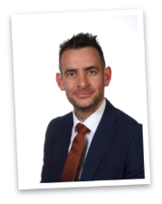

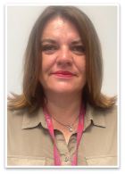
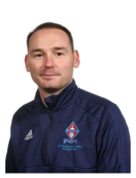
Safeguarding
Mrs C Ourabi- Senior Deputy Head and DSL
Three Deputy DSL's; Mr Quail, Mr Duncker-Brown, Mrs Weller
Have a statutory duty to implement and follow KCSIE 2025
Situations happen and school are on hand to support
Work closely with external agencies
Receive DV notifications within 24 hours

Slide 32



Chosen school charities
Show racism the red card
Padley centre
Young Minds
Notes:
Including national competitions

Slide 33
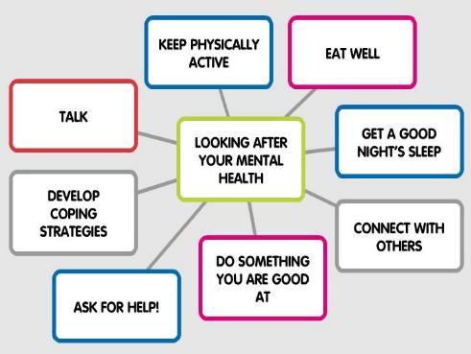


Mental Health Team
Mrs Ourabi- Trained as a Senior Mental Health Lead.
Most of Pastoral team is MHFA trained
2 Pastoral workers – Attendance and School nurse
Not experts

Slide 34


Pastoral Support

Slide 35













Resources
Ask for HELP!

Slide 36

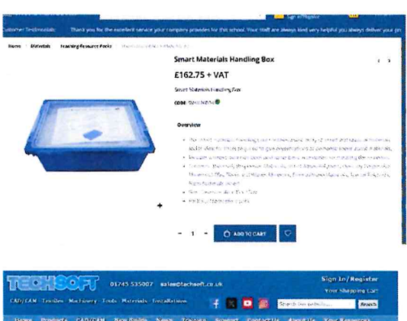

Support the PSFA

Slide 37


Support the PSFA

Slide 38
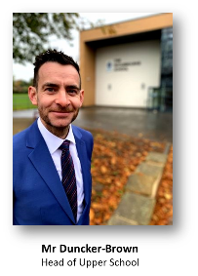
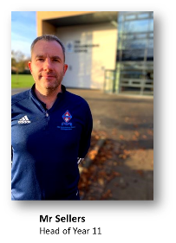
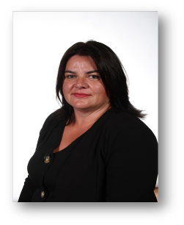
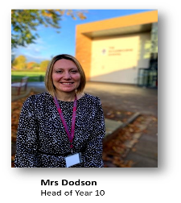
14+ process
14 + Evening
Meet Upper school team on 8th January 2026 for the post 14 options parents evening

