Slide 1

Year 7 Information Evening
Lower School Office Pastoral Team
The Ecclesbourne School
18th September 2025

Slide 2


This evening:
Vision and Aims
School Performance
School Expectations and Attendance
Personal Development
Support on offer for students

Slide 3

A broad and balanced curriculum that develops the knowledge and skills pupils need to thrive now and for a fulfilling future

Slide 4
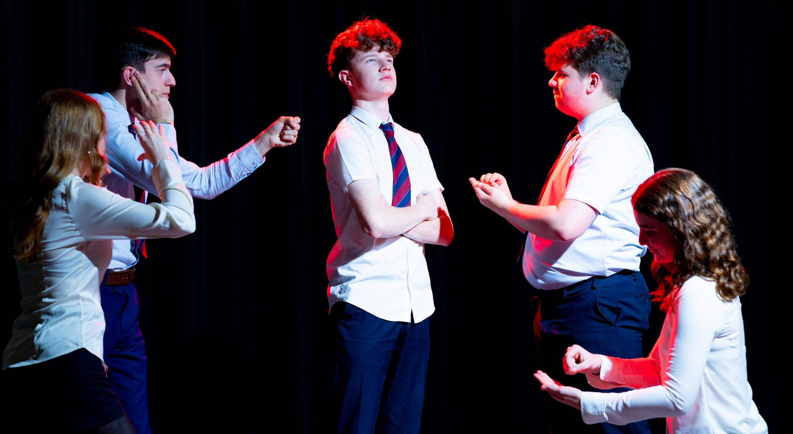
Develop pupils’ resilience and confidence in themselves and their capacity for growth

Slide 5
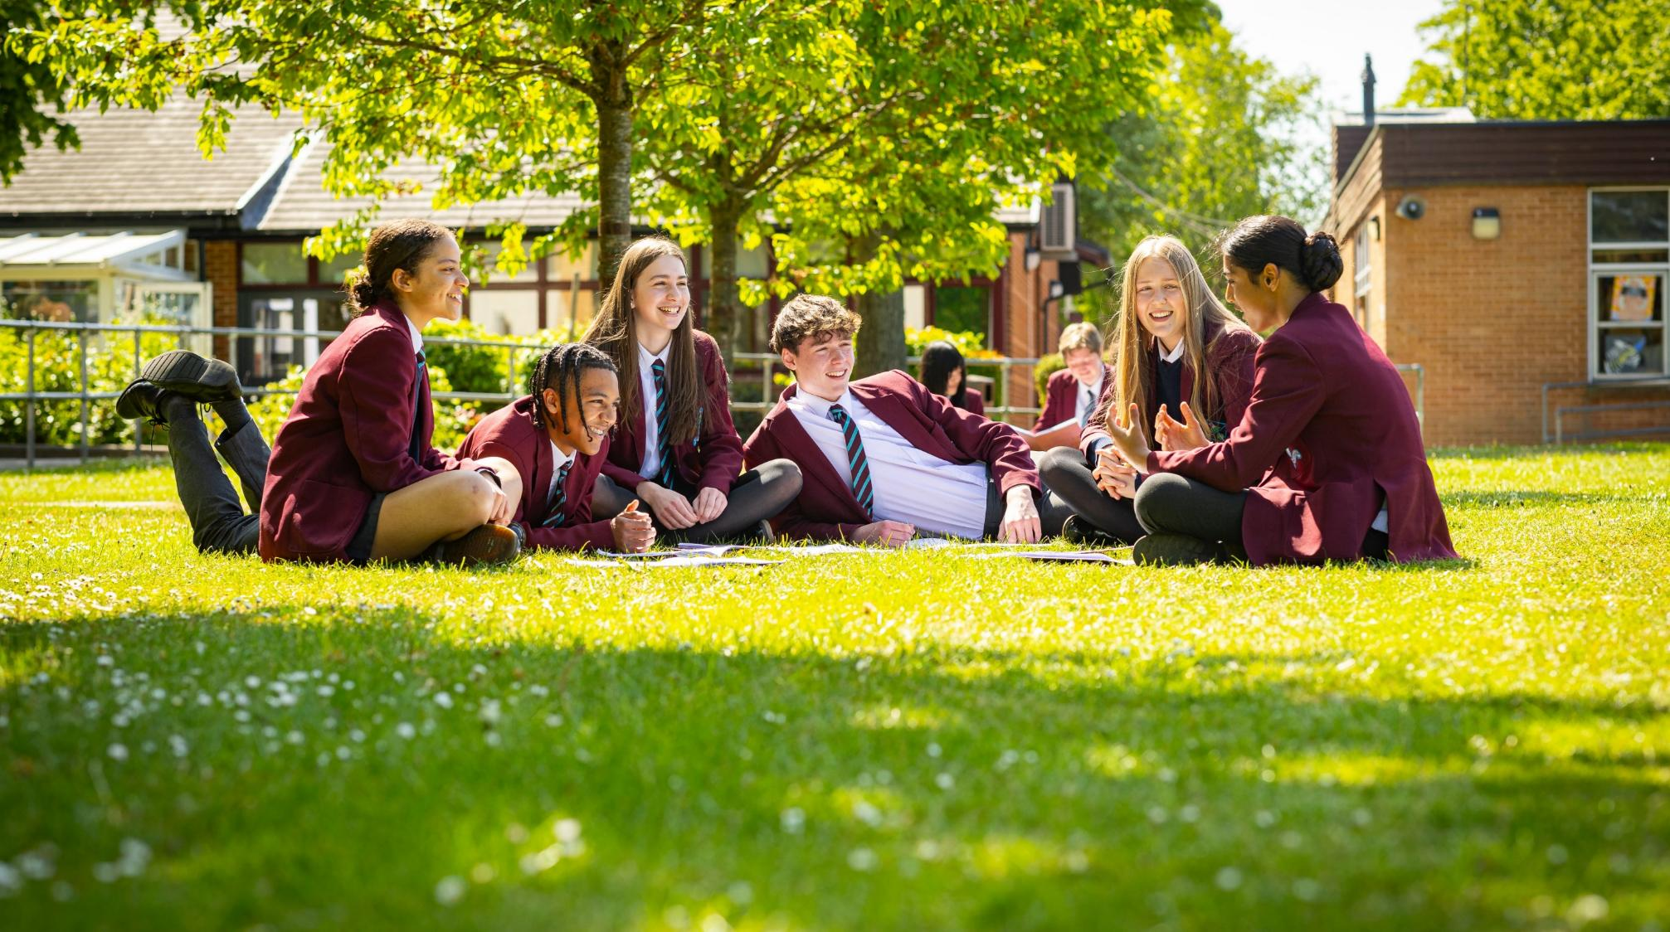
Ensure pupils feel valued, value others and learn to work together to make a positive contribution

Slide 6

Ensure pupils stay safe and healthy in mind and body

Slide 7

Develop creativity in an innovative learning environment

Slide 8
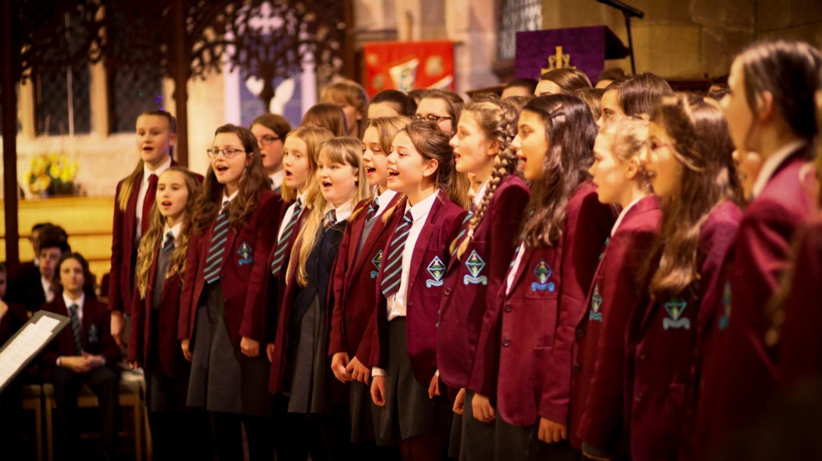
Appreciate the spiritual, moral, social and cultural richness of the world at large

Slide 9

The Ecclesbourne School strives to be a successful and caring learning community that inspires individuals to meet the challenges of the future

Slide 10

Academic Performance

Slide 11
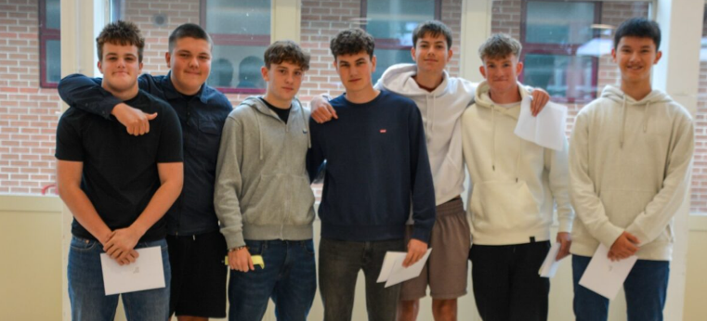

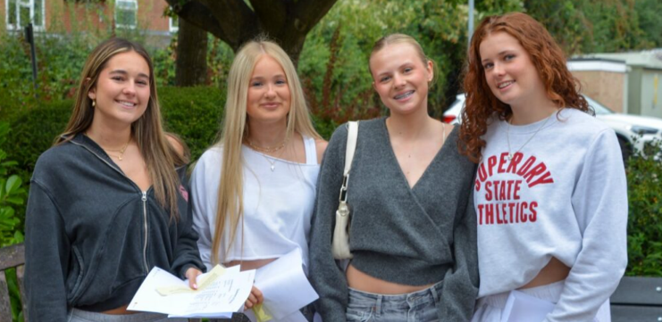
GCSE Performance

Slide 12
Results - Year 11
 | 2017 | 2018 | 2019 | 2023 | 2024 | 2025
% 5 A-C (9-4) | 90 | 89 | 93 | 86 | 86 | 91
% 5A-C (9-4) EM | 86 | 84 | 91 | 84 | 82 | 83
A*- A (9-7) | 38 | 25 | 38 | 32 | 34 | 35
% A*-C EM (9-4) | 87 | 86 | 91 | 86 | 86 | 87
% A*-C EM (9-5) | 73 | 64 | 72 | 68 | 67 | 71
% Ebacc (4+) | 44 | 45 | 43 | 46 | 52 | 50
P8 | +0.2 | +0.4 | +0.6 | +0.4 | +0.46 | +0.74
A8 | 58 | 55 | 59 | 57 | 57.32 | 58.31

Slide 13

Derbyshire Ranking
86%
67%
57
9-4 inc E&M
9-5 inc E&M
Attainment 8

Slide 14
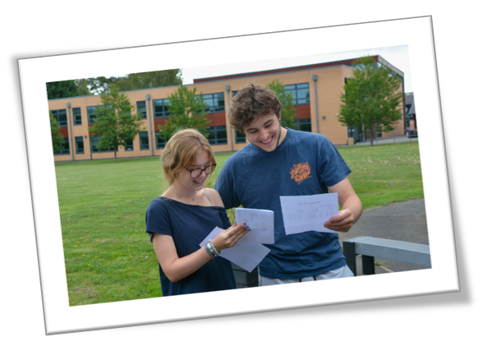

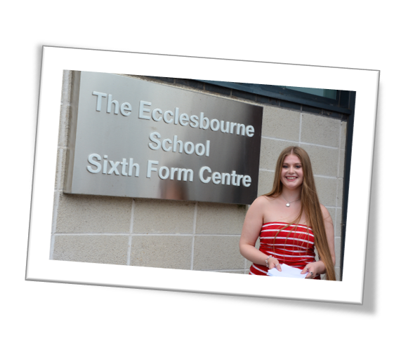
A-Level Performance

Slide 15
Results - Year 13
 | 2013 | 2014 | 2015 | 2016 | 2017 | 2018 | 2019 | 2020 | 2021 | 2022 | 2023 | 2024 | 2025
Students | 164 | 153 | 170 | 168 | 158 | 151 | 167 | 154 | 165 | 194 | 191 | 205 | 172
A*- C | 82 | 83 | 81 | 82 | 83 | 86 | 81 | 89 | 90.6 | 89 | 80 | 81 | 85
A*- B | 61 | 62 | 60 | 62 | 61 | 63 | 60 | 69 | 74 | 72 | 60 | 59 | 65
A*-A | 32 | 36 | 29 | 32 | 31 | 32 | 32 | 38 | 53 | 39 | 30 | 30 | 35
A* | 11 | 14 | 8 | 11 | 10 | 12 | 9 | 13 | 26.6 | 13 | 11 | 10 | 11

Slide 16
Year 7 Tutors
7E Mr Newcombe
7C Miss Williams
7L Miss Royal
7B Mrs Pestell
7N Mrs Pearce
7R Mrs Cooper
7S Ms Le Croisette
7U Mr Booth

Slide 17
Key dates (Please note these can be subject to change)
11th September 2025 Y7 Photographs
Week commencing 15th September Reading and Writing tests
24th September Mini Olympics
26th September 2025 Prize Day
7th October- Parents Evening BCLR
14th October Parents Evening ENUS
14th October 2025 WRAT (Wellbeing, Record of Achievement and Target setting) review process
3rd November 2025 Whole School Closure Day
21st November Children in Need Non-Uniform Day
27th November 2025 House Plays evening performance
Interim reports will be issued in the week beginning 8th December 2025
8th and 9th December Drama Trip Derby Playhouse
10th December St Alkmunds Christmas Carol Concert.
10th December Student Christmas Lunch
16th December 1.30pm-4.30pm Opportunity to meet the tutors
17th December Christmas Concert
19th December Year 7 Christmas Concert
10th February 2026 Stars in Your Eyes
12th February –Lower school spoken English semi-final.
17th March 2026 WRAT
20th March Interim Grades and Non-uniform day
15th April- Spring Concert
17th April Whole School Closure Day
8th June Year 7 reports to parents
Week beginning 22nd June- Lincoln Trip
Week commencing 6th July Whole School Production
7th July Sports Day
17th July Rewards Trips

Slide 18


CODE OF CONDUCT
Be respectful and avoid causing distress to others.
Always try your hardest and do your best.
Think about how you can give service and help those around you.
Work together with others to create a positive and supportive learning environment.
INTEGRITY | TENACITY | SERVICE
COURTESY
COMMUNITY
CO-OPERATION
COMMITMENT
Our theme for this term is Community
BE KIND AND THOUGHTFUL

Slide 19
Our Values
We are a large and inclusive school community with respect and tolerance at the heart of our core values.
We expect each and every child to treat others utilising these core values.
Where a pupil’s actions fall short of expectations we will address this through a combination of sanctions and learning opportunities.
The school is proud of its excellent exam results and the progress that pupils make during their time at our school. These results and progress are a tribute to the excellent teaching and learning and the hard work of pupils.
Where a pupil impacts the learning of others then action will be taken.

Slide 20
Sanctions
To support the management of good classroom behaviour, pupils will be given a chance to correct their behaviour, but if the behaviour persists a teacher detention will be issued.
Sanctions which staff may use include: verbal reprimand; detention; a written apology or reflection; lesson removal; missing break time; extra work or repeating unsatisfactory work until it meets the required standard; or school-based community service.
Sanctions which pastoral leaders may use include: loss of privileges – for instance, the loss of a position of responsibility or not being allowed to participate in a non-uniform day or extra-curricular activity; internal seclusion; being placed “on report” for monitoring for behaviour, uniform or punctuality.

Slide 21
Strategic Leadership Team Involvement
If a pupil continues to be disruptive, is defiant to the class teacher, is unkind to another pupil or uses discriminatory language then the pupil will be removed from the classroom by a member of the Strategic Leadership Team. This will result in a significant sanction and parents/carers will be informed.
Where we continue to concerned with a child's behaviour then parents/carers will be invited into school for a meeting to discuss the concerns, and a behaviour support plan can be put in place working with everyone’s input so the plans have the best chance of succeeding.

Slide 22
The Detention System
Section 5 of the Education Act 1997 gives schools the authority to detain pupils after the end of a school session on disciplinary grounds.
Teacher Detention: 30 minutes during lunchtime or after school. Students will always be given enough time to have lunch and use the toilet.
Faculty Detention: 60 minutes after school.
SLT Detention: 60 minutes after school. This is usually held on a Thursday. These are set for serious misdemeanours and repeated failure to respond to sanctions. Parents will be informed and will be given 24-hours’ notice of an after-school detention.
For a more detailed look at our behaviour policy, please click on the link. Behaviour Policy

Slide 23
Supporting your Children with Behaviour
Make sure your child has the correct equipment including: stationary, a fully charged laptop and subject specific supplies, e.g. PE kit or ingredients.
Download the Satchel One App to keep track of your child's homework. This is a great way to help them keep on top of their workload!
Ensure they arrive to school on time.
Inform the Head of School/Year if there is something that is worrying your child. This can stop situations escalating and support can be put in place.
Talk to your child about their behaviour as there might be an underlying reason as to why they are not adhering to the school rules.
Support the school in its behaviour decisions, pupils will thrive where everyone works together.

Slide 24

Rewards
Merits
Prize Giving
Roll of Honour
Merit/Colour Ties
Governors Awards Evening

Slide 25
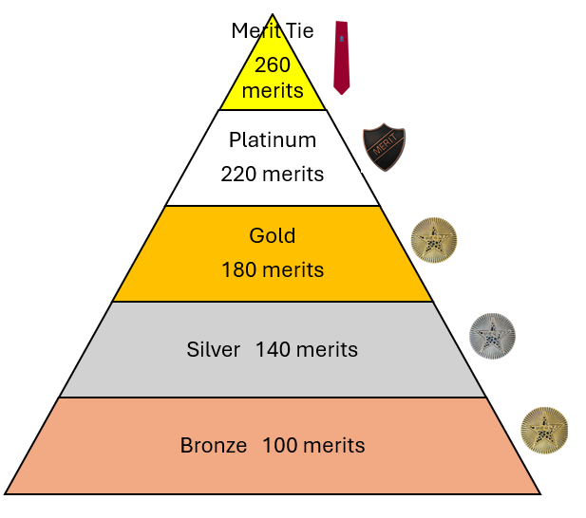
Merits & Rewards
We are still running the Merits for rewards this year! We will be offering the same rewards as last year, including:
Praise
Phone call home
Pin badges
Postcards
Rewards trips
Form breakfasts
Golden ticket early lunch pass
Merit ties

Slide 26
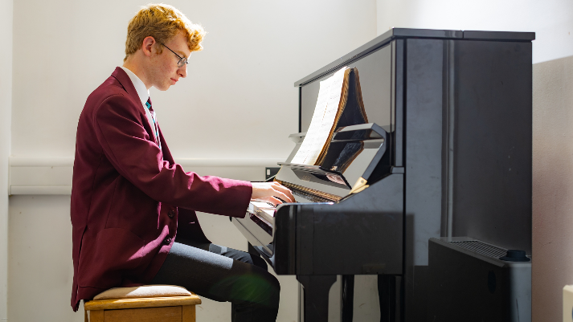

Extracurricular Activities
Sports teams and clubs
Music
Drama
House plays
Duke of Edinburgh
Trips and Visits
And there is a wide range of subject related clubs to go to!

Slide 27
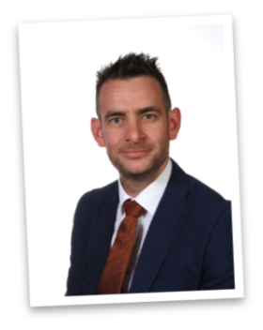

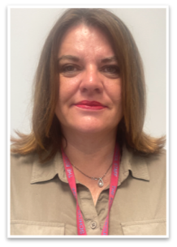
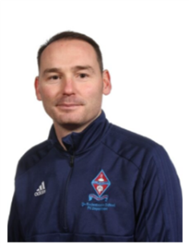
Safeguarding
Mrs C Ourabi- Senior Deputy Head and DSL
Three Deputy DSL's; Mr Quail, Mr Duncker-Brown, Mrs Weller
Have a statutory duty to implement and follow KCSIE 2025
Situations happen school are on hand to support; we are not here to pry
Work closely with external agencies
Receive DV notifications within 24 hours

Slide 28
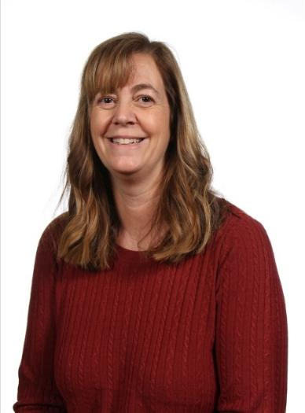
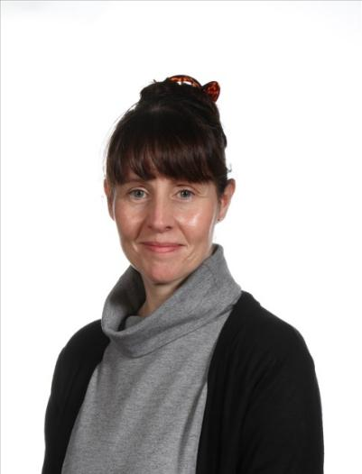
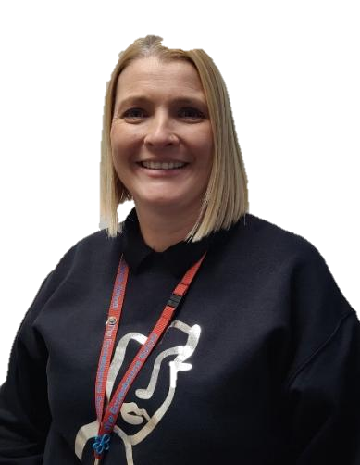
Pastoral Support Team
Mrs Parry
Pastoral Support
Mrs Monk
Pastoral Support and Attendance Officer​
Mrs Tanser
Pastoral Support and School Nurse​

Slide 29
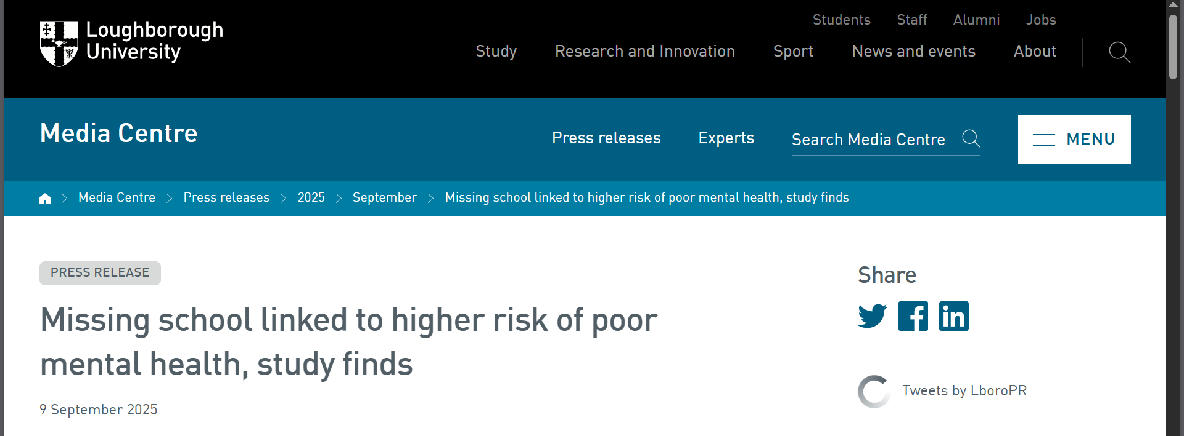
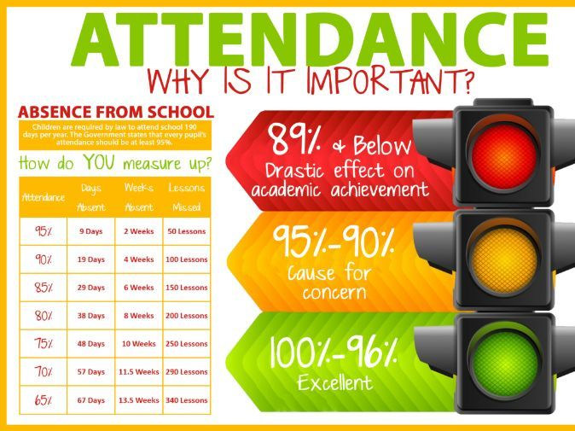

Attendance

Slide 30


Our Attendance Process
Set high expectations for attendance
Monitor data looking for patterns of absence for students and sub-groups
Maintain contact with families and follow statutory guidance' Working together to improve school attendance 2024’.
Listen and understand where problems emerge
Facilitate and formalise support to improve attendance
Liaise with the local authority

Slide 31

Personal Development
PDC curriculum
Leadership opportunities
Wider curriculum
Assemblies
Pastoral support
Our VALUES

Slide 32
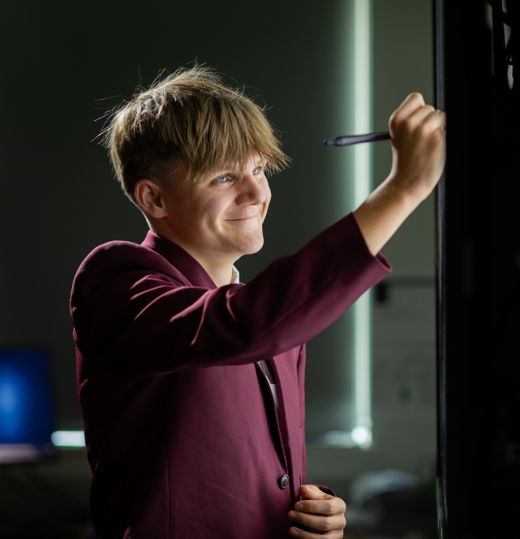
Academic Support with work
Students should talk to their subject staff.
Talk to Lower School Office; i.e. their Head of Year or one of the wider team or their form tutor.
The library is available at lunchtimes and after school until 4.45pm.
We will also identify students throughout the year and look at how we can support them

Slide 33
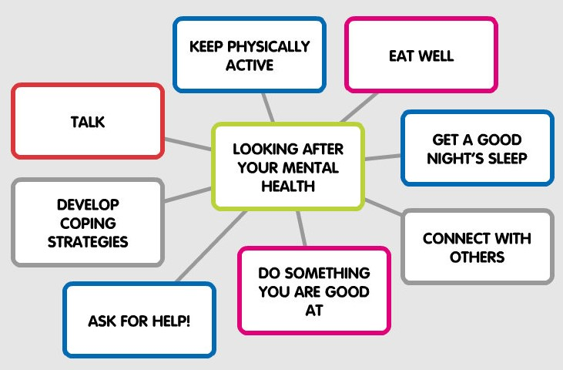


Mental Health Team
Mrs Ourabi and Mr Quail are Trained as a Senior Mental Health Leads
Most of Pastoral team is MHFA trained
2 Pastoral workers – Attendance and School nurse
Not experts

Slide 34


Pastoral Support

Slide 35













Resources
Ask for HELP!

Slide 36

What do we do?

Slide 37





How do we fund raise?

