Slide 1


Year 12 Information Evening
Sixth Form team
The Ecclesbourne School
23rd September 2025

Slide 2


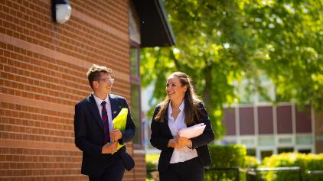

This evening:
Vision and Aims
School Performance
Key Year 12 dates, expectations and opportunities.
Post-18 preparation.
Wellbeing.
Keeping safe online.
Independent learning and how to support your children.

Slide 3

A broad and balanced curriculum that develops the knowledge and skills pupils need to thrive now and for a fulfilling future

Slide 4
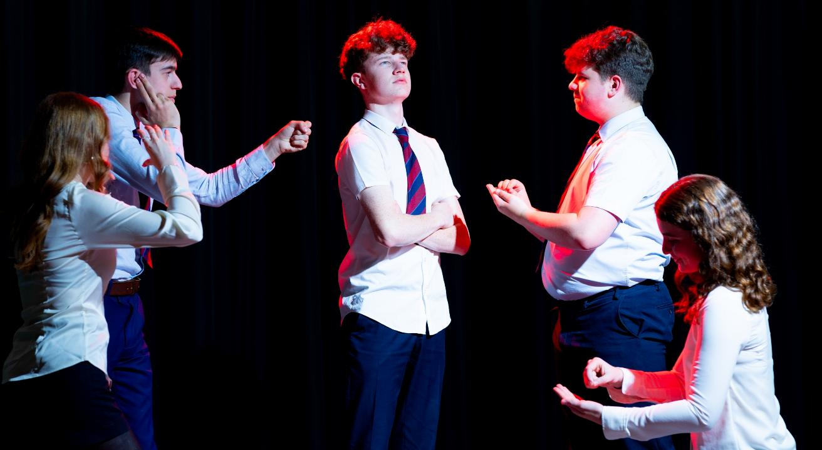
Develop pupils’ resilience and confidence in themselves and their capacity for growth

Slide 5

Ensure pupils feel valued, value others and learn to work together to make a positive contribution

Slide 6

Ensure pupils stay safe and healthy in mind and body

Slide 7
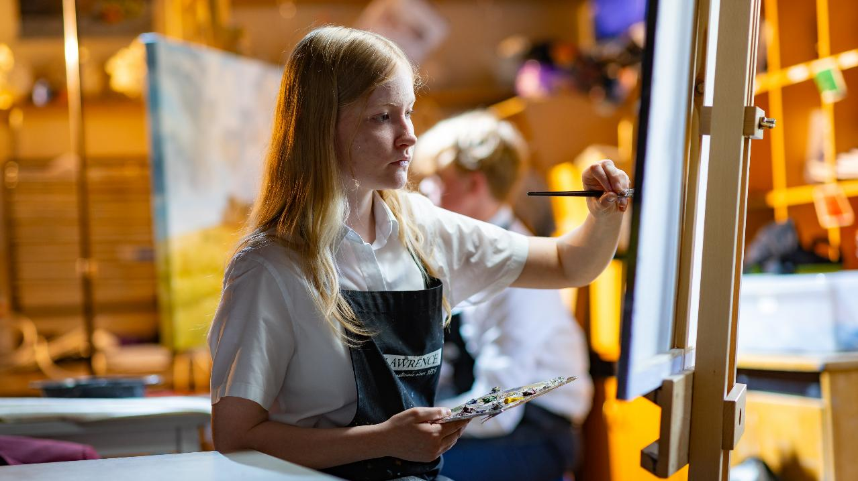
Develop creativity in an innovative learning environment

Slide 8

Appreciate the spiritual, moral, social and cultural richness of the world at large

Slide 9

The Ecclesbourne School strives to be a successful and caring learning community that inspires individuals to meet the challenges of the future

Slide 10

Academic Performance

Slide 11
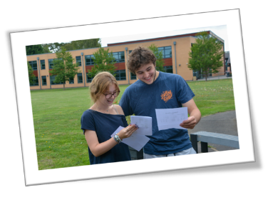

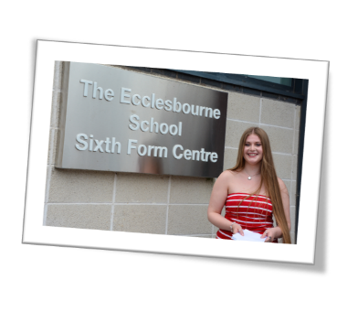
A-Level Performance

Slide 12
Results - Year 13
 | 2013 | 2014 | 2015 | 2016 | 2017 | 2018 | 2019 | 2020 | 2021 | 2022 | 2023 | 2024 | 2025
Students | 164 | 153 | 170 | 168 | 158 | 151 | 167 | 154 | 165 | 194 | 191 | 205 | 172
A*- C | 82 | 83 | 81 | 82 | 83 | 86 | 81 | 89 | 90.6 | 89 | 80 | 81 | 85
A*- B | 61 | 62 | 60 | 62 | 61 | 63 | 60 | 69 | 74 | 72 | 60 | 59 | 65
A*-A | 32 | 36 | 29 | 32 | 31 | 32 | 32 | 38 | 53 | 39 | 30 | 30 | 35
A* | 11 | 14 | 8 | 11 | 10 | 12 | 9 | 13 | 26.6 | 13 | 11 | 10 | 11

Slide 13
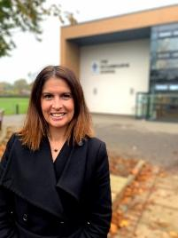
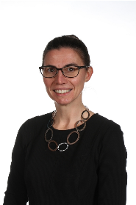
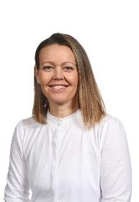
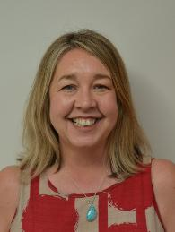
Sixth form Pastoral Team
Mrs Weller
Head of Sixth Form
Mrs Hadwin
Head of Year 12
Mrs Bamber
Head of Year 13
Mrs Cox
Administration/
Admissions Lead

Slide 14
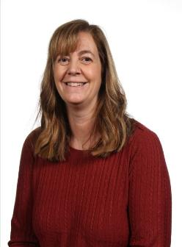
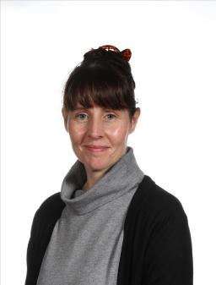
Pastoral Support Team
Mrs Monk
Pastoral Support and Attendance Officer​
Mrs Tanser
Pastoral Support and School Nurse​

Slide 15
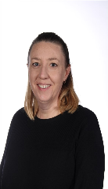
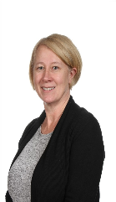
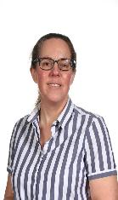

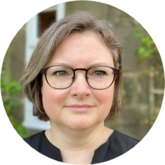
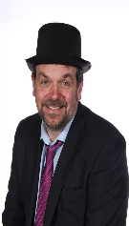

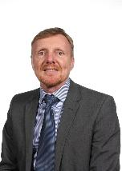
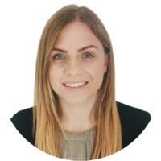

Year 12 Tutors
12C Dr Gregory
12D Mrs Rafferty/Mr Dickson
12G Mrs Daly
12H Mrs Wilden/Ms Rankin
12J Mrs Smith
12P Dr Page
12S Miss Short/Ms Boden
12W Mr Walton

Slide 16
Form time and Pastoral Education
PDC on Tuesdays; students learn about a range of areas including finance, health, drugs, online safety and healthy relationships. This is in PDC groups of mixed forms (carousel).
2 assemblies a week; on a range of issues, e.g. consent, diversity, wellbeing, kindness, climate change and global issues.
Homework is set via Show My Homework/Satchel One.
Uniform-help us to help your child.

Slide 17
Routines
Money for food - £5 limit on thumbs. Can use card or cash for other purchases or as parents you can increase your child's daily limit by emailing TinaSpencerKeyse@ecclesbourne.derbyshire.sch.uk
Forms for driving – no lessons in registrations, PDC or lessons. Other forms explained in welcome pack on the school website.
Cars- must be registered with SFO and a badge be collected to help identify cars and support students with any issues.

Slide 18
Key dates
Prize Day - 26th September
6th form open evening – 2nd October volunteers needed and spread the word
Community Tea party – 8th October
Year 12 Parents’ Evening - 23rd October 2025
House play evening performance – Wed 26th November 2025
Driver awareness day – 12th February 2026
Year 12 careers trip – 10th March
Post 18 Day and Parents information evening 19th March 2026
Year 12 reports 12th March 2026
Year 12 work experience week 27th April 2026
Year 12 mock exams 22nd June 2026

Slide 19



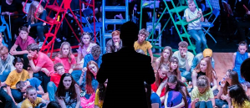
Enrichment Opportunities
In Sixth Form there are many exciting enrichment opportunities to get involved with
Duke Of Edinburgh​
Debate ​
Sixth Form Sport events/teams​
Shine media ​
School Gym​
Community Ambassador events
Choir ​
Mock Trial ​
Book club
Drama productions
Music concerts
Sports teams
House plays

Slide 20

Posts of Responsibility
Co-Heads
House captains
Student Council member
Anti-Bullying Ambassadors
Well-Being Ambassadors
Diversity Leaders
Peer Mentors
Subject Mentor
Buddy Readers
Lesson Support
Community Ambassadors​
Everyone is also a prefect: This involves monitoring an area of the school for half a lunch time each week and is a way of giving back to the school. Remember as a Sixth Former, you are a role model to all other students in our school. ​
​

Slide 21
Roles in Sixth Form
Most students in Sixth Form have 1 or more extra roles and these provide extra talking points for applications in the future making them important for:​
University applications​
Apprenticeship applications​
Part-time job applications​
Development of important life skills ​
Leadership, communication, teamwork, organisation etc.​
They are also great fun and rewarding opportunities to be involved in!

Slide 22
Student comments April 2024
I got to see the cases the vets were presented with, and how they diagnosed the patient
I really enjoyed working with robots as it involved a lot of problem solving and coding.
Getting to do proper work that an employee would do.
Enjoyable and never a dull moment.
The insight it gave me in to pursuing a career in this field .
Getting to see all the interconnectivity between university departments and all the amazing work the people were doing there.
Meeting lots of new people and finding out about all their jobs . It helped me develop my communication skills.

Slide 23
Bursary
With the expense that can sometimes come with Level 3 study, such as trips and equipment and materials families can struggle.
If you have any concerns, please do look at the bursary section on the website as we have a budget each year which is used to help those who need it.

Slide 24

Behaviour and the Four Cs
From the School’s Policy:
“If we are to create a community in which high quality learning can take place and all of its members can work happily together, an atmosphere of good order is vital. School rules and procedures exist to foster this ethos but students are also encouraged to develop self-discipline and consideration for others.”

Slide 25
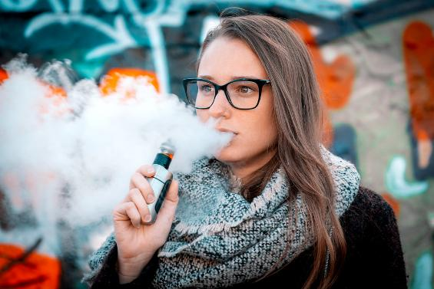
VAPING
If any Year12/13 is caught vaping on the school site or in uniform in our local community, they will be suspended. Please talk to your son/daughter regarding this.
All students have been reminded of this.

Slide 26

Behaviour-We owe it to students to have high expectations
Need to avoid low-level distractions:
  Uniform issues.
  Missing equipment.
  Late to lesson.
Use of offensive language.
Social media related issues.
This doesn’t work without all of us working together.
Thanks for your support so far.
Home
School
Student

Slide 27


Merits-recognising excellence in all of its forms
Awarded for:
  Outstanding work
  Consistently high standards of work
  Consistent effort in lessons
  Improvements in standards of work/behaviour/attendance
  Attendance to sports and other clubs
  Community support
  Involvement in School activities

Slide 28

Rewards
Form breakfasts
Golden ticket early lunch pass
Prize Giving
Reward trips
Roll of Honour
Merit/Colour Ties
Governors Awards Evening
Great personal references for jobs, apprenticeships and UCAS

Slide 29
What does a 6th form students study plan look like?
5 hours a week per subject outside of lesson.
They have between 5-7 study periods in school that they need to use effectively.
We will encourage them to get started well and use time efficiently.
Home study will be vital for them to be able to meet our expectations and therefore cope with the transition to Level 3 qualifications.

Slide 30
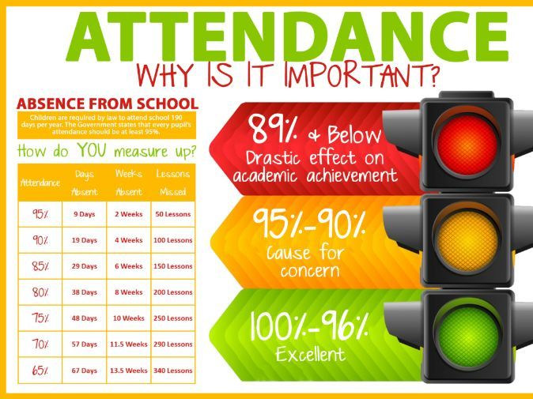
Attendance; changes for 25-26

Slide 31
New government expectations and our policy
The government's expectation have been raised and more powers are being given to schools to enforce attendance.
Anything less than 90% is considered persistent absence and more than 10 sessions in 10 weeks allows the school to fine.
We are a full-time establishment, which allows us to give students the best possible experience and opportunities.
If attendance in 6th form is lower than expected, a student will enter our support programme.
We know there are exceptional circumstances and we will always work with you to support your child.

Slide 32
Stages
Stage 1 – a letter home to share concerns and a meeting with student.
Stage 2 – further meeting and student placed on attendance report and will lose privilege of leaving site at lunch and early at the end of the day
Stage 3 – letter home to invite parents in for meeting to address issues and plan support actions to help.
Stage 4: Meeting with parents and Head of Sixth form and Education Welfare Officer and written warning given
Stage 5: meeting with head teacher and risk of removal from 6th Form at school. Local authority to be informed.

Slide 33
Post 18 Support programme
 | Current Year 12 | Current Year 13 | Year round
September | Access to Oxbridge event with former students. Med Society Introduction | UCAS application support. | Careers advisor appointments. Apprenticeship application support. Reference writing for jobs. CV support Access to Unifrog Speakers from: Sheffield University Sheffield Hallam University. Nottingham University. Ask apprenticeships / EMA Training. Bristol University Medicine Alumni talks (apprenticeships and university) Virtual work experience
October | Super curricular launch: MOOCS Online work experience Super curricular reading | Early Entry deadline October
November |  | UCAS application support.
December
January | Using Unifrog for Post 18 | Final UCAS deadline January 2025
February |  | Financial survival skills, student loans, budgeting, keeping finances safe. Study skills Apprenticeship application support. Support for late UCAS applications.
March | Investigating all Post-18 options Personality and skills profiling What career/What Uni visit Post 18 Day 2025
April | Work experience preparation Work experience
May | Employability skills – Interviews, CVs, common questions for online applications, LinkedIn, Networking and online reputation Assessment day activity
June | Examinations | Examinations
July | Early Entry application process begins. Personal statement writing support.
August |  | A level results Support available from SFO

Slide 34

Year 12 Work Experience
Aim for every student to attend
Aim is to be more “work ready” and to bridge the gap between academic studies and the world of work.
Monday 27th April to Friday 1st May 2026
Can begin to look now
Once a placement is found the student registers the application for work experience on Unifrog (further details to follow in a Parent letter which will be sent shortly with your own log in so you can support your child.)

Slide 35
Sixth Form Work Experience.
Purpose -
to be more “work ready” and to bridge the gap between your academic studies and the world of work.
When does it happen -
Week beginning 27th April 2026
Or
During a school holiday
Virtual work experience (in addition to face-to-face)
The length of the work experience placement may vary.

Slide 36
What career area are you most interested in?
What skills do you need to work in this career area?
Research appropriate placements
Write to /call places requesting a placement
When you get a confirmation, reply. And thank them!
Electronic form + parental consent.
If you have no specific career area in mind, think of a job area where you could best develop useful, transferrable skills.
This will, hopefully, be closely linked to your A level choices.
Speak to Mrs Parker or Mrs Earp for help sourcing placements.

Slide 37

Unifrog brings into one place every undergraduate university course, apprenticeship, and college course in the UK, as well as other opportunities, such as School Leaver Programmes, MOOCs and every college at Oxford and Cambridge. This makes it easy for students to compare and choose the best university courses, apprenticeships or further education courses for them.
They can also explore exciting opportunities further afield by looking at English taught undergraduate programmes available in Europe and the USA.
Additionally, the platform helps students successfully apply for these opportunities when writing their UCAS personal statement, applications and CVs and guiding them through the process, allowing teachers to give live feedback.
Parent login reminders and guidance for parents of students new to Ecclesbourne will be emailed out before half term.

Slide 38
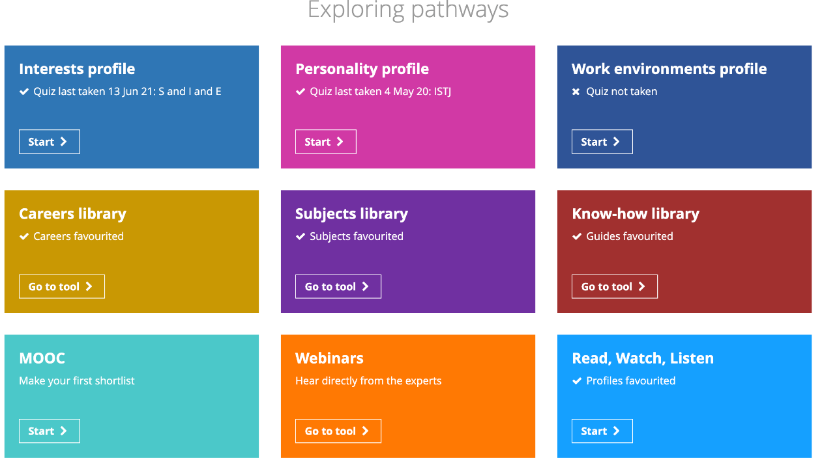

Slide 39
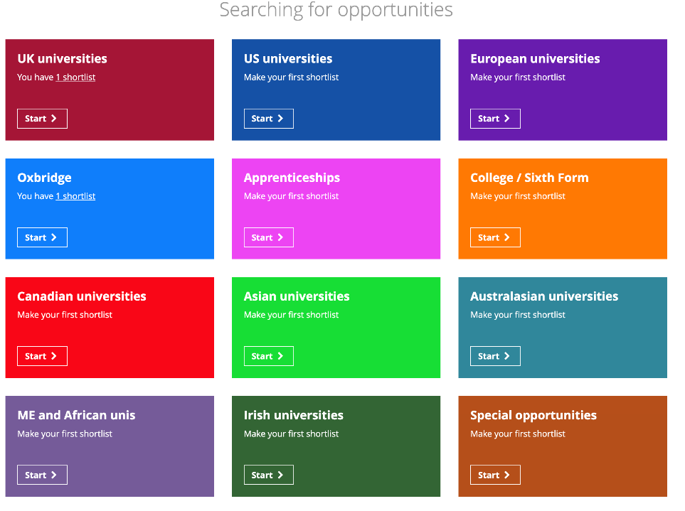

Slide 40

Super curricular exploration
MOOCs
MOOCs are massive , open, online courses. Unifrog brings together lots of courses at universities around that world that you can search by subject. Most are free but you may need to pay for a certificate at the end of the course, if you want one.
www.mooc.org/courses
Virtual work experience
https://www.springpod.com/virtual-work-experience/search
https://www.speakersforschools.org/vwex/
Sites offering excellent Insight days and virtual work experience.

Slide 41



Super curricular exploration
Each subject has books, magazines and journals they can recommend to students.
The subject library in unifrog has a ‘geek out’ section.
The School librarian can offer support with recommendations.

Slide 42
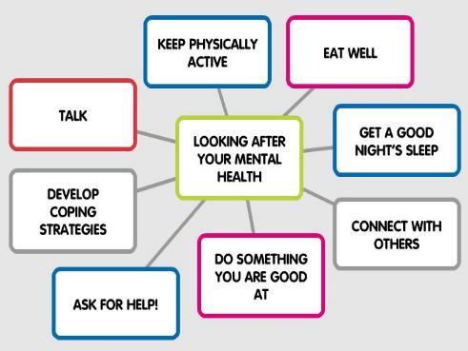


Mental Health Team
Mrs Ourabi- Trained as a Senior Mental Health Lead.
Most of Pastoral team is MHFA trained
2 Pastoral workers – Attendance and School nurse
Not experts

Slide 43

WHERE TO
FIND ADVICE
AND SUPPORT
How you feel matters and you deserve to feel supported. If you’re worried about how you’re feeling, speak to an adult you trust. You are not alone and support is available.
Trusted adult
Speak to:
If you want to understand more about looking after your mental health, YoungMinds has practical tips from young people, advice on feeling and conditions, as well as information on getting the support you need.
For help and advice, visit youngminds.org.uk
Form teachers
Well-being ambassadors
Heads of Year
Pastoral staff
Welfare Hub
Peer support
Toot toot

Slide 45











Resources
Ask for HELP!

Slide 46








Derbyshire 24/7 mental health support line on 0800 028 0077

Slide 47


External Support
Get in touch with our Parents Helpline
Our Parents Helpline offers vital advice and guidance to parents/carers who are concerned about their child’s mental health.
We can give you advice on:
how to access support
navigating services for your child
practical techniques that can help you and your child
signposting to other organisations
If you are a parent/carer in need of some help, please get in touch.
Derbyshire Mental Health Support Line
Derbyshire Mental Health Support Line tel: 0800 028 0077. Mental health support line for Derbyshire people of all ages. Open 24 hours per day, 7 days per week.

Slide 48


More external resources
provides free, safe and anonymous mental health and emotional well-being online support for young people aged 11 to 25.
offers free online counselling and emotional wellbeing support for parents and carers of young people.

Slide 49

Reach out to an adult or someone you trust. This could be a relative, a teacher or a friend.
Or contact your local GP, school nurse or other health/social care professional.
There are also lots of other people who want to listen. You could contact:
ChildLine: www.childline.org.uk 0800 1111 (call, email, text chat, message boards)
Samaritans: www.samaritans.org 116 123 (call, email, letters)
Visit Kooth: www.kooth.com for anonymous online counselling support
Text SHOUT to 85258 for 24/7 text support.
Young Minds: www.youngminds.org.uk text YM to 85258 for 24/7 text support.
Papyrus: www.papyrus-uk.org / HOPELINEUK 0800 0684141 (9am to midnight, including weekends and bank holidays) a confidential support and advice service for:
  Children and Young People under the age of 35 who are experiencing thoughts of suicide
  Anyone concerned that a young person could be thinking about suicide
  You can also text 07860 039 967 or email pat@papyrus-uk.org
  You can also ring the Derby 24/7 mental health support line on 0800 028 0077

Slide 50
Supporting your child
https://www.barnardos.org.uk/support-hub/emotional-wellbeing – a dedicated service to help children, young people and their families or carers with problems caused by the coronavirus outbreak.
https://www.youngminds.org.uk/parent/parents-helpline-and-webchat
- If you're concerned about a child or young person's mental health, you can get free, confidential advice via phone, email or webchat
https://www.actionforchildren.org.uk/our-work-and-impact/children-and-families/good-mental-health/
- has lots of tips to help you spot signs of mental health issues in children and advice on the action you can take to help.

Slide 51
https://www.nhs.uk/nhs-services/mental-health-services/mental-health-services-for-young-people/children-young-people-mental-health-services-cypmhs/
Children and young people’s mental health services (CYPMHS) is used as a term for all services that work with children and young people who have difficulties with their mental health or wellbeing.
https://www.trentpts.co.uk/
Provide a range of evidence-based treatment, to support different mental health challenges. These include Counselling, Cognitive Behavioural Therapy
https://www.beateatingdisorders.org.uk/
Support for a child or young person with an eating disorder.

Slide 52
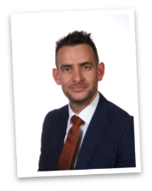

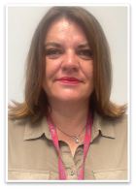
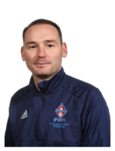
Safeguarding
Mrs C Ourabi- Senior Deputy Head and DSL
Three Deputy DSL's; Mr Quail, Mr Duncker-Brown, Mrs Weller
Have a statutory duty to implement and follow KCSIE 2025
Situations happen school are on hand to support; we are not here to pry
Work closely with external agencies
Receive DV notifications within 24 hours

Slide 53
Online Safety
The Ecclesbourne School

Slide 54

Statistics – OFCOM 2022
Global Context:
Population = 7.91 billion, 8 billion by 2023. 67.1% of the population use mobile phones – 5.31 billion.
Global internet users has grown 192 million in the last year.

Slide 55
Statistics for Young People
99% of children went online in 2021.
Most popular activities are Video Sharing Platforms (TikTok etc) – 95% of children.
22% of 12-17 year olds said they were unable to detect a fake online social media profile.
53% of 13-17 year olds said being online was good for mental health.
36% of 8-17's said they saw something ‘worrying or nasty’ in the last 12 months online. 59% said they would report something like this.
84% of 8-17's said they had been bullied online.

Slide 56

Cyberbullying
Cyberbullying or online bullying is any form of bullying that is carried out through the use of electronic media devices such as computers, laptops, smartphones, tablets or gaming devices and apps or social networking sites that use the internet.

Slide 57
Types of Cyberbullying
Negative comments on a post; dislikes
Replica videos or videos mimicking someone else’s post
Gaming: making negative comments via a game; killing/attacking someone’s avatar
Setting up fake profiles
Sharing offensive / unflattering photos of someone
Cyberstalking
Catfishing
Prank calls
Outing
Spreading rumours via apps / websites / texts / messaging services
Setting up dedicated ‘group chats’ to victimise someone
Threats to harm
Retribution

Slide 58
What will the school do for cyberbullying?
Seek students’ views on bullying.
Ensure that all students know who to speak to about bullying.
Ensure that all students are aware of the range of sanctions for those engaging in bullying.
Involve students in anti-bullying campaigns in school through the assemblies, PDC and the wider school curriculum.
Offer support to students who have been bullied and to those who are bullying in order to address the problems they have.
Raise awareness of the types of bullying and what to do through posters, and projects led by the anti-bullying ambassadors.
Please contact the pastoral team if you have any worries.

Slide 59
Keeping your child safe online.
https://www.nspcc.org.uk/keeping-children-safe/online-safety/#guides
Online safety guides to help you navigate online risks – whether your kids are gaming, chatting, posting or streaming.
https://www.internetmatters.org/advice/14plus/
Lots of excellent information and links to other online safety sites.

Slide 60
PDC and Assembly Programme
Staff and pupils will be made aware of online safety issues and concerns through training and the curriculum, this will be delivered via ICT lessons, assemblies, the PDC program and external providers when needed. This covers a range of online safety issues, including;
online fraud and scams,
copycat websites,
phishing e-mails,
identity theft,
cyberbullying/trolling,
cyberstalking,
online grooming,
online radicalisation,
offensive/illegal content,
child sexual exploitation and young produced sexual imagery (sexting),
using social media platforms.

Slide 61
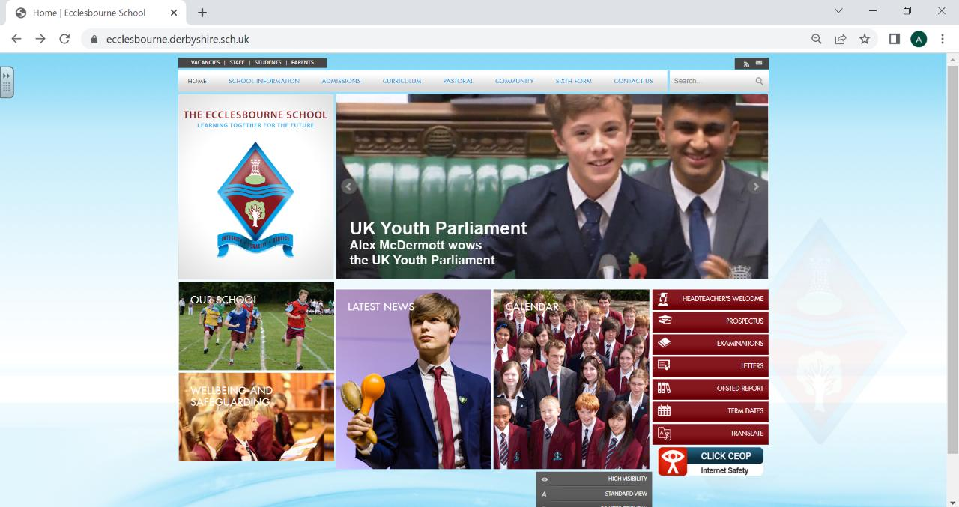

Slide 62
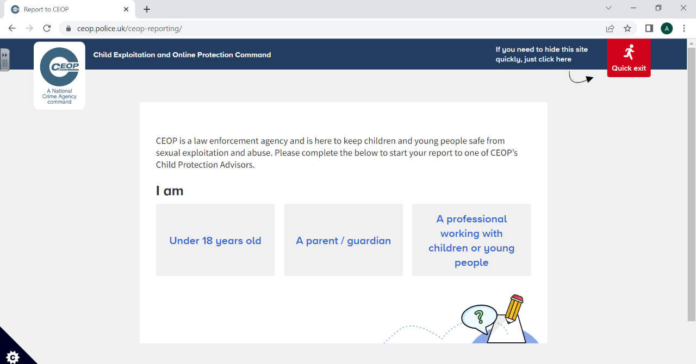
CLICK CEOP

Slide 63
Things parents and carers can report to CEOPs:
I am worried my child is being groomed online
My child has shared a nude picture online and is now being threatened
Someone is asking my child to communicate with them on a live-streaming platform
My child is meeting up with someone they met online
I've noticed changes in my child's behaviour which I think may be due to someone they met online
My child has SEND and I am worried about the people they are talking to online
I am a foster carer/adoptive parent and I am worried that my child's abusive birth father/mother is trying to contact them online

Slide 64
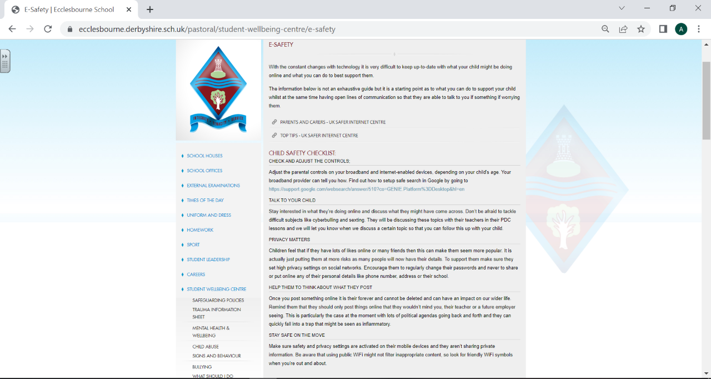

Slide 65
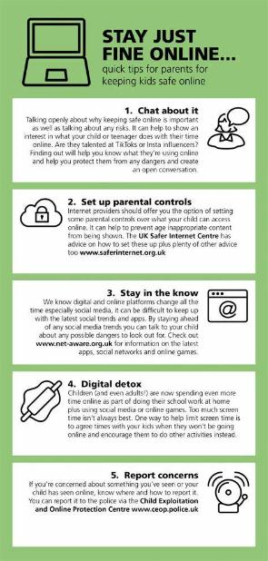
Tips for Parents
TALK TO YOUR CHILD
PRIVACY MATTERS
HELP THEM TO THINK ABOUT WHAT THEY POST

Slide 66
Support with work
Students should talk to their subject staff.
Talk to Sixth form office; i.e. their Head of Year
The library is available at lunchtimes and after school until 4.45pm.
Study skills will be taught in subject specific settings but a general study session will be run for all to attend to increase their knowledge and skill set on preparing for examinations.
Subject specific revision sessions are offered by a range of subjects as exams get closer.

Slide 67
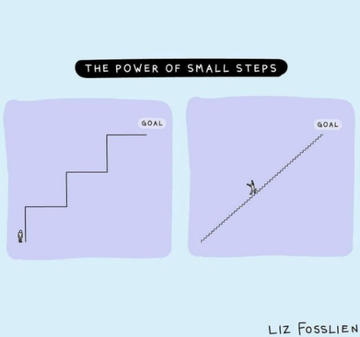
Study Advice for Parents and Carers

Slide 68
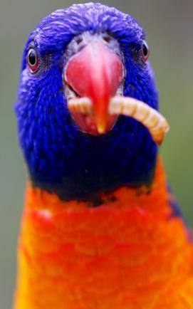
START EARLY
The more time your child gives themselves to study and revisit work, the more opportunity they have to cover each subject without needing to cram for assessments. They will be have more time to practise what they need to learn and consolidate it into their memory.

Slide 69

GET INVOLVED
It is definitely your child’s responsibility to revise! But now and again maybe you could test them on their flashcards. Ask them to explain their mind maps or PowerPoints.

Slide 70

BE ENCOURAGING AND CELEBRATE MINI GOALS
We encourage the students to set themselves a small number of mini goals to achieve at the end of each day.

Slide 71

HELP THEM TO NOT GET DISTRACTED
What distracts your child? Their phone? You Tube? Talk with them to decide the best strategies for avoiding distractions, e.g. phone in a different room when completing homework, preparing for tests, charging phone downstairs.

Slide 72

GET A GOOD BALANCE
Plenty of sleep
Healthy snacks
Going for walks
Exercise

Slide 73
USE HELPFUL APPS
Flipd is an app that stops you procrastinating and keeps you motivated.
Quizlet is a way of creating key word flashcards
How to use Flipd - YouTube
Learning tools and flashcards - for free! | Quizlet
Adapt helps you to create your own revision timetable.
Seneca has hundreds of tasks linked to specific exam courses
Adapt - free Revision Timetable App for A-level & GCSE (getadapt.co.uk)
Free Homework & Revision for A Level, GCSE, KS3 & KS2 (senecalearning.com)

