Slide 1
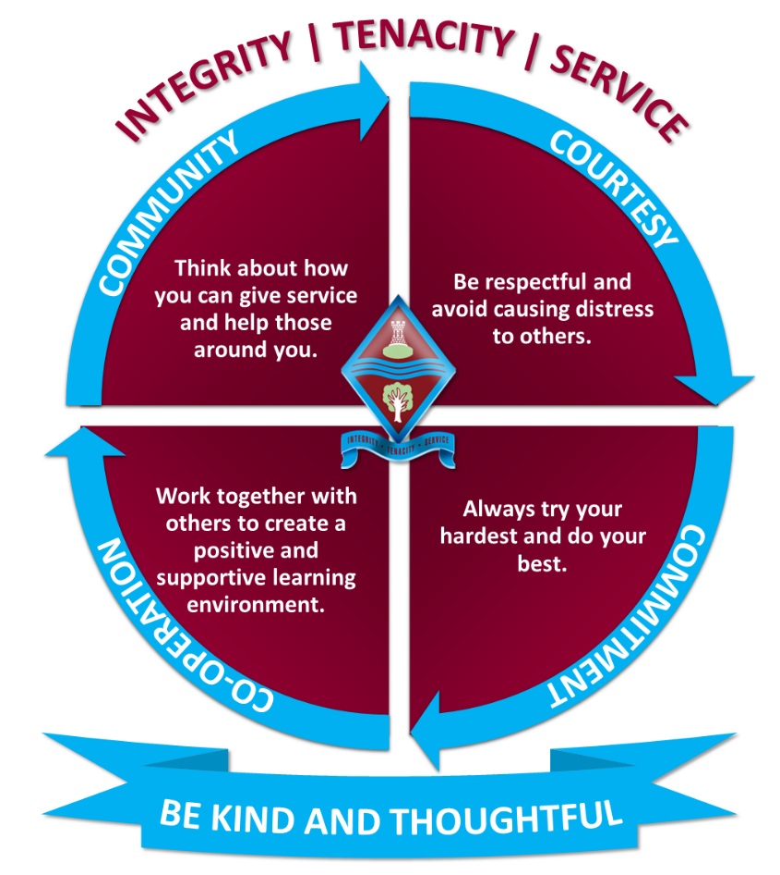
Year 10 Information Evening
Upper School Office Pastoral Team
The Ecclesbourne School
10th September 2025

Slide 2
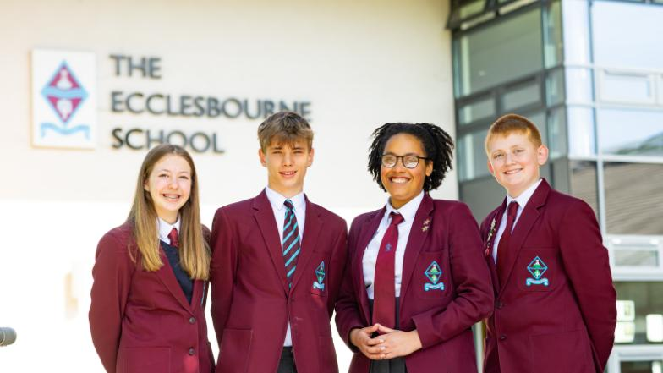
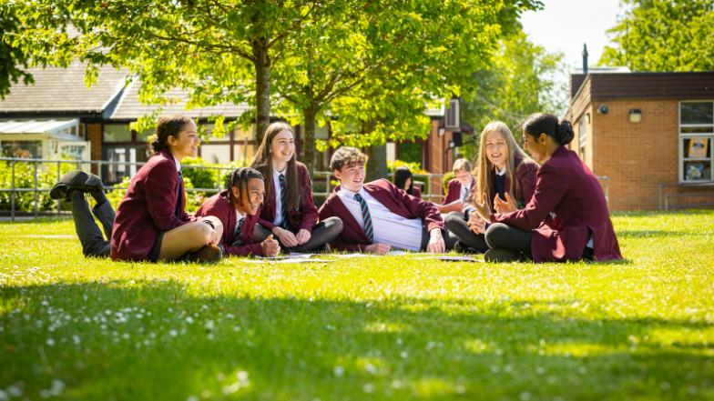

This evening:
Vision and Aims
School Performance
School Expectations and Attendance
Personal Development
Careers and Work Experience.
  Work experience week is the 29th June – 3rd July 2026
Support on offer for students

Slide 3
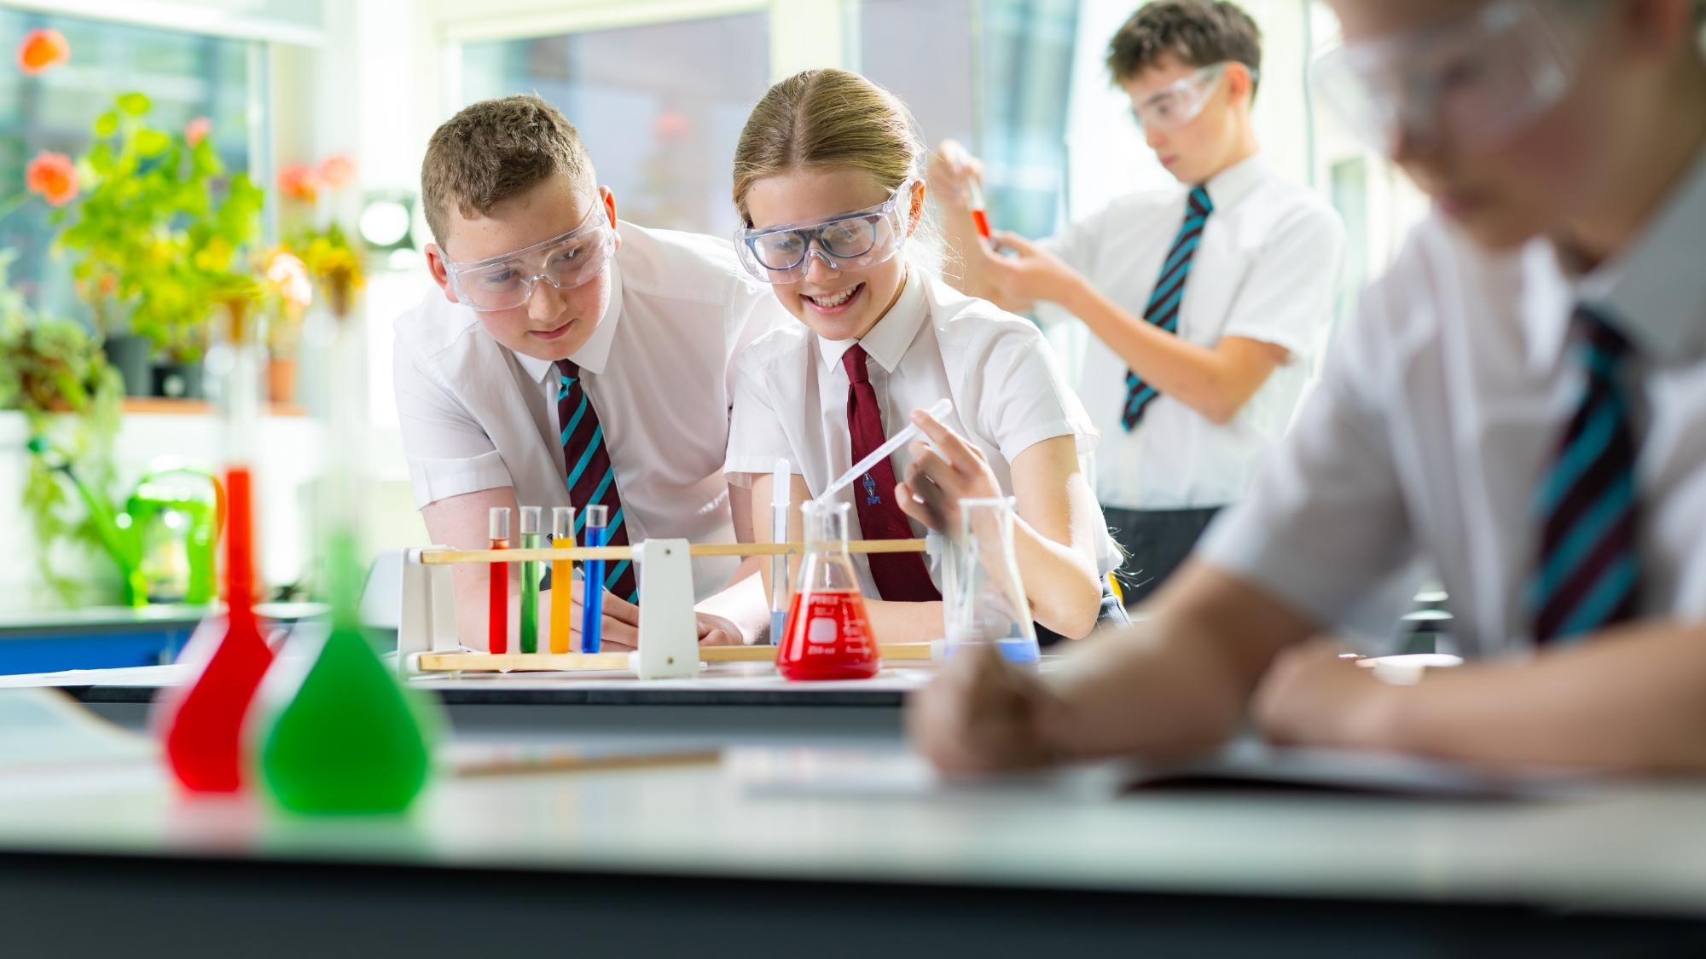
A broad and balanced curriculum that develops the knowledge and skills pupils need to thrive now and for a fulfilling future

Slide 4
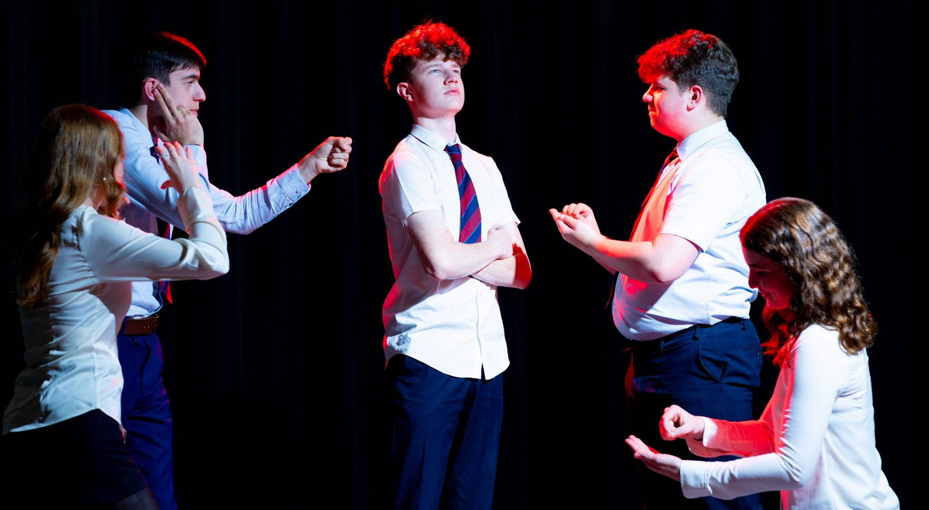
Develop pupils’ resilience and confidence in themselves and their capacity for growth

Slide 5
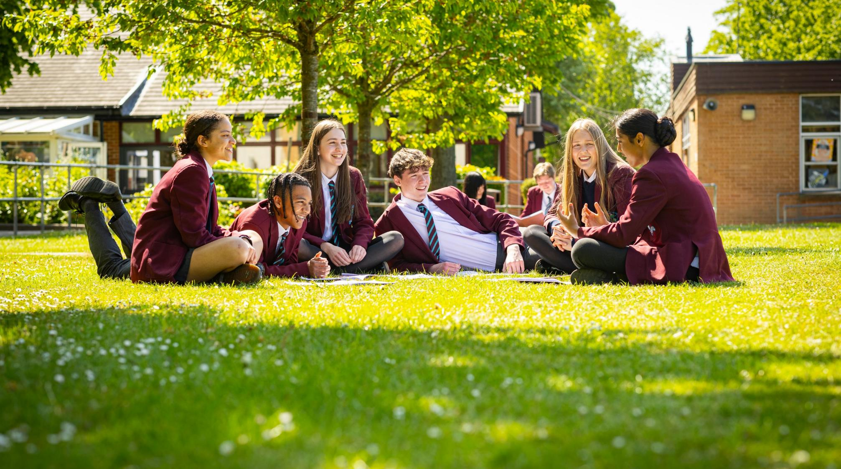
Ensure pupils feel valued, value others and learn to work together to make a positive contribution

Slide 6

Ensure pupils stay safe and healthy in mind and body

Slide 7

Develop creativity in an innovative learning environment

Slide 8
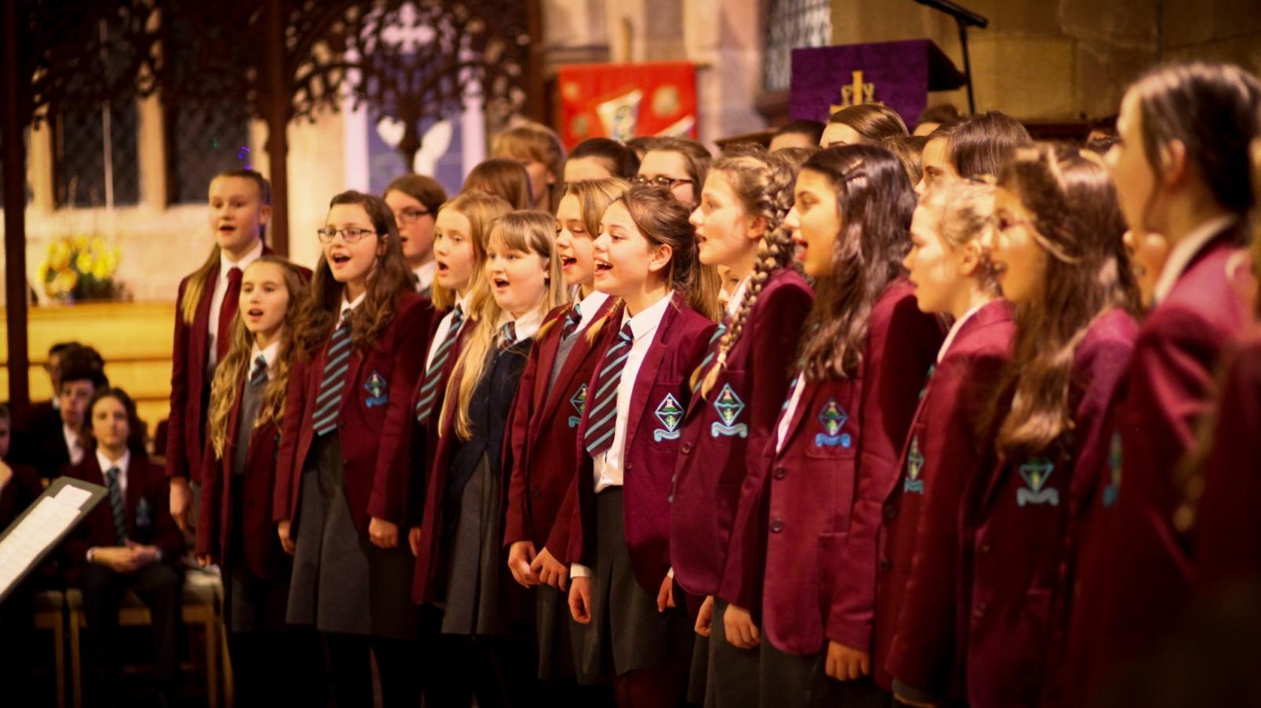
Appreciate the spiritual, moral, social and cultural richness of the world at large

Slide 9

The Ecclesbourne School strives to be a successful and caring learning community that inspires individuals to meet the challenges of the future

Slide 10

Academic Performance

Slide 11
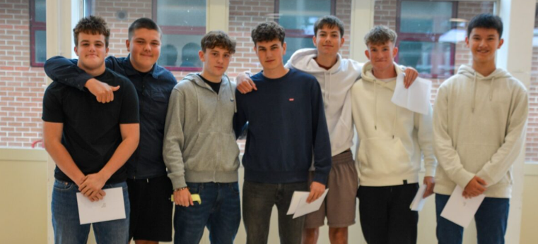

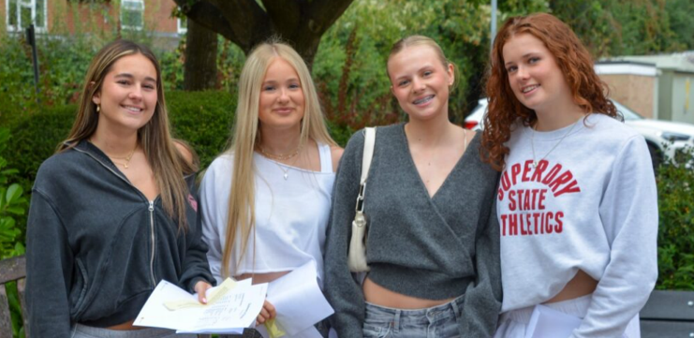
GCSE Performance

Slide 12
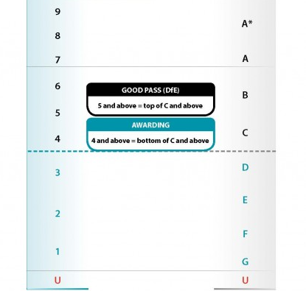
GCSE Grading
Pass at level 2
GCSE subjects graded 1 to 9.
GCSE subjects have terminal exams.
Coursework in some subjects.
Pass at level 1

Slide 13
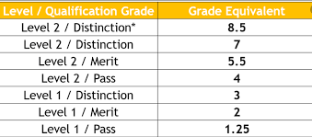
BTEC Grading
GCSE subjects graded 1 to 9.
BTEC Level 1 Pass to Level 2 Distinction*
GCSE subjects have terminal exams.
Coursework in some subjects.

Slide 14
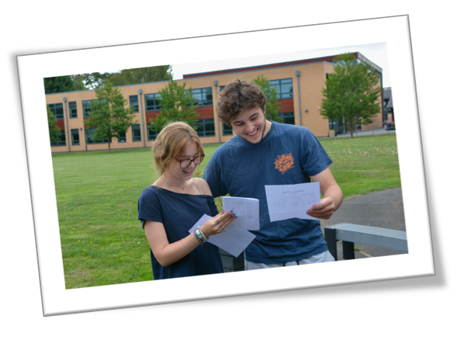

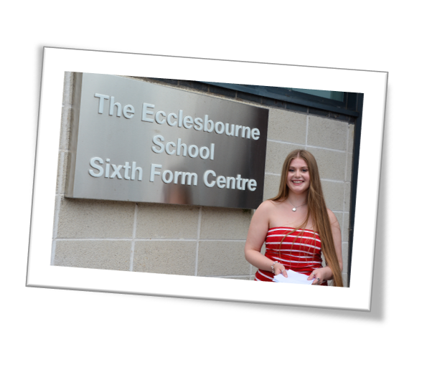
A-Level Performance

Slide 15
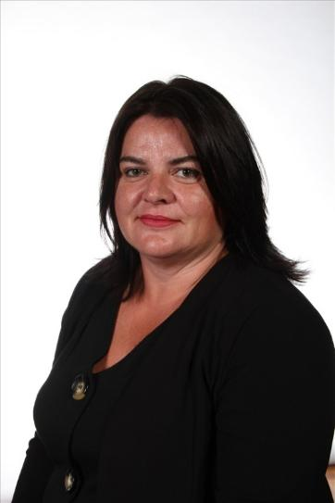
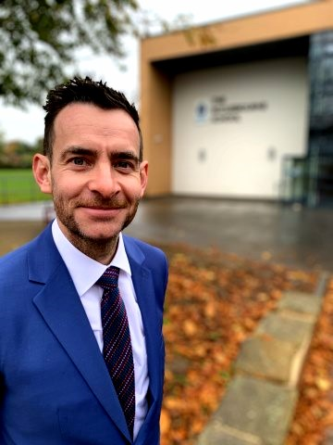
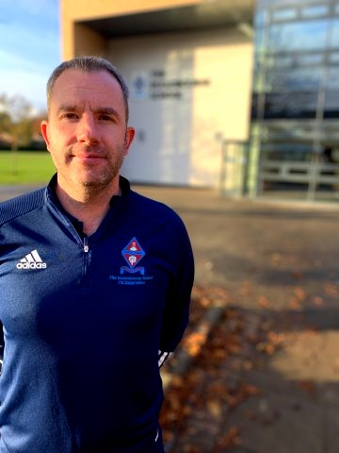
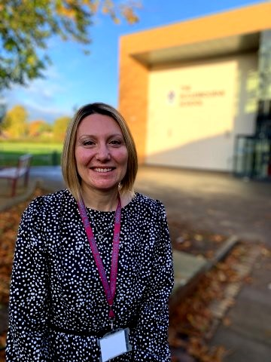
Pastoral Team
Mrs Ourabi
Head of Pastoral and DSL​
Mr Duncker-Brown
Head of Upper School
Mr Sellers
Head of Year 10
Mrs Dodson
Head of Year 11

Slide 16
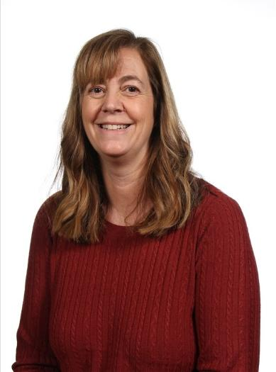
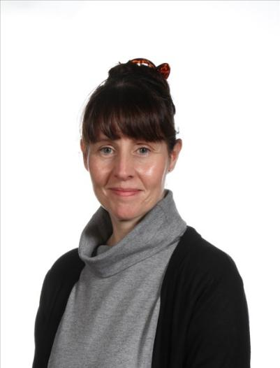
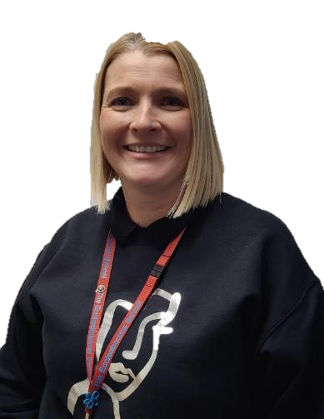
Pastoral Support Team
Mrs Parry
Pastoral Support
Mrs Monk
Pastoral Support and Attendance Officer​
Mrs Tanser
Pastoral Support and School Nurse​

Slide 17
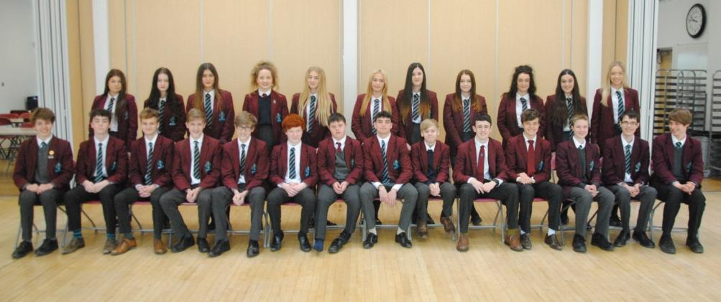
Year 10 Tutors
10E Mr D Davies
10C Mr J Poplawski
10L Mrs G Furniss
10S Mrs S Smyth
10B Mr A Basey
10U Mrs S Sharma/Mrs L Dowling
10R Mrs A Rogers
10N Mr D Sutton
10T Mr P Baxter

Slide 18
Key dates (Please note these can be subject to change)
11th September 2025 Y10 Photographs
26th September 2025 Prize Day
1st October 2025 Y10 Construction Careers trip
14th October 2025 WRAT (Wellbeing, Record of Achievement and Target setting) review process
3rd November 2025 Whole School Closure Day
4th November 2025 Drama Trip
12th November 2025 SV2 Talk
27th November 2025 House Plays evening performance
3rd December 2025 Careers Trip
Interim reports will be issued in the week beginning 8th December 2025
14th + 15th January 2026 Art Trip + Workshop
28th January 2026 Maths Challenge
10th February 2026 Stars in Your Eyes
Year 10 full reports will be published in the week beginning 9th March 2026
17th March 2026 WRAT
19th March 2026 Maths Olympiad
27th-30th March 2026 Western Front Trip
15th-16th April 2026 Language Listening Exams
17th April Whole School Closure Day
22nd April-1st May (inclusive) 2026 Year 10 Exams
2nd June 2026 Year 10 Parents’ Evening
Week beginning 8th June 2026 Language Speaking exams
29th June-3rd July 2026 Work Experience
7th July 2026 Work experience follow up in school
13th July 2026 Y10 Art Mock Exam
17th July Rewards Trips

Slide 19
Upper School Overview
26th September Prize Day
8th December Data Home
17th March WRAT
14th October WRAT
9th March Report
13th July Y10 Art exam
15th-16th April Language Listening Exams
22nd April-1st May Year 10 Exams
W/b 8th June Language Speaking exams
29th June-3rd July Work Experience
2nd June Year 10 Parents’ Evening
Year 10
Autumn 1
Autumn 2
Spring 1
Spring 2
Summer 1
Summer 2
September 16+ Launch
February 16+ Interview 2 + Offers
September Prize Day
October WRAT
March WRAT
November Data Home
March English + Maths 2nd Mock
November 16+ Interview 1
May GCSE exams start
June GCSE exams finish
October 6th Form open Evening
December Language Speaking mocks + Art Mock
January Year 11 Mock Exams
February Mock Results Home
Year 11
Autumn 1
Autumn 2
Spring 1
Spring 2
Summer 1
Summer 2

Slide 20


CODE OF CONDUCT
Be respectful and avoid causing distress to others.
Always try your hardest and do your best.
Think about how you can give service and help those around you.
Work together with others to create a positive and supportive learning environment.
INTEGRITY | TENACITY | SERVICE
COURTESY
COMMUNITY
CO-OPERATION
COMMITMENT
Our theme for this term is Community
BE KIND AND THOUGHTFUL

Slide 21
Our Values
We are a large and inclusive school community with respect and tolerance at the heart of our core values.
We expect each and every child to treat others utilising these core values.
Where a pupil’s actions fall short of expectations we will address this through a combination of sanctions and learning opportunities.
The school is proud of its excellent exam results and the progress that pupils make during their time at our school. These results and progress are a tribute to the excellent teaching and learning and the hard work of pupils.
Where a pupil impacts the learning of others then action will be taken.

Slide 22
Sanctions
To support the management of good classroom behaviour, pupils will be given a chance to correct their behaviour, but if the behaviour persists a teacher detention will be issued.
Sanctions which staff may use include: verbal reprimand; detention; a written apology or reflection; lesson removal; missing break time; extra work or repeating unsatisfactory work until it meets the required standard; or school-based community service.
Sanctions which pastoral leaders may use include: loss of privileges – for instance, the loss of a position of responsibility or not being allowed to participate in a non-uniform day or extra-curricular activity; internal seclusion; being placed “on report” for monitoring for behaviour, uniform or punctuality.

Slide 23
Strategic Leadership Team Involvement
If a pupil continues to be disruptive, is defiant to the class teacher, is unkind to another pupil or uses discriminatory language then the pupil will be removed from the classroom by a member of the Strategic Leadership Team. This will result in a significant sanction and parents/carers will be informed.
Where we continue to concerned with a child's behaviour then parents/carers will be invited into school for a meeting to discuss the concerns, and a behaviour support plan can be put in place working with everyone’s input so the plans have the best chance of succeeding.

Slide 24
The Detention System
Section 5 of the Education Act 1997 gives schools the authority to detain pupils after the end of a school session on disciplinary grounds.
Teacher Detention: 30 minutes during lunchtime or after school. Students will always be given enough time to have lunch and use the toilet.
Faculty Detention: 60 minutes after school.
SLT Detention: 60 minutes after school. This is usually held on a Thursday. These are set for serious misdemeanours and repeated failure to respond to sanctions. Parents will be informed and will be given 24-hours’ notice of an after-school detention.
For a more detailed look at our behaviour policy, please click on the link. Behaviour Policy

Slide 25
Supporting your Children with Behaviour
Make sure your child has the correct equipment including: stationary, a fully charged laptop and subject specific supplies, e.g. PE kit or ingredients.
Download the Satchel One App to keep track of your child's homework. This is a great way to help them keep on top of their workload!
Ensure they arrive to school on time.
Inform the Head of School/Year if there is something that is worrying your child. This can stop situations escalating and support can be put in place.
Talk to your child about their behaviour as there might be an underlying reason as to why they are not adhering to the school rules.
Support the school in its behaviour decisions, pupils will thrive where everyone works together.

Slide 26

Rewards
Merits
Prize Giving
Roll of Honour
Merit/Colour Ties
Governors Awards Evening

Slide 27
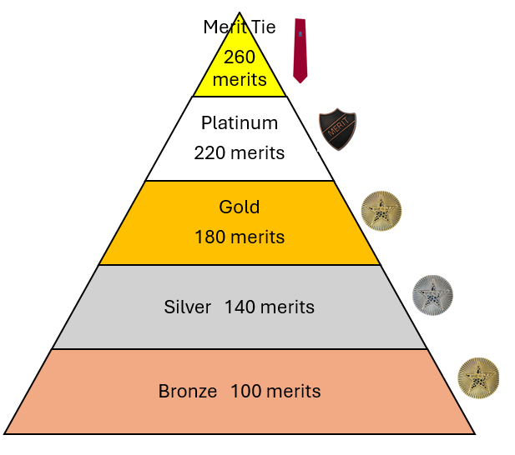
Merits & Rewards
We are still running the Merits for rewards this year! We will be offering the same rewards as last year, including:
Praise
Phone call home
Pin badges
Postcards
Rewards trips
Form breakfasts
Golden ticket early lunch pass
Merit ties

Slide 28
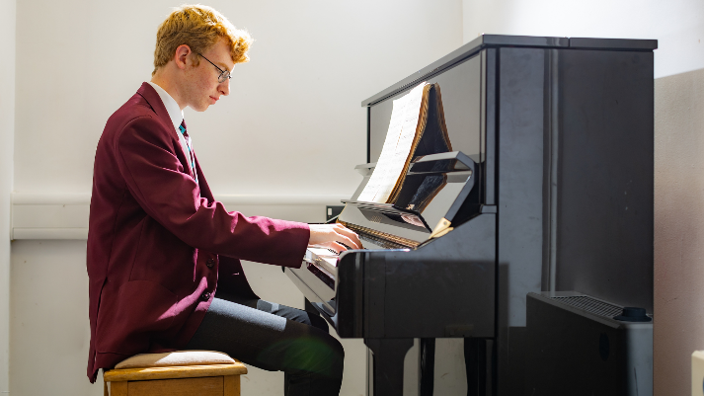

Extracurricular Activities
Sports teams and clubs
Music
Drama
House plays
Duke of Edinburgh
Trips and Visits
And there is a wide range of subject related clubs to go to!

Slide 29
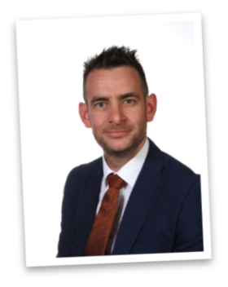
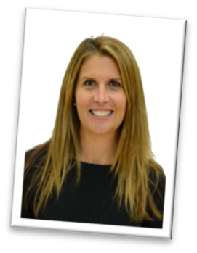
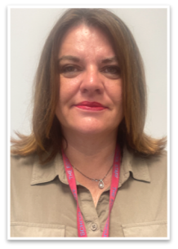
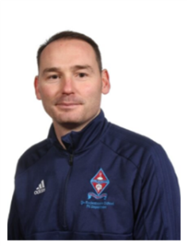
Safeguarding
Mrs C Ourabi- Senior Deputy Head and DSL
Three Deputy DSL's; Mr Quail, Mr Duncker-Brown, Mrs Weller
Have a statutory duty to implement and follow KCSIE 2025
Situations happen school are on hand to support; we are not here to pry
Work closely with external agencies
Receive DV notifications within 24 hours

Slide 30
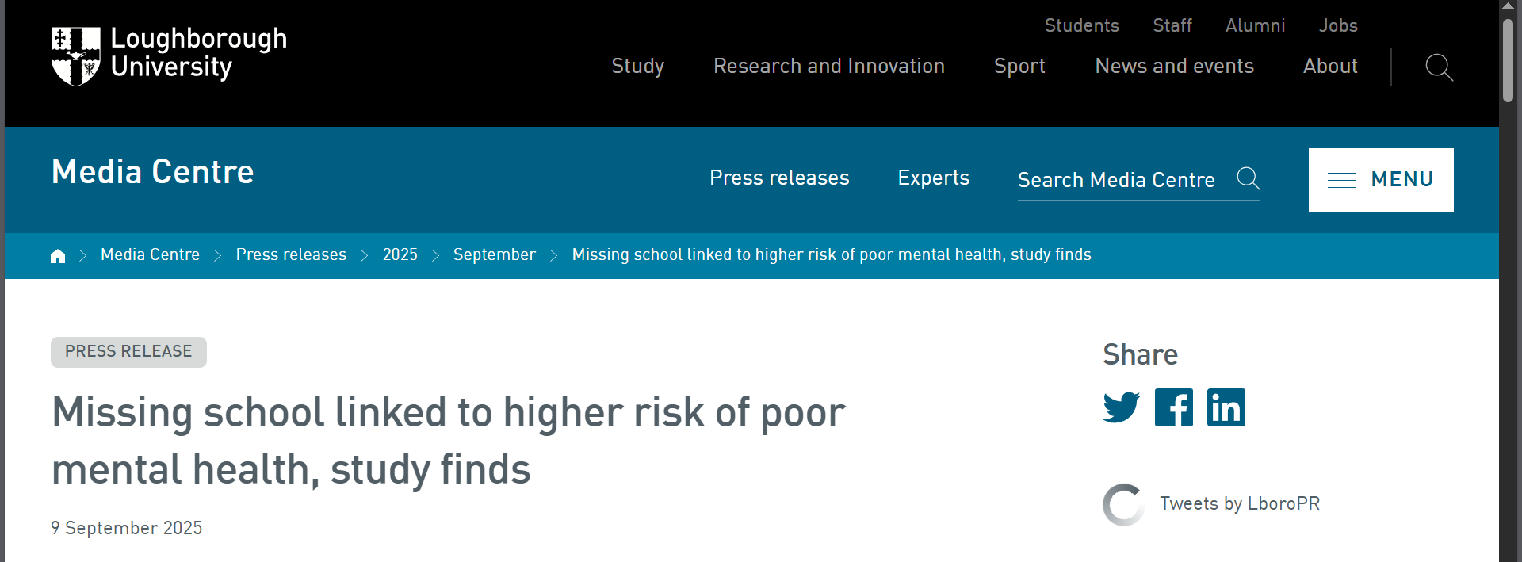
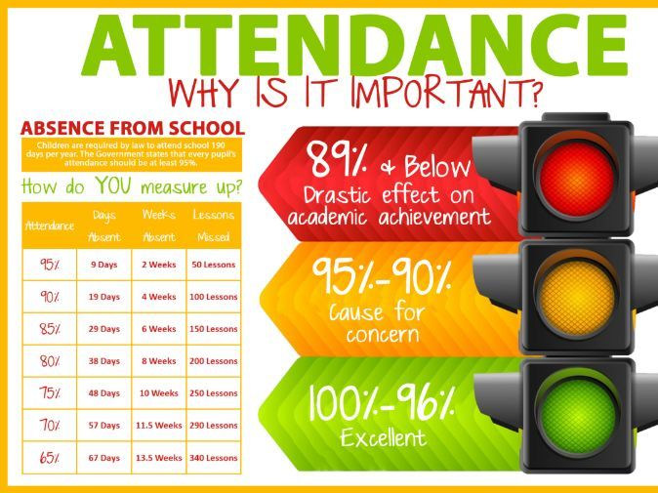

Attendance

Slide 31


Our Attendance Process
Set high expectations for attendance
Monitor data looking for patterns of absence for students and sub-groups
Maintain contact with families and follow statutory guidance' Working together to improve school attendance 2024’.
Listen and understand where problems emerge
Facilitate and formalise support to improve attendance
Liaise with the local authority

Slide 32

Personal Development
PDC curriculum
Leadership opportunities
Wider curriculum
Assemblies
Pastoral support
Our VALUES

Slide 33
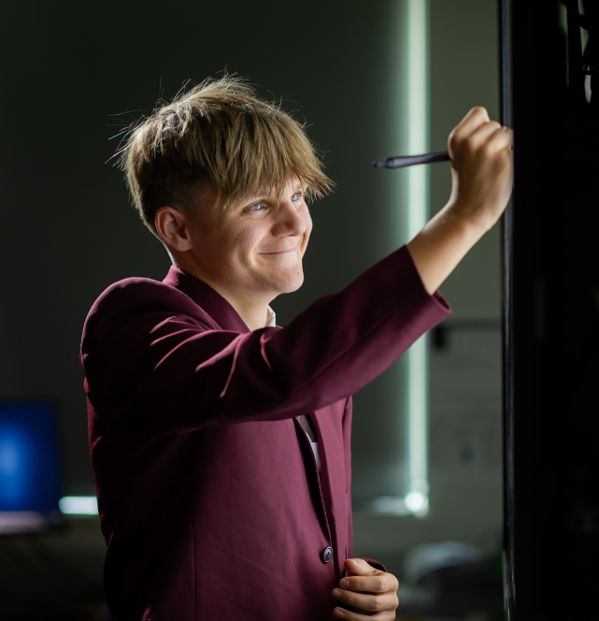
Academic Support with work
Students should talk to their subject staff.
Talk to Upper School Office; i.e. their Head of Year or one of the wider team or their form tutor.
The library is available at lunchtimes and after school until 4.45pm.
We will also identify students throughout the year and offer them some subject specific tutoring.
We can also arrange for mentors.
Revision sessions are offered by a range of subjects as exams get closer.

Slide 34
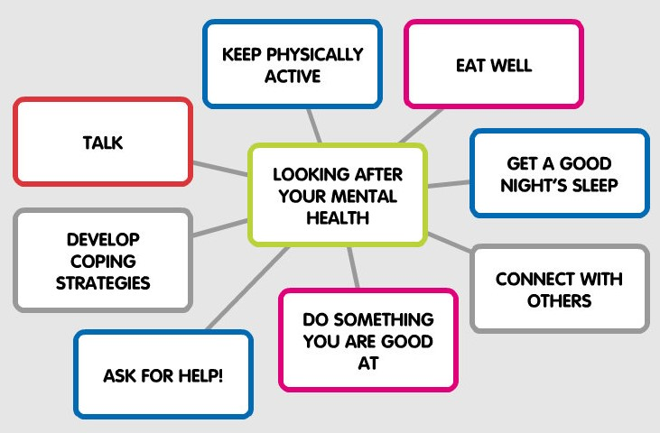


Mental Health Team
Mrs Ourabi- Trained as a Senior Mental Health Lead.
Most of Pastoral team is MHFA trained
2 Pastoral workers – Attendance and School nurse
Not experts

Slide 35
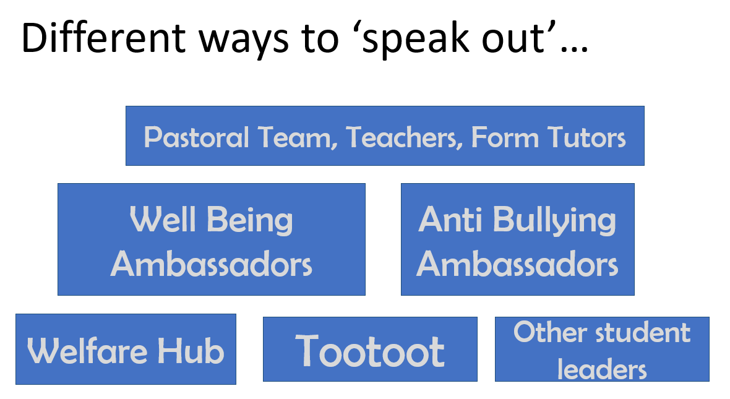

Pastoral Support

Slide 36













Resources
Ask for HELP!

Slide 37
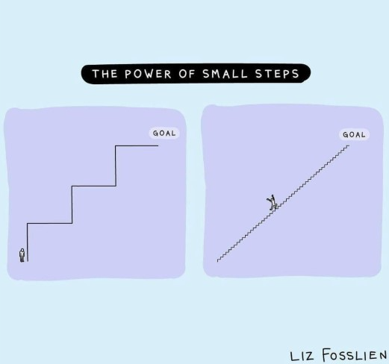
Revision Advice for Parents and Carers
Key Stage 4 | Ecclesbourne School

Slide 38
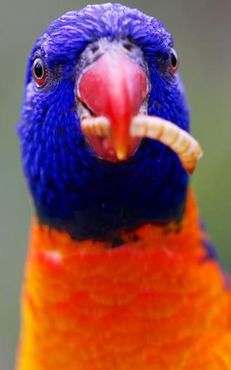
START EARLY
The more time your child gives themselves to revise, the more opportunity they have to cover each subject without needing to cram. They will be have more time to practise what they need to learn and consolidate it into their memory.

Slide 39

HELP THEM MAKE A REVISION TIMETABLE
You can ensure that your child devises a realistic revision programme for themselves. You can factor in events that might be happening.

Slide 40


GO SHOPPING FOR STATIONERY
Students know that they need to mix up the style of revision that they do. Having a range of different stationery will help them with that.

Slide 41

GET INVOLVED
It is definitely your child’s responsibility to revise! But now and again maybe you could test them on their flashcards. Ask them to explain their mind maps or PowerPoints.

Slide 42

BE ENCOURAGING AND CELEBRATE MINI GOALS
We encourage the students to set themselves a small number of mini goals to achieve at the end of each day.

Slide 43

HELP THEM TO NOT GET DISTRACTED
What distracts your child? Their phone? YouTube? Talk with them to decide the best strategies for avoiding distractions, e.g. phone in a different room, 10 internet rewards for 40 minutes revision.

Slide 44

GET A GOOD BALANCE
Plenty of sleep
Healthy snacks
Going for walks
Exercise

Slide 45
USE HELPFUL APPS
Flipd is an app that stops you procrastinating and keeps you motivated.
Quizlet is a way of creating key word flashcards
How to use Flipd - YouTube
Learning tools and flashcards - for free! | Quizlet
Adapt helps you to create your own revision timetable.
Seneca has hundreds of tasks linked to specific exam courses
Adapt - free Revision Timetable App for A-level & GCSE (getadapt.co.uk)
Free Homework & Revision for A Level, GCSE, KS3 & KS2 (senecalearning.com)

