Slide 1
5-19 Public Health Nursing Team
Amber Valley

Slide 2
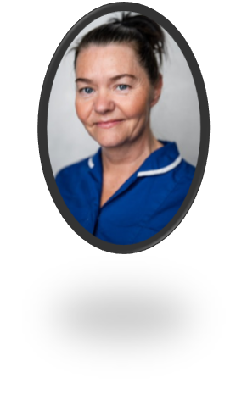
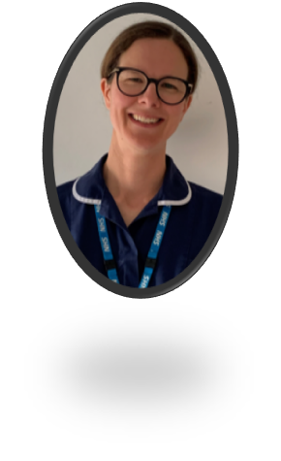
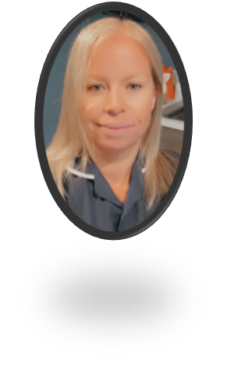
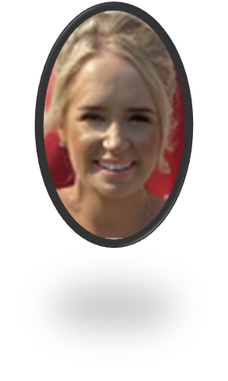
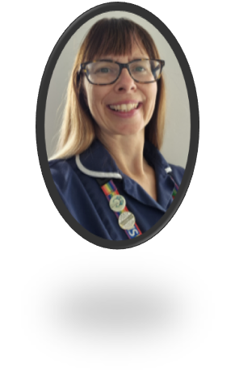
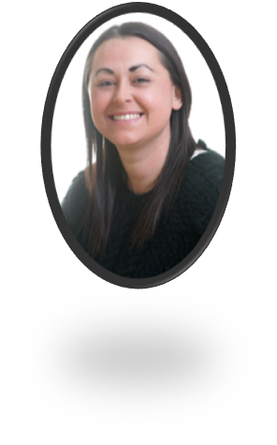
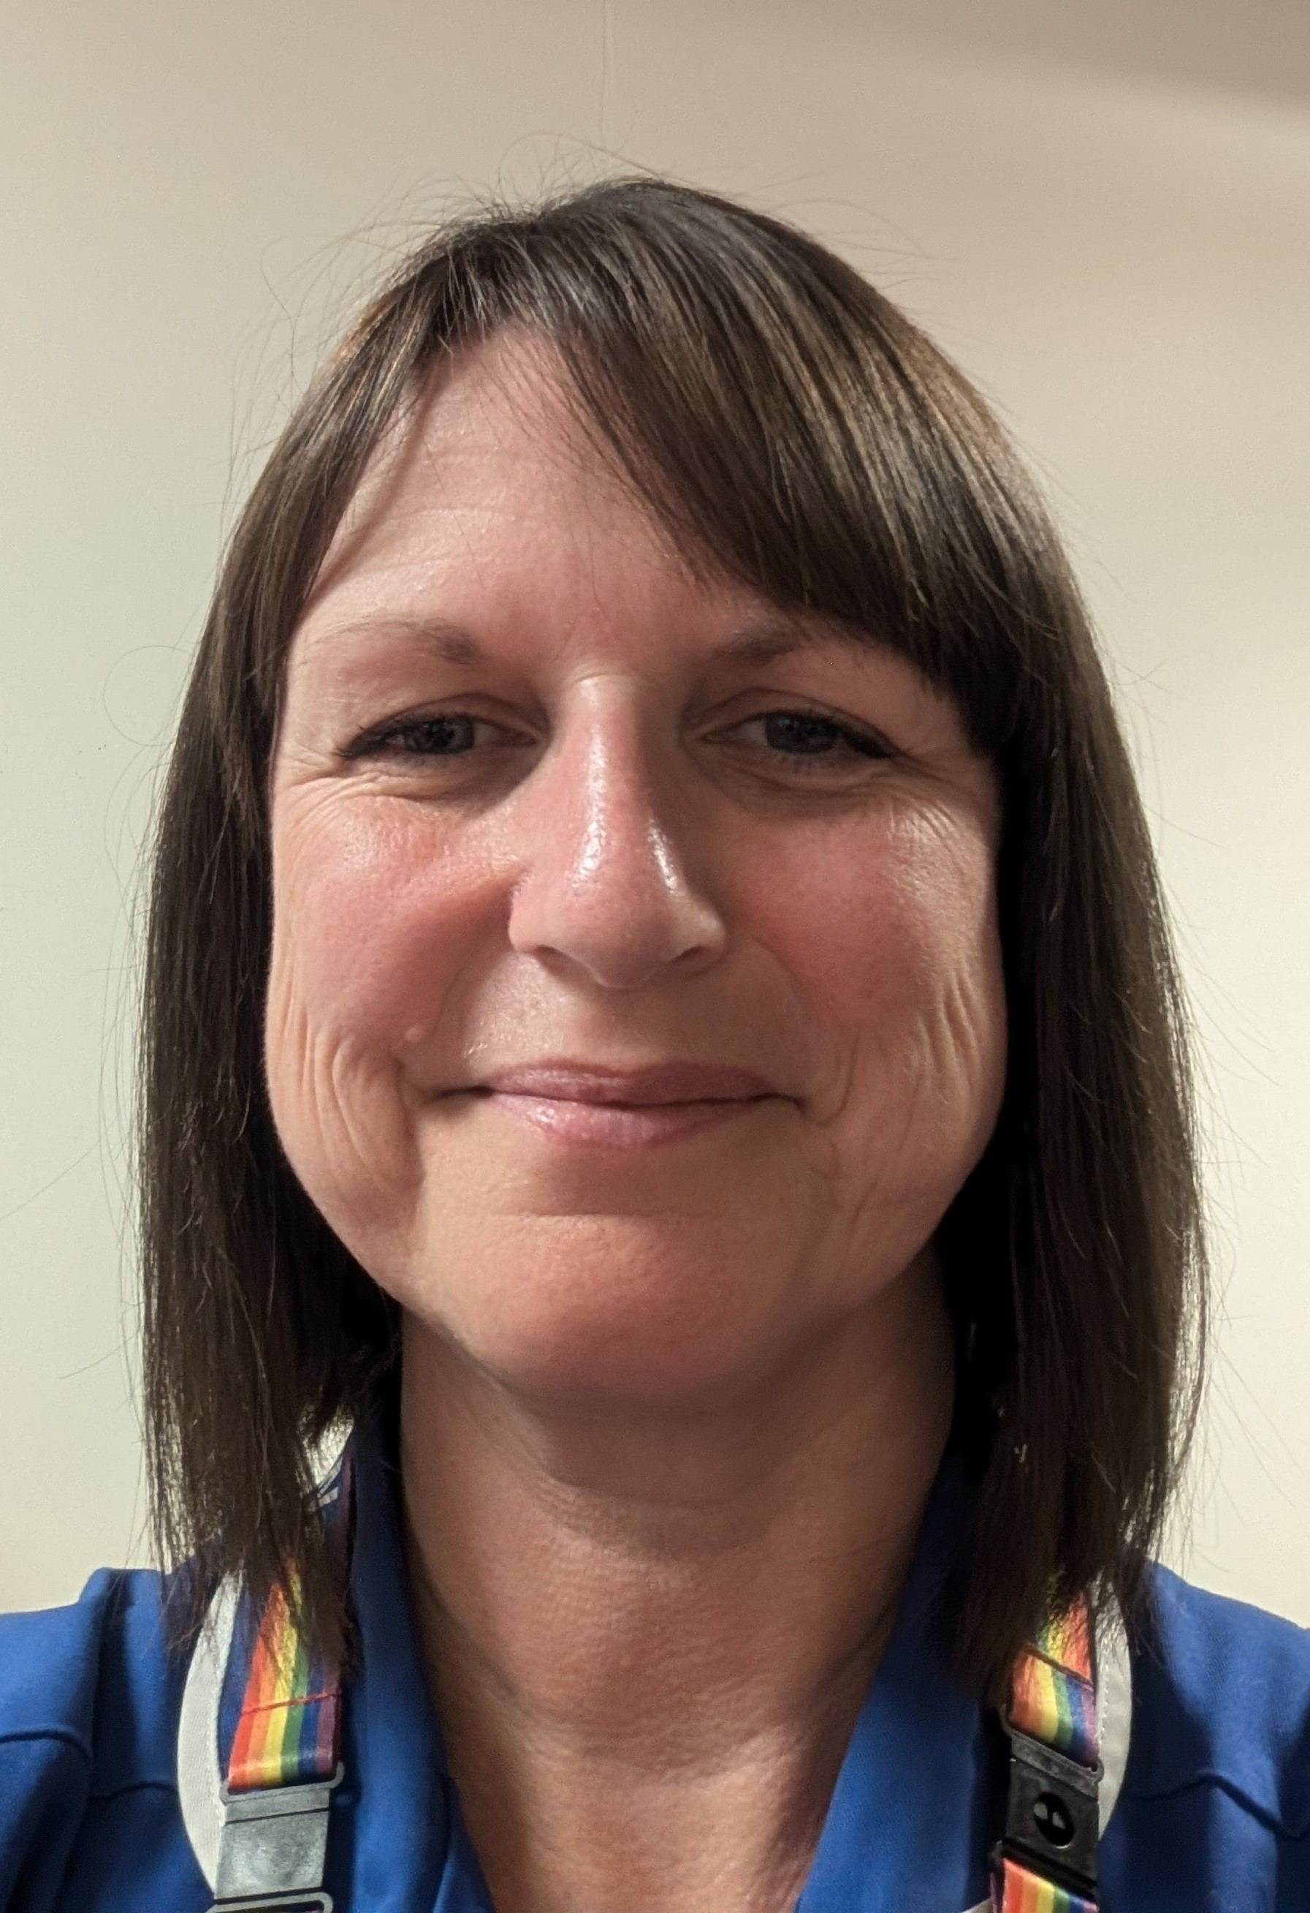
Your Team is here to support you…
Tammy
Laura
Charlotte
Georgia
Paula
Sarah
Sarah
Catherine

Slide 3
Gender & sexuality
Drugs & alcohol
Body image
Sleep
Smoking & vaping
What do we do?
Puberty
General health
Emotional health & anxiety
Young carers
Relationships & friendships

Slide 4
We are a
service

Slide 5
How to connect with us…
Text ChatHealth: 07507 330025
Monday to Friday 9am – 4.30pm (except bank holidays)
Website: derbyshireteenhealth.nhs.uk
Instagram: @DerbysTeenHealth
Telephone: 01246 515100
Monday to Friday 9am – 4.30pm (except bank holidays)
Talk to school

