Slide 1

Year 9 Information Evening

Slide 2
Welcome to the Year 9 Information Evening
Senior Section
The Ecclesbourne School
25th September 2024

Slide 3

The Ecclesbourne School strives to be a successful and caring learning community that inspires individuals to meet the challenges of the future
Notes:
Welcome to Ecclesbourne and these are our aims

Slide 4


Code of Conduct / Inclusive Language Charter
Our VALUES
Notes:
So how do we achieve that. Instilling our values through the Code of Conduct

Slide 5
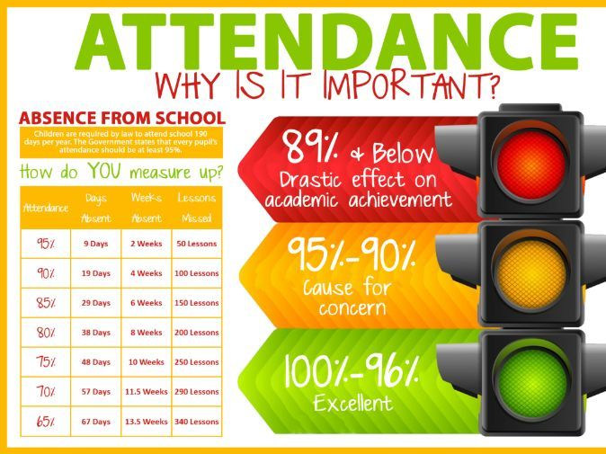
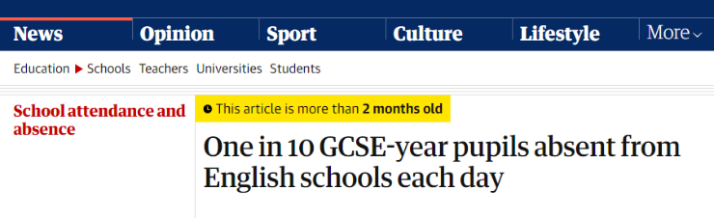

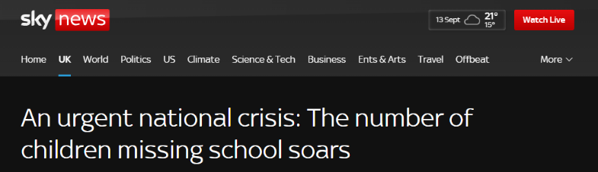
Attendance
Notes:
So what do we need students to do and parents. These are typical headlines we are seeing in the press

Slide 6

Our Attendance Process
Set high expectations for attendance
Monitor data looking for patterns of absence for students and sub-groups
Listen and understand where problems emerge
Facilitate support to improve attendance
Formalise support
Liaise with the local authority
Notes:
Need to work with us to maintain high levels

Slide 7
Behaviour Expectations
School will set high standards which all students are expected to adhere to​
High standards students expected to maintain communicated by school​
School will have routines and checks to help students maintain high standards​
Have clear sanctions in place where high standards are not maintained​
Monitor behaviour patterns looking at individuals and sub-groups​
Educate young people to reduce further incidents​
Share concerns and actions with parents​
Notes:
Behaviour should set good role models to younger students

Slide 8

Year 9 Tutors in Senior Section
9B Mrs A Shaw
9C Mrs H Heanue
9L Ms L Mooney
9R Mr D Hewitt
9E Mrs J Stanley
9N Ms J Colgan
9S Ms D Telford
9U Miss L Bailey
Head of Year
Mrs Emma Stott
Progress leader
Mrs Rachael Laughlin
Notes:
So who is our community? Explain about structure of school offices and breadth and depth of staff

Slide 9

CODE OF CONDUCT
Be respectful and avoid causing distress to others.
Always try your hardest and do your best.
Think about how you can give service and help those around you.
Work together with others to create a positive and supportive learning environment.
INTEGRITY | TENACITY | SERVICE
COURTESY
COMMUNITY
CO-OPERATION
COMMITMENT
Our theme for this half term is Community
BE KIND AND THOUGHTFUL

Slide 10

Year 9 Vision
A story of kindness, friendship, courage and hope.
An unlikely group of friends goes on a journey to find home.
Notes:
Where has the journey started . This Journey involves support from lots of people and determination on their part to contribute, show resilience

Slide 11
Personal Development
PDC curriculum
Leadership opportunities
Wider curriculum
Assemblies
Pastoral support
Our VALUES
Notes:
Year 9 is about developing the students in preparation for their GCSE . Whole person important not just results but a citizen that can function in society So how do we achieve that?

Slide 12

Personal development

Slide 13
Extra curricular activities
Time | Club | Supervisor | Venue
Monday before school | Badminton (paid club) | Donna Kellogg | Sports Hall
Monday after school; | Cheerleading Club | Miss MacCormick | Sports Hall
Monday after school; | Brass Group | Mr Knapp | M1
Monday lunchtime; | Maths Club | Mrs Rafferty | M3
Monday lunchtime; | String Group | Mr Knapp | M1
Monday lunchtime; | Music Theory Club | Mr Dickson | M2
Monday lunchtime; | Fitness Club | Mr Ourabi | Fitness Suite
Monday lunchtime; | Poetry by Heart ( 14th October) | Mrs Bell | E4
Tuesday lunchtime; | Calligraphy Club | Miss Piper | C10
Tuesday lunchtime; | Science Homework Club from 1:15pm | Mrs Naylor & Mrs Yallop | B14
Tuesday lunchtime; | Drama Club | Mrs Taylor | B1
Tuesday lunchtime; | IGNITE | Mr Sutton & Mrs Owen-Moore | L7
Tuesday lunchtime; | Girls Football | Mrs Street | Astro
Tuesday lunchtime; | Boys Trampolining | Mr Carnwell | Sports Hall
Tuesday afterschool | Chamber Choir | Mrs Leonard | M2
Notes:
A wealth of opportunities available and encourage students to participate

Slide 14
Extra curricular activities
Time | Club | Supervisor | Venue
Wednesday lunchtime; | Books and Biscuits | Mrs Bell | E4
Wednesday lunchtime; | Orchestra | Mr Knapp | Theatre
Thursday lunchtime; | Media Club | Mr Young | E3
Thursday lunchtime; | Textile and fashion club | Ms Telford, Mrs Stanley, Mrs Stewart | B9
Thursday lunchtime; | School Choir | Mrs Leonard | Theatre
Thursday lunchtime; | Boys Football | Mr Weller | Field
Thursday lunchtime; | Netball | Miss Minto | Courts
Thursday after school; | Shakespeare Schools Festival | Ms James | B1
Friday lunchtime; | History Film Club | Miss MacCormick | A3
Friday lunchtime; | Swing Band (Brass grade and wind 4+) | Mr Knapp | M1
Notes:
Every day there is something to do

Slide 15

Ecclesbourne PE Department Extra-curricular Timetable for Half Term One
DAY | BEFORE SHOOL: 7:45-8:30am | LUNCHTIME 12:40 – 1:15pm | AFTER SHOOL 3:45 – 4:45pm
MONDAY | All Years Badminton, D Kellogg, SH (Paid) | Year 8 Boys & Girls Fitness (LMO) Fitness suite Year 7 Girls Football (ALS) Astro Year 7 Boys Football (MAS) Field All Years Table Tennis Club (SAC) SH Girls Trampolining Club (OTQ) SH
TUESDAY | Year 9 Netball (LCB) Astro | Year 9 Boys & Girls Fitness (LMO) Fitness suite Year 10,11 & 6th Form Netball (LCB, LAM) Courts Year 7 Boys Football (MAS) Field Year 8/9 Girls Football (ALS) Astro Boys Trampolining Club (SAC) SH | Year 8 Football Matches – See Fixtures Board Year 11 Football Matches – See Fixtures Board
WEDNESDAY |  | Year 11 Boys & Girls Fitness (LMO) Fitness suite Year 10 Boys Football (SAC) Field Year 7 Netball (LAM & LCB) Astro | All Years Hockey (OTQ) Astro Year 7 Football Matches – See Fixtures Board Year 9 Football Matches – See Fixtures Board
THURSDAY |  | Year 10 Boys & Girls Fitness (LMO) Fitness suite Year 8 Boys Football (JWE) Field Year 10/11 Girls Football (ALS) Astro Year 8 Netball (LAM) Courts | Year 10 Football Matches – See Fixtures Board
FRIDAY |  | Year 7 Boys & Girls Fitness (LMO) Fitness suite Year 9 Boys Football (ADG) Astro Year 11 Boys Football (OTQ) Field
Notes:
This includes sporting activities

Slide 16
GCHQ competition
Tuesday lunch we do puzzles that are set by GCHQ
( yes the national security organisation).
We are preparing for a national competition which takes place in November when we have to solve puzzles which focus on decoding.
All students work in groups of no more than 4
Notes:
Including national competitions

Slide 17




Chosen school charities
Show racism the red card
Padley centre
Belper Shed
Notes:
Including national competitions

Slide 18

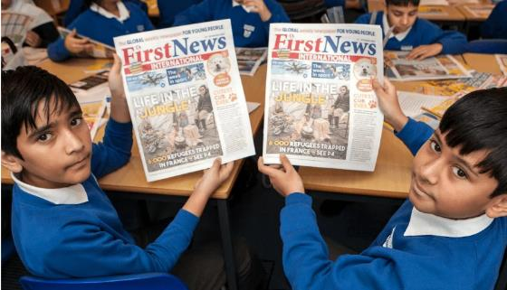
First news courtesy of the PSFA
Our fundamental belief is that, if the world is to become a better place, the next generation has to be better informed than the last.
It’s the whole reason we exist.
Every day we remember that children are 27% of the world’s population and 100% of the future.
Notes:
Including national competitions

Slide 19
Chelsea’s choice (Courtesy of PSFA)
Preventing child sexual abuse
Chelsea’s Choice is an Applied Theatre Production. The play is followed by a question and answer sessions to explore some of the issues raised.
The play tells the story of a group of three students who discover the diary of a girl called Chelsea. Chelsea was a young girl who, having fallen out with her friends and family, was approached by a man called Gary. Gary was older, owned a car, had a flat and treated her like an adult. Unfortunately Gary was not what he seemed to be – and Chelsea was sexually exploited. Chelsea's story is played out and examined by the three students who, along with their teacher, attempt to understand what happened to Chelsea and how it could have been prevented.
Notes:
Including national competitions

Slide 20
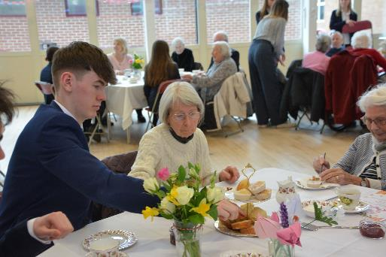
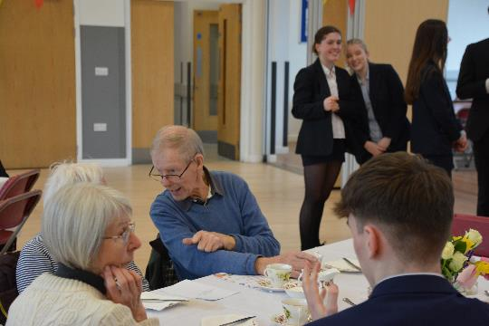
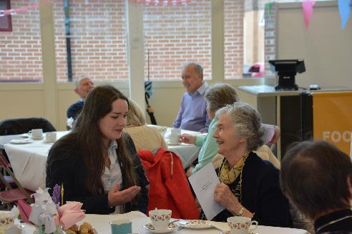
Community Tea Party
Notes:
Including national competitions

Slide 21

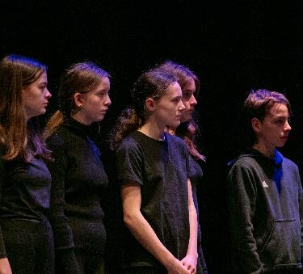
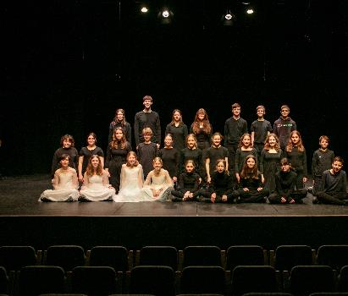
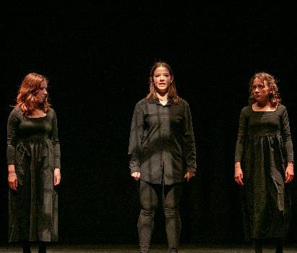
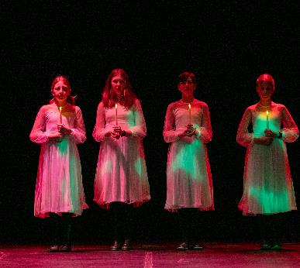
Coram Shakespeare Schools Festival
A midsummer nights dream
March 2025

Slide 22
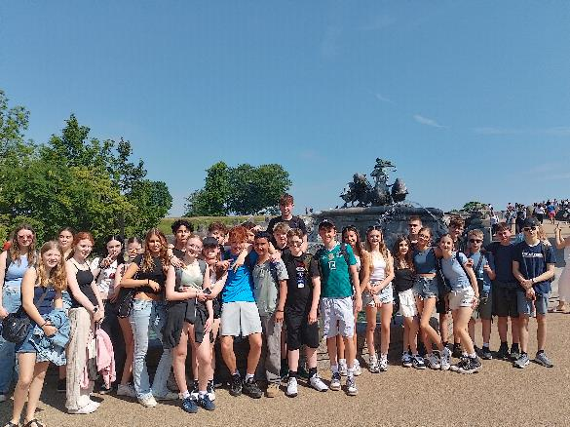
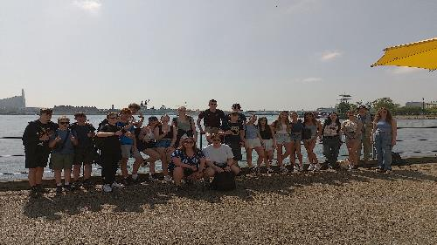
Danish Exchange
Denmark UK 2025 Exchange
25 students out to Denmark in May 2025 on the 45th exchange.
DATES: Wednesday 28th May 2025 – Tuesday 3rd June 2025.
Notes:
Including national competitions

Slide 23
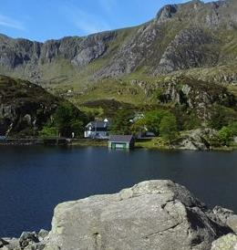

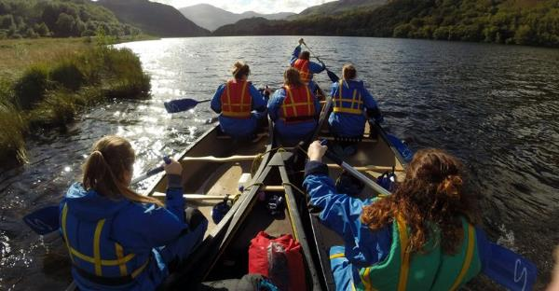

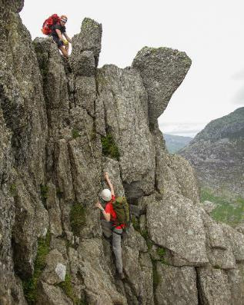

21st July 2025 Outward bound trip
Year 9 residential trip
Notes:
The sounds of Outward Bound - YouTube
Outward Bound - More Than You Think – YouTube

Slide 24
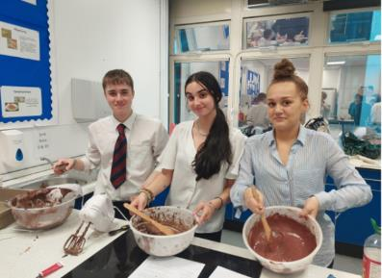
Leadership Opportunities
To get support* from:
Peer Mentors
Buddy Readers
House Captains
To get involved in:
Student Council
Well-Being Ambassadors*
Anti-Bullying Ambassadors*
Community Ambassadors
Reading Ambassadors

Slide 25
Key dates (Please note these can be subject to change)
23rd/24th September Lea Green Team Building activity day
25th September Maths Olympiad Challenge (Set 1)
25th September House dance auditions
27th September 2024 Prize Day
1st October 2024 WRAT (Wellbeing, Record of Achievement and Target setting) review process
9th October Air cadets opportunities
9th October Community Tea party
23rd/24th October Army careers day
4th November 2024 Whole School Closure Day
5th-8th November 2024 Community Week
Nov GCHQ competition
28th November 2024 House Plays evening performance.
Interim reports issued w/b 9th December 2024
17th December 2024 WRAT (Wellbeing, Record of Achievement and Target setting) review
8th Jan Enterprise day
23rd January Parents evening B,C,L,R
24th January Parents evening E,N,S,U
7th February GCSE choices to be made
12th February 2025 Stars in Your Eyes.
March – Battle of the bands
Interim reports will be issued in the w/b 21st Mar
5th April 2025 Whole School Closure Day
28th May -3rd June Denmark exchange visit
11th June 2025 full reports will be published
23rd-27th June End of Year exams
21st -25th July Outward Bound trip
Notes:
So when does all this take place BE MINDFUL TO NOT BOOK HOLIDAYS FOR EXAM WEEK

Slide 26

Rewards
Merits
Prize Giving
Breakfast celebrations
Merit Ties
Sports Award Ceremony
Governors Awards Evening
Assembly Commendations/shared success
Attendance Certificates
Notes:
This will lead to rewards

Slide 27
Support with work
Students should talk to their subject staff.
Talk to Head of Year or one of the wider team or their form tutor.
The library is available at lunchtimes and after school.
We will also identify students throughout the year and offer them some subject specific tutoring.
We can also arrange for mentors.
Revision resources are offered by subjects as exams get closer.
Notes:
So how can we support your child to achieve

Slide 28


Pastoral support
Notes:
So how can your child ask for help

Slide 29
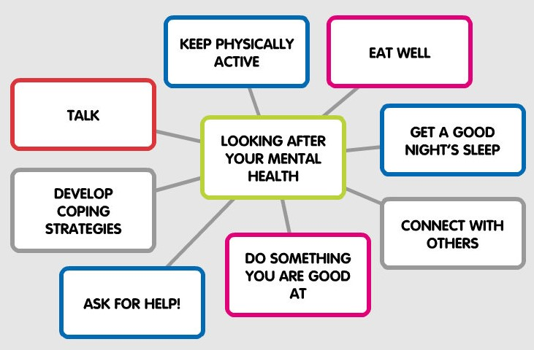


Maintaining Good Mental Health

Slide 30













Resources
Ask for HELP!

Slide 31
Rolls-Royce Young Apprenticeship Programme
Programme Length: 2 Years - 1 Day a Week
Join us on our Young Apprenticeship Programme to broaden your qualification portfolio, develop new skills, and strengthen applied skills in Math’s, English, Science, Engineering, and IT.
What is the programme?
The programme is delivered in partnership between Rolls-Royce and Derby College. Your practical and theoretical training will take place at the Rolls-Royce Learning and Development Centre at our dedicated Apprentice Academy.
All training is delivered by Derby College. It takes place one day per week during term time on a Thursday. You will remain in school for the rest of the week and follow your usual timetable. You’ll also attend a week’s work experience placement at a Rolls-Royce site in Derby during the programme.
Notes:
Youngsters and opportunities have changed so with that in mind we are hoping to offer this programme

Slide 32
Rolls-Royce Young Apprenticeship Programme 2024
What entry requirements are there?
You must be in Year 9 at the time of application and achieving a 95% or above attendance rate at school. You’ll also need to be studying Maths and English and Science (excluding Biology).
Alongside that, you’ll need:
An interest in the practical side of engineering and enjoy making things
To be open-minded, curious, and adaptable a love of learning and applying new skills.
You will also need to live within a reasonable travelling distance of the Rolls-Royce Apprentice Academy.
What qualifications do I receive?
If you successfully complete the course, you’ll receive Performing Engineering Operations L2 units and Level 2 Tech Award in Engineering.
Applications Open from: March until April 2025
Assessment Centres will be running in Mid-May [Dates TBC] for successful applications only.

Slide 33
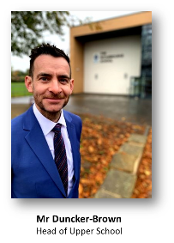
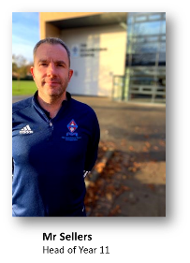
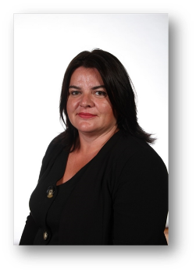
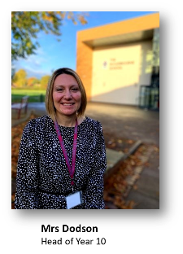
14+ process
14 + Evening
Meet Upper school team on 9th January 2025 for the post 14 options parents evening

