Slide 1

Year 10 Information Evening
Upper School Office Pastoral Team
The Ecclesbourne School
11th September 2024

Slide 2

This evening:
Vision and Aims
School Expectations and Attendance
Personal Development
Careers and Work Experience.
  Work experience week is the 30th June - 4th July 2025.
Support on offer for students

Slide 3
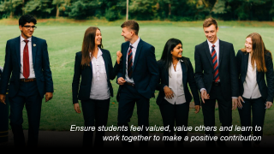
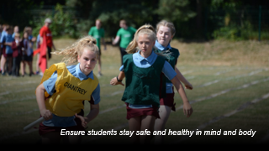
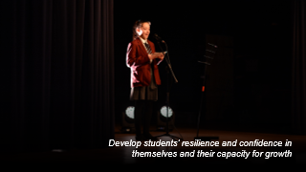



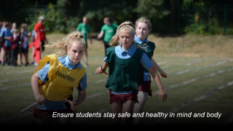
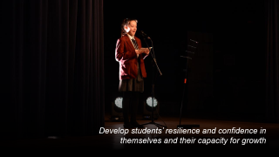




Vision & Aims

Slide 4

A broad and balanced curriculum that develops the knowledge and skills students need to thrive now and for a fulfilling future

Slide 5
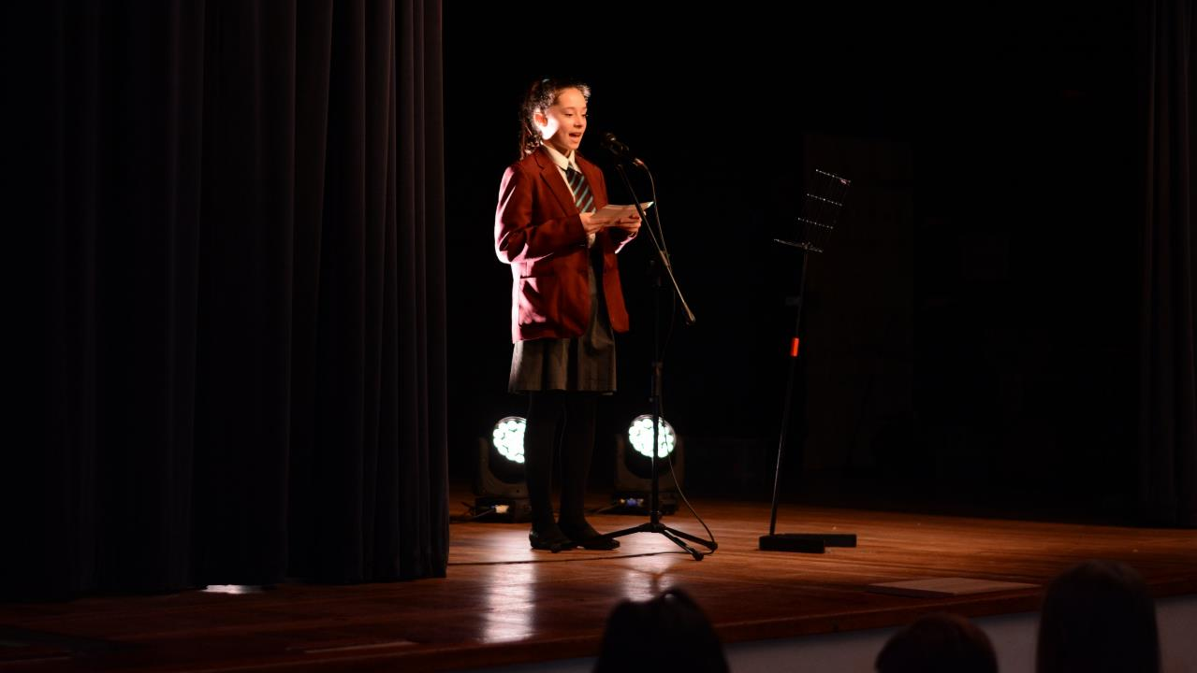
Develop students’ resilience and confidence in themselves and their capacity for growth

Slide 6

Ensure students feel valued, value others and learn to work together to make a positive contribution

Slide 7
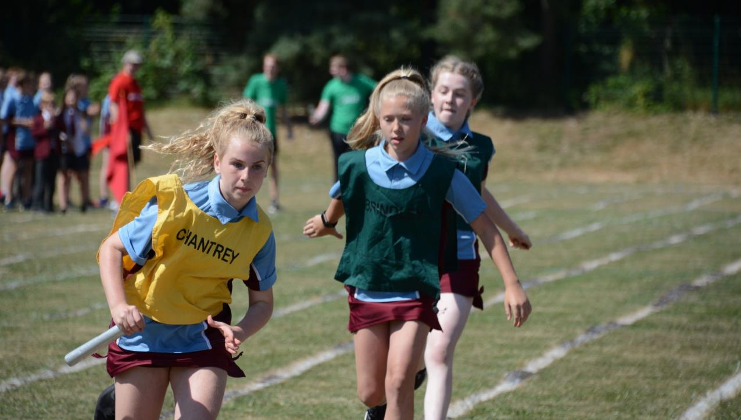
Ensure students stay safe and healthy in mind and body

Slide 8

Develop creativity in an innovative learning environment

Slide 9

Appreciate the spiritual, moral, social and cultural richness of the world at large

Slide 10

The Ecclesbourne School strives to be a successful and caring learning community that inspires individuals to meet the challenges of the future

Slide 11

CODE OF CONDUCT
Be respectful and avoid causing distress to others.
Always try your hardest and do your best.
Think about how you can give service and help those around you.
Work together with others to create a positive and supportive learning environment.
INTEGRITY | TENACITY | SERVICE
COURTESY
COMMUNITY
CO-OPERATION
COMMITMENT
Our theme for this term is Community
BE KIND AND THOUGHTFUL

Slide 12
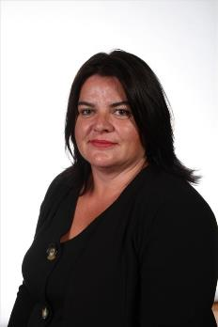
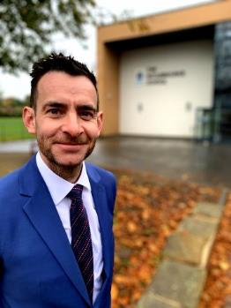
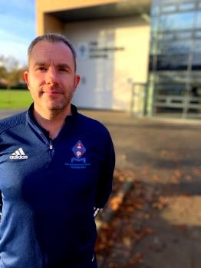
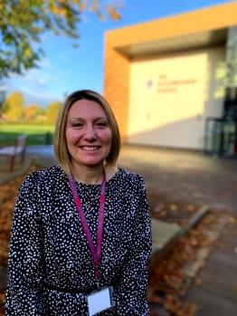
Pastoral Team
Mrs Ourabi
Head of Pastoral and DSL​
Mr Duncker-Brown
Head of Upper School
Mr Sellers
Head of Year 11
Mrs Dodson
Head of Year 10

Slide 13
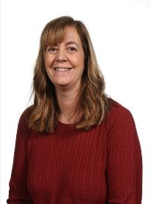
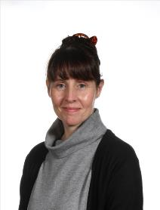
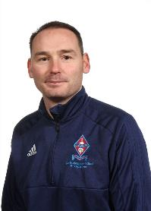
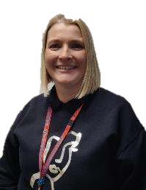
Pastoral Team
Mrs Parry
Progress Leader ​
Mrs Monk
Pastoral Support and Attendance Officer​
Mrs Tanser
Pastoral Support and School Nurse​
Mr Quail
​

Slide 14
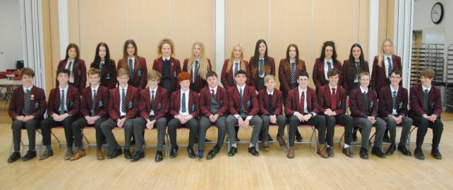
Year 10 Tutors
10E Mr Shaw
10C Mr Knapp
10L Miss Harcus
10S Mrs Daniels
10B Miss McCabe
10U Mr Forster
10R Mr Jordan
10N Mr Plant
10T Mrs Heraud

Slide 15
Key dates (Please note these can be subject to change)
12th September 2024 Y10 Photographs
27th September 2024 Prize Day
1st October 2023 WRAT (Wellbeing, Record of Achievement and Target setting) review process
4th November 2024 Whole School Closure Day
5th-8th November 2024 Community Week
28th November 2024 House Plays evening performance.
Interim reports will be issued in the week beginning 9th December 2024.
17th December 2024 WRAT (Wellbeing, Record of Achievement and Target setting) review
16th January 2025 Art Workshop
29th January 2025 Maths Challenge
12th February 2025 Stars in Your Eyes.
14-17th February 2025 Western Front Trip
26th February 2025 Year 10 Parents’ Evening.
Interim reports will be issued in the week beginning 21st March 2025.
5th April 2025 Whole School Closure Day
28th April-7th May (inclusive) 2025 Year 10 Exams will be from the.
Week beginning 2nd June 2025 Year 10 Language mock speaking exams.
30th June-4th July Work Experience.
Year 10 full reports will be published in the week beginning 30th June 2025.
8th July 2025 Work experience follow up in school.
14+15th/17th+18th July Y10 Geography Field work trip.
16th July 2025 Y10 Art Mock Exam

Slide 16
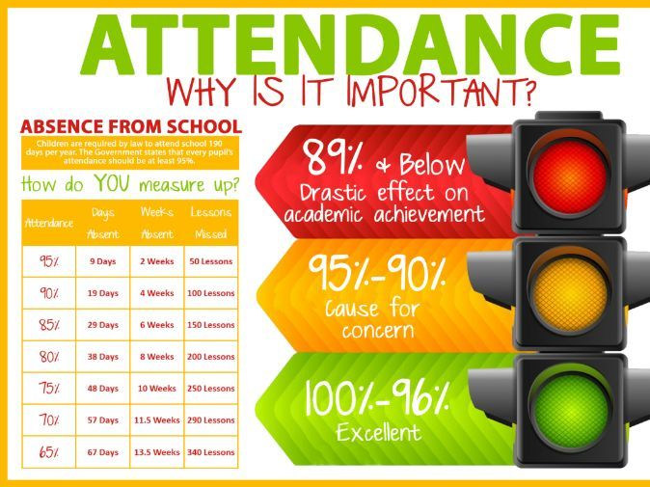
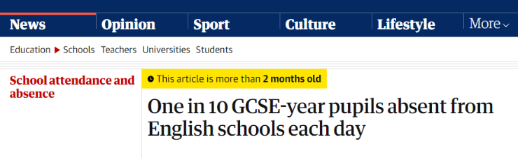

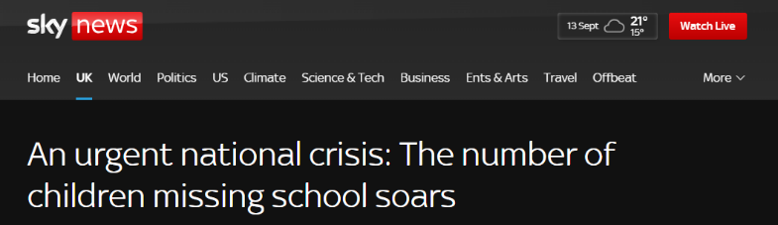
Attendance

Slide 17

Our Attendance Process
Set high expectations for attendance
Monitor data looking for patterns of absence for students and sub-groups
Listen and understand where problems emerge
Facilitate support to improve attendance
Formalise support
Liaise with the local authority

Slide 18
Behaviour Expectations
School will set high standards which all students are expected to adhere to​
High standards students expected to maintain communicated by school​
School will have routines and checks to help students maintain high standards​
Have clear sanctions in place where high standards are not maintained​
Monitor behaviour patterns looking at individuals and sub-groups​
Educate young people to reduce further incidents​
Share concerns and actions with parents​

Slide 19

Rewards
Merits.
Prize Giving.
Roll of Honour.
Merit/Colour Ties.
Sports Award Ceremony.
Governors Awards Evening.
Assembly Commendations/shared success.
Attendance Certificates.

Slide 20
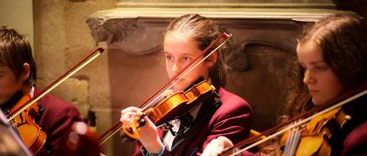
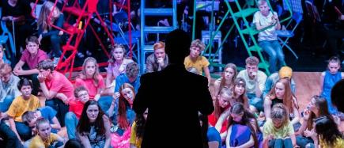

Extracurricular Activities
Sports teams and clubs
Music
Drama
House plays
Duke of Edinburgh
Trips and Visits
And there is a wide range of subject related clubs to go to!

Slide 21


Personal Development

Slide 22
Personal Development
PDC curriculum
Leadership opportunities
Wider curriculum
Assemblies
Pastoral support
Our VALUES

Slide 23

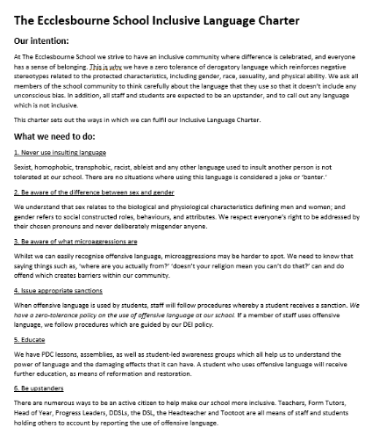
Code of Conduct / Inclusive Language Charter
Our VALUES

Slide 24
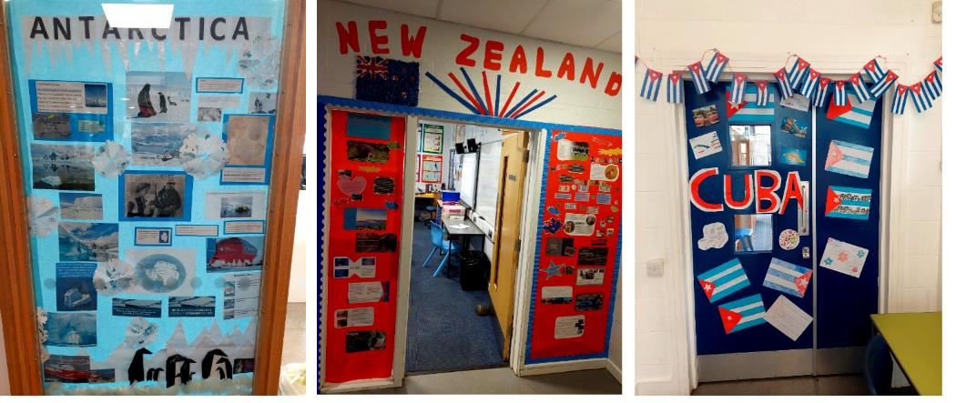
Community Week 2023

Slide 25
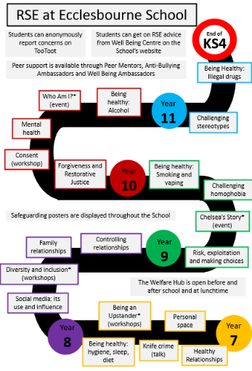
Personal Development, Citizenship and Careers
PDC
PDC curriculum

Slide 26

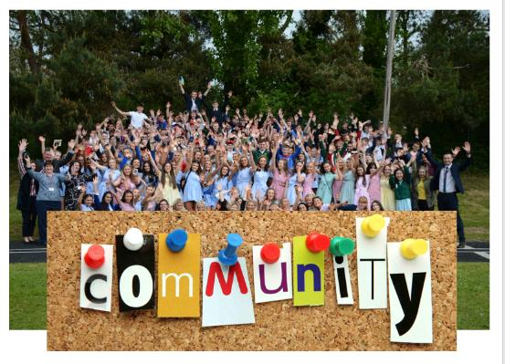



Assemblies

Slide 27
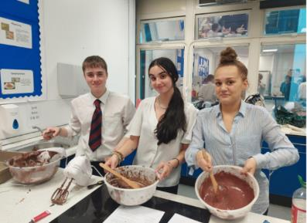
Leadership Opportunities
To get support* from:
Peer Mentors
Buddy Readers
House Captains
To get involved in:
Student Council
Well-Being Ambassadors*
Anti-Bullying Ambassadors*
Community Ambassadors
Reading Ambassadors

Slide 28
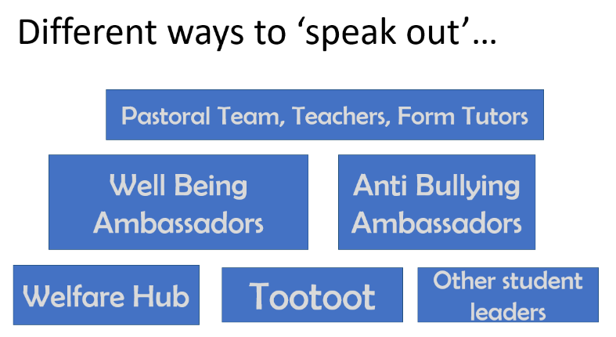

Pastoral Support

Slide 29
Academic and Pastoral Support

Slide 30
Support with work
Students should talk to their subject staff.
Talk to Upper School Office; i.e. their Head of Year or one of the wider team or their form tutor.
The library is available at lunchtimes and after school until 4.45pm.
We will also identify students throughout the year and offer them some subject specific tutoring.
We can also arrange for mentors.
Revision sessions are offered by a range of subjects as exams get closer.

Slide 31
USE HELPFUL APPS
Flipd is an app that stops you procrastinating and keeps you motivated.
Quizlet is a way of creating key word flashcards
How to use Flipd - YouTube
Learning tools and flashcards - for free! | Quizlet
Adapt helps you to create your own revision timetable.
Seneca has hundreds of tasks linked to specific exam courses
Adapt - free Revision Timetable App for A-level & GCSE (getadapt.co.uk)
Free Homework & Revision for A Level, GCSE, KS3 & KS2 (senecalearning.com)

Slide 32
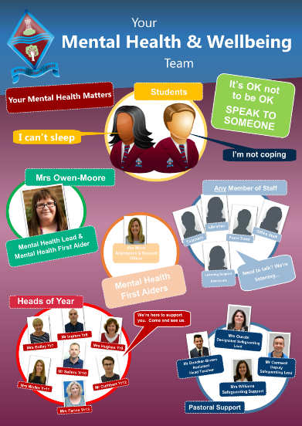
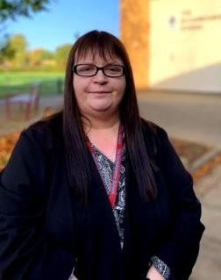
Mental Health Team
Most of Pastoral team is MHFA trained
2 Pastoral workers – Attendance and School nurse
Not experts
Mrs Owen-Moore
Deputy Head and Mental Health Lead​

Slide 33
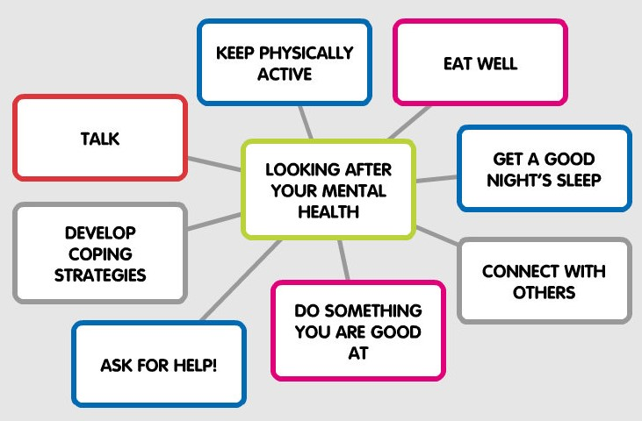


Maintaining Good Mental Health

Slide 34

Importance of Reading
In the school library we have many books that can help:
We have a wide range of fiction, reflect real-life situations and issues that young people face.
Our non-fiction includes self-help guidance and understanding mental health and illness.
READING WELL have an excellent selection of recommended reading, called "Books on Prescription" https://reading-well.org.uk/books/books-on-prescription
Sarah Brennan, Young Minds Chief Executive, said:
“Books can play a vital role in promoting the mental and emotional well being of young people. They help to break the isolation experienced by young people and demonstrate that their feelings and problems are not unique.”

Slide 35


Wellbeing Ambassadors
The Wellbeing Ambassadors establishes and supports an empowered team of young people to become leaders of wellbeing and mental health initiatives for their peers.
Assemblies.
Helping to run the wellbeing hub.

Slide 36













Resources
Ask for HELP!

Slide 37
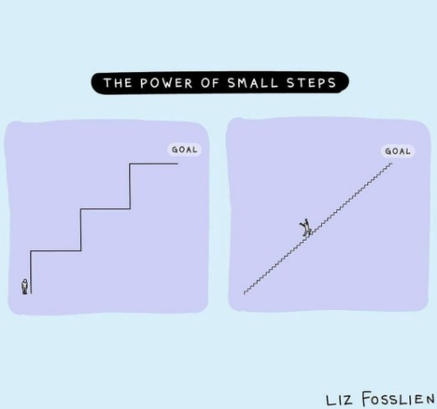
Revision Advice for Parents and Carers
Key Stage 4 | Ecclesbourne School

Slide 38
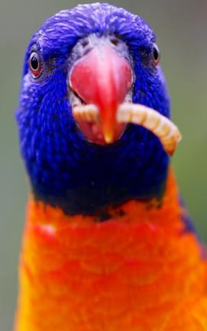
START EARLY
The more time your child gives themselves to revise, the more opportunity they have to cover each subject without needing to cram. They will be have more time to practise what they need to learn and consolidate it into their memory.

Slide 39

HELP THEM MAKE A REVISION TIMETABLE
You can ensure that your child devises a realistic revision programme for themselves. You can factor in events that might be happening.

Slide 40


GO SHOPPING FOR STATIONERY
Students know that they need to mix up the style of revision that they do. Having a range of different stationery will help them with that.

Slide 41

GET INVOLVED
It is definitely your child’s responsibility to revise! But now and again maybe you could test them on their flashcards. Ask them to explain their mind maps or PowerPoints.

Slide 42

BE ENCOURAGING AND CELEBRATE MINI GOALS
We encourage the students to set themselves a small number of mini goals to achieve at the end of each day.

Slide 43

HELP THEM TO NOT GET DISTRACTED
What distracts your child? Their phone? YouTube? Talk with them to decide the best strategies for avoiding distractions, e.g. phone in a different room, 10 internet rewards for 40 minutes revision.

Slide 44

GET A GOOD BALANCE
Plenty of sleep
Healthy snacks
Going for walks
Exercise

