Slide 2
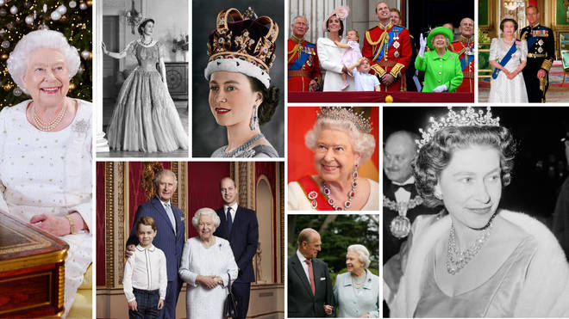

Slide 3
Year 7 Ecclesbourne school competition

Slide 4
YEAR 7 AND QUEENS PLATINUM JUBILEE –
(Celebration weekend Thursday 2nd June to Sunday 5th June )
Competition Launch Monday April 25th
Due by Friday 13th May
Every entry receives a merit for their house – merit cup
Tea party Friday May 27th period 5 for winners 1,2,3 in each subject and platinum badges
The student who enters the most – plant a tree
Subject staff to Judge for the winners

Slide 5
Each child that enters receives a merit for their house
The winners s first , second and third in each subject involved will attend a jubilee tea party period 5 on Friday 27th May
The ideas I have so far , and pleaes feel free to correct them or suggest an alternative ,
Art – a portrait of the Queen
We are happy to launch it and they do it in their own time – deadline May 13th
Or if there was room for them to do it in their art lessons that would be ok too.

Slide 6
Year 7
Portrait of the Queen
Art Competition
Each child that enters receives a merit for their house
The winners s first , second and third in each subject involved will attend a jubilee tea party period 5 on Friday 27th May
The ideas I have so far , and pleaes feel free to correct them or suggest an alternative ,
Art – a portrait of the Queen
We are happy to launch it and they do it in their own time – deadline May 13th
Or if there was room for them to do it in their art lessons that would be ok too.

Slide 7
Create a portrait to help
celebrate the
Queen’s Platinum Jubilee.

Slide 8
You may work in any style
or use any media from
collage to pencil or paint.

Slide 9
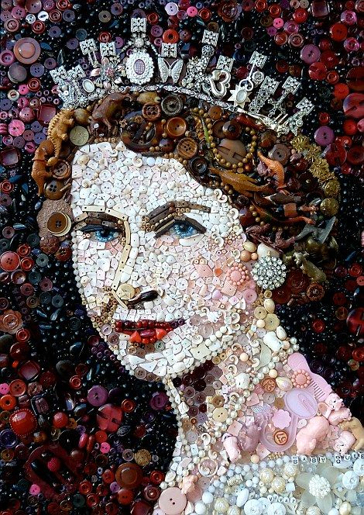
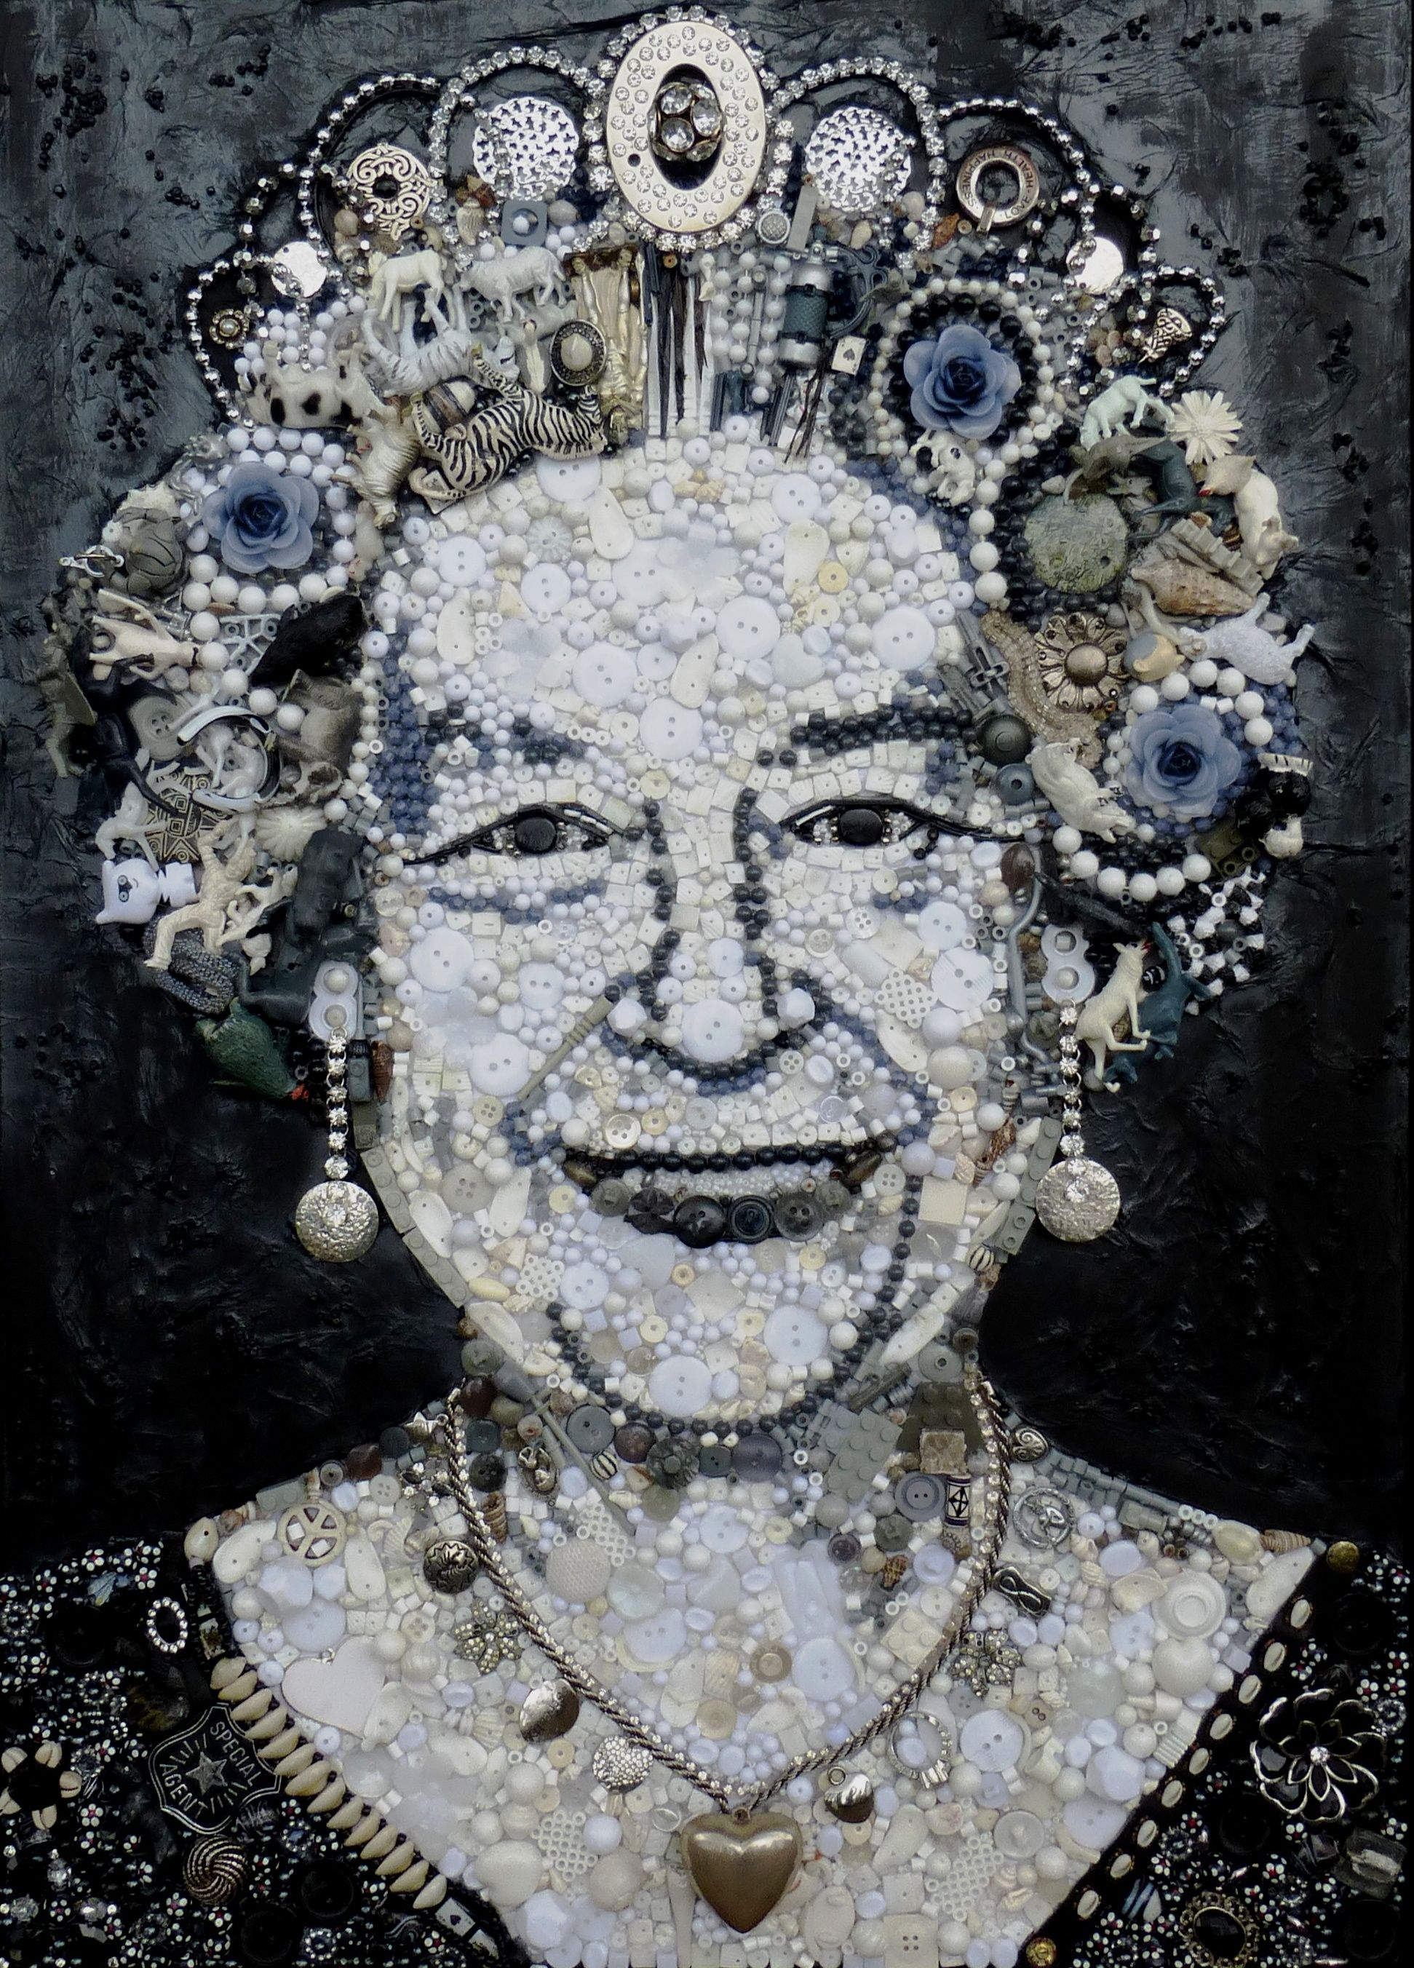
Here are some ideas…
Found material Collage

Slide 10
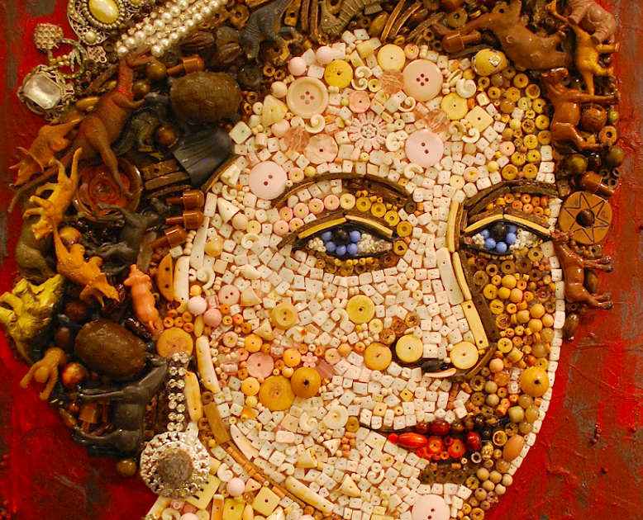
Here are some ideas…
Found material Collage

Slide 11
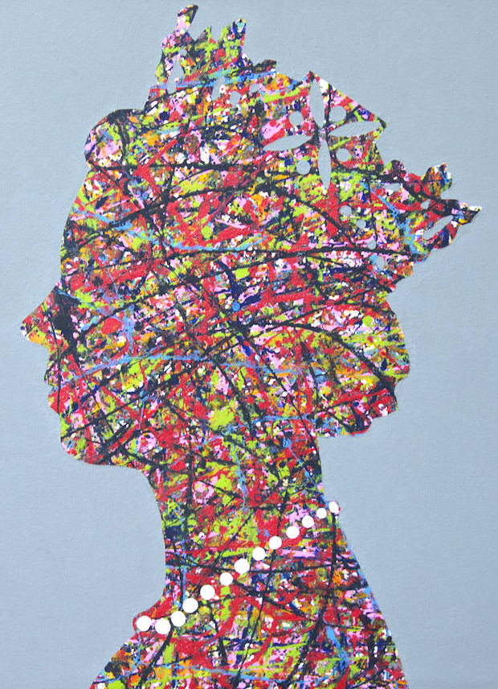
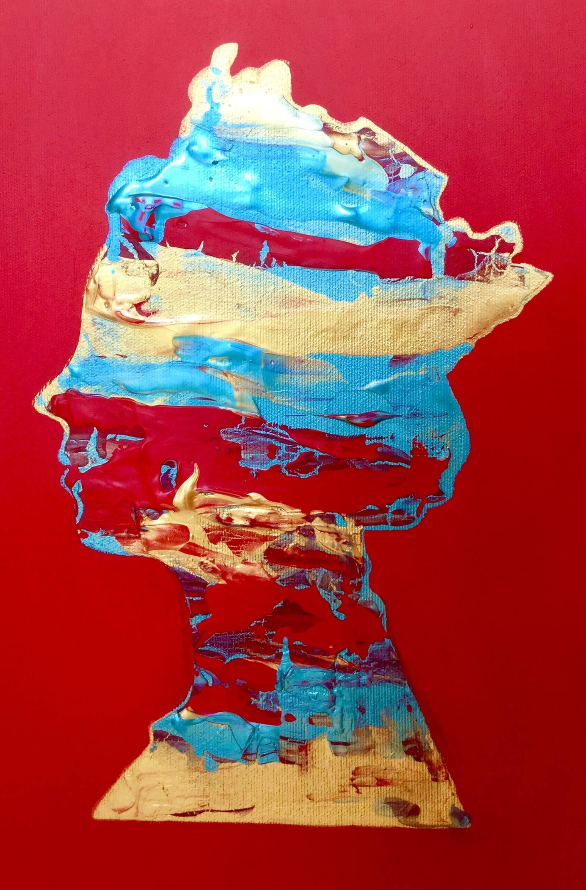
Here are some ideas…
Creative silhouettes

Slide 12
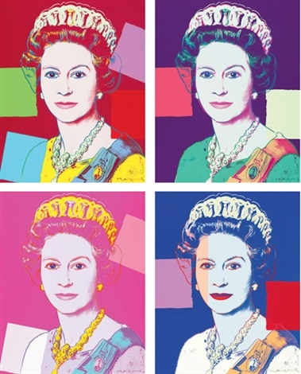
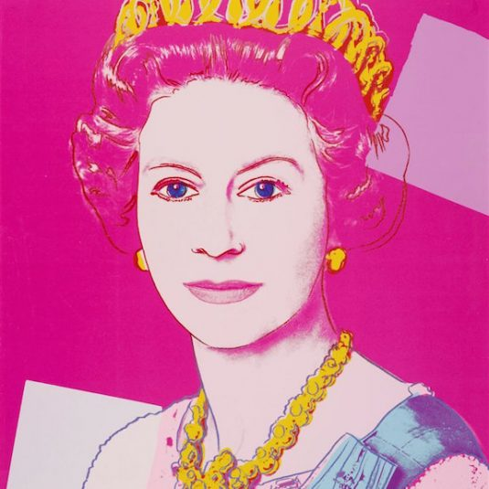
Here are some ideas…
Pop Art Style

Slide 13
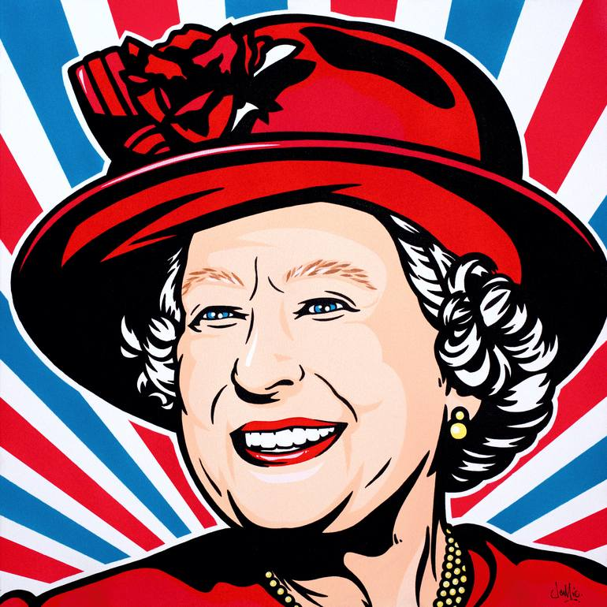
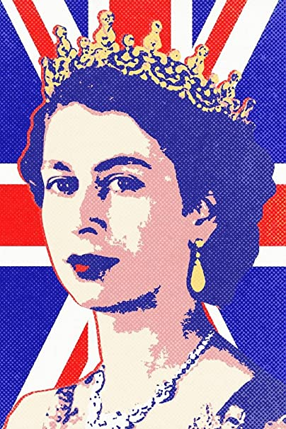
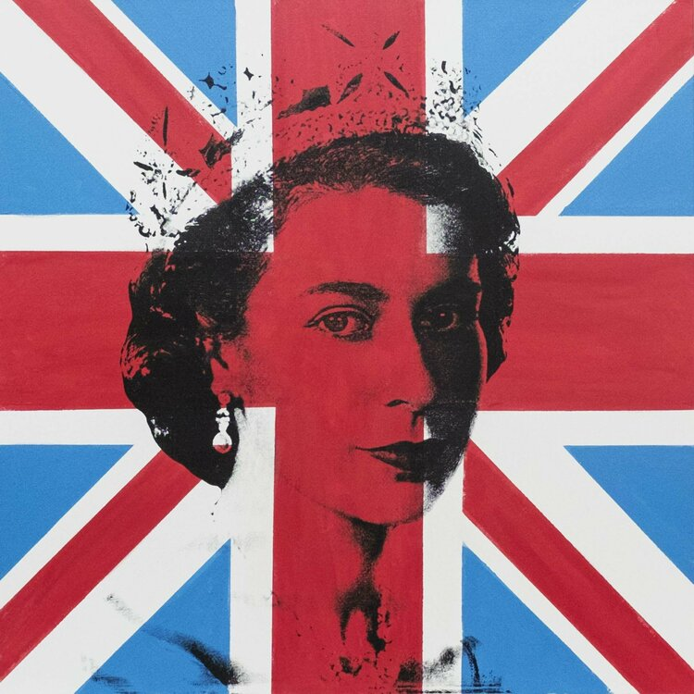
Here are some ideas…
With the Union Jack

Slide 14
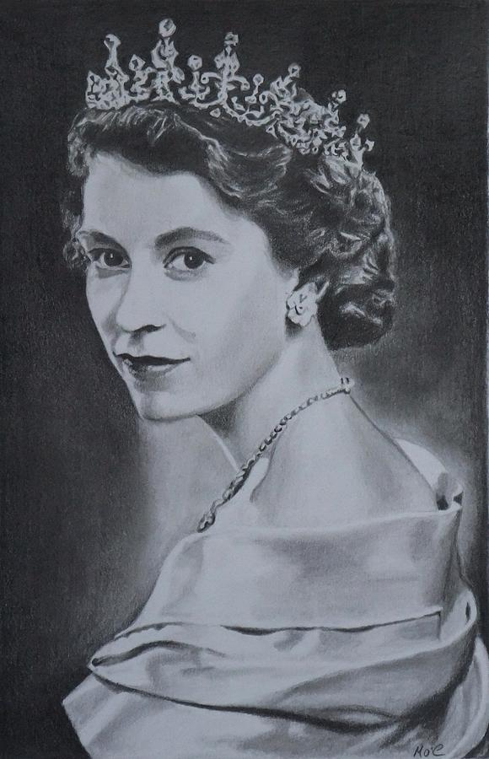
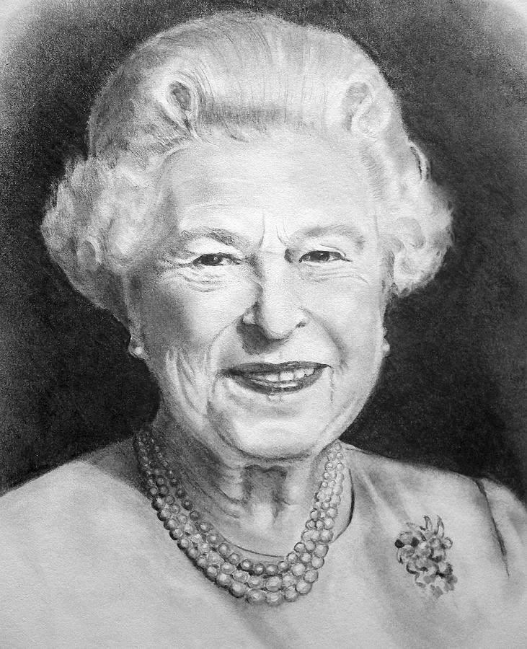
Here are some ideas…
Simply using pencil.

Slide 15
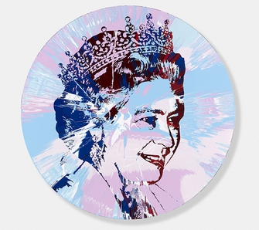
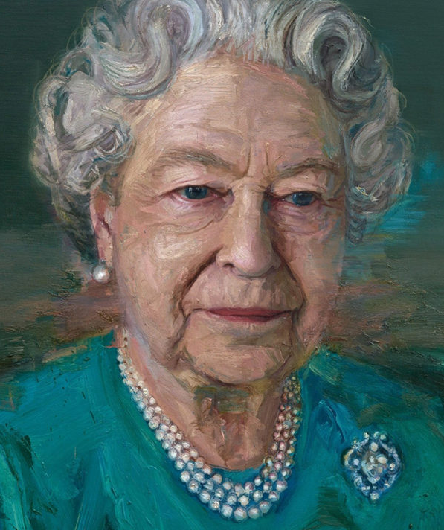
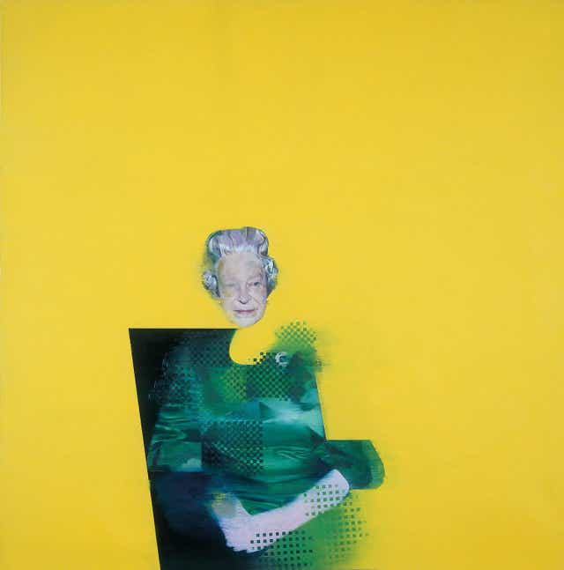
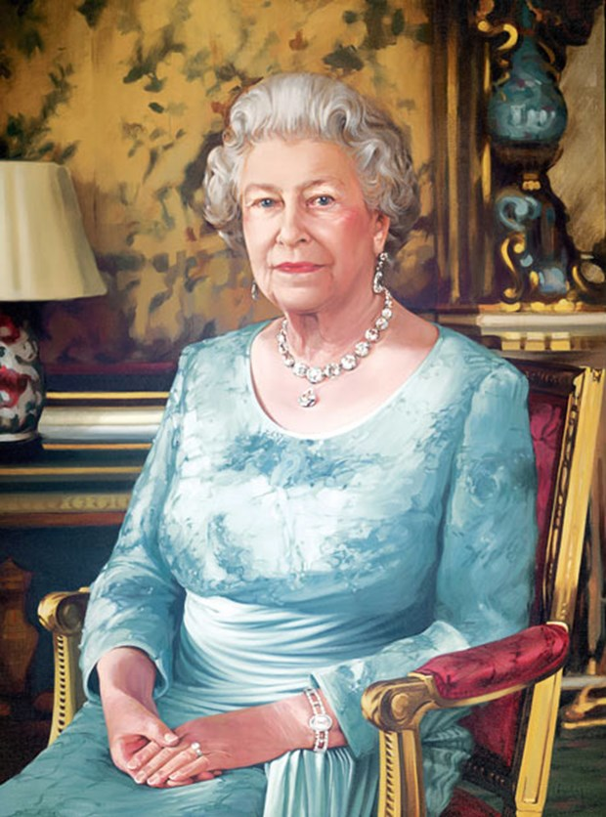
Here are some ideas…
or even using
paint.

Slide 16
What will
YOU
Create?

Slide 17
Every entry earns a merit
for their house.
The winner, runner up and third place
entries will attend a Jubilee Tea Party
Period 5 on Friday 27th May.
The deadline to enter is
Friday 13th May.

Slide 18
Each child that enters receives a merit for their house
The winners s first , second and third in each subject involved will attend a jubilee tea party period 5 on Friday 27th May
The ideas I have so far , and pleaes feel free to correct them or suggest an alternative ,
Art – a portrait of the Queen
We are happy to launch it and they do it in their own time – deadline May 13th
Or if there was room for them to do it in their art lessons that would be ok too.

Slide 19
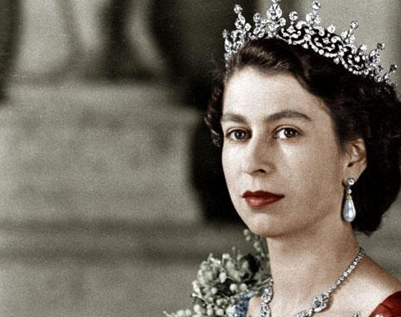
Computer Science
Collect a puzzle sheet from your ICT teacher.
Hand it in to Mr Harrison (Lower School Office) by 13 May 2022
This Photo by Unknown Author is licensed under CC BY-SA-NC

Slide 20
Each child that enters receives a merit for their house
The winners s first , second and third in each subject involved will attend a jubilee tea party period 5 on Friday 27th May
The ideas I have so far , and pleaes feel free to correct them or suggest an alternative ,
Art – a portrait of the Queen
We are happy to launch it and they do it in their own time – deadline May 13th
Or if there was room for them to do it in their art lessons that would be ok too.

Slide 24
Each child that enters receives a merit for their house
The winners s first , second and third in each subject involved will attend a jubilee tea party period 5 on Friday 27th May
The ideas I have so far , and pleaes feel free to correct them or suggest an alternative ,
Art – a portrait of the Queen
We are happy to launch it and they do it in their own time – deadline May 13th
Or if there was room for them to do it in their art lessons that would be ok too.

Slide 25
Let’s write like a laureate…
The British Poet Laureate is an honorary position appointed by the monarch of the United Kingdom, currently on the advice of the prime minister.
The role does not entail any specific duties, but there is an expectation that the holder will write verse for significant national occasions.
The first official holder of the position was John Dryden, appointed in 1668 by Charles II. The holder of the position as at January 2022 is Simon Armitage who succeeded Carol Ann Duffy in May 2019.
The payment for this post is rather unusual, in that it is £5,750 per annum and a barrel of sherry!!!

Slide 26
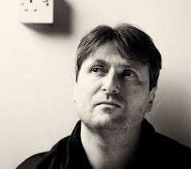
Let’s write like a laureate…
On the next slide are some extracts and examples of poems that Simon Armitage (the current poet laureate has written).
Cocoon was written in recognition of the relaxing of rules after the pandemic
The Patriarchs – an Elegy was written to mark the death of Prince Philip, the Duke of Edinburgh
Ode to a Clothes Peg – was written about a…clothes peg!!!
So being poet laureate is a huge responsibility but looks like it can be fun too!!

Slide 27
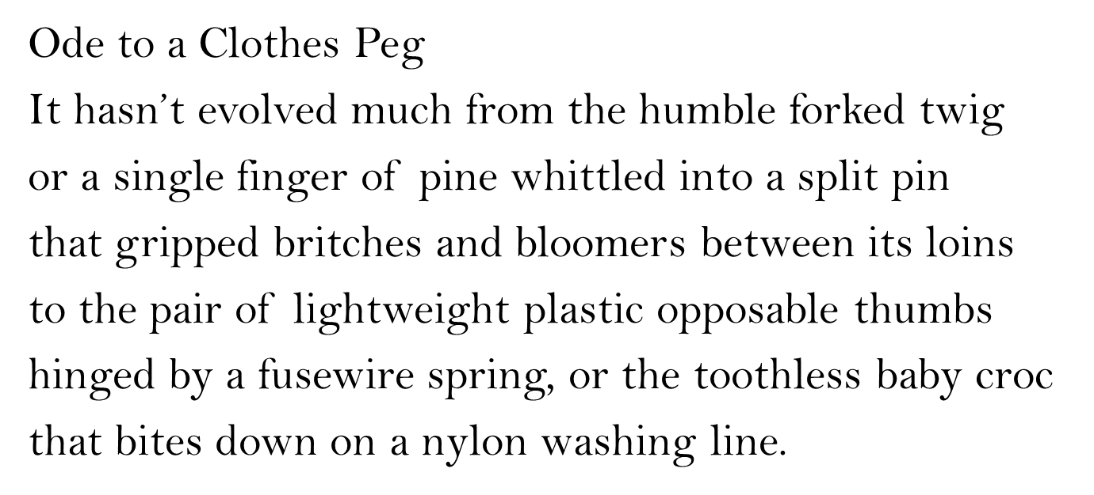
Some examples (and extracts from) the work of the current poet laureate Simon Armitage
COCOON
Where did the world go?
Once round the sun then landed us right here
Back where we started from
Conquistadors of the high street and malls
Bold explorers of swimming baths and service stations
And superstores. Pioneers of the new world
Which is the old world wearing a nervous smile
Think of your hand or arm brushing actual skin
Imagine breathing a stranger in
First contact, close encounters
A butterfly yawns and hoists its new born wings
To the full blown dawn
Once round the sun then the doors open and
Touch wood, cross fingers, cue fanfare
Out we come.

Slide 28
Let’s write like a laureate…
Your task is to write like a laureate by….
Writing a poem to commemorate the Queen’s Platinum Jubilee (70 years on the throne)
Your poem can be written in any form (eg. Sonnet, villanelle, in quatrains, concrete – or shape – poem, ballad etc)
Aim to write at least 12 lines – it does not have to rhyme!!!

Slide 29
Let’s write like a laureate…
Queen Elizabeth II is the longest reigning British monarch ever and the 4th longest reigning monarch in the world.
She's the only person in the UK allowed to drive without a licence.
Her favourite dogs are corgis
She has worked with 14 different Prime Ministers in her lifetime and….
The ‘royal prerogative’ means that the Queen can dismiss a prime minister.
I’m sure you’ll be able to find out lots more interesting and unusual ideas to inspire your poem…
Some interesting facts…

Slide 30
Let’s write like a laureate…
You should
aim to write at least 12 lines
Write it out neatly and hand it in to your English teacher
You can type it but you will need to print it out
You can illustrate it but you DO NOT have to.
Hand it in by Friday 13th May
And enjoy ☺
What do I need to do?

Slide 31
Each child that enters receives a merit for their house
The winners s first , second and third in each subject involved will attend a jubilee tea party period 5 on Friday 27th May
The ideas I have so far , and pleaes feel free to correct them or suggest an alternative ,
Art – a portrait of the Queen
We are happy to launch it and they do it in their own time – deadline May 13th
Or if there was room for them to do it in their art lessons that would be ok too.

Slide 32
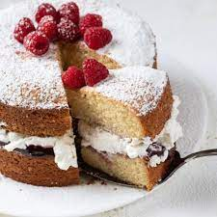
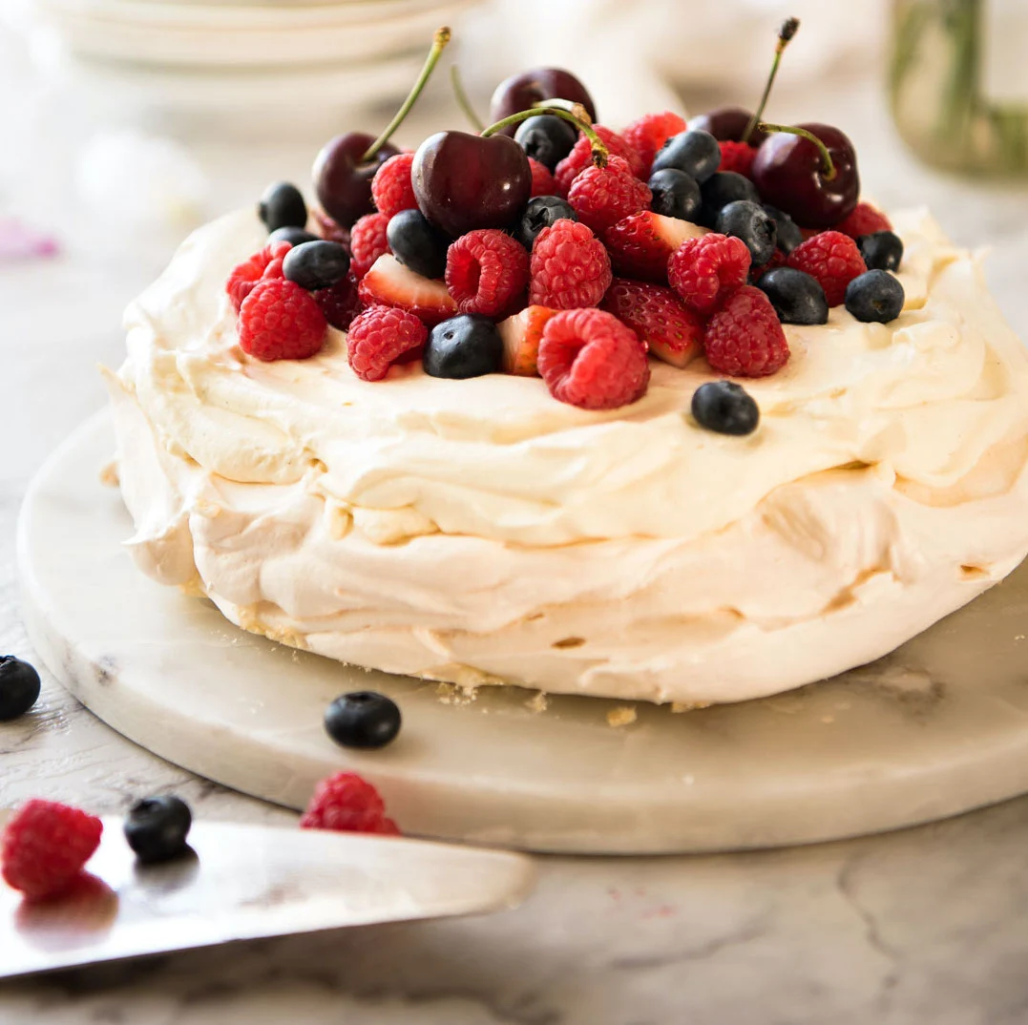
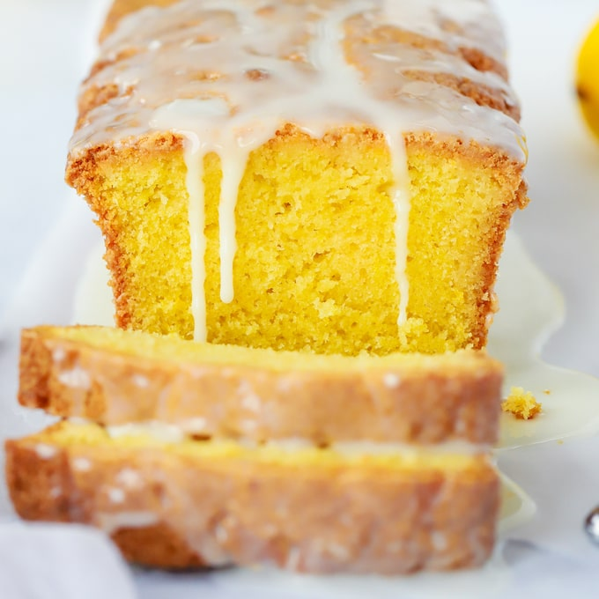
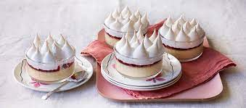
The Platinum Pudding competition
You are going to design, make and bake a pudding suitable for the Queens Platinum Jubilee
Your pudding should be suitable to be served at a Tea Party to celebrate the Queens Platinum Jubilee. Each entry will gain a merit for your House and the winners, whose pudding best reflects the 70 year reign of The Queen will be invited to a Tea Party on Friday 27th May!​
Bring a photograph and description of your pudding to either Mrs Stott or Mrs Vernon by Friday 13th May!​

Slide 33
Each child that enters receives a merit for their house
The winners s first , second and third in each subject involved will attend a jubilee tea party period 5 on Friday 27th May
The ideas I have so far , and pleaes feel free to correct them or suggest an alternative ,
Art – a portrait of the Queen
We are happy to launch it and they do it in their own time – deadline May 13th
Or if there was room for them to do it in their art lessons that would be ok too.

Slide 34
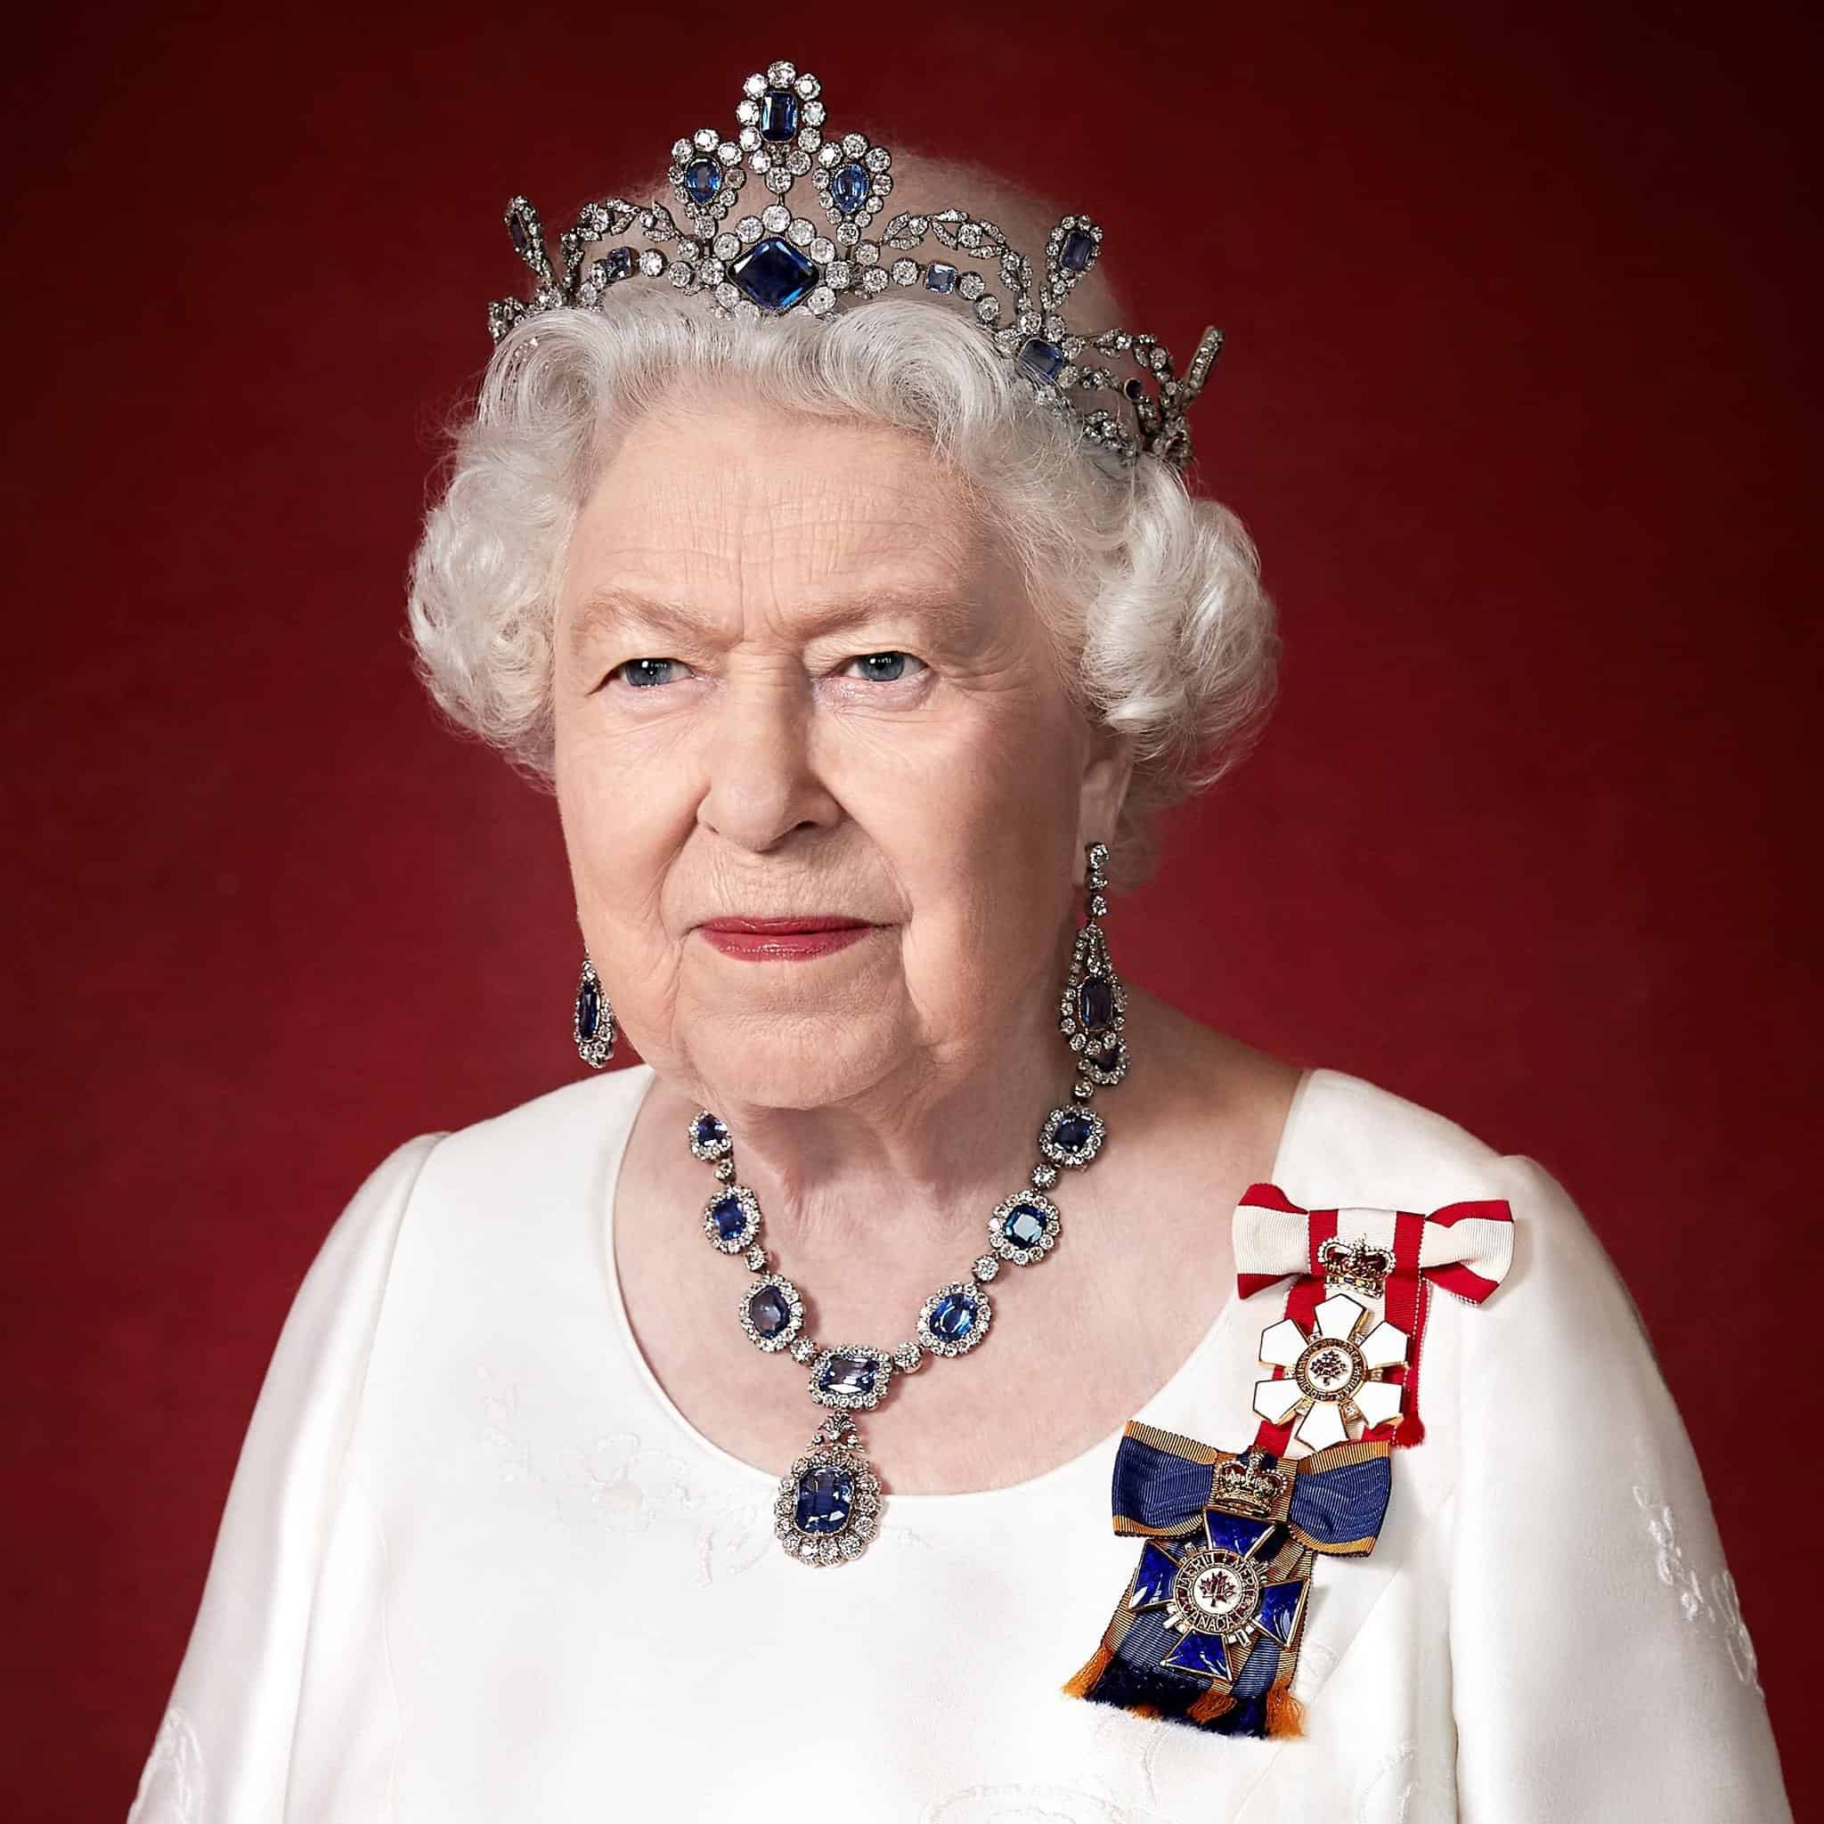
Design a poster to describe the qualities and character of the Queen in a language of your choice – French , Spanish or German
Submit to Mr Sutton by Friday 13th may

Slide 35
Each child that enters receives a merit for their house
The winners s first , second and third in each subject involved will attend a jubilee tea party period 5 on Friday 27th May
The ideas I have so far , and pleaes feel free to correct them or suggest an alternative ,
Art – a portrait of the Queen
We are happy to launch it and they do it in their own time – deadline May 13th
Or if there was room for them to do it in their art lessons that would be ok too.

Slide 36
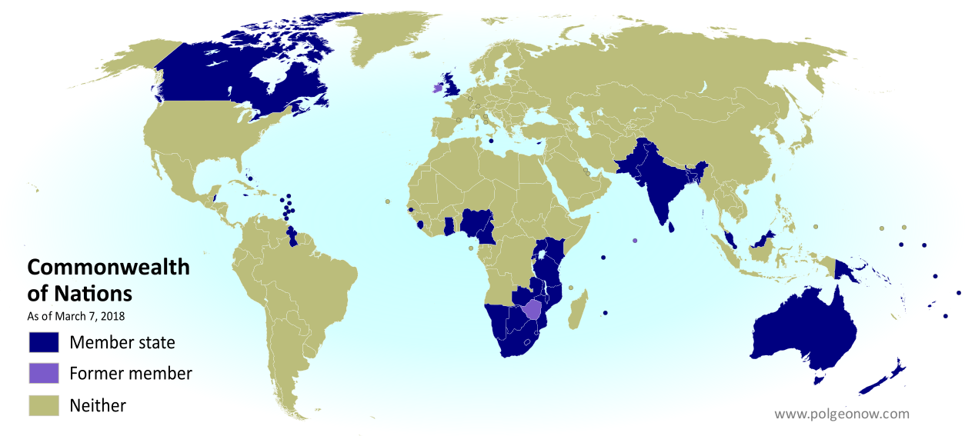
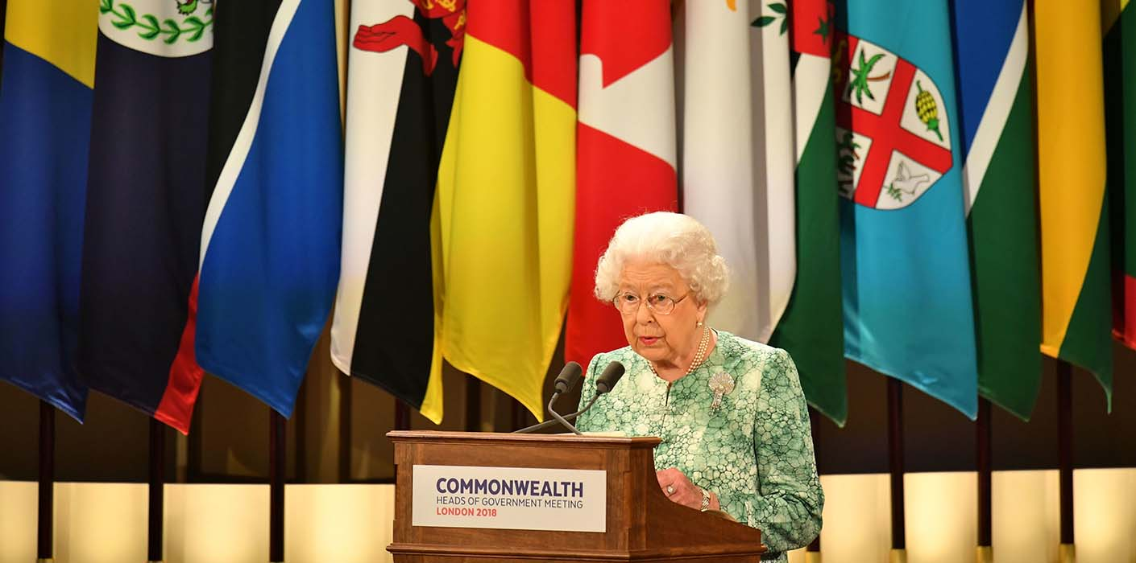
Geography: Who is in the Commonwealth?
The Commonwealth is an association of countries across the world. Although historically connected to the British Empire, any country can apply to be a member of the Commonwealth. The Commonwealth consists of 54 countries, including the United Kingdom. Queen Elizabeth is the head of the Commonwealth. All entries due to Mr Beardsley by Friday 13th May
How to enter:
Create a timeline, as creatively as you can, that details when each of the 54 countries joined the Commonwealth (hint: UK, Canada, Australia, New Zealand and South Africa were founding members in 1931 and Rwanda is the most recent to join in 2009).
To accompany your timeline create a colour coded map to show where each country is and when they joined i.e. UK, Canada, Australia, New Zealand and South Africa should all be coloured the same – remember to include a key!

Slide 37
Each child that enters receives a merit for their house
The winners s first , second and third in each subject involved will attend a jubilee tea party period 5 on Friday 27th May
The ideas I have so far , and pleaes feel free to correct them or suggest an alternative ,
Art – a portrait of the Queen
We are happy to launch it and they do it in their own time – deadline May 13th
Or if there was room for them to do it in their art lessons that would be ok too.

Slide 38
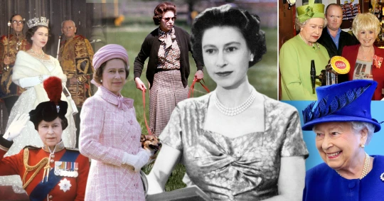
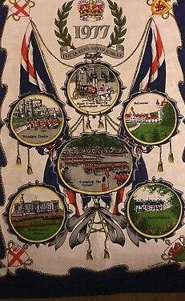
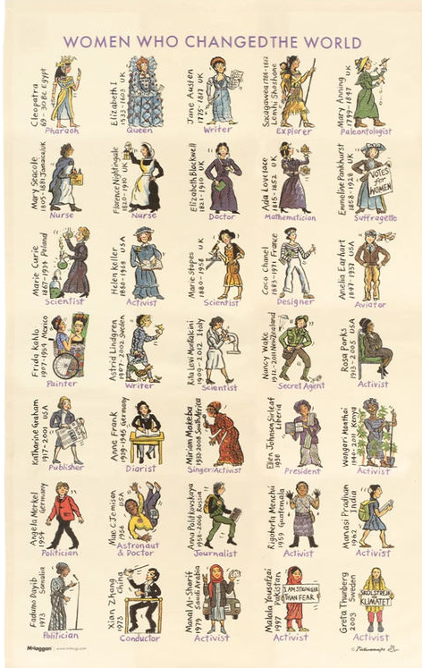
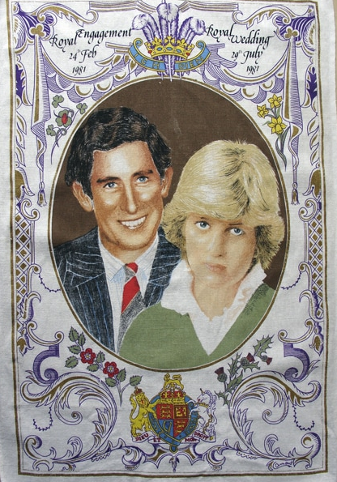
The Platinum Jubilee History Challenge!
For the History Department, the Platinum Jubilee means two things:
Celebrating 70 years of modern British history.
Those naff commemorative tea towels.
Challenge: We would like you to combine the two and improve the quality of Royal tea towels for the 70th Jubilee.
Create a design for a commemorative tea towel that celebrates 70 years of British history
You could:
Celebrate events related to Elizabeth II’s time as queen
or
Observe important events in British history from 1952 to present
Bring your design to Mr Cuthbert (A1) by Friday 13th May to win a place at the Tea Party on the 27th May. Each entry will be rewarded with a house point.
Less like these…and more like this!

Slide 39
Each child that enters receives a merit for their house
The winners s first , second and third in each subject involved will attend a jubilee tea party period 5 on Friday 27th May
The ideas I have so far , and pleaes feel free to correct them or suggest an alternative ,
Art – a portrait of the Queen
We are happy to launch it and they do it in their own time – deadline May 13th
Or if there was room for them to do it in their art lessons that would be ok too.

Slide 40
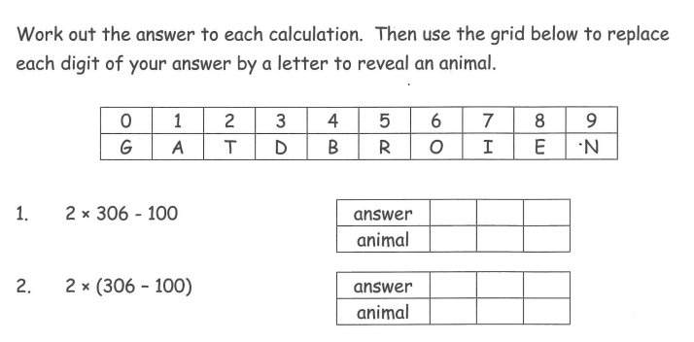
The Platinum Maths competition
You are going to design, make and solve a maths code themed around the Queens Platinum Jubilee
Your code could be based on any maths topic area. Each entry will gain a merit for your House and the winners, whose code best reflects the 70 year reign of The Queen will be invited to a Tea Party on Friday 27th May!​
email a copy your code to mweighill@ecclesbourne.derbyshire.sch.uk
by 9am Friday 13th May!​
Please send the code and also the answers to qualify

Slide 41
Each child that enters receives a merit for their house
The winners s first , second and third in each subject involved will attend a jubilee tea party period 5 on Friday 27th May
The ideas I have so far , and pleaes feel free to correct them or suggest an alternative ,
Art – a portrait of the Queen
We are happy to launch it and they do it in their own time – deadline May 13th
Or if there was room for them to do it in their art lessons that would be ok too.

Slide 42
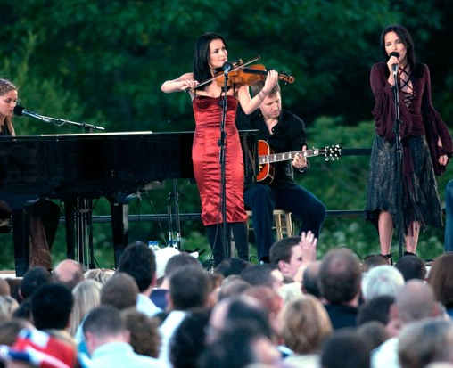
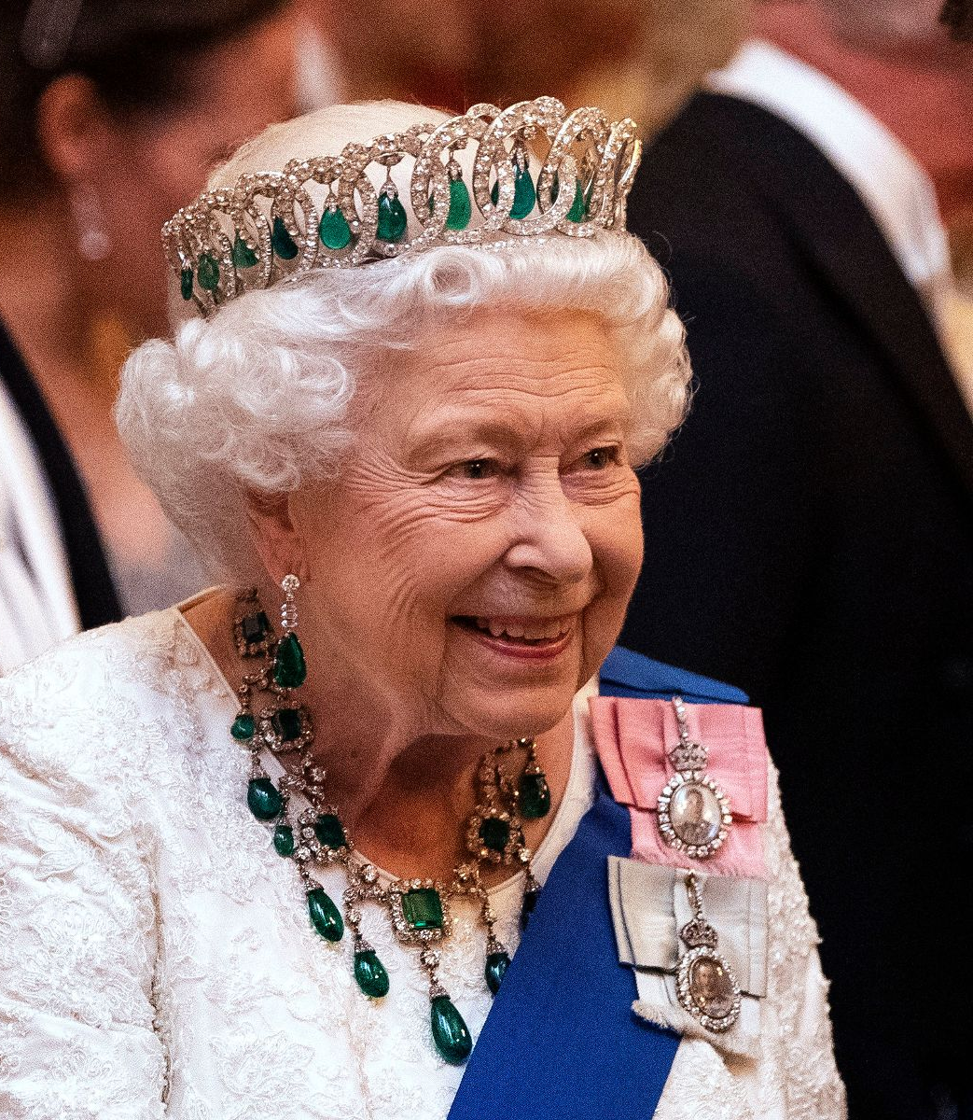
Music Competition – Queen 70 years !
Write and perform a song.
The competition will be explained to you in your music lessons .
You can then work on it in your own time.
You will present to your music teachers lunch time of the 12th May
1,2 and 3rd winners go to the tea party

Slide 43
Each child that enters receives a merit for their house
The winners s first , second and third in each subject involved will attend a jubilee tea party period 5 on Friday 27th May
The ideas I have so far , and pleaes feel free to correct them or suggest an alternative ,
Art – a portrait of the Queen
We are happy to launch it and they do it in their own time – deadline May 13th
Or if there was room for them to do it in their art lessons that would be ok too.

Slide 44
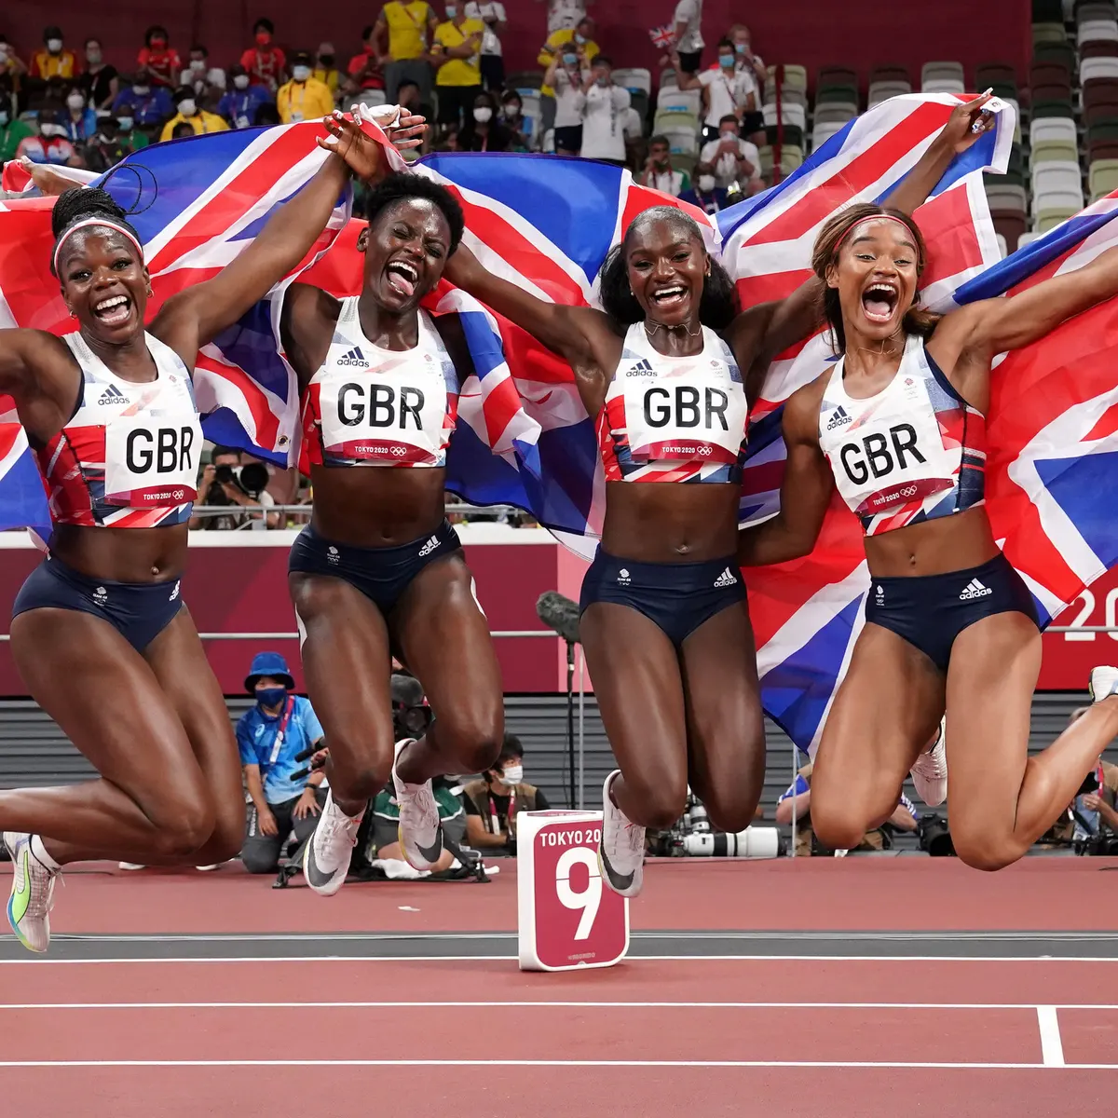
Physical Education
Jubilee celebration for PE. Can you design a new Commonwealth games athletics kit for team GB to celebrate. This of the colours and themes that make GB unique!

Slide 45
Each child that enters receives a merit for their house
The winners s first , second and third in each subject involved will attend a jubilee tea party period 5 on Friday 27th May
The ideas I have so far , and pleaes feel free to correct them or suggest an alternative ,
Art – a portrait of the Queen
We are happy to launch it and they do it in their own time – deadline May 13th
Or if there was room for them to do it in their art lessons that would be ok too.

Slide 46
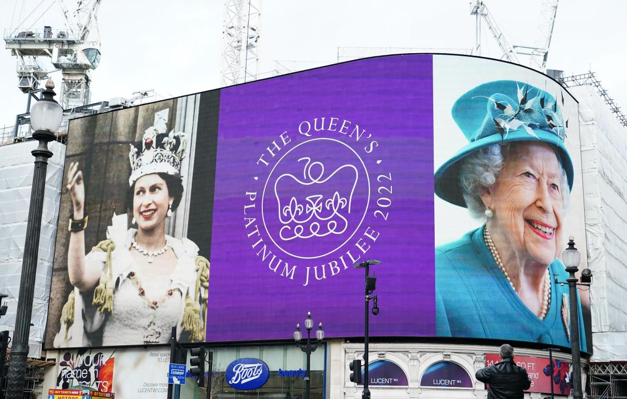
The Queens Platinum Jubilee competition- Religious Studies
HOW TO ENTER
Choose a charity that the Queen supports
Design a poster and report on what the charity does and why it does it.
Find 3 religious teachings that say something important about charity.
Entries to Mrs Owen-Moore by Friday 13th May
The Queen is patron to a lot of Charities and organisations.
Charity is really important in all the 6 major world religions we study.

Slide 47
Each child that enters receives a merit for their house
The winners s first , second and third in each subject involved will attend a jubilee tea party period 5 on Friday 27th May
The ideas I have so far , and pleaes feel free to correct them or suggest an alternative ,
Art – a portrait of the Queen
We are happy to launch it and they do it in their own time – deadline May 13th
Or if there was room for them to do it in their art lessons that would be ok too.

Slide 48
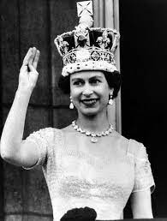
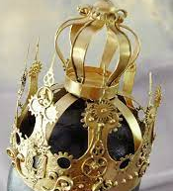
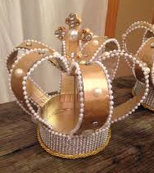
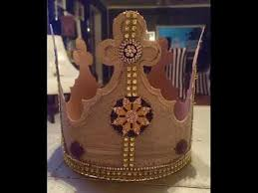
Create a crown and be monarch for a day!
Use the D&T workshop to assemble using corrugated card and hot-glue.

Slide 49
Each child that enters receives a merit for their house
The winners s first , second and third in each subject involved will attend a jubilee tea party period 5 on Friday 27th May
The ideas I have so far , and pleaes feel free to correct them or suggest an alternative ,
Art – a portrait of the Queen
We are happy to launch it and they do it in their own time – deadline May 13th
Or if there was room for them to do it in their art lessons that would be ok too.

Slide 50
Science Competition
In 2022, Her Majesty The Queen will become the first British Monarch to celebrate a Platinum Jubilee after 70 years of service.
Since her coronation in 1953 there have been many Scientific discoveries and advances in Science. We want you to decide which is the best Scientific discovery which has taken place since 1953 – 2022, along with a reason why you think this is the best and how it was discovered.
Create a poster detailing the following:
The Scientific discovery
How it was discovered and who it was discovered by
Why this is useful and needed in this day and age
Why it is the best discovery in your opinion
All entries to Mrs Butler by Friday 13th May

Slide 51
Each child that enters receives a merit for their house
The winners s first , second and third in each subject involved will attend a jubilee tea party period 5 on Friday 27th May
The ideas I have so far , and pleaes feel free to correct them or suggest an alternative ,
Art – a portrait of the Queen
We are happy to launch it and they do it in their own time – deadline May 13th
Or if there was room for them to do it in their art lessons that would be ok too.

Slide 52
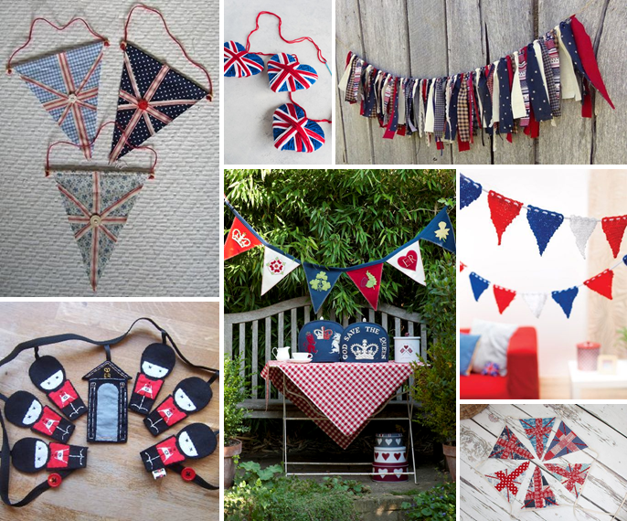
The Queens Platinum Jubilee Textiles Competition
How to Enter
Using whatever materials you can find borrow or buy, create a piece of bunting that celebrates the Queens Platinum Jubilee.
Each piece of bunting will be added to larger string of bunting to celebrate the Queens Jubilee. Each entry will gain a merit for your House and the winners, whose piece best reflects the 70 year reign of The Queen will be invited to a Jubilee Tea Party on Friday 27th May!
Bring your entries to either Miss Wint or Mrs Swan by Friday 13th May!

Slide 53
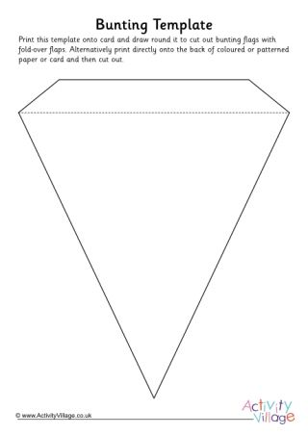

Slide 54
Each child that enters receives a merit for their house
The winners s first , second and third in each subject involved will attend a jubilee tea party period 5 on Friday 27th May
The ideas I have so far , and pleaes feel free to correct them or suggest an alternative ,
Art – a portrait of the Queen
We are happy to launch it and they do it in their own time – deadline May 13th
Or if there was room for them to do it in their art lessons that would be ok too.

