Slide 1
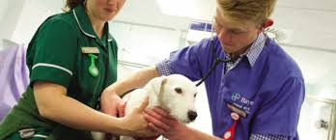
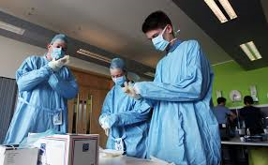
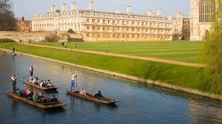
Making an early application – Oxford, Cambridge, Medicine, Dentistry, Veterinary Science

Slide 2
One of these…
+ four other universities
All course choices see the same personal statement.
Don’t mention Oxford/Cambridge by name.

Slide 3
Four applications for medicine, dentistry or veterinary science
+ one back up options e.g. biomedical science

Slide 4
Early entry application cycle
Choose your five universities
Complete the your UCAS application online
Complete pre-interview assessments and exams
Initial ideas/first draft = 17th July
Second draft= 4th September
Final draft = 25th September
Sent to UCAS by 15th October
Oxbridge = early December
M/D/V = December -March
Interviews and “at-interview” assessments
Make choices
Result of application
Oxbridge = Early January
M/D/V = May at the latest

Slide 5
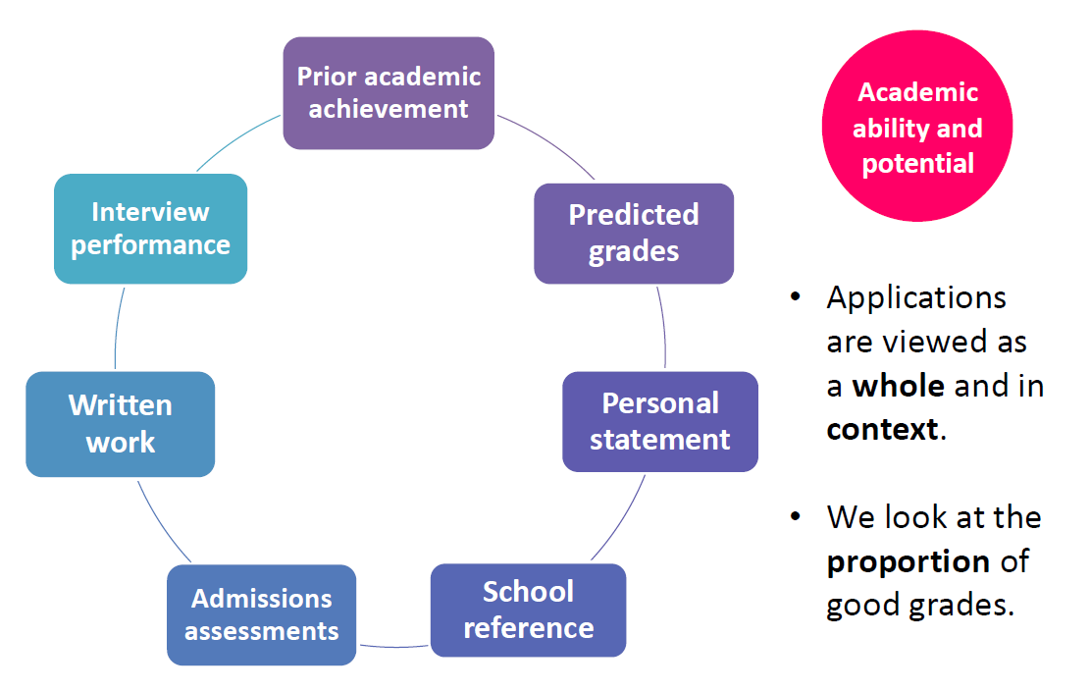
Please read carefully the advice given on the course website

Slide 6
Complete the your UCAS application online

Slide 7
Oxbridge
All admissions decisions are based solely on academic criteria (ability and potential).
Therefore, in their personal statement, we’re looking for applicants to: • explain their reasons for wanting to study the subject at university
• demonstrate enthusiasm for and commitment to their chosen course • express any particular interests within the field
• outline how they’ve pursued their subject interest in their own time.
Such information is often used as a basis for discussion at interview.

Slide 8
Focus on the academic
Admissions tutors at Oxford and Cambridge are looking for candidates who are passionate about their chosen academic field. There is no requirement to be able to contribute to university life in any other field than the one in which you have chosen to study.
You can show your interest and ability in your subject with examples of books you’ve read, an EPQ you’ve written, a prize you’ve won, lectures you’ve attended, documentaries you’ve watched, podcasts you’ve listened to, or really anything you can think of!
Tip:
Instead of: “I am interested in molecular biology”
Try: “My interest in molecular biology led me to read X”

Slide 9
Think about ‘super-curricular’ activities
Super-curricular activities are when you go beyond what you have studied in your school syllabus, either by going more in depth, or by learning about a related topic from scratch. You can do this by reading books, attending lectures, taking MOOCs, going on trips, watching films or in any number of other ways.
Oxbridge will look for evidence of super-curricular activities rather than extracurricular activities because they demonstrate passion and curiosity for your chosen subject, as well as your ability and motivation to learn independently.

Slide 10
Show that you are intellectually curious and thoughtful
Oxbridge admissions tutors are looking for thoughtful and perceptive students who are curious about their chosen subject. How much material you have consumed on your subject is not as important as how deeply you have thought about each one. For example, there’s no point listing thirteen books that you’ve read with no comments or thoughts about any of them.

Slide 11
To demonstrate a thoughtful approach to your studies, you can do things like:
Give an example of something you found particularly interesting in what you learned, and explain why you found it interesting.
Write about the process that led you to discover a new material or idea.
For example: “Learning about A at school led me to read X. I was particularly interested by the chapter on B, because …. This led me to further research B by watching Y.”
Draw links between topics, books, articles, films or lectures to show that you are not just capable of consuming information, but processing and analysing it.
For example: Did two different theorists interpret a concept differently? Is there a theme that runs through a set of books you’ve read? Did you disagree with an opinion presented at a lecture?

Slide 12
Try to be original…
The vast majority of applicants have really good grades, which can make it difficult to stand out from the crowd. This is where your ability to be perceptive and original comes in. Think about how the subject that you are applying for relates to your other studies, the world around you, and even your personal experiences.
Remember that the people who will read your application, and interview you, have made a career out of their chosen subject, and it really is their passion. They will genuinely be interested to have a conversation with you if you can bring an interesting or original thought to your Personal Statement and interview.

Slide 13
Use your Reference
If there’s anything that you can’t fit into your Personal Statement, but think would benefit your application, discuss it with the teacher who is in charge of writing your reference.
Your reference needs to focus on your suitability for the university course in question, but it has more scope to also cover activities which will paint you in a positive light more generally. For example, if you are a school prefect, this would normally be better off in the Reference rather than the Statement.

Slide 14
Proof-read, then proof-read again
One thing which can negatively affect the opinion of Admissions Tutors is a typo. Even if it’s something really minor, some tutors are very strict on accuracy, and it could be the difference between receiving an offer or not.
Proof-read your Personal Statement several times yourself, and then ask your parents, friends, or teachers to read it over, looking specifically for typos or grammatical errors. A lot of the time, it's easier for someone with fresh eyes to spot a typo than for the person writing.

Slide 15
Stay relevant
No one wants to know about your passion for your subject from before you could walk. Anything you include should be directly linked to your interest and suitability for the course, or at least connected somehow. They want to know what's motivating your study of it NOW.

Slide 16
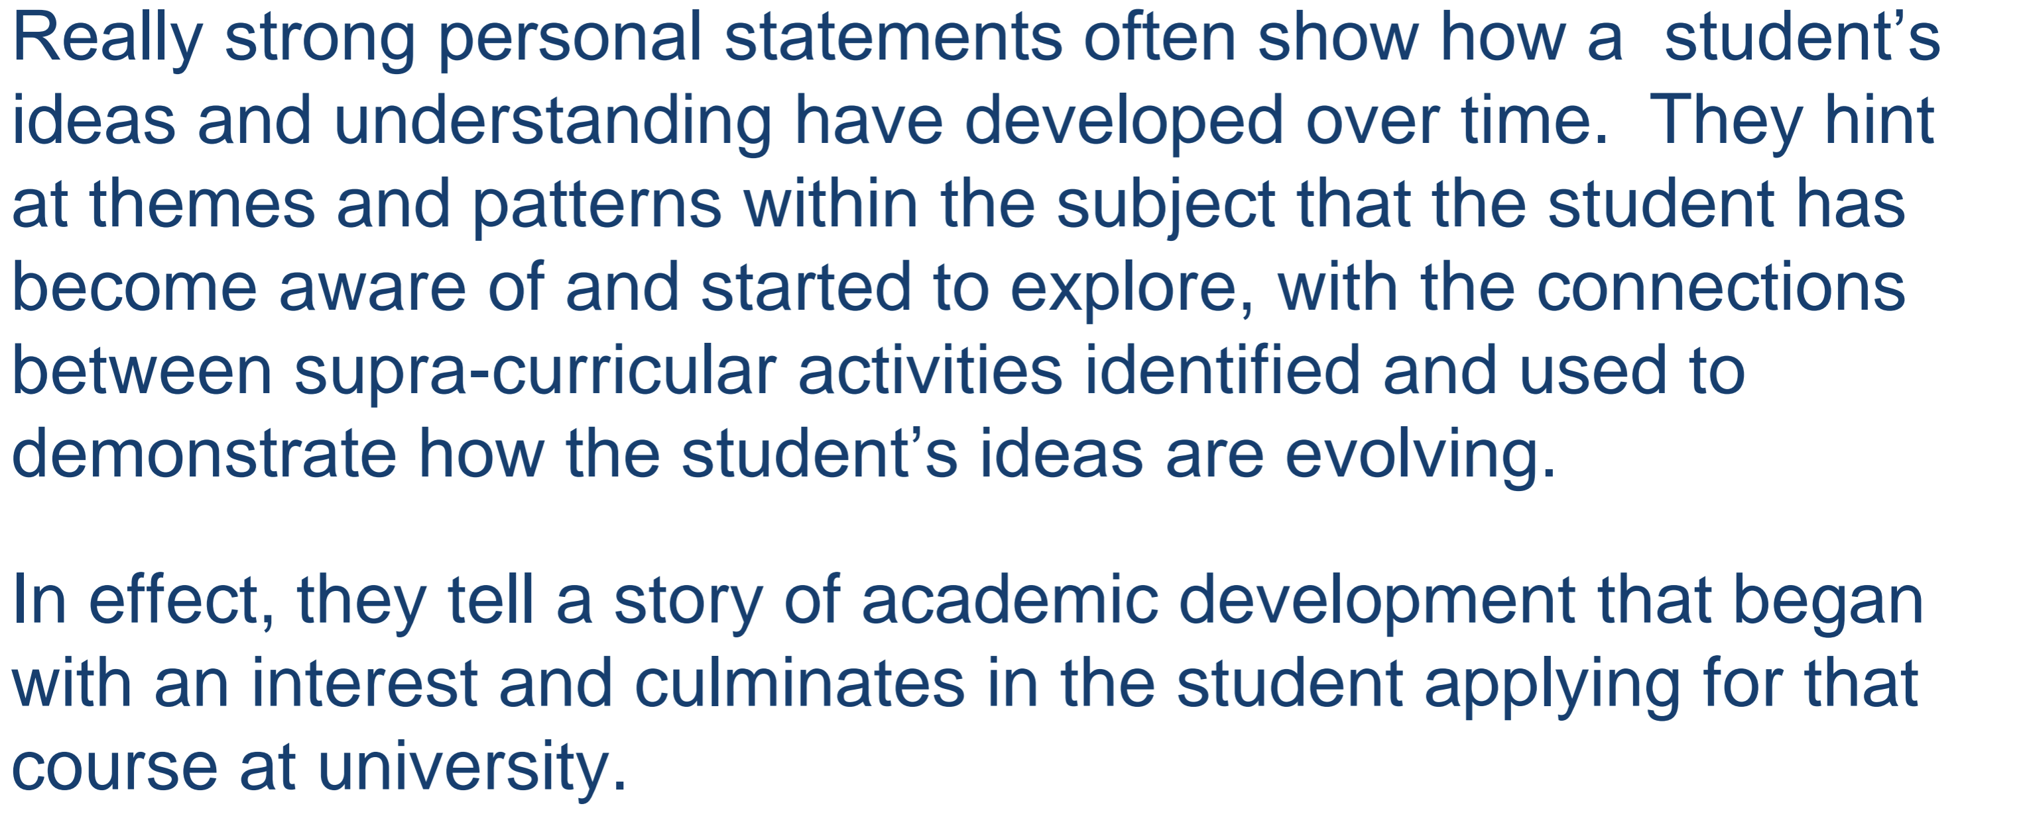

Slide 17
Work/ research experience
Know when your work experience is relevant. An English tutor will be interested in your work as research assistant for a professor. They'll be less interested by your summer internship at Goldman.
For some subjects, work experience is more crucial than others, namely the sciences and of course, medicine. Don't just state it, explain what you learnt and how it's helped you. Students with an interest in research fare well in Oxbridge applicant as courses are research-heavy - you will be writing 1-2 essay each week for Humanities subjects, and science subjects require extensive independent research prior to tutorials. Therefore, demonstrating research experience is extremely beneficial to application.

Slide 18
Check and double check claims of knowledge
Check any claims of knowledge or understanding as
1) if they are inaccurate, this will be an immediate red flag for admissions tutors and
2) they might be tested at interview.

Slide 19
Less is more
Try to be specific and DON'T waffle. Tutors hate it when you try to sound over the top of use overly-complicated words. One of the most frequent pitfalls admissions tutors see are students trying to fit as much as possible into their statement. LESS IS MORE. Don't write about every book you've ever read, but choose one or two to illustrate your enthusiasm for the subject.
Write in simple, straightforward, everyday English.
Express yourself as succinctly as possible using short sentences.
Do not get weighed down in jargon or complicated terminology – and if you do use some, make sure that you use it properly.

Slide 20
Create links if including extracurricular
The right way to use extracurricular activities in an Oxbridge Personal Statement is to explain how your experiences were specifically relevant for the course you are applying to.
For example, if you are applying to study French:
Instead of: “Taking Grade 8 violin taught me the self-discipline required to study a university degree”
Try: “As well as teaching me self-discipline, taking Grade 8 violin allowed me to explore French culture further by performing the work of French composers such as X”
If you can’t find a link between your extracurricular activity and your course, then it might be better to just not include it, unless it’s really particularly interesting or impressive in its own right (for example, a trip abroad probably doesn’t need to be mentioned, but a medal in rowing can be good).
In an Oxbridge Personal Statement, aim for a 90/10 split between academic content, and content focused on extracurricular activities.

Slide 21
Cambridge SAQ
Applicants can make additional comments particularly relevant to their Cambridge application in an additional personal statement. We recommend that these focus on interest in the specific Cambridge course, rather than (for example) reasons for choosing a particular College. This additional personal statement is optional. Applicants won’t be disadvantaged if they have nothing to add and shouldn’t repeat information provided in their UCAS personal statement here as we’ll already have received a copy of this.

Slide 22
Additional work to support an application.
Applicants may be asked to submit examples of their written work from a relevant A Level/IB (or equivalent) course (as submitted to and marked by the teacher), particularly for arts and social sciences subjects.
A discussion of this may then form part of the interview. Details of the Colleges that typically ask for written work can be found in the relevant course entry on our website. However, if this is required the College will advise the student about what sort of work this should be, where it should be sent and the deadline for its submission (usually by mid-November). If an applicant has any queries, they should contact their College’s Admissions Office as soon as possible for clarification. Applicants are asked to complete a cover sheet confirming that it’s their own work and detailing the circumstances in which it was written. We recommend that students submit work they’ll be happy discussing during an interview, and that they keep copies of anything they send so they can re-read it in preparation.

Slide 23
Personal statement
A Medicine/Dentistry Personal Statement is your chance to highlight any of your skills or qualities that you need to be a Doctor and write about your motivation to study Medicine.
Medical Schools use your Personal Statement in different ways. Some won’t pay much attention to it, some will use it as a basis to shortlist who to invite to interview, and some will use it to form the basis of some interview questions.
Why do you want to study Medicine, what is your motivation? What have you done to learn about it? Why are you a great fit for Medicine? Work experience and what you have learnt from it. Volunteering, what you have learnt from it, wider reading/super curricular and what you have learnt from it, extra curricular and how this demonstrates your suitability.

Slide 24
Medicine/Dentistry Personal Statements should cover the following elements, so that Medical Schools can get to know you.
Motivation — Why do you want to study Medicine and become a Doctor?
Exploration — What have you done to learn about Medicine? For example: work experience, volunteering, wider reading or research
Suitability — Why are you a good fit for Medicine?
Reflection should be a big part of your PS. When you’re writing it, don’t just list your work experience placements, academic achievements and extracurricular activities — reflect on key learning points and link everything back to qualities that are important for Medicine.

Slide 25
Skills and attributes
Conscientiousness
Insight into your own health
Effective communication, including reading, writing, listening and speaking
Teamwork
Ability to treat people with respect
Resilience and the ability to deal with difficult situations
Empathy and the ability to care for others
Honesty
Motivation to study medicine and genuine interest in the medical profession
Insight into your own strengths and weaknesses
The ability to reflect on your own work
Personal organisation
Academic ability
Problem solving
Dealing with uncertainty
Manage risk and deal effectively with problems
Ability to take responsibility for your own actions
Give examples of how you have demonstrated these skills through work experience, super curricular or extra curricular.
Explain what you learnt from your work experience.

Slide 26
How Should I Structure My Personal Statement?
The structure is a matter of personal preference, but we advise you to follow a format that covers the following points:
Why you want to study Medicine and become a Doctor (Motivation)
Work experience and/or volunteering – and what you learned from it (Exploration)
Wider reading and study beyond your school curriculum (Exploration)
Skills from extracurricular activities which are relevant to a Doctor’s skill set, e.g. leadership skills, communication skills, teamwork, etc (Suitability)
Conclusion (Motivation)

Slide 27
Personal statement cont ..
In general, there are five main ways that your Personal Statement will be used by Medical Schools:
Not used in any part of the selection process at all
Read but not assessed
Used to help decide between two candidates who are otherwise tied
Used during interviews
Used for shortlisting candidates to invite to interview
Medic portal gives a good summary of how much different institutions use the personal statement in their selection criteria.

Slide 28
Check out the supporting information for applying to medicine on Unifrog.

Slide 29
Vet – personal statement
Motivation: show what has motivated you to follow this career path.
Be specific, and make it current or recent.
What aspects are of special interest to you?
Where do you hope the degree will lead?
Reflect on what it is that’s driving you now, not something out-of-date.

Slide 30
Vet – personal statement
Experience: provide some detailed evidence that shows you’re realistic and informed about the challenges you will face. Describe some of your experiences and observations, both of veterinary practice and from your wider animal experience.
Get the balance right. They want you to show the breadth of your experience, but they want depth as well.
Try to write briefly but reflectively about some of the highlights and what you learned from them.
Also, try to include something that demonstrates your understanding of why interpersonal skills are crucial.

Slide 31
Vet – personal statement
Academic interests and wider reading:
give them a glimpse of your current academic and scientific interests, whether it’s from your studies, a project or issues you’ve come across in journals, books, blogs, events you’ve attended, and so on.
If Cambridge is amongst your choices, it’s especially important to demonstrate your intellectual curiosity and your passion for science.

Slide 32
Vet – personal statement
Extra-curricular activities:
Demonstrate your resilience, initiative, self-motivation, compassion, or other relevant transferable skills.
This could be through the contribution you have made to school, college, or community activities, volunteering, your part-time work, or any wider interests, personal achievements, or responsibilities.
Again, be specific!

Slide 33
Veterinary - Cambridge
The University of Cambridge's requirements are slightly different, as they are more concerned about your interest in 'the scientific principles that underlie both the health and disease of animals.' They do require you to demonstrate a commitment to the profession and say that some experience will be useful, but they don't want you to give up on your other extra-curricular interests for the sake of gaining extensive work experience.
You will need to take the Natural Science Admission Assessment.

Slide 34
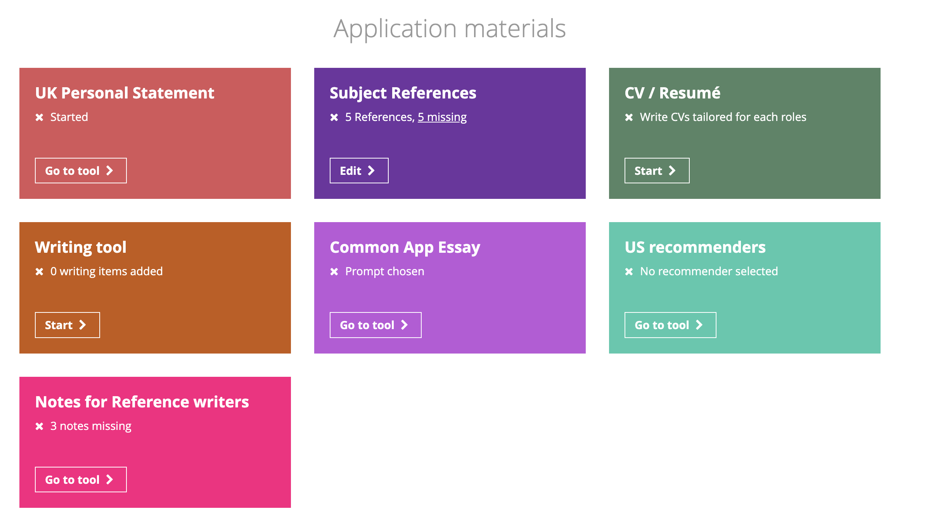
Using Unifrog to support personal statement writing.
You must paste a copy of your personal statement into Unifrog so that your tutor can see it to support with the reference writing process.

Slide 35
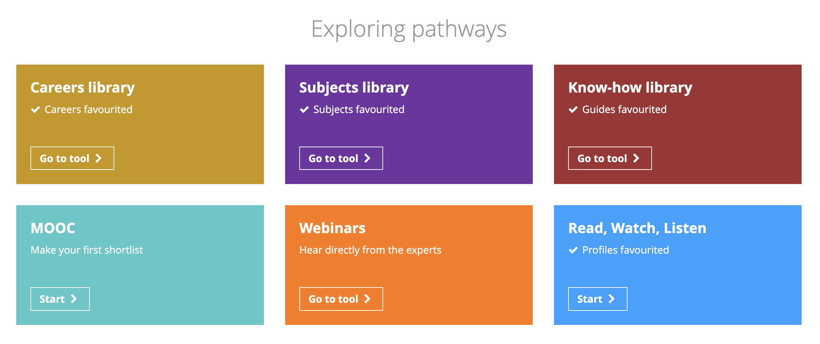
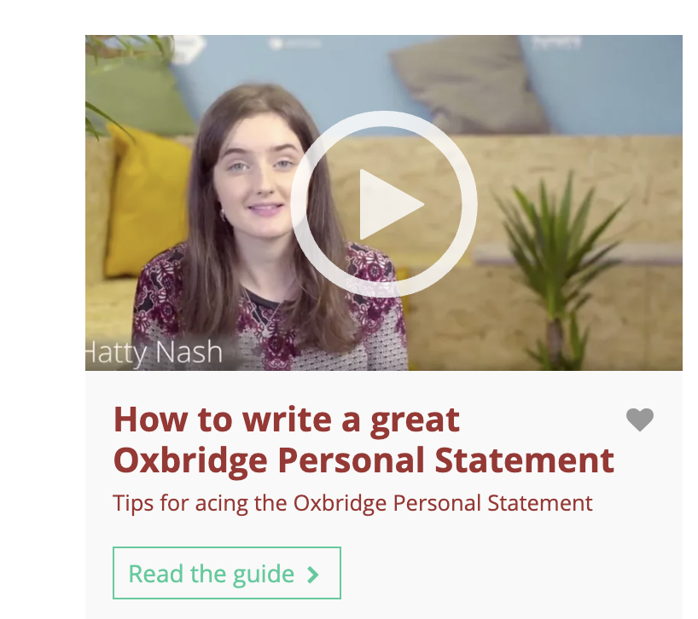
The know -how library has videos with tips on writing personal statements.

Slide 36
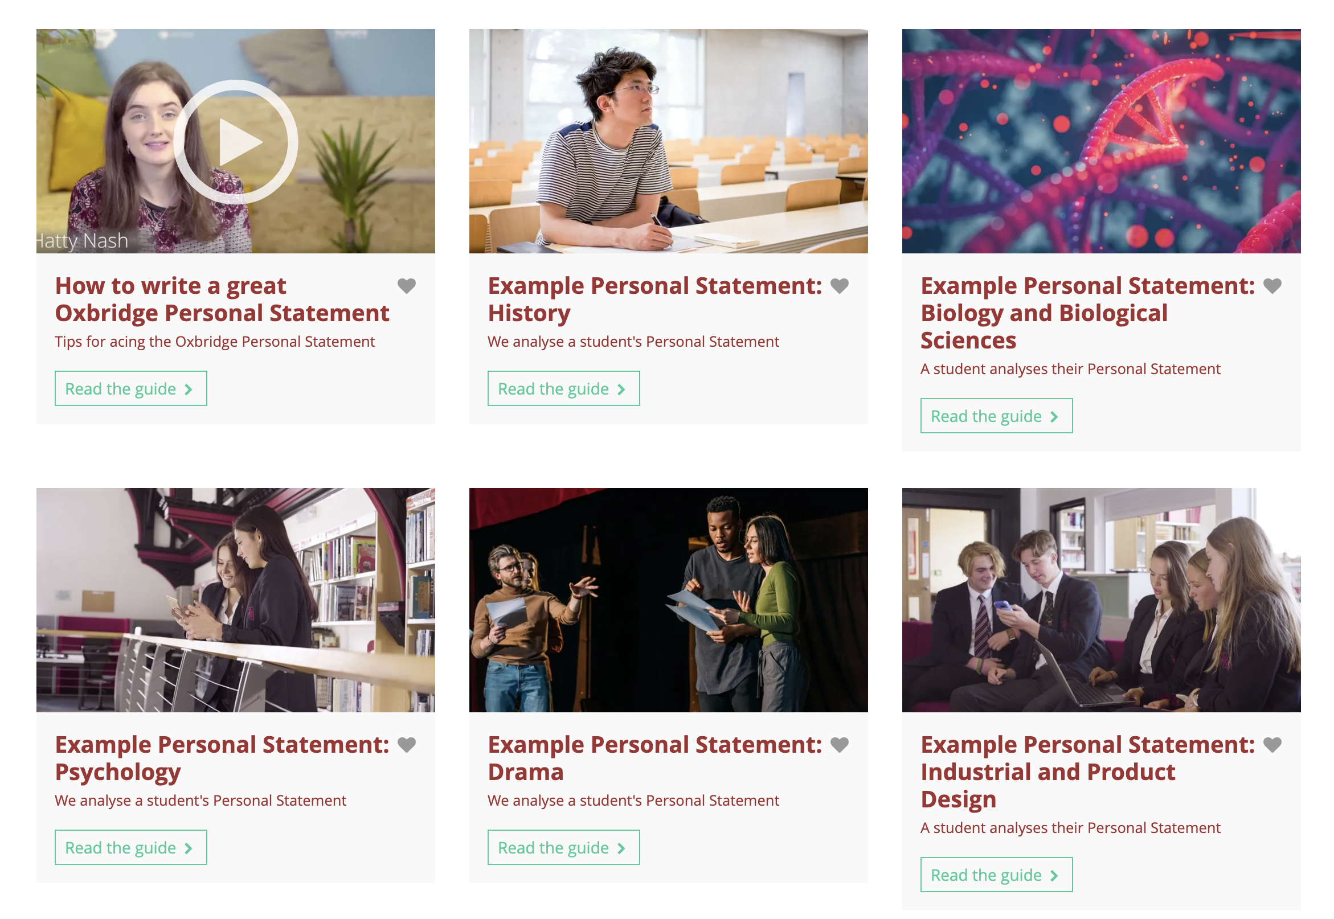
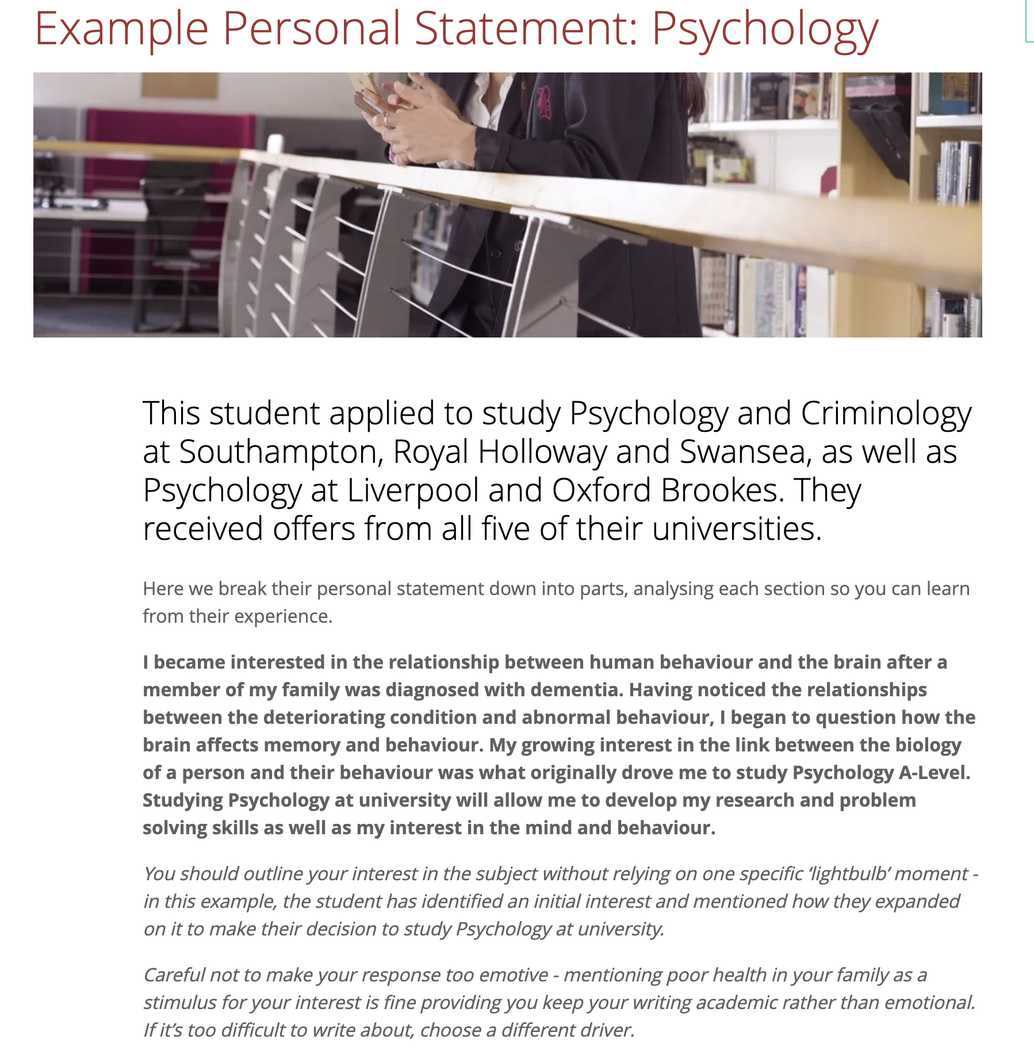
In the Know-how library you can also search for example personal statements.

Slide 37
Where else can I get help?
You will have a named member of SFO who will support with your application.
Your tutor will be excellent support and subject staff will be happy to help out with the subject specific part if you need guidance.
Mrs Bamber will check all early entry application forms, attach the final reference and send it to UCAS. She is happy to support you at any point.

Slide 38
Month | University preparation activities | Key dates
April 2023 | Explore course choices & locations. Attend Open Days. Continue super curricular exploration. Virtual Work experience | Wb 24/04/23 Work experience.
May 2023 |  | UCAS search tool display 2024 courses
June 2023 | Year 12 Exams – grades are used as one of the components informing projected grades for UCAS. | 20/06/23 UCAT booking opens
July 2023 | UCAS applications begin. Early entry personal statement writing first draft deadline to SFO 17/07/23 | 12/07/23 Conservatoire applications open for 2024 entry.
August 2023 | Personal statement writing and finalising course choices.
September 2023 | Early entry personal statement writing second draft to SFO 04/09/23 Early Entry final draft to SFO 25/09/23 Early entry book admissions tests.
October 2023 | Interim internal deadline for applications for all UCAS courses 13/10/23 BMAT & other Oxbridge admissions tests. | 02/10/23 Conservatoire music application (Drama, Dance and musical Theatre vary – see websites) 16/10/23 Oxbridge, Medicine, Dentistry and Veterinary deadline.
November 2023 | Final internal deadline for all applications for UCAS courses 25/11/23
December 2023 | Interviews.

Slide 39
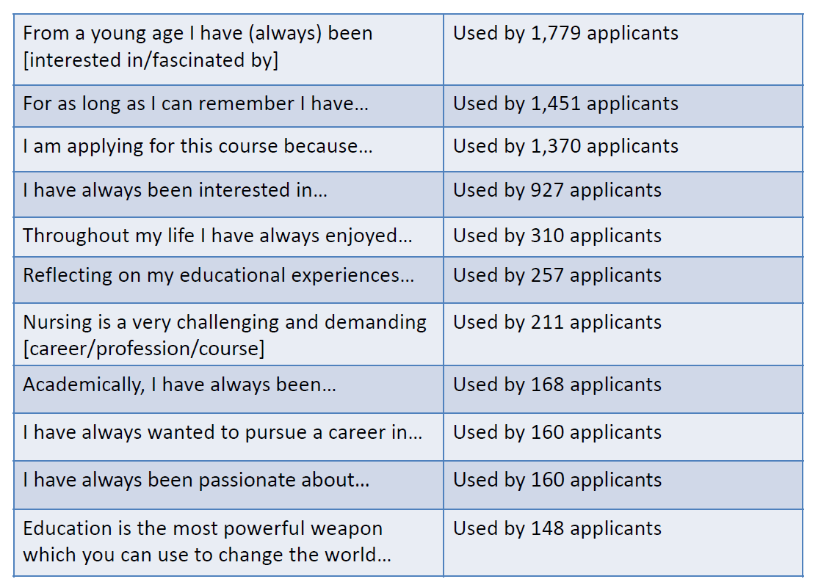
Avoid the cliches!

Slide 43
Complete pre-interview assessments and exams
Oxbridge may ask for written work to be submitted in advance.
For entrance exams, you must do your own research and LET THE EXAMS OFFICE KNOW!
BMAT or UKCAT – check with individual universities.
Most exams can be sat in school, apart from UKCAT and LNAT. For these two, you need to enter yourself online.
Make use of past papers online and look to see if there are any books aimed at helping students to prepare for the test you will sit.
Check the Unifrog guides.

Slide 44
Admissions tests - UCAT
The University Clinical Aptitude Test (UCAT) is used by Med School admissions teams to help shortlist candidates for interview. For 2021, UCAT tests will only take place in testing centres because this is the “best and most secure experience for candidates”.
The UCAT test is designed to help Medical Schools gauge whether a candidate has the attitude, mental ability and professionalism needed to thrive on a Medicine or Dentistry course. It’s considered a key entry requirement alongside your grades, work experience and Personal Statement by UCAT Universities.
30 UK universities use UCAT as part of their admission criteria. The weighting given to UCAT and the score threshold varies in different institutions.
The UCAT test assesses verbal reasoning, decision making, abstract reasoning, quantitative reasoning and situational judgment.
For more information https://www.ucat.ac.uk/
The UCAT can be sat between 10 July - 28 September 2021.

Slide 45
Admission tests BMAT –
The BMAT (BioMedical Admissions Test) is a two-hour aptitude test required by a handful of medical, dental and veterinary schools.
Section 1 tests your skills in problem-solving, understanding arguments, and data analysis and inference. You’ll answer 32 multiple-choice questions in 60 minutes.
Section 2 tests your ability to apply scientific knowledge typically covered in school science and mathematics by the age of 16. You’ll answer 27 multiple-choice questions in 30 minutes.
Section 3 tests your ability to select, develop and organise ideas, and to communicate them in writing, concisely and effectively. You’ll write an essay on one of three questions that you choose, and you get 30 minutes to do this.
All BMAT past papers are available to download online from the Cambridge Assessment Admissions Testing website. So with sufficient practice, you should feel confident and well prepared.

Slide 46
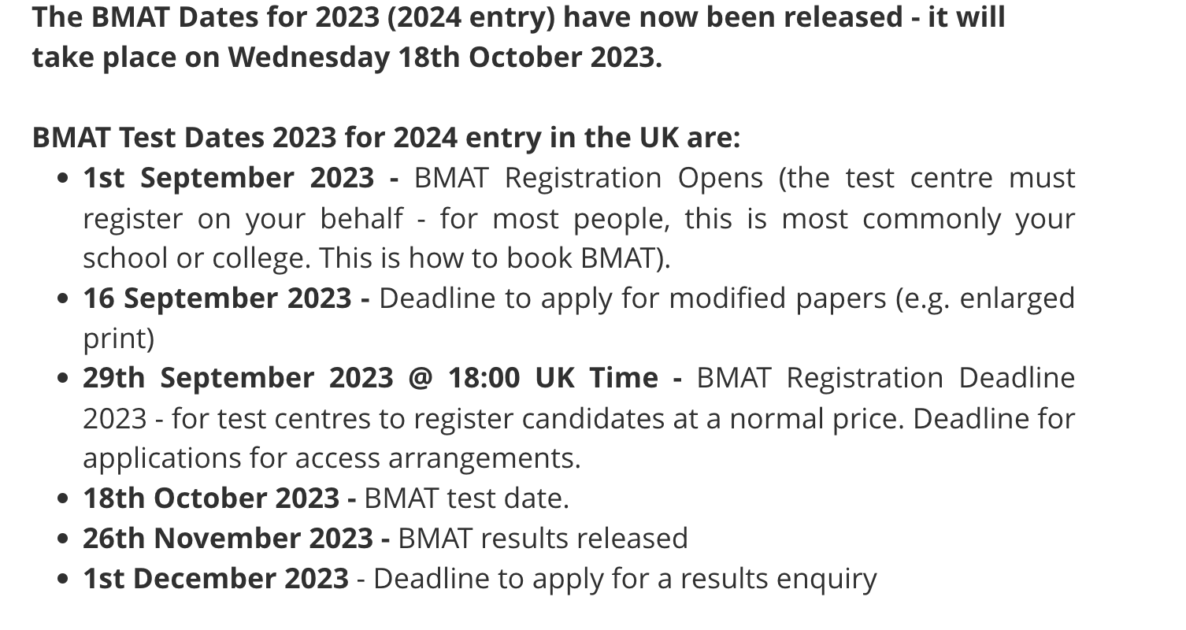

Slide 47
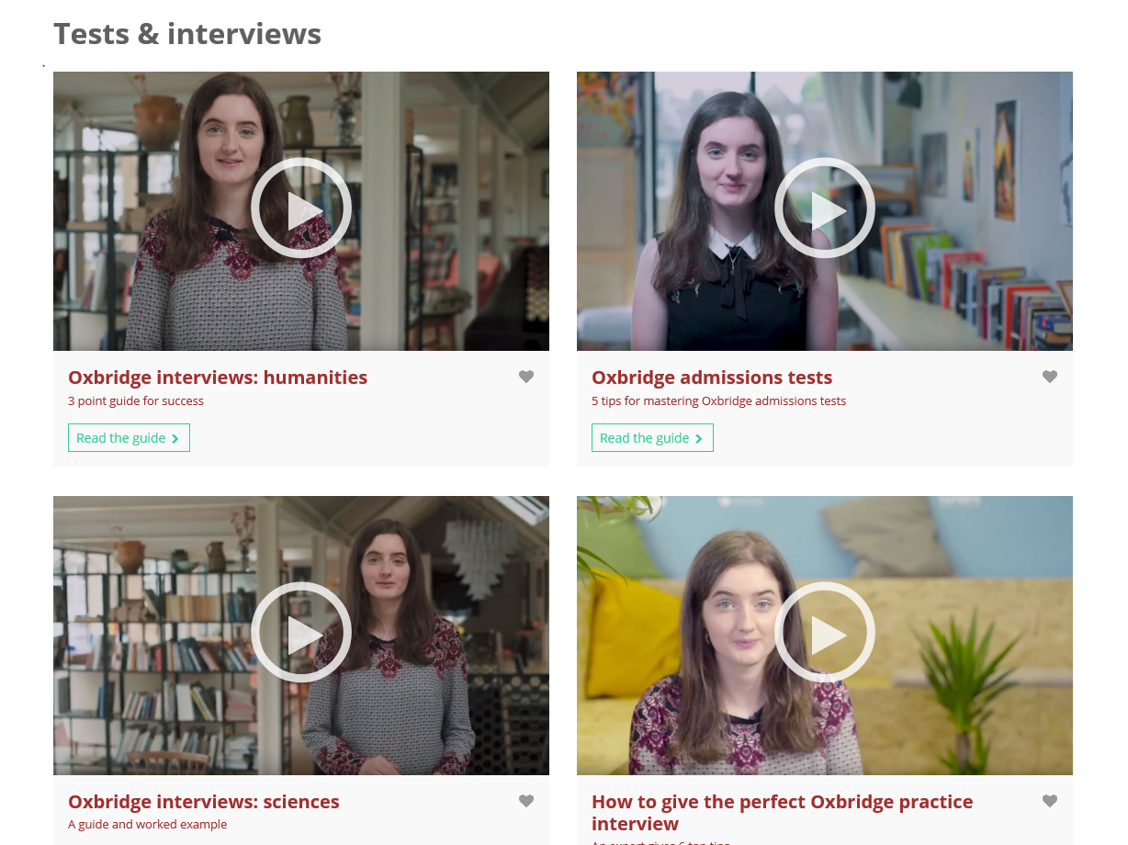
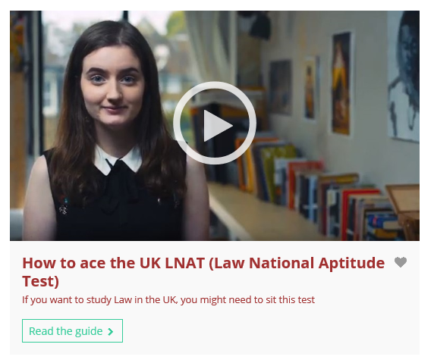

Slide 48
Interview preparation
Mock interviews with a subject specialist.
Watch online – YouTube / Unifrog / university websites.
MMI – common for medicine, dentistry and veterinary science.
Links with external experts.
Know your statement!

Slide 49
What do They Want at the Interview?
WHO SHOULD APPLY?
STUDENTS WHO:
Already read independently.
Who have the right combination of subjects at A level.
Who have strong GCSE performance.
Who think clearly and analytically.
Who can be flexible in their thinking.
Who do not just want to know the right answer.
Who love their subject.

Slide 50
What will the Interview be Like? Oxbridge

Slide 51
What Will the Interview Be Like? Medicine / Dentistry / Veterinary Science
https://www.themedicportal.com/application-guide/medical-school-interview/mmi-interviews/
You could be sitting across from an interview panel – be ready to talk about your work experience and personal statement.
Or you could have a series of MMI (multi mini interviews) interviews where you have to make a series of ethical judgements or asked to solve problems.
How can I prepare for a medical interview? https://www.themedicportal.com/how-to-prepare-for-your-medicine-interview/
Dentistry / Veterinary Science / Medicine – How to Prepare…
Use your work experience. Lean on the experience logged in your personal portfolio and use specific examples when giving a response.
Make sure you understand key ethical concepts relating to medicine, like the 4 pillars and patient confidentiality. (Or for being a vet or dentist).
Make sure you understand key scientific concepts.
If it’s in your personal statement – know about it!!
Know what it takes to be a good doctor / dentist / vet. Make a list of qualities and practise demonstrating them in your responses.
Keep up to date with medical / veterinary . dentistry news. Questions may be inspired by stories or debates in the media.
Practise giving 8-minute presentations in response to common MMI questions. This will help with time management on the day.
Research the medical school you are being interview at and ensure you link the content of your answers to what you discover.

Slide 52
Advice from previous applicants
How best to prepare:
Speak with willing subject staff, people from elsewhere
Take advantage of interview practice
Research staff at the college you are applying to
Know your personal statement!
Look at courses in advance

Slide 53
Advice from previous applicants
For the interview itself:
Don’t rush into answers!
Don’t be thrown by questions, apply the knowledge you do have
Relax and mingle with other applicants
Wear comfortable clothes
Think aloud in responses
Think of interesting questions*

Slide 54
Any questions?
pbamber@ecclesbourne.derbyshire.sch.uk

