Slide 1
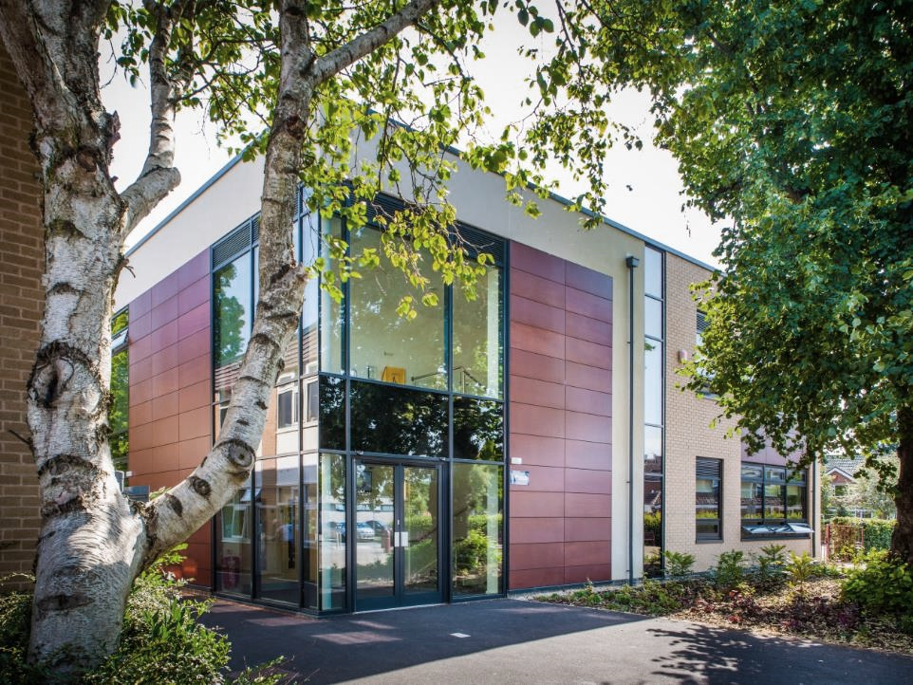
Welcome
THE ECCLESBOURNE SCHOOL
Information and Options Evening 2024

Slide 2
Year 9 Senior Section to date
Summer Reward challenge
GCHQ Languages competition
Team building trip to Lea Green
Serving at Community Tea Party
Girls football team
Blues Programme
Padley centre donations
Student council met Pauline Latham
Form tutor reps met Gez Kinsella
Weekly quiz with reward
Photography competition
Hindu temple trip
Football & Hockey team
House chess competition
Ten pin bowling reward
Musical performances
House plays
V&A challenge
Enterprise day
Army visit

Slide 3
Year 9 Senior Section upcoming
Visit to Beth Shalom
Prevent training
Chelsea’s story
Outward Bound trip Wales
Shakespeare festival
Stars in your eyes
Mock trial
Residential trip to PGL Caythorpe court
End of Year exams (June)

Slide 4
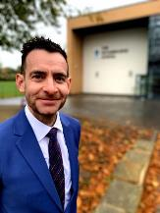
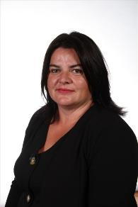
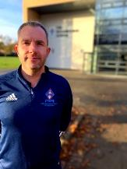
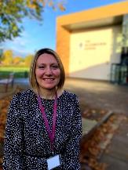
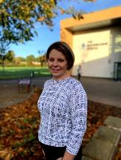
Pastoral Team
Mr Duncker-Brown Head of Upper School
Mrs Green
Head of Diversity, Equality, and Inclusion​
Mrs Ourabi
Head of Pastoral and DSL​
Mr Sellers
Head of Year 10
Mrs Dodson
Head of Year 11
Mrs Stott
Head of Year 9

Slide 5
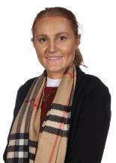
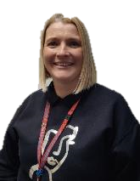
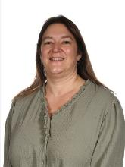
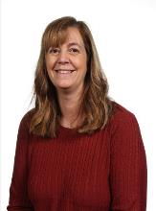
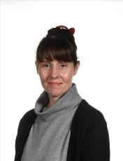
Pastoral Team
Miss Piper
Progress Leader and Anti-Bullying Lead​
Mrs Parry
Progress Leader ​
Mrs Laughlin
Progress Leader ​
Mrs Monk
Pastoral Support and Attendance Officer​
Mrs Tanser
Pastoral Support and School Nurse​

Slide 6
Timeline 2024
23rd January Year 9 Tutors interview their students
25th January Parents’ Evening 4.30-7.00pm – 9B, 9C, 9L & 9R
30th January Year 9 Tutors interview their students
1st February Parents’ Evening 4.30-7.00pm – 9E, 9N, 9U & 9S
2nd February Tutors submit student options
W/b 5th February Pastoral Team interviews where required
9th February Final Options choices submitted

Slide 7
Vision & Aims

Slide 8
A broad and balanced curriculum that develops the knowledge and skills pupils need to thrive now and for a fulfilling future

Slide 9
Develop pupils’ resilience and confidence in themselves and their capacity for growth

Slide 10
Ensure pupils feel valued, value others and learn to work together to make a positive contribution

Slide 11
Ensure pupils stay safe and healthy in mind and body

Slide 12
Develop creativity in an innovative learning environment

Slide 13
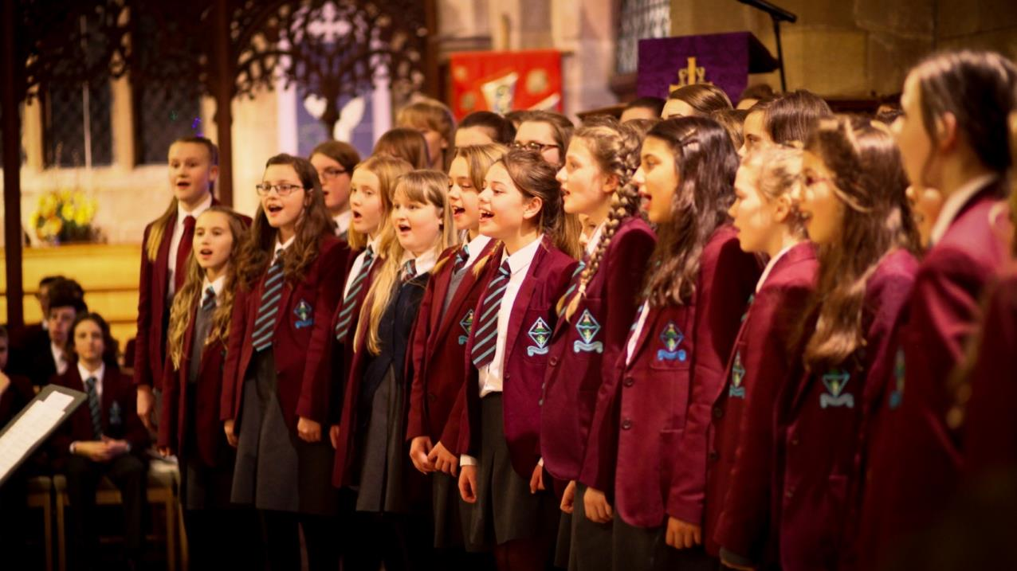
Appreciate the spiritual, moral, social and cultural richness of the world at large

Slide 14
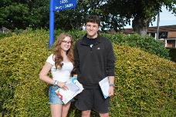
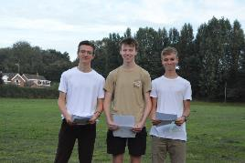
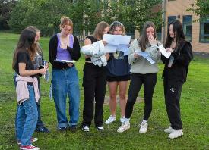
GCSE Performance

Slide 15
Results - Year 11
 | 2017 | 2018 | 2019 | 2023
% 5A-C (9-4) | 90 | 89 | 93 | 86
% 5A-C (9-4)EM | 86 | 84 | 91 | 84
A*- A (9-7) | 38 | 25 | 38 | 32
% A*-C EM (9-4) | 87 | 86 | 91 | 86
% A*-C EM (9-5) | 73 | 64 | 72 | 68
% Ebacc(4+) | 44 | 45 | 43 | 46
P8 | +0.2 | +0.4 | +0.6 | +0.4
A8 | 58 | 55 | 59 | 57

Slide 16
Derbyshire Ranking
86%
68%
57
9-4 inc E & M
9-5 inc E & M
Attainment 8

Slide 17
The Times Parent Power Survey

Slide 19
Attendance
The link between attendance and attainment:
In 2018/19, just 40% of persistently absent (PA) children in KS2 achieved expected KS2 standards, compared with 84% of pupils who were regular attenders.
36% of PA children in KS4 got 9 to 4 in their English and maths GCSEs, also compared with 84% of regular attenders.¹
It’s never too late to benefit from good attendance:
More than half (54%) of pupils who were PA in Year 10 and then rarely absent in Year 11, passed at least 5 GCSEs, compared to 36% of pupils who were persistently absent in both years.²

Slide 20
Attendance
Attendance is important for more than just attainment:
Regular school attendance can facilitate positive peer relationships, which is a protective factor for mental health and wellbeing.³
1: The link between absence and attainment at KS2 and KS4, Academic year 2018/19 – Explore education statistics – GOV.UK (explore-education-statistics.service.gov.uk)
2: Missing Children, Missing Grades | Children's Commissioner for England (childrenscommissioner.gov.uk)
3: Mental Health and Attendance at School (Chapter 1) - Mental Health and Attendance at School (cambridge.org)

Slide 21
Our principles
A broad and balanced curriculum that develops the knowledge and skills students need to thrive now and for a fulfilling future
To meet the learning needs of all students
To give choice over the subjects students choose to study
To have high expectations for all students so that you all achieve well

Slide 22
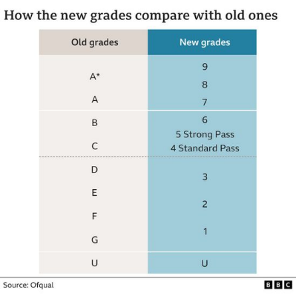
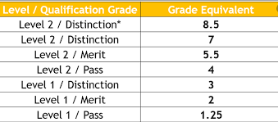
GCSE and BTEC Courses and Grading
All subjects graded 1 to 9.
All subjects have terminal exams.
Coursework in some subjects; especially BTECs.
Marks awarded for accurate spelling, punctuation and grammar in a range of subjects.
GCSEs are challenging; lots of content and rigour.
Only a few subjects have Higher and Foundation Tiers.

Slide 23
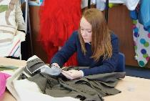
The English Baccalaureate
The government expects that the English Baccalaureate is to be the default option for all students, but that schools should be able to determine the small minority of students for whom taking the whole EBacc is not appropriate.
The Ebacc consists of:
English
Mathematics
Combined or Separate Sciences
French, German or Spanish
Geography or History

Slide 24
Separate Science Route
Ecclesbourne 14+ GCSE Options

Slide 25
Ecclesbourne Options – Separate Science Route Compulsory Curriculum – Learning Hours
YEAR 10
3 hours English
4 hours Maths
5 hours Science
1 hour PDC
1 hour PE
TOTAL= 14 hours
YEAR 11
4 hours English
4 hours Maths
7 hours Science
1 hour PDC
1 hour PE
1 hour Study/ Enrichment
TOTAL= 18 hours
English & English Literature
Mathematics
Separate Science
(Biology, Chemistry & Physics)
Core PE & PDC/RE
Core 1
Compulsory Curriculum

Slide 26
Ecclesbourne Options – Separate Science Route Compulsory Curriculum – Core PE/RS/PDC
English & English Literature
Religious Education, Personal Development & Citizenship
Drugs and Health Education
Sex and Relationships
Careers
RE - Ethics
Physical Education
Enrichment
1 hour of Thursday afternoon in Year 11 is either a Study Period or Duke of Edinburgh award.
Mathematics
Separate Science
(Biology, Chemistry & Physics)
Core PE & PDC/RE
Core 1
Compulsory Curriculum

Slide 27
Ecclesbourne Options – Separate Science Route Core 2 Humanities and Languages – Learning Hours
English & English Literature
YEAR 10
3 hrs MFL
3 hrs Humanities
YEAR 11
2 hrs MFL
2 hrs Humanities
French or German or Spanish
Mathematics
Separate Science
(Biology, Chemistry & Physics)
History or Geography
Core PE & PDC/RE
Core 1
Compulsory Curriculum
Core 2
Humanities and Languages

Slide 28
Ecclesbourne Options – Separate Science Route 2 Free Choices – Learning Hours
English & English Literature
Art & Design
Drama
Music
GCSE PE
French
German
Spanish
Business
BTEC ICT
Cambridge National Sports Science
Computer
Science
Food & Nutrition
Design Technology; Res Mat, Graphics, Textiles
Religious Studies
History
Geography
BTEC Health & Social Care
2 Further Subjects
French or German or Spanish
Mathematics
Separate Science
(Biology, Chemistry & Physics)
History or Geography
Core PE & PDC/RE
Year 11
2 hrs Free Option 1
2 hrs Free Option 2
Year 10
3 hrs Free Option 1
3 hrs Free Option 2
Core 1
Compulsory Curriculum
Core 2
Humanities and Languages
2 Free Choices

Slide 29
Combined Science; Trilogy Route
Ecclesbourne 14+ GCSE Options

Slide 30
Ecclesbourne Options – Combined Science Route Compulsory Curriculum – Learning Hours
YEAR 10
3 hours English
4 hours Maths
5 hours Science
1 hour PDC
1 hour PE
TOTAL= 14 hours
YEAR 11
4 hours English
4 hours Maths
7 hours Science
1 hour PDC
1 hour PE
1 hour Study/
Enrichment
TOTAL= 18 hours
English & English Literature
Mathematics
Combined Science
Core PE & PDC/RE
Core 1
Compulsory Curriculum

Slide 31
Ecclesbourne Options – Combined Science Route Compulsory Curriculum – Core PE/RS/PDC
English & English Literature
Religious Education, Personal Development & Citizenship
Drugs and Health Education
Sex and Relationships
Careers
RE - Ethics
Physical Education
Enrichment
1 hour of Thursday afternoon in Year 11 is either a Study Period or Duke of Edinburgh award.
Mathematics
Combined Science
Core PE & PDC/RE
Core 1
Compulsory Curriculum

Slide 32
Ecclesbourne Options – Combined Science Route Core 2 Humanities and Languages – Learning Hours
English & English Literature
YEAR 10
3 hrs Humanities
YEAR 11
2 hrs Humanities
Mathematics
History or Geography
Combined Science
Core PE & PDC/RE
Core 1
Compulsory Curriculum
Core 2
Humanities

Slide 33
Ecclesbourne Options – Combined Science Route 3 Free Choices – Learning Hours
English & English Literature
Art & Design
Drama
Music
GCSE PE
French
German
Spanish
Business
BTEC ICT
Cambridge National Sports Science
Computer
Science
Food & Nutrition
Design Technology; Res Mat, Graphics, Textiles
Religious Studies
History
Geography
BTEC Health & Social Care
3 Further Subjects
Mathematics
History or Geography
Combined Science
Core PE & PDC/RE
Year 10
3 hrs Humanities*
3 hrs Free Option 1
3 hrs Free Option 2
3 hrs Free Option 3
Year 11
2 hrs Humanities*
2 hrs Free Option 1
2 hrs Free Option 2
2 hrs Free Option 3
Core 1
Compulsory Curriculum
Core 2
Humanities
3 Free Choices

Slide 34
Options and Balance
Remember students should aim for balance and choose subjects that reflect their interests and aptitude
Options | Ecclesbourne School

Slide 35
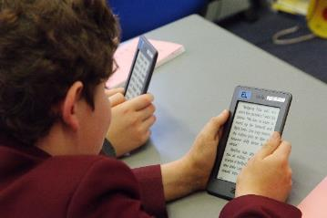
Learning Support Option
Why might the workload be too heavy in Years 10 and 11?
How to reduce the workload?
LEARNING SUPPORT OPTION
Reinforce learning in all subject areas.
Support coursework.
Additional work on literacy and numeracy skills.
GCSEs are a big step up in terms of expectations.
There is pressure from coursework and final examinations.
Too much for some students.
Who?
Some students, but possibly not all, who currently having help in the Learning Support Faculty.
Learning Support have made recommendations.

Slide 36
No need to worry
There will be lots of help and advice from the Pastoral Team.
We will offer advice to ensure options do not close down future career choices or opportunities for further study.

Slide 37
There is plenty of help available!
Students can talk to:
Form Tutor
Head of Year
Staff in Senior Section
Staff in Upper School Office
Careers Team
Parents:
If you need help, or just want to talk through options with us then don’t hesitate to pick up the phone and give us a ring or drop us an email.

Slide 38
AQA GCSE Business

Slide 39
Why choose GCSE Business?
A subject that relates to the world that you live in and are an active part of the business community as a consumer of goods and services sold by businesses.
You will learn business concepts and theories that you can then apply to a real business situation.
For example, you will learn about the different sorts of business types that someone could set up and then apply it to a specific situation.

Slide 40
GCSE Business- Route through the whole course
Revision
Globalisation
Technology
Paper 1
Competitive environment
Economic climate
Influences on business
Paper 2
Legislation
POST 16
Interest rates
Sources of finance
Cash flow
Mock exam
Financial performance
Financial calculations
Finance
Human resources
Motivating employees
Training
Recruitment & selection
YEAR 11
Year 10 exam
Organisational structures
Marketing Mix
Customer service
Ethical considerations
Environmental considerations
Marketing
Understanding customers
Segmentation
Concept of quality
Expanding a business
Market research
Production processes
Business Operations
Exchange rates
Business planning
Business location
Key
Role of procurement
Unit of work
Business in the real world
Purpose & nature of business
Aims & objectives
Stakeholders
Teaching Topic
KS 3
YEAR 10
Internal assessment
Business Ownership
External assessment

Slide 41
Should you pick Business?
Do you enjoy understanding the world around you?
Would you like to the opportunity to explore theories and concepts in the most relevant way, through the context of events in the business and economic world?
Are you a critical thinker?

Slide 42
How is the course examined?
You will take 2 examination papers of 1 hour and 45 minutes each.
The structure is the same for both, a mix of multi-choice, short and longer questions. The longest are 9 and 12 mark questions.
In these you will look at choices a business could make and show that you can see the relevance of both and make a reasoned decision.
For example, you may be asked whether a business should recruit a worker for a new role from inside or outside the business.
Paper 1
Business in the real world • Influences on business • Business operations • Human resources
Paper 2
Business in the real world • Influences on business • Marketing • Finance

Slide 43
Find out more:
GCSE & A Level Teacher of Business – Miss Mooney (F3)
lmooney@ecclesbourne.derbyshire.sch.uk
Head of Business & Economics – Mrs Taylor (Sixth Form Centre)
KGTaylor@ecclesbourne.derbyshire.sch.uk

Slide 44
BTEC Tech Award
Health and Social Care
(Level 2)

Slide 45
Course content
Why might you choose to take a BTEC?
BTEC Tech Award Health and Social Care
Component 1
Human Lifespan Development
(Coursework – 30%)
Component 2
Health and Social Care Services and Values
(Coursework – 30%)
Component 3
Health and Well-Being
(External exam – 40%)
The Grades … Distinction*
Distinction
Merit (Level 2)
Pass (Level 2)
Merit (Level 1)
Pass (Level 1)
Because it involves coursework so there is less emphasis on exam performance
Because it has practical, vocational content

Slide 46
Component 1: Human Lifespan Development
Internally assessed coursework
30% of final grade
Completed during Year 10
Physical, intellectual, emotional and social growth from birth to late adulthood
Factors (e.g. economic, social, physical) which affect human development
Life events and changes such as divorce, bereavement
Support for life events and changes

Slide 47
Component 2: Health and Social Care Services and Values
Different health and social care services
Barriers to accessing services (e.g. psychological, physical, economic)
Care Values and how to demonstrate them
Internally assessed coursework, 30% of final grade completed in Year 11

Slide 48
Component 3: Health and Well-Being
Lifestyle choices and well-being
Health indicators
Measures of health
Treatment plans
Externally assessed exam in summer of Year 11
40% of final grade

Slide 49
Is this the course for me?
Girls and boys take the subject
If you’re interested in a future career in the Health and Social Care sector this course is extremely valuable
It helps you with meeting deadlines as you get used to doing coursework

Slide 50
GCSE Design and Technology
Graphics/Resistant Materials

Slide 51
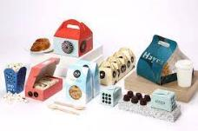
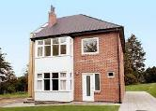
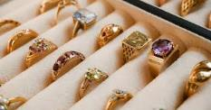
What do all these items have in common?

Slide 52
Design and Technology
Both courses- Graphics and Resistant Materials:
Offer an opportunity to apply maths, science and problem solving skills to a range of mini projects and practical work in both Year 10 and 11.
50/50 Split of coursework (NEA) and exam
Exam is sat in the summer at the end of Year 11.
NEA starts in the summer term of Year 10 and runs till Easter of Year 11.
NEA, you get to choose what you design and make from one of three contexts e.g. Storing and securing items for 2023-24.
Cover three main areas in the exam:
Core principles- All materials knowledge
Specialist principles
Design and make principles.
What is D&T – and why do we need it? (youtube.com)

Slide 53
So what is the difference?
Graphics
Resistant Materials
Material focus: Papers and boards and plastics.
CAD: Photoshop, 2D design, TinkerCAD
Design/projects: Marketing materials, packaging and Point of sale, branding/merch, Interior design models and product design
Material focus: Timbers, plastics and metals.
CAD: TinkerCAD, Fusion 360 and 2D Design
Design/projects: Furniture, storage devices, decorative items, Interior design, engineering, Architecture, Product design.

Slide 54
Project Work:
Graphics Projects:
Resistant Material Projects:

Slide 55
GCSE Computer Science BTEC Tech Award in Digital Information Technology

Slide 56
GCSE Computer Science
Learn to program using Visual Basic
Brilliant if you enjoy problem solving and the programming elements of the course
Important if you wish to pursue Computer Science at A Level, wish to study it at University or would like a job which requires programming
100% exam with 2 papers:
Paper 1: Programming
Paper 2: Computer Science Theory

Slide 57
BTEC Tech Award in Digital Information Technology
Learn how to make professional user interfaces in PowerPoint and also how to make complex data models using Microsoft Excel
Brilliant if you enjoy doing coursework rather than just focussing on an exam
Important if you wish to develop your ICT skills further but do not wish to learn how to program.
2 Pieces of course work done in class worth 60% of the final grade
1 theory exam worth 40% of the final grade

Slide 58
GCSE Food Preparation & Nutrition
GCSE Food Preparation and Nutrition aims to equip students with the knowledge, understanding and skills required to cook and apply the principles of food science, nutrition and healthy eating.

Slide 59
GCSE Food Preparation & Nutrition: Content
The main emphasis is the development of strong practical cookery skills and techniques and a good understanding of nutrition.
You will discover the essentials of food science, nutrition and how to cook. You will understand the huge global challenges that we face to supply the world with nutritious and safe food.
It is another step towards creating a healthier society and improving the nation’s cooking skills as well as setting some students on the path to careers in the food and hospitality industry.

Slide 60
GCSE Food Preparation & Nutrition: Assessment
Food Preparation and Nutrition written exam
1 hour 30 minutes 50% of total GCSE
Food Investigation Task (Scientific investigation)
45 marks
Non-examined assessment (NEA) 15% of total GCSE
Food Preparation Task (Prepare 3 dishes in 3 hours)
105 marks
Non-examined assessment (NEA) 35% of total GCSE

Slide 61
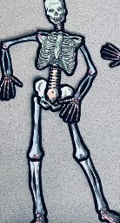
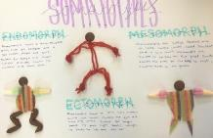
GCSE Physical Education (Edexcel)
Course Overview and Assessment
There are 3 components to GCSE Physical Education:
Component 1 - The Human Body and Movement in Physical Activity and Sport
Movement analysis
Physical training
Applied anatomy and physiology
Written exam 1 - 1 hour 15 mins (30%)

Slide 62
Component 2+3
Component 2 - Socio-Cultural Influences and Well-being in Physical Activity and Sport
Health, fitness and well-being
Sports psychology
Socio-cultural influences
Written exam 2- 1 hour 15 mins (30%)
Component 3 - Non-Exam Assessment
Practical assessment in individual and team activities 30%
Written Coursework 10%

Slide 63
Practical Assessment
Students have to be assessed in 3 activities from the list below. One activity must be from the individual list and one from the team list. The third activity can be from either list. The written coursework is on one sporting activity from the specification.
Team Activities
Football, Badminton (Doubles), Tennis (Doubles), Cricket, Hockey, Netball, Rugby (League or Union), Squash (Doubles), Table Tennis (Doubles), Dance (Group Dance).
Individual Activities
Athletics, Skiing or Snowboarding, Gymnastics, Trampolining, Dance (Solo performance), Swimming, Tennis (Singles), Badminton (Singles), Table Tennis (Singles), Squash (Singles).

Slide 64
OCR Cambridge
National
Certificate
in Sport Science
Level 2

Slide 65
Course outline
Four units to be completed over the 2 years:
Unit R180 Reducing the risk of sports injury’s 40%
Unit R181 Applying the principles of training 40%
Unit R185
Sports Nutrition 20%

Slide 66
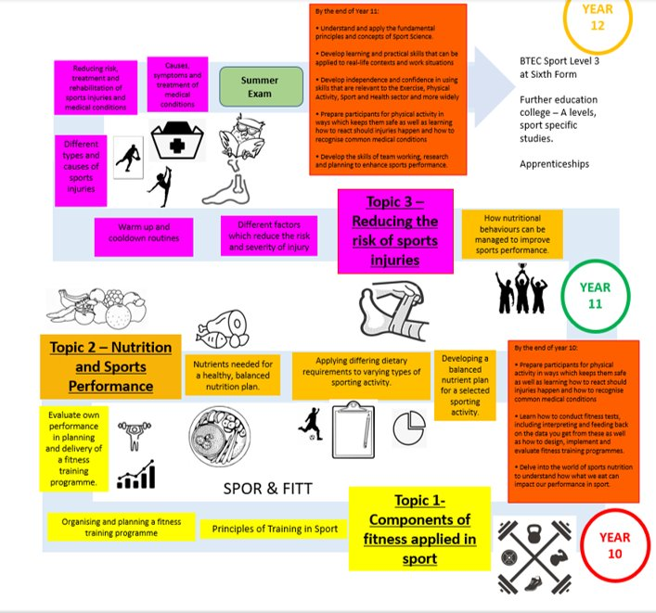

Slide 67
UNIT 1: Reducing the risk of sports injuries and dealing with common medical conditions
This unit is assessed by an exam.
By completing this unit, you will prepare as a participant to take part in physical activity in a way which minimises the risk of injuries occurring. It will also prepare you to know how to react to common injuries that can occur during sport and physical activity, and how to recognise the symptoms of some common medical conditions.
Topics that you study will include:
Different factors which influence the risk and severity of injury
Warm up and cool down routines
Different types and causes of sports injuries
Reducing risk, treatment and rehabilitation of sports injuries and medical conditions
Causes, symptoms and treatment of medical conditions

Slide 68
UNIT 2: Applying the principles of training, fitness and how it affects skill performance
This unit is assessed by a set assignment and practical application, (coursework and practical assessments in TWO sports from the pre-approved list).
By completing this unit, you will conduct a range of fitness tests, understand what they test and their advantages and disadvantages. You will also learn how to design, plan and evaluate a fitness training programme. You will then interpret the data collected from these fitness tests and learn how best to feed this back.
Topics include:
Components of fitness applied in sport
Principles of training in sport
Organising and planning a fitness training programme
Evaluate own performance in planning and delivery of a fitness training programme

Slide 69
R183: Nutrition and sports performance
This is assessed by a set assignment.
By completing this unit, you will gain understanding of healthy, balanced nutrition. You will consider the necessity of certain nutrients and their role in enabling effective performance in different sporting activities. The knowledge you gain will be used to produce an appropriate, effective nutrition plan for a performer.
Topics include:
•Nutrients needed for a healthy, balanced nutrition plan.
•Applying differing dietary requirements to varying types of sporting activity
•Developing a balanced nutrition plan for a selected sporting activity
•How nutritional behaviours can be managed to improve sports performance.

Slide 70
Comparisons with two sports courses:
GCSE PE & Sports Science both have the same amount of practical time.
Both courses are worth a full GCSE.
Both will give you a pathway through into the 6th form to study sport, no dead ends.

Slide 71
Comparison
GCSE PE
Equivalent to one full GCSE
1 x GCSE PE practical lesson per week
2 x GCSE PE theory lessons per week
(You also get one core PE lesson per week that everyone in Year 10 completes).
Assessment:
60% Theory (two exams in year 11).
10% coursework
30% Practical (three sports)
Sports Science
Equivalent to one full GCSE
1 x Sports Science practical lesson per week
2 x Sports Science theory lessons per week
(You also get one core PE lesson per week that everyone in Year 10 completes).
Assessment
40% Theory (one exam in Year 11).
60% Coursework (two units completed including assessment in two sports)

Slide 72
Timeline 2024
23rd January Year 9 Tutors interview their students
25th January Parents’ Evening 4.30-7.00pm – 9B, 9C, 9L & 9R
30th January Year 9 Tutors interview their students
1st February Parents’ Evening 4.30-7.00pm – 9E, 9N, 9U & 9S
2nd February Tutors submit student options
W/b 5th February Pastoral Team interviews where required
9th February Final Options choices submitted

