Slide 1
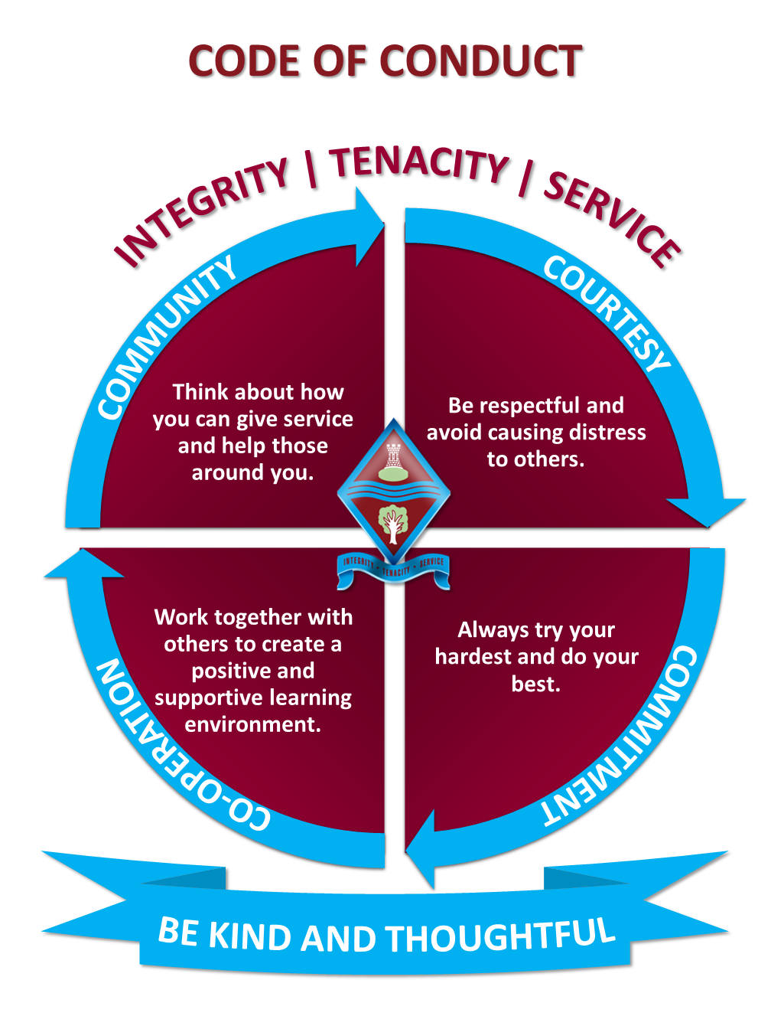
Assembly
Briefing

Slide 2
Timings
Arriving on time will mean a calm start to the exam for you.
And you will be present to hear important instructions.
For a morning exam you must be outside your exam venue at 8.40/8.45am at the latest.
For an afternoon exam you must be outside your exam venue at 1.15/1.20pm at the latest.

Slide 3
Don’t take anything into your exam that you are not allowed

Slide 4
Prohibited (banned) items
No phone
No watch (of any kind)
No headphones
Anything with any writing on it.
Calculator cases/covers
If you bring any of these items into the exam you must inform the invigilators immediately.

Slide 5
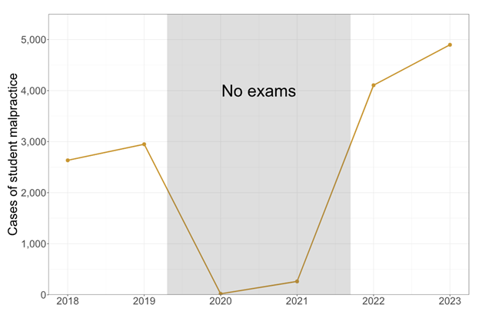
Malpractice
Malpractice means not following the rules. Malpractice is the intentional and unintentional not following of the rules.
We have to conform to JCQ regulations to uphold the integrity of the exams.

Slide 6
Candidate malpractice
Communicating or attempting to communicate with other candidates in the exam room.
Having unauthorised items and materials in the exam room.
Attempting to access papers before an exam.

Slide 7
Consequences of malpractice
Loss of marks
Loss of paper
Loss of qualification
Loss of qualifications
…

Slide 8
Emergencies
Follow the instructions of the invigilators.
Close your paper.
Do not communicate.
Assemble in your usual place on the MUGA.
DON’T PANIC.
You will get to finish your exam

Slide 9
Contingency day
6th June 2024 (PM)
13th June 2024 (AM)
26th June 2024 (AM + PM)

Slide 10
Results day
A level – Thursday 15th August
GCSE – Thursday 22nd August
If you are not going to be able to come to school email Mrs Green or exams@ecclesbourne.derbyshire.sch.uk

Slide 11
Good luck

