Slide 1

Upper School Pastoral Team
Mrs Ourabi-Head of Upper School
Mr Duncker-Brown-Assistant Head
Mrs Maunder-Head of Year 11
Mr Partridge-Head of Year 10
Mr Sellers-Upper School Progress Leader

Slide 2
This evening:
Changes to GCSE’s
The role of the Pastoral Team
Expectations and rewards
Post 16 Provision

Slide 3
Changes to GCSE
Nearly all subjects graded 1 to 9
All subjects have terminal exams (removal of modular exams)
Removal of coursework from most subjects others given less weighting
Content deeper and more challenging concepts
Greater curriculum time given

Slide 4
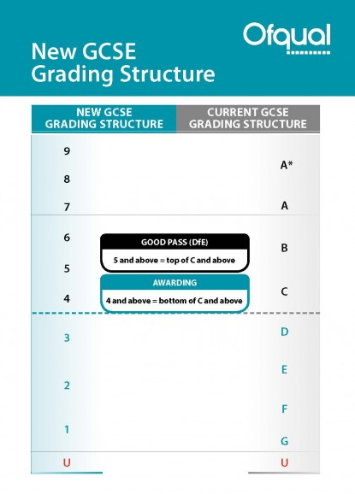
5 – A good pass and this is what you will require for many Level 3 courses.

Slide 5
Year 10 Tutors
10B-Mrs Taylor
10D-Mr Davies
10F-Mr Sellers
10H-Mrs Earp
10J-Mr Poplawski
10K-Mr Ford
10L-Miss Softley
10M-Mr Lee
10S-Mrs Swan

Slide 6
Settling in to new forms and subjects
Give it time
Students may feel overwhelmed by information
Students may feel anxious with regard to change in friendship groups
Students may feel anxious about the start of the GCSE courses

Slide 7
Planners
Same routine as Lower School
Please check and sign planners on a weekly basis
Uniform-Help us to help your child

Slide 8
Work experience
Work experience will take place from 3rd-7th July 2017.
It is a good idea to start thinking about possible placements now. More information will follow shortly.

Slide 9
Support with work
Students should talk to subject staff
Talk to Upper School office
The library is available at lunchtimes and after school until 4.45pm

Slide 10
Progress reviews
W/C 10th October-Year 10 Assessment Week-effort grades
W/C 28TH November -Whole School Assessment week. Target and current attainment grades
W/C Monday 5th December-Interim Reports to Parents
Friday 10th February-Year 10 Reports to Parents
W/C 26th June-Year 10 Internal Exams
Friday 14th July-Year 10 Interim Reports to Parents

Slide 11
Date | Event
Friday 9th September | Year 10 Photographs
Thursday 15th September | Year 10 GCSE Parents Information Evening
Friday 16th September | Year 10 Oxford Trip
Monday 19th September | House Assembly Brindley-New Hall Nightingale-Main Hall
Wednesday 21st | House Assembly Flamsteed-New Hall Chantrey-Main Hall
Thursday 29th September | Prize Day Rehearsal
Friday 30th September | Prize Day
W/C 10th October | Year 10 Assessment Week-effort grades It’s your call-(tbc)
W/C 17TH October | Tutors review effort grades Year 10 Art Print Workshop (2 days, tbc)
Tuesday 18th October | Year 10 Work Experience Launch-PDC

Slide 12

Monday 7th November | WSCD
Thursday 10th November | House Assembly Brindley-New Hall Nightingale-Main Hall
Friday 11th November | House Assembly Flamstead-New Hall Chantrey-Main Hall
Friday 18th November | Children In Need –non-uniform day
W/C 28TH November | Whole School Assessment Week Target and current attainment grades
Thursday 1st December | Year 10 to watch the House Plays
W/C Monday 5th December | Interim Reports to Parents
Tuesday 6th December | Students Christmas Lunch
W/C Tuesday 3rd January | Year 10 RAT Week.
Wednesday 4th January | Year 10 Enterprise Information Evening
Wednesday 8th Thursday 9th February | Year 10 Jaguar Visits
Thursday 9th February | Year 10 RSE Day
Friday 10th February | Year 10 Reports to Parents
Tuesday 21st February | Year 10 R.S Mosque Visit
Friday 24th February | House Assembly Brindley-New Hall Nightingale-Main Hall

Slide 13
Monday 27th February W/C 27TH February | House Assembly Flamsteed-New Hall Chantrey-Main Hall Possible Year 10 History Trip
Friday 3rd March | Year 10 What Career Trip (NEC)
Friday 17th March | Comic Relief (tbc)
Friday 28th April | PSFA Non-Uniform Day
Thursday 4th May | Geography Fieldwork
Friday 5th May | Geography Fieldwork
Tuesday 9th May | Technology Show
Monday 5th June | Year 10 Art GCSE Trip
Tuesday 6th June | Year 10 Art GCSE Trip
W/C 12th June | RATS to be completed
Thursday 22nd June | House Assembly Flamsteed-New Hall Chantrey-Main Hall
Friday 23rd June | House Assembly Brindley-New Hall Nightingale-Main Hall
W/C 26TH June | Year 10 Internal Exams
W/C 3RD July | Year 10 Work Experience
Monday 10th July | Work Experience Follow-up p1-3
Friday 14th July | Year 10 Interim Reports to Parents
Monday 17th July | Year 10 Parents Evening

Slide 14
Year 11
Year 11 can be daunting for many students due to work demands
6th Form Mentoring scheme is on offer
Staff Mentoring programme
Revision guidance in PDC
Comprehensive revision plan is offered by all subjects
Lunchtime work rooms are available
After school sessions will be available for many subjects
Mock exams are used as a measure for the 16+ process

Slide 15
Behaviour and Rewards
The Ecclesbourne School

Slide 16
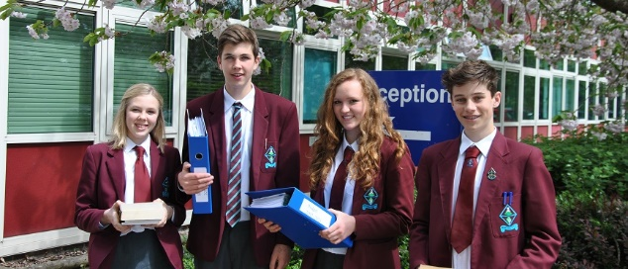
Behaviour
From the School’s Policy:
“If we are to create a community in which high quality learning can take place and all of its members can work happily together, an atmosphere of good order is vital. School rules and procedures exist foster this ethos but students are also encouraged to develop self-discipline and consideration for others.”

Slide 17

Behaviour-We owe it to students to have high expectations
Is excellent
Need to avoid low-level distractions:
  Uniform issues
  Missing equipment
  Late to lesson
  Chatting
Key is School-Student-Home Tripod hence the Home-School agreement.
Thanks for your support so far.
Home
Student
School

Slide 18
Code of Conduct
Students must:
  Avoid activities that cause distress or discomfort to others.
  Always behave in a fashion which reduce the chance of injury to themselves or others.
  Do nothing that causes loss or damage to school property or the property of others.
  Behave in a way which would reflect credit on themselves and the school.
This and the School Rules and Procedures are in the planner.

Slide 19
Uniform
Girls
  “Trutex” Mid-grey stitched down pleated skirt/mid-grey trousers
Boys
  Charcoal grey trousers
White shirt/blouse
School tie
“Trutex” Navy blue/mid-grey pullover/cardigan
Blazer
Black/Brown flat/low heel shoes
School polo shirt in summer
Wristwatch + 1 pair ear lobe studs
Moderate make up + no nail varnish

Slide 20
PE Kit
Girls
  “Falcon” sky blue maroon panel polo shirt
  Maroon skort
  White sock + shoes
  Sky blue with maroon lettering hockey socks
  Shin pads
  Shadow stripe burgundy shorts (optional)
  Navy blue with sky blue panel hooded school sweatshirt
  Navy jogging bottoms
Boys
  “Falcon” sky blue maroon panel polo shirt
  Maroon shorts
  White socks + shoes
  Long sleeved reversible rugby/football shirt in maroon with sky blue panel
  Sky blue with maroon lettering rugby socks
  Shin pads
  Black football boots with aluminium safety studs
  Navy blue tracksuit trousers

Slide 21

Equipment-Prepared for learning
Blue/Black pen
Eraser pen for ink (not Tipp-Ex)
HB Pencil
Rubber
Coloured pencils (not felt tips)
Pencil sharpener
Pair of compasses
Protractor
Cheap calculator (preferably scientific)
Ruler
Small glue stick

Slide 22

Rewards
Prize Giving
Roll of Honour
Merit/Colour Ties
Sports Certificates and Sports Award Ceremony
Governors Awards Evening
Merits Awards
Letters of Commendation

Slide 23
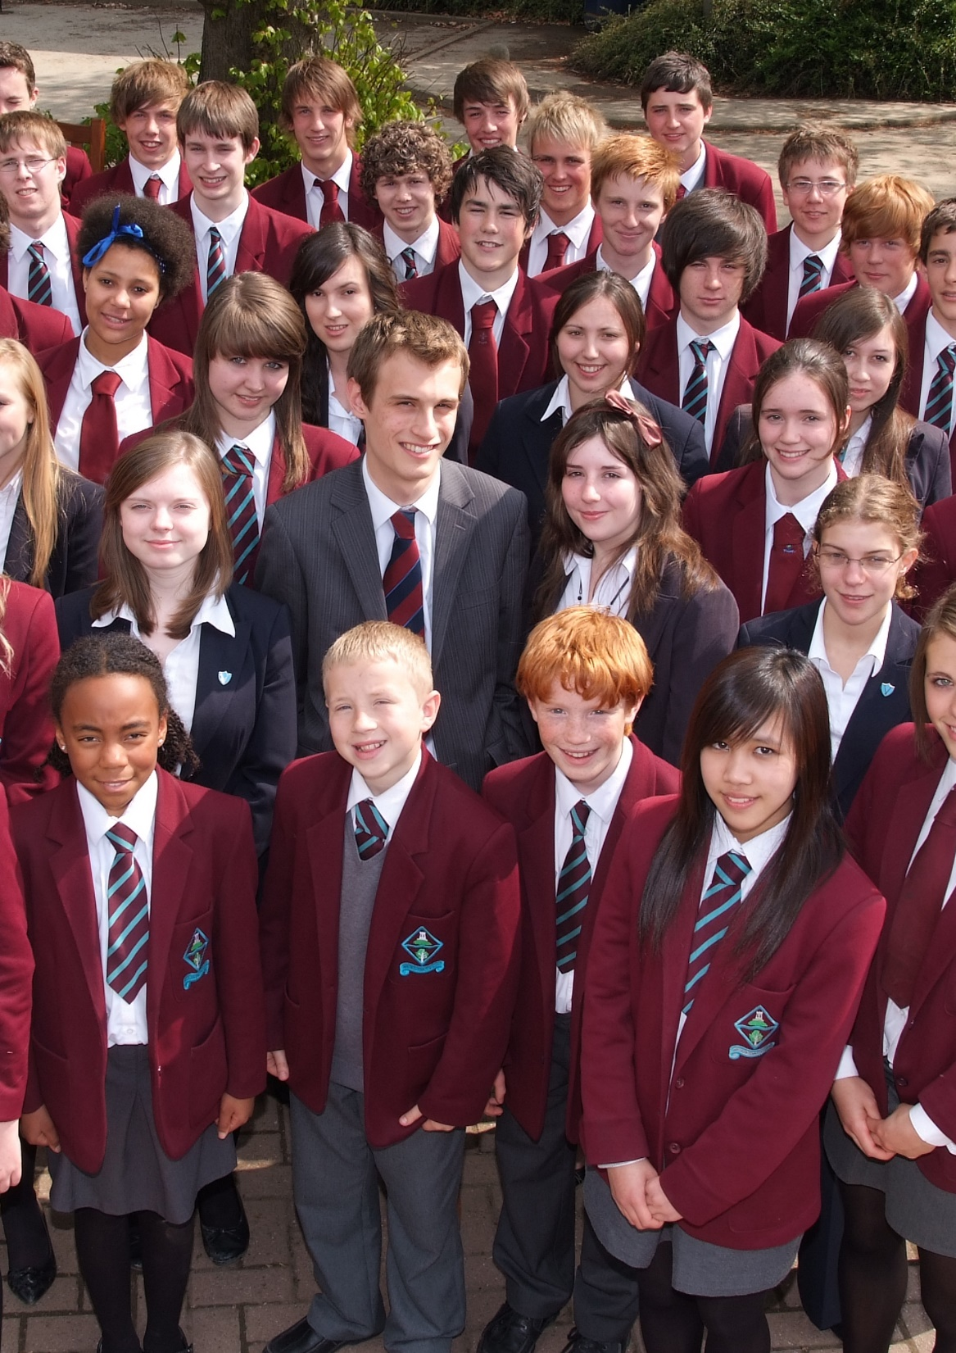
Rewards
Assembly Commendations
Record of Achievement and Target Setting
Attendance Certifications
Posts of Responsibility:
  House Captains
  Peer Mentors
  Co-Head Prefects
  Prefects
  Sports Leaders
Buddy Readers
Subject Mentors
Student Councillors

Slide 24


Merits-recognising excellence in all of its forms
Awarded for:
  Outstanding work
  Consistently high standards
  Consistent effort
Recognition:
  For Years 10 and 11 a cinema ticket for 2 students per half term who receive the most merits (N.B. can only win once per year)
  Letters of commendation
  Letters of congratulation for 50/100/150 etc.
  Names read out in assembly
  Prize at the end of the year
  Looking at other with the help of the school council

Slide 25
Post 16 Support Offered;
Begins through monitoring and intervention- strong tracking system
Early Identification- different pathways and personalised timetables
Stretch and Challenge activities
Careers Evenings
Trips
Mentoring
Two interviews
External independent advice

